Slide 1
ECCOMAS-Style HVAC RL Presentation
Corrected Legacy Sinergym Pipeline and Surrogate Digital Twin Validation Theme: physically meaningful MORL control with corrected observation/action semantics, gaussian reward shaping, and RBC-guided warm-start.
Conference-style summary of the corrected legacy Sinergym branch and the surrogate digital twin validation pipeline. Focus: the architectural idea encoded in sinergym_backend.py and the resulting live metrics.

Slide 2
ArticleRus Benchmark and Research Question
ArticleRus defines the thesis-era benchmark we want to match or exceed: - mean HVAC power reduced from ~480-500 W to ~410-420 W - mean comfort penalty reduced from ~2.3 to ~1.8 - 95th percentile comfort penalty reduced from ~1.21 to ~0.42 - smoother indoor thermal dynamics under RL than under baseline strategies Our contribution in this deck: - rebuild the legacy Sinergym branch into an honest live pipeline - explain the corrected backend architecture - show the current live gap to the thesis target - validate the surrogate digital twin against BOPTEST comfort-oriented traces

Slide 3
Unified Research Pipeline
1. Legacy Sinergym EnergyPlus 5-zone building Corrected backend semantics
2. MORL PPO Gaussian reward BC warm-start from RBC
3. Live Evaluation Power / comfort / trajectory PPO vs RBC vs baselines
4. Digital Twin Surrogate replay on BOPTEST traces Parity and yearly validation
в†’
в†’
в†’
The presentation follows this chain end-to-end: we first repair the legacy control environment, then optimize PPO under a multi-objective reward, and finally validate the surrogate digital twin on comfort-oriented BOPTEST traces exported from the MORL/PPO pipeline.

Slide 4
Core Idea Encoded in sinergym_backend.py
The backend is the architectural center of the thesis branch: - resolves physical variables by name - computes MORL scalarization on top of physical state - logs raw, limited, and executed actions - connects wrappers, reward, and live evaluation into one reproducible path This is why the corrected pipeline is trustworthy in a way the old article-style figures were not.
temp_name = "Zone Air Temperature(SPACE1-1)" energy_name = "Facility Total HVAC Electricity Demand Rate(Whole Building)" weights = MORLWeights(comfort=0.9, energy=0.1) reward = MORLReward( reward_shape="gaussian", target_temp=22.0, gaussian_sigma=1.0, gaussian_offset=0.2, weights=weights, )
Conference message: the contribution is not only a controller, but a corrected experimental infrastructure for HVAC RL.

Slide 5
Step 1: Observation and Action Semantics
Critical corrections: - obs[10] = heating setpoint - obs[11] = cooling setpoint - obs[12] = real zone air temperature - obs[16] = HVAC demand rate Earlier legacy runs mistakenly optimized or reported comfort using setpoint-like channels. After fixing this, the branch became honest but much harder, which explains why our current metrics are higher than the thesis target.
action_parameterization: "midpoint_gap" normalize_action: true rate_limit: true safety: true obs[10] -> heating setpoint obs[11] -> cooling setpoint obs[12] -> zone air temperature obs[16] -> HVAC power
The midpoint-gap parameterization makes actions valid by construction and greatly reduces wrapper-induced distortion.

Slide 6
Step 2: MORL Reward Design
Tested reward families: - linear - exponential - gaussian - cubic Best current family: - gaussian reward - comfort weight = 0.9 - energy weight = 0.1 - sigma = 1.0 - offset = 0.2 - target temperature = 22 C This was the strongest corrected configuration across the honest sweeps we ran.
scalar_reward = w_comfort * r_comfort + w_energy * (r_energy + r_control) r_comfort = gaussian_peak * exp(-0.5 * (deviation / sigma)^2) - gaussian_offset
Exponential reward improved after BC warm-start but still underperformed the gaussian family in both comfort-energy trade-off and in-band occupancy.

Slide 7
Step 3: RBC to Behavior-Cloning Warm-Start
BC warm-start solved the cold-start failure mode: - PPO from scratch tended to drift toward cold/high-power regimes - RBC demonstrations anchor the policy in a safe thermal region - RL fine-tuning then optimizes power around that anchor Current BC summary: - dataset size = 20000 - epochs = 40 - final BC loss = 0.112
maybe_run_rbc_warmstart( model, env_factory=EnvFactory, env_cfg=env_cfg, warm_cfg=train_cfg["bc_warmstart"], seed=seed, out_dir=out_dir, )
Empirically this raised the corrected live PPO into the same operating region as RBC. The remaining challenge is no longer catastrophic failure, but the last comfort gap between PPO and RBC.

Slide 8
Experimental Protocol and Logging
Legacy Sinergym protocol: - EnergyPlus: Eplus-5Zone-hot-continuous-v1 - policies: PPO, Rule-based, Random, Zero-hold - metrics: mean HVAC power, mean comfort penalty, p95 comfort penalty, in-band occupancy - evaluation horizon: 500 steps for smoke-run reporting Digital twin protocol: - comfort traces from Thermostatic PPO and HDRL yearly controllers - offline surrogate replay against BOPTEST traces - metrics: RMSE, MAE, bias, actual/predicted in-band occupancy - exported logs support exact mobile-app reproduction of the temperature-hold figure

Slide 9
Current Legacy Sinergym Metrics
Thesis benchmark Mean HVAC power: 410-420 W Mean comfort penalty: ~1.8 P95 comfort penalty: ~0.42
Current PPO Power: 499.8 W Comfort: 11 P95: 89.14 In-band: 41%
Rule-based control Power: 518.24 W Comfort: 10.94 P95: 89.49 In-band: 59%
Interpretation: the corrected PPO already beats RBC on power, but still trails RBC slightly on comfort. This is the central optimization gap that remains to be closed.

Slide 10
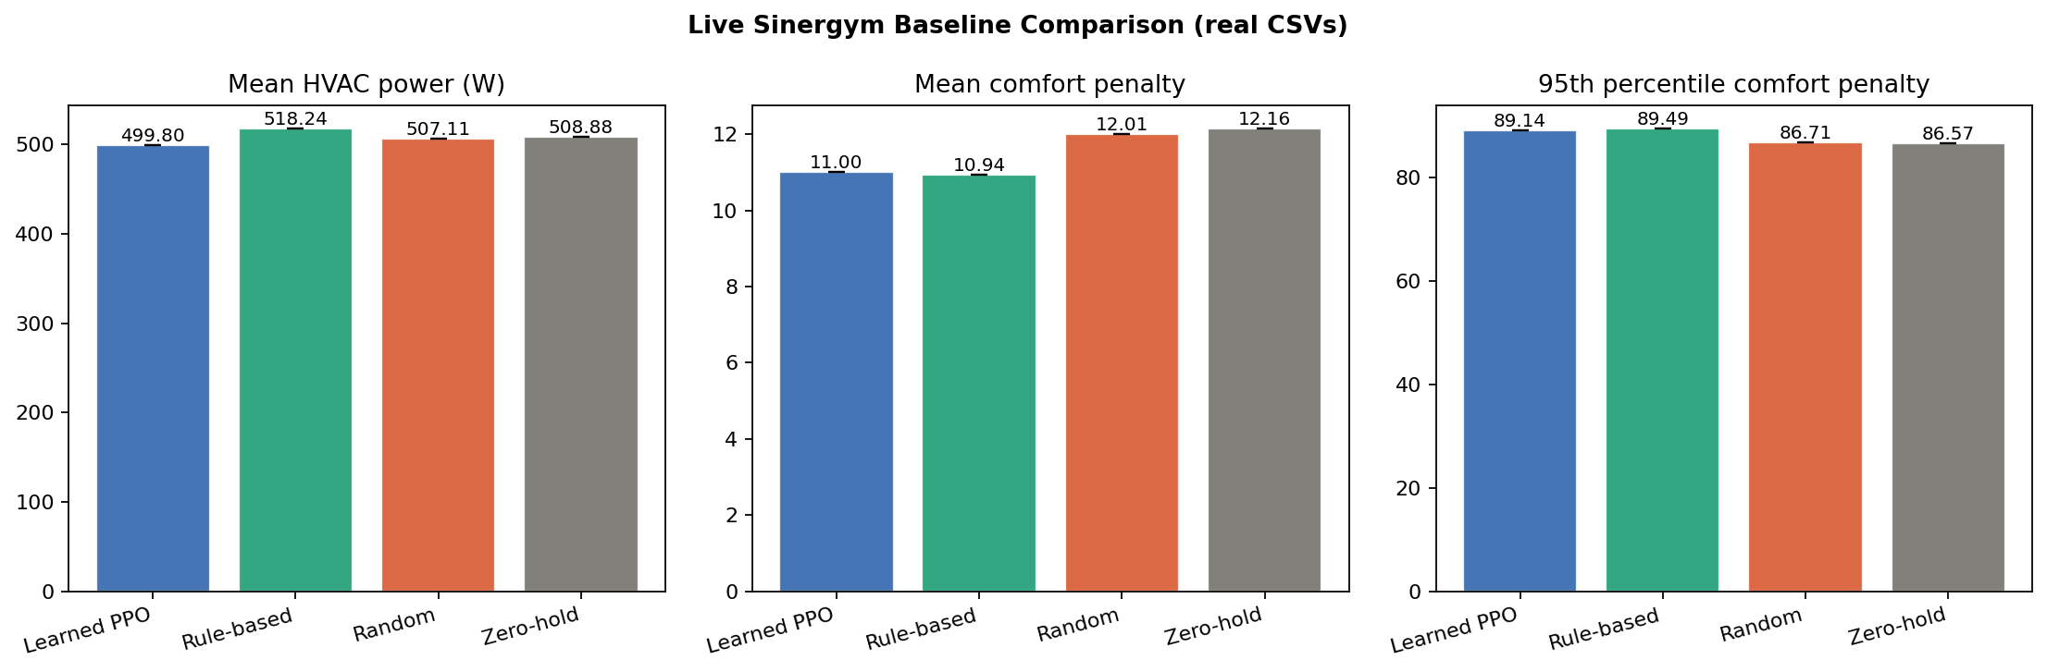
Live Baseline Comparison

Slide 11
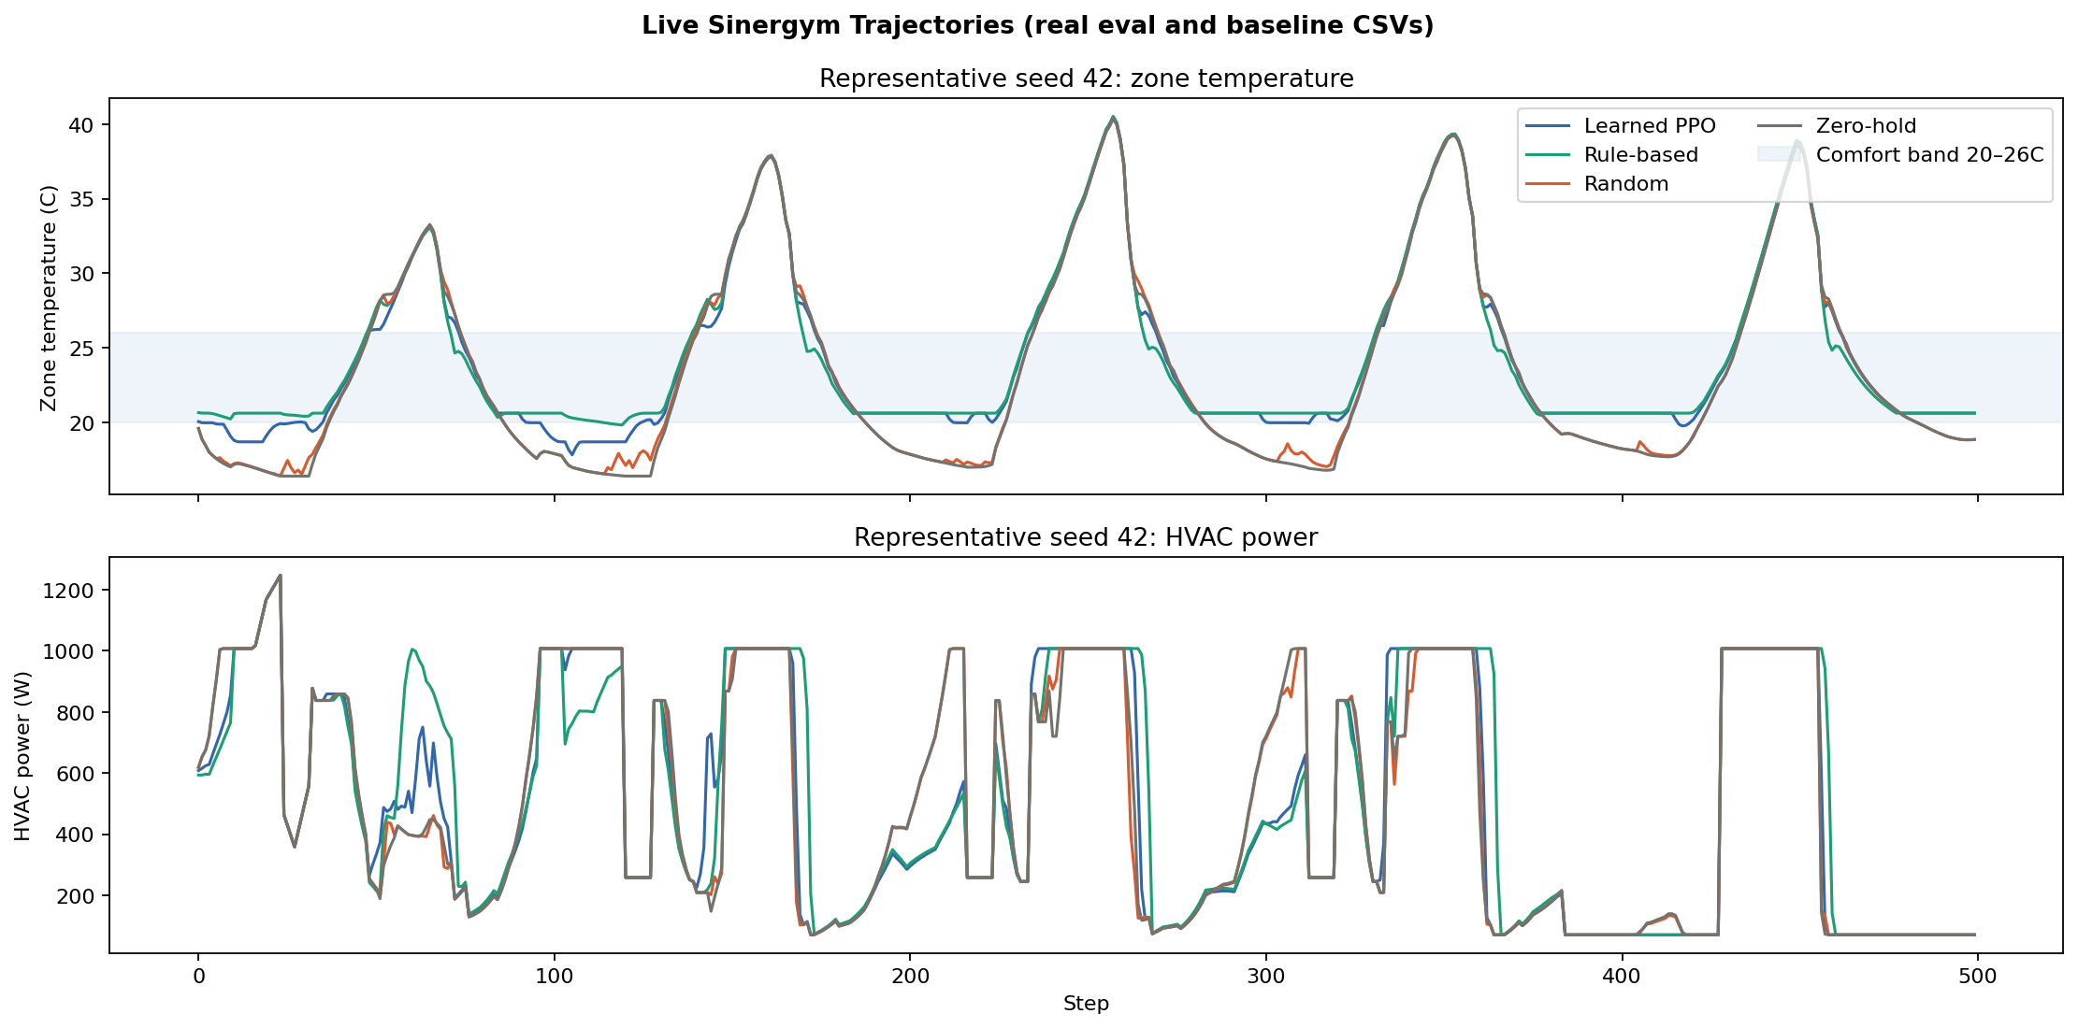
Representative PPO and RBC Trajectories

Slide 12
Digital Twin Validation Workflow and Plot Logs
For the surrogate digital twin we do not validate on arbitrary exploratory trajectories. Instead, we replay comfort-oriented action traces exported from Thermostatic PPO and HDRL yearly controllers. Plot-ready files produced by the pipeline: - surrogate_v3_log.csv - boptest_comfort_trace_log.csv - surrogate_temperature_hold_plot_long.csv - surrogate_temperature_hold_plot_meta.json These files are sufficient to reproduce the figure exactly in a mobile application.
for trace in comfort_traces: replay = surrogate_rollout(model, trace) compare( actual_t_zone=trace["actual_t_zone"], pred_t_zone=replay["pred_t_zone"], actual_power=trace["actual_power_w"], pred_power=replay["pred_power_w"], )
The digital twin is therefore evaluated as a replay model aligned with the real BOPTEST control traces, not as a free-running visual toy.

Slide 13
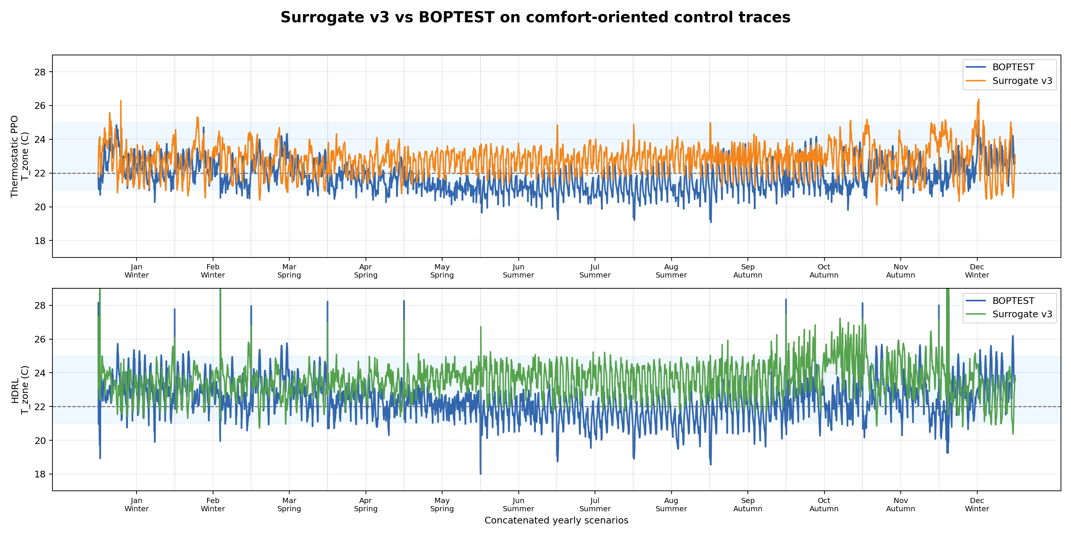
Surrogate v3 vs BOPTEST on Yearly Comfort Traces

Slide 14
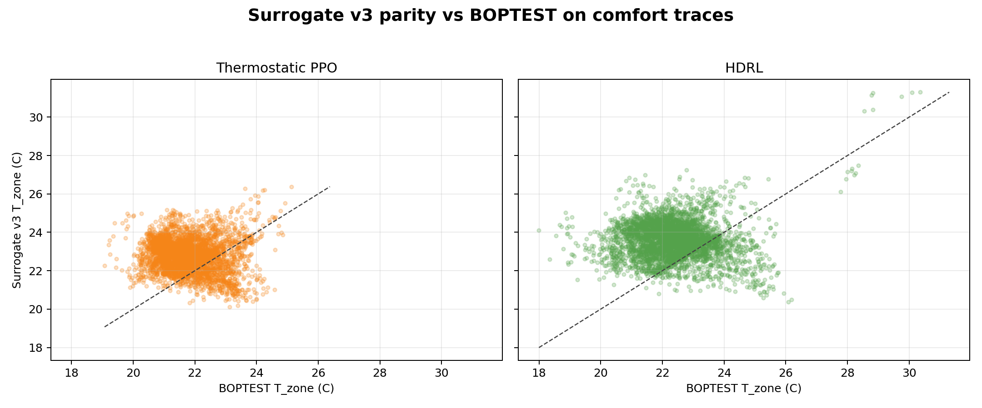
Surrogate Parity and Controller-Level Digital Twin Metrics
Surrogate validation summary Thermostatic PPO - RMSE: 1.59 C - MAE: 1.35 C - Bias: +1 C - Actual in-band: 82.1% - Predicted in-band: 97.4% HDRL - RMSE: 1.89 C - MAE: 1.59 C - Bias: +1.21 C - Actual in-band: 88.8% - Predicted in-band: 93.8%
BOPTEST controller summary Thermostatic PPO - MAE22: 0.72 C - within 1C: 72.3% - energy total: 3078.07 kWh HDRL - MAE22: 0.9 C - within 1C: 66% - energy total: 2956.33 kWh Standard PI - MAE22: 2.84 C - within 1C: 16.5% - energy total: 1230.19 kWh

Slide 15
Conclusions and Roadmap
Main takeaways: - the corrected Sinergym branch is now physically meaningful and reproducible - Gaussian MORL reward + BC warm-start is the strongest legacy configuration found so far - PPO already beats RBC on energy, but still trails RBC slightly on comfort - the digital twin tracks BOPTEST trends but still has a warm bias Immediate next steps: - narrow sweep over BC intensity and PPO learning rate - keep the current gaussian reward fixed - reduce surrogate warm bias before using the twin as a final comfort evaluator Honest status versus ArticleRus: - we are competitive and reproducible - we are not yet at the thesis target metrics

