Slide 1



Viscosity Ratio Identification in the Buckley-Leverett Model Using PINN
Authors: Samson Dawit Bekele, Timur Imankulov, Yerzhan Kenzhebek
Department of Computer Science, Al-Farabi Kazakh National University
Presenter: Samson Dawit Bekele
samsondawitb@gmail.com

Slide 2
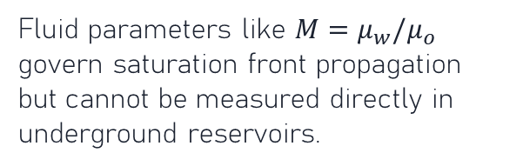
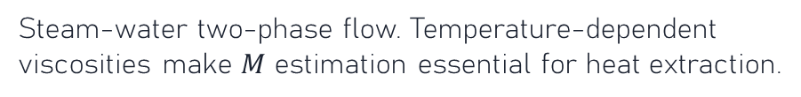
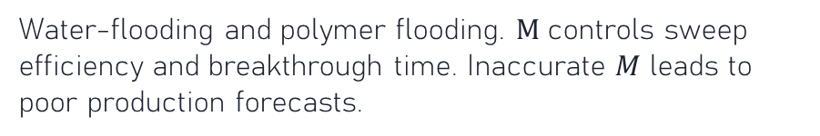
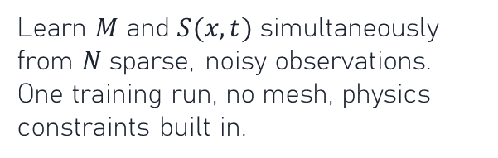
Motivation and Applications
Why Parameter Identification Matters
The Challenge
Traditional Approach
Our Approach: Inverse PINN
Fluid parameters like $M=μ_{w}/μ_{o}$ govern saturation front propagation but cannot be measured directly in underground reservoirs.
History matching: iterative PDE-solver inversion. Expensive (100s of runs), mesh-dependent, struggles near discontinuities.
Learn $M$ and $S(x,t)$ simultaneously from $N$ sparse, noisy observations. One training run, no mesh, physics constraints built in.
Application Areas
Enhanced Oil Recovery
$CO_{2}$ Geological Storage
Water-flooding and polymer flooding. $M$ controls sweep efficiency and breakthrough time. Inaccurate $M$ leads to poor production forecasts.
Supercritical CO2 displaces brine in aquifers. Leakage risk depends on mobility ratio. BL is a standard screening model.
Geothermal Systems
Hydrogen Underground Storage
Steam-water two-phase flow. Temperature-dependent viscosities make $M$ estimation essential for heat extraction.
Emerging application. H2/brine mobility ratios are uncertain. PINN-based inversion enables rapid real-time calibration.
Congress of the Kazakhstan Mathematical Society 2026

Slide 3
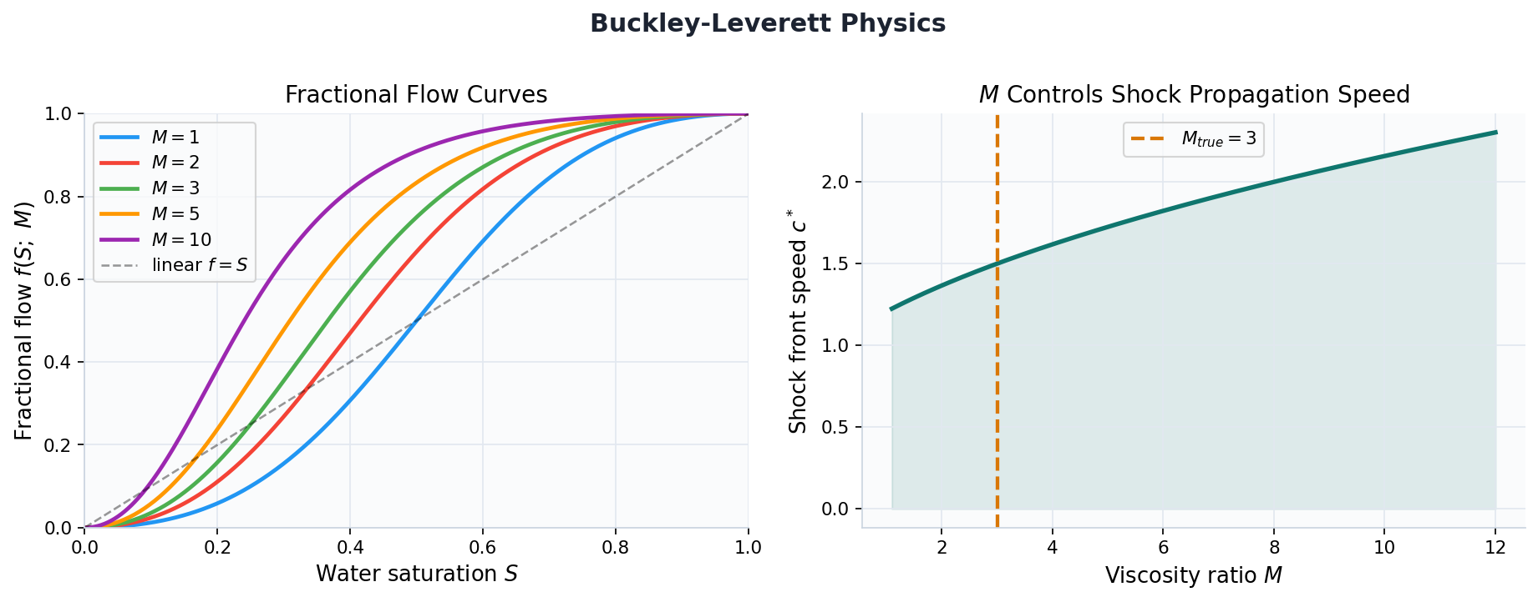
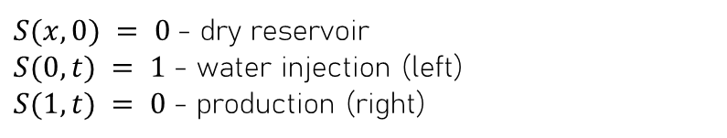
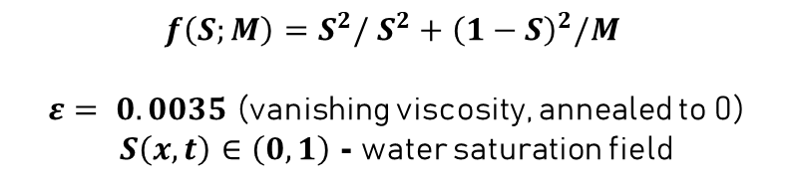
The Buckley-Leverett Forward Model
Hyperbolic conservation law for two-phase incompressible flow
Governing PDE (with viscous regularization):
$$∂_{t}S+∂_{x}f\left(S;M\right)=ε,∂_{xx}S$$
Initial and Boundary Conditions:
$S(x, 0) = 0$- dry reservoir $S(0, t) = 1$- water injection (left) $S(1, t) = 0$- production (right)
$f\left(S;M\right)=S^{2}/ S^{2}+{\left(1−S\right)}^{2}/M$ $ε= 0.0035$ (vanishing viscosity, annealed to 0) $S\left(x,t\right)∈\left(0,1\right)$ - water saturation field

Slide 4
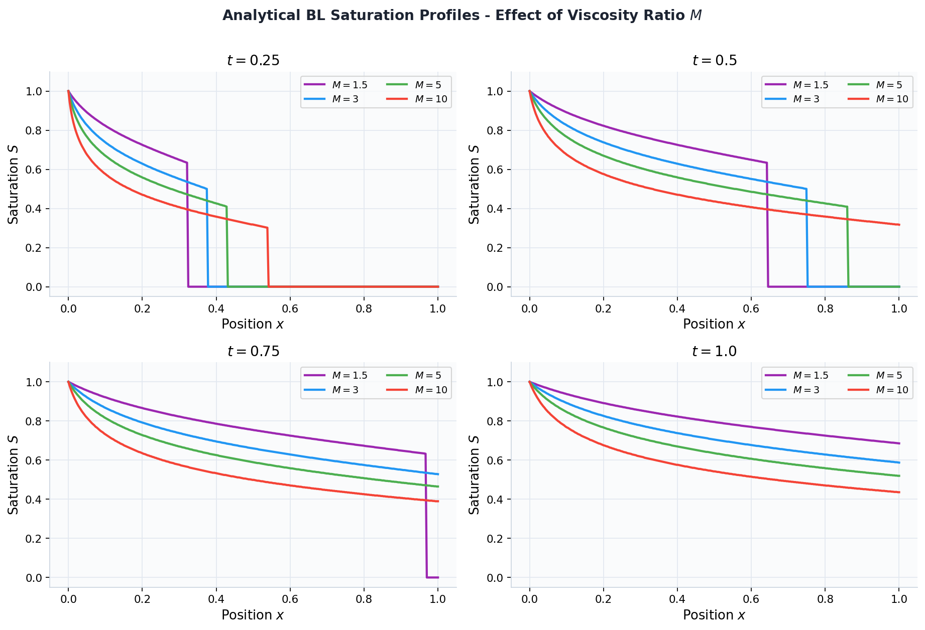
Shock Dynamics - Analytical BL Profiles
$M$ shifts the shock front position and changes displacement efficiency
Congress of the Kazakhstan Mathematical Society 2026

Slide 5

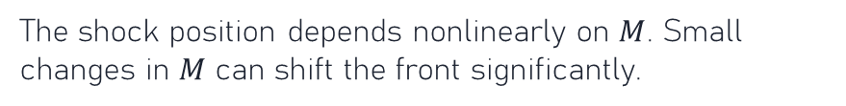
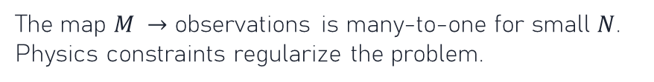
The Inverse Problem
Recover $M$ from $N$sparse, noisy saturation measurements
Given: $N$ observations $\{\left(x_{i},t_{i},S_{i}^{\text{obs}}\right)with{ S}_{i}^{\text{obs}}=S\left(x_{i},t_{i}\right)+η_{,}η_{i}∼𝓝\left(0,σ^{2}\right)$
Find: $M$ (viscosity ratio) and $S(x,t)$ (saturation field) simultaneously
Ill-posedness
Moving discontinuity
The map $M →$ observations is many-to-one for small $N$. Physics constraints regularize the problem.
The shock position depends nonlinearly on $M$. Small changes in $M$ can shift the front significantly.
Noise sensitivity
Computational cost
Observations near the shock front are most informative but also most affected by measurement noise.
Traditional adjoint methods need $𝒪\left(100\right)$ PDE solves. PINN amortizes this cost into one training run.
Congress of the Kazakhstan Mathematical Society 2026

Slide 6
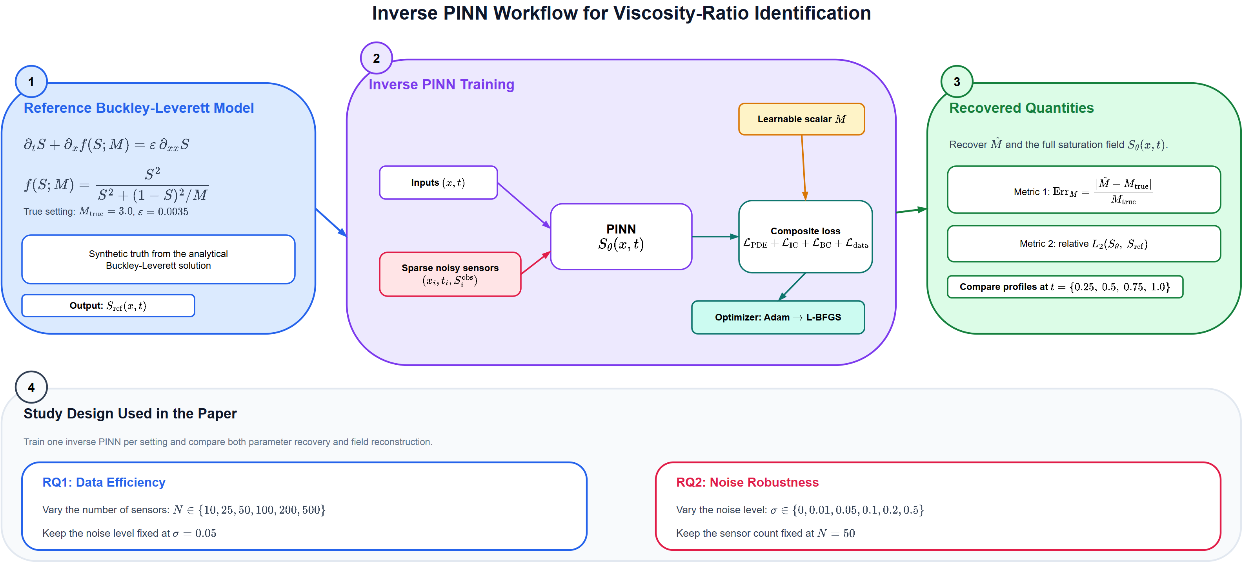
Inverse PINN Architecture
workflow diagram of the full inverse learning pipeline
Congress of the Kazakhstan Mathematical Society 2026

Slide 7



Model Architecture, Loss Function, and Training
Neural Network $S_{θ}\left(x,t\right)$
Loss Function and Training
Composite loss (all weights = 1.0): $ℒ_{\text{𝒫𝒟}\text{ℰ}}$ - PDE residual at 50,000 LHS points
$ℒ_{\text{𝒫𝒟}\text{ℰ}}=\text{mean}\left(r{\left(x,t;θ,M\right)}^{2}\right)$ $ℒ_{\text{ℐ}\text{𝒞}}$- initial condition at 512 points $ℒ_{\text{ℐ}\text{𝒞}}=\text{mean}\left({\left(S_{θ}\left(x,0\right)−0\right)}^{2}\right)$ $ℒ_{\text{ℬ}\text{𝒞}}$- boundary conditions ${ ℒ}_{\text{ℬ}\text{𝒞}}=\text{mean}\left({\left(S_{θ}\left(0,t\right)−1\right)}^{2}+{\left(S_{θ}\left(1,t\right)−0\right)}^{2}\right)$ $ℒ_{\text{𝒹𝒶𝓉𝒶}}$- sensor mismatch at $N$ points (primary driver of M) ${ ℒ}_{\text{𝒹𝒶𝓉𝒶}}=\text{mean}\left({\left(S_{θ}\left(x_{i},t_{i}\right)−S_{i}^{\text{obs}}\right)}^{2}\right)$ $ℒ_{\text{𝓉}\text{ℴ}\text{𝓉𝒶𝓁}}=ℒ_{\text{𝒫𝒟}\text{ℰ}}+ℒ_{\text{ℐ}\text{𝒞}}+ℒ_{\text{ℬ}\text{𝒞}}+ℒ_{\text{𝒹𝒶𝓉𝒶}}$
Input: $(x, t)$ - 2D (position and time) Input: $M$ is NOT an input - it is a learnable parameter Hidden: 30 layers x 50 neurons = 1,500 hidden units Activation: tanh (smooth, suitable for PDE problems) Output: 1 neuron + sigmoid $⇒S_{θ}∈\left(0,1\right)$ Params: 74,151 total (Xavier initialization) Learnable scalar $M$ (torch.nn.Parameter): Init: $M_{0}=1.0$ True: $M^{∗}=3.0 lr_{M}=1e−2$
Optimized jointly with $θ$ via backprop Vanishing viscosity stabilization: PDE modified: $∂_{t}S+∂_{x}f−ε,∂_{xx}S=0$ $ε= 0.0035$ - prevents shock divergence Corresponds to $\sim 7$cells of smoothing in 300-pt grid
Optimizer: Phase 1: Adam - 2,000 epochs$,lr_{θ}=1e−3,lr_{M}=1e−2$ LR halved at epochs 700 and 1,350 Phase 2: L-BFGS - 1,000 steps, lr = 1.0 (2nd-order polish)
Congress of the Kazakhstan Mathematical Society 2026

Slide 8
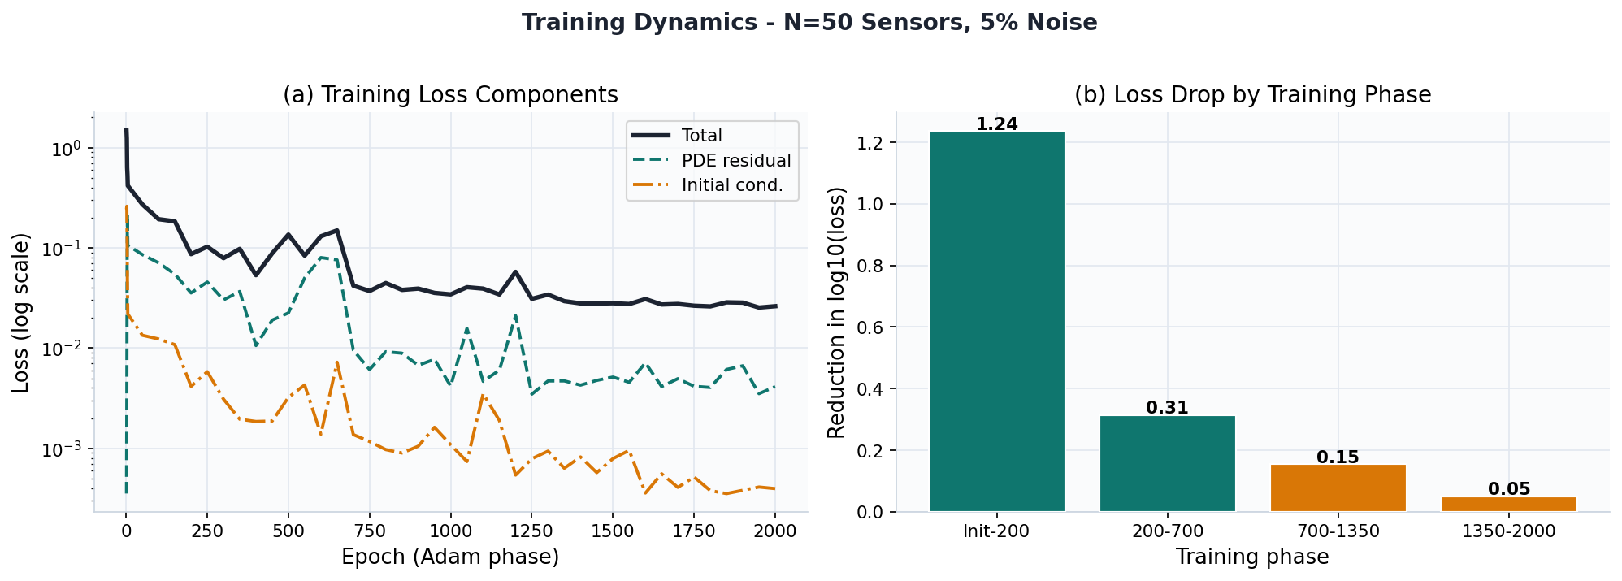
Training Dynamics - Loss Convergence
Adam phase: 2,000 epochs | N=50 sensors, 5% noise, $M_{true}=3.0$
Congress of the Kazakhstan Mathematical Society 2026

Slide 9


Experimental Design
Systematic ablation: two independent research questions
RQ1 - Data Efficiency
RQ2 - Noise Robustness
Question: How many sensor observations are needed to accurately identify $M$? Varied: $N_{\text{data}}∈\{10,25,50,100,200,500\}$ Fixed: $M_{\text{true}}=3.0$ Noise $σ= 5\%$
Architecture: 30 layers x 50 neurons Collocation: 50,000 LHS points Training: Adam(2000) + L-BFGS(1000)
Question: How much measurement noise can the inverse PINN tolerate? Varied: $σ∈\{0\%, 1\%, 5\%, 10\%, 20\%, 50\%\}$ Fixed: $M_{\text{true}}=3.0$ $N_{\text{data}}=50$
Architecture: 30 layers x 50 neurons Collocation: 50,000 LHS points Training: Adam(2000) + L-BFGS(1000)
Congress of the Kazakhstan Mathematical Society 2026

Slide 10
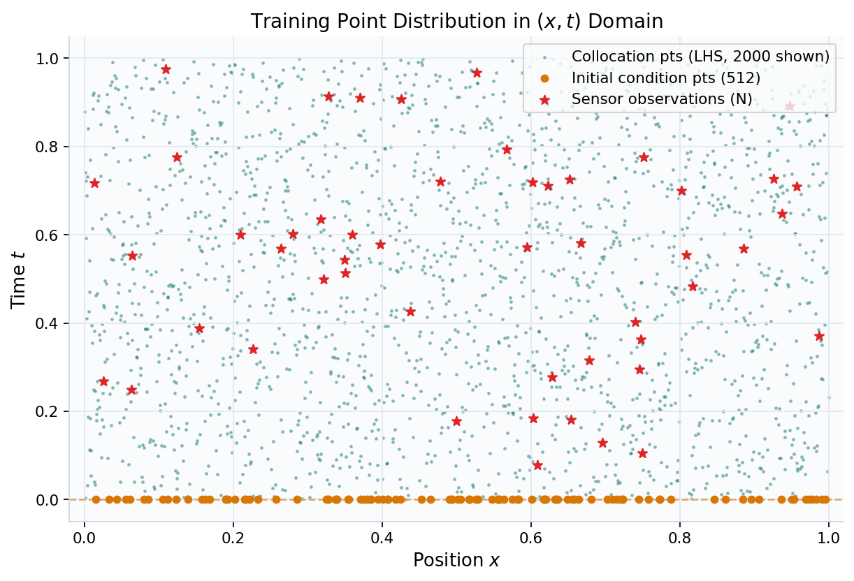
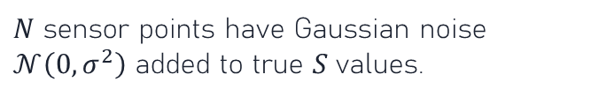
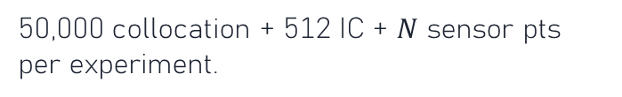
Data Generation - Latin Hypercube Sampling
Why LHS over uniform random?
Full coverage
Guarantees each row and column of the domain is sampled exactly once.
No clustering
Avoids accidental gaps where the PDE residual is never enforced.
Noise injection
$N$ sensor points have Gaussian noise $𝒩\left(0,σ^{2}\right)$ added to true $S$ values.
Scale
50,000 collocation + 512 IC + $N$ sensor pts per experiment.
Congress of the Kazakhstan Mathematical Society 2026

Slide 11
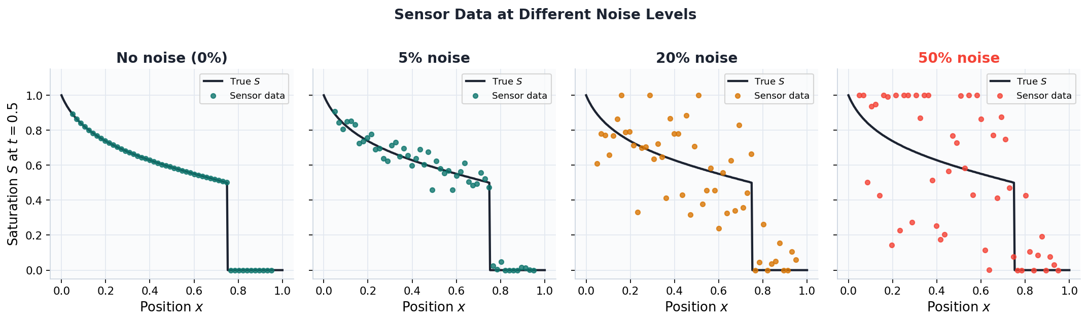
What Sensor Data Looks Like at Different Noise Levels
50% noise fundamentally changes what the optimizer sees
Congress of the Kazakhstan Mathematical Society 2026

Slide 12
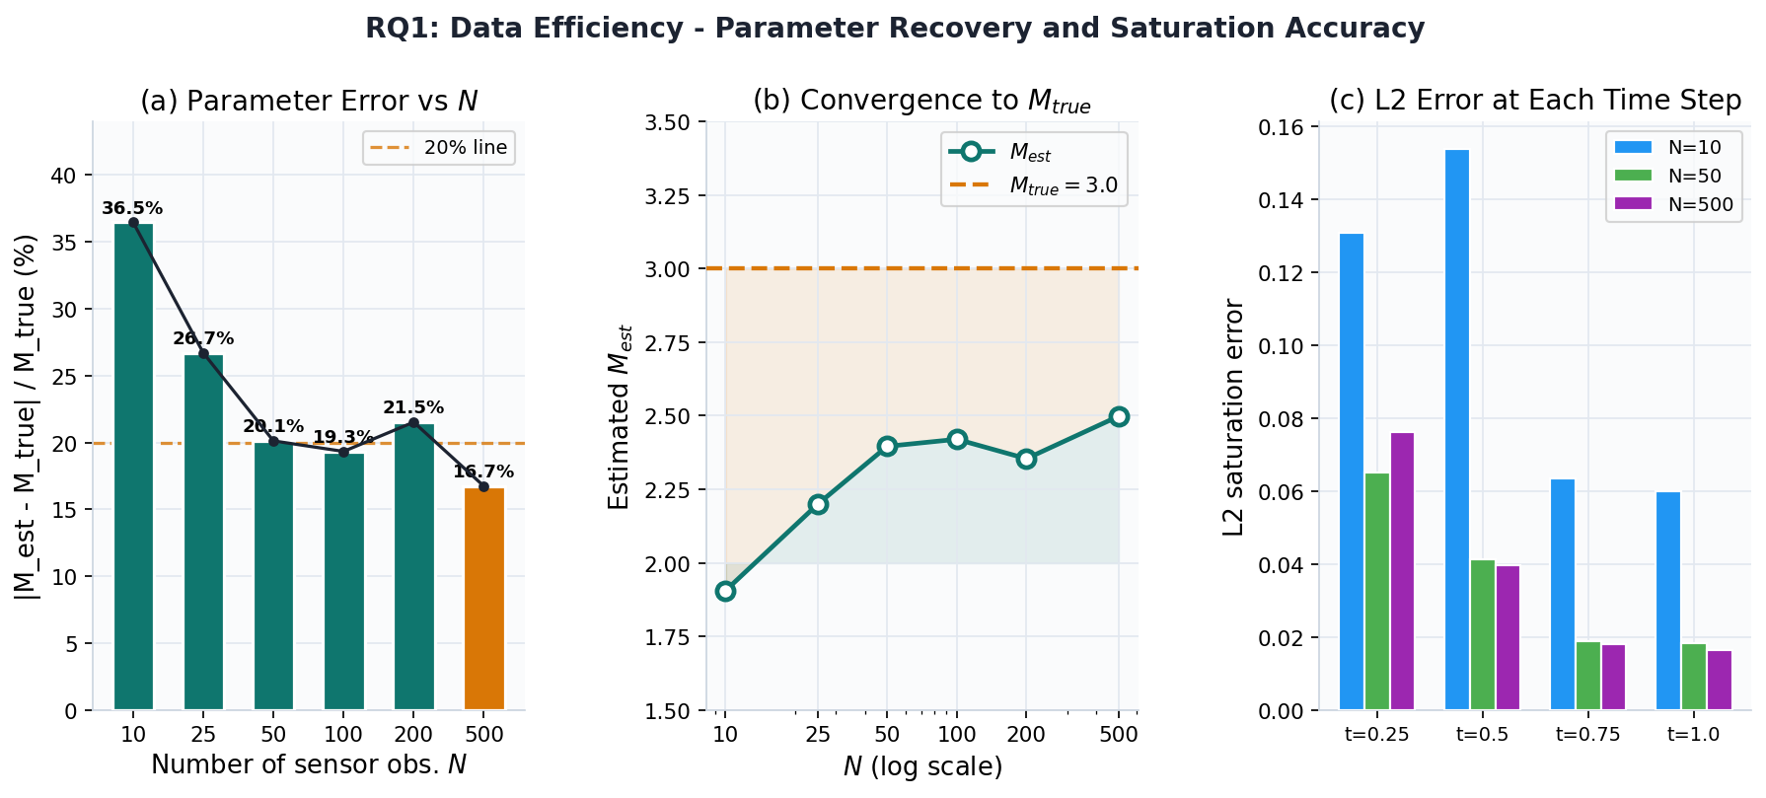
RQ1 Results - Data Efficiency
Parameter error, $M$convergence, and L2 accuracy across $N$
Congress of the Kazakhstan Mathematical Society 2026

Slide 13
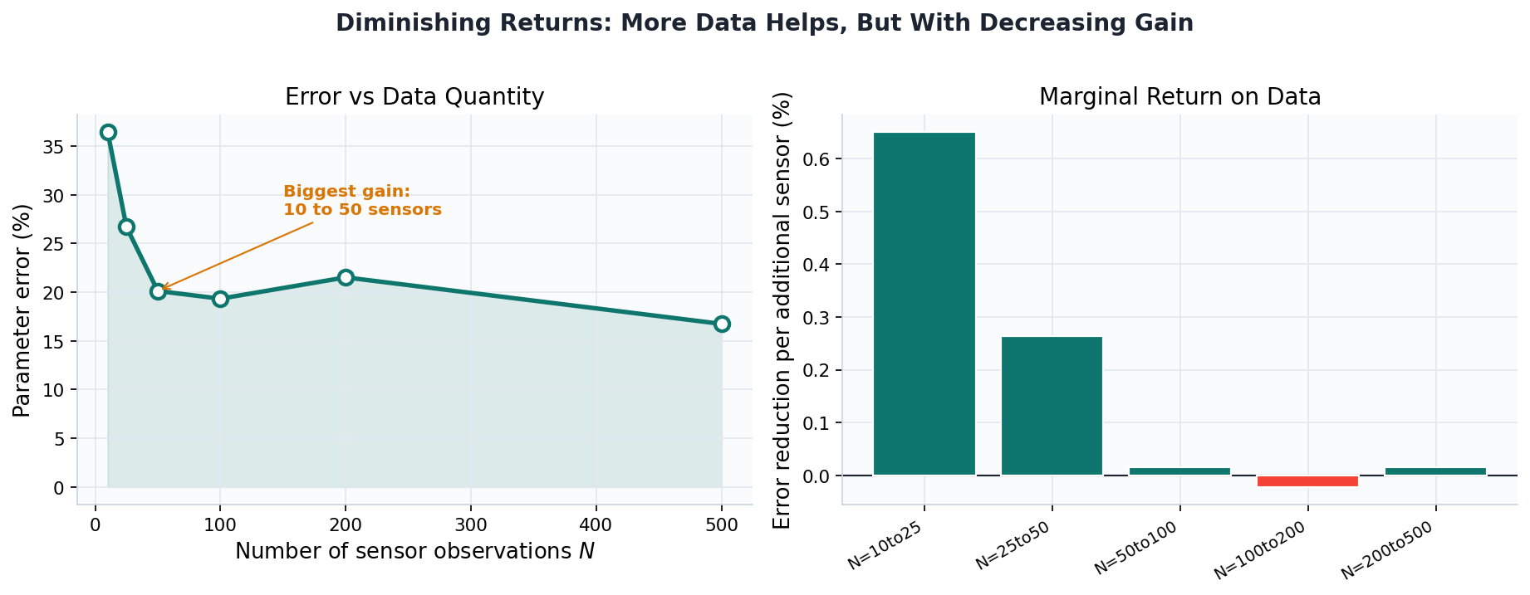
RQ1 - Diminishing Returns Analysis
The first 50 sensors provide most of the gain
Key insight: the 10 to 50 sensor transition yields the steepest error drop. N=100 gives only marginal improvement over N=50. N>100 shows no monotone improvement, suggesting optimization variance dominates data quantity.
Congress of the Kazakhstan Mathematical Society 2026

Slide 14
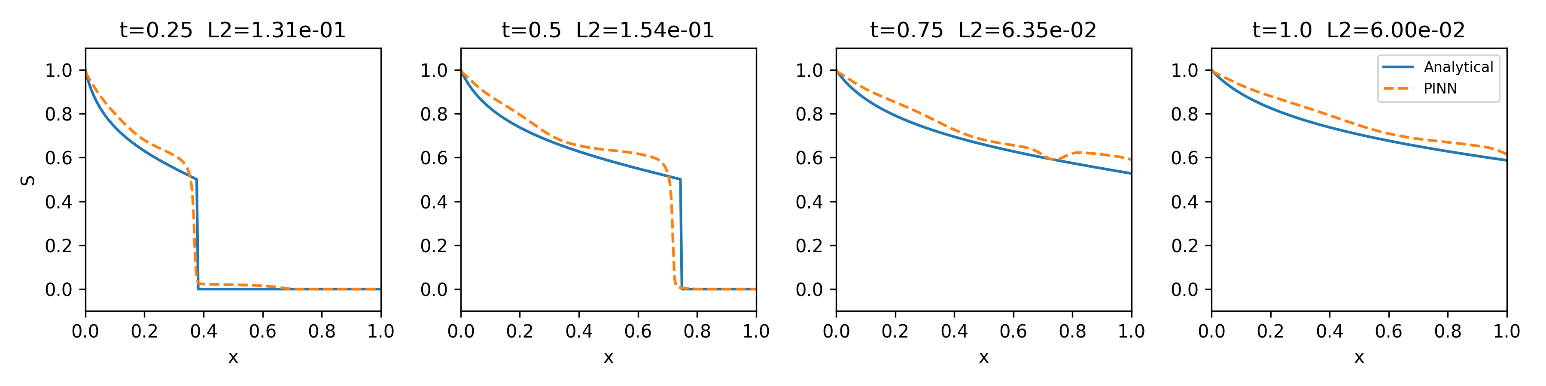
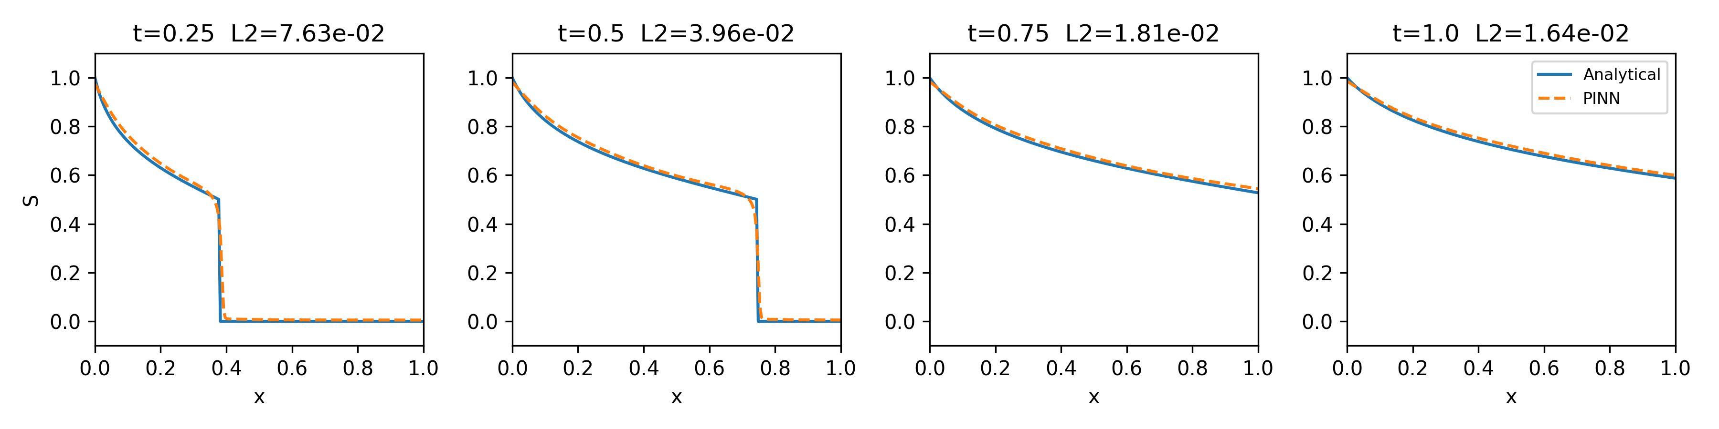
RQ1 - Saturation Profiles: N=10 vs N=500
Time snapshots at $t=0.25, 0.5, 0.75, 1.0$ | 5% noise
$$N=10: M_{est}=1.91 | Error=36.5\% | Shock position wrong at all times$$
$$N=500:M_{est}=2.50 | Error=16.7\% | Good shock tracking at all times$$
Congress of the Kazakhstan Mathematical Society 2026

Slide 15
RQ1 - Best Case: N=500 Saturation Profile
PINN captures the shock front accurately across the full time domain
$M_{estimated}=2.498$| $M_{true}=3.0$| $Error = 16.7\% | L2 Saturation = 0.047$
Congress of the Kazakhstan Mathematical Society 2026

Slide 16
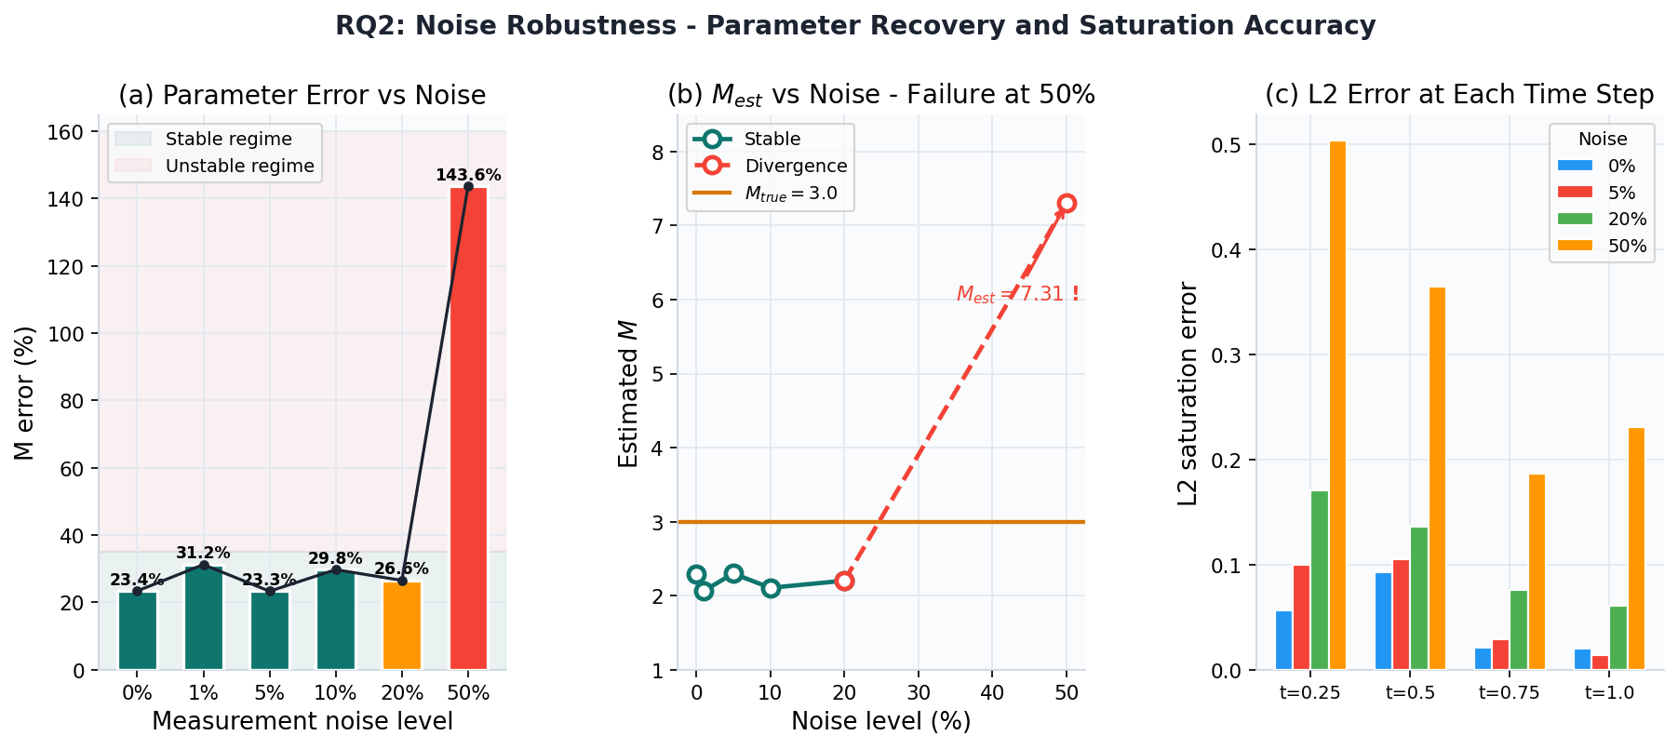
RQ2 Results - Noise Robustness
Robust 0-20% noise | catastrophic failure at 50%
Congress of the Kazakhstan Mathematical Society 2026

Slide 17
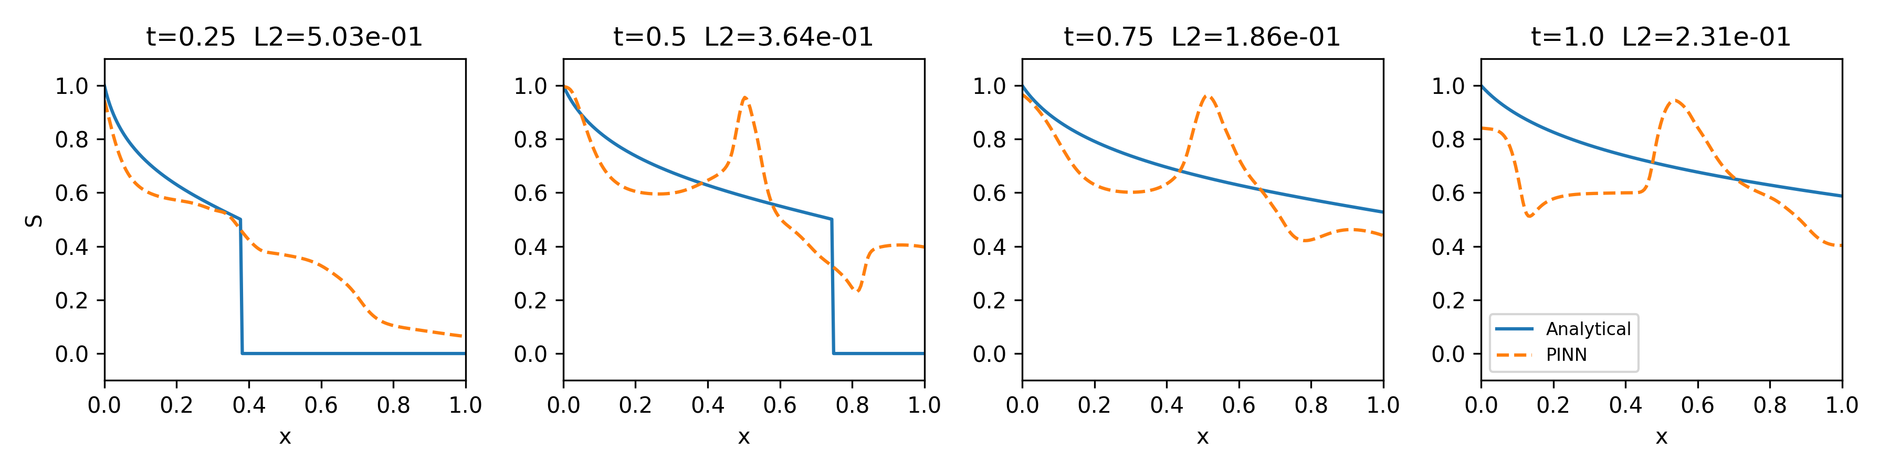
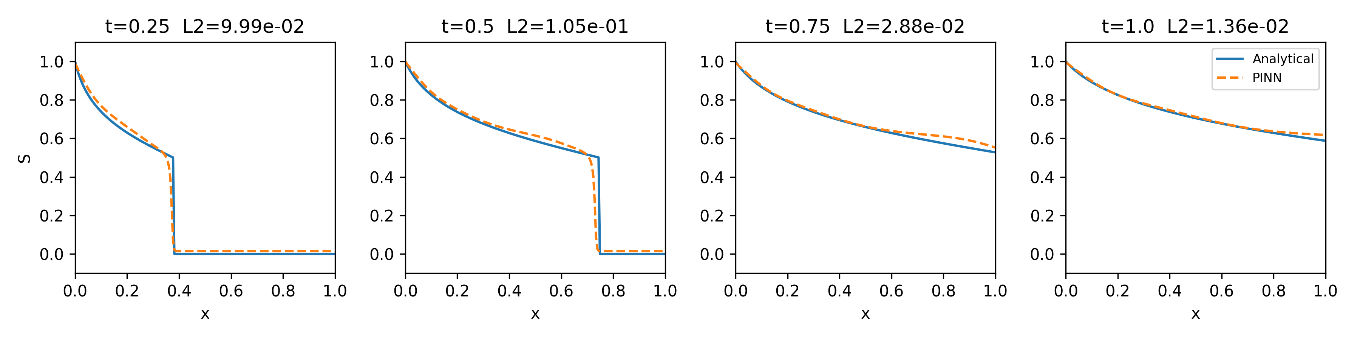
RQ2 - Saturation Profiles: 5% vs 50% Noise
Same N=50 sensors - noise level determines whether $M$ is recoverable
$$50\% noise: M_{est}=7.31 | Error=144\% | Optimization diverges$$
$5\% noise: M_{est}=2.30$ | $Error=23.3\%$| $Physically consistent$
Congress of the Kazakhstan Mathematical Society 2026

Slide 18
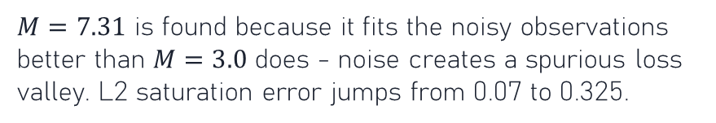
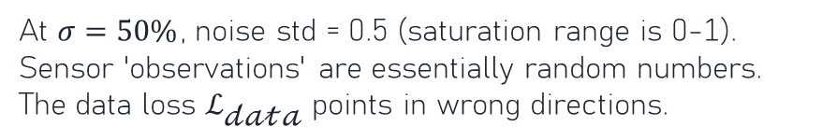
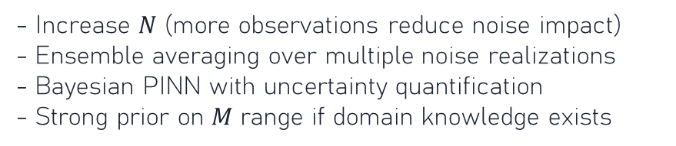
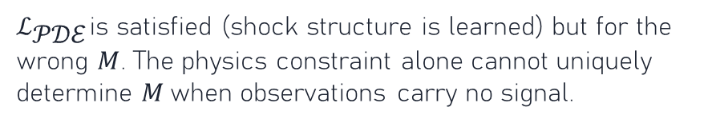
Why Does the Method Fail at 50% Noise?
Structural analysis of the optimization landscape
Signal overwhelmed
False minimum in $M$
At $σ=50\%$, noise std = 0.5 (saturation range is 0-1). Sensor 'observations' are essentially random numbers. The data loss $ℒ_{\text{𝒹𝒶𝓉𝒶}}$ points in wrong directions.
$M=7.31$ is found because it fits the noisy observations better than $M=3.0$ does - noise creates a spurious loss valley. L2 saturation error jumps from 0.07 to 0.325.
Physics loss cannot compensate
Mitigation strategies
$ℒ_{\text{𝒫𝒟ℰ}}$is satisfied (shock structure is learned) but for the wrong $M$. The physics constraint alone cannot uniquely determine $M$when observations carry no signal.
- Increase $N$ (more observations reduce noise impact) - Ensemble averaging over multiple noise realizations - Bayesian PINN with uncertainty quantification - Strong prior on $M$ range if domain knowledge exists
Congress of the Kazakhstan Mathematical Society 2026

Slide 19
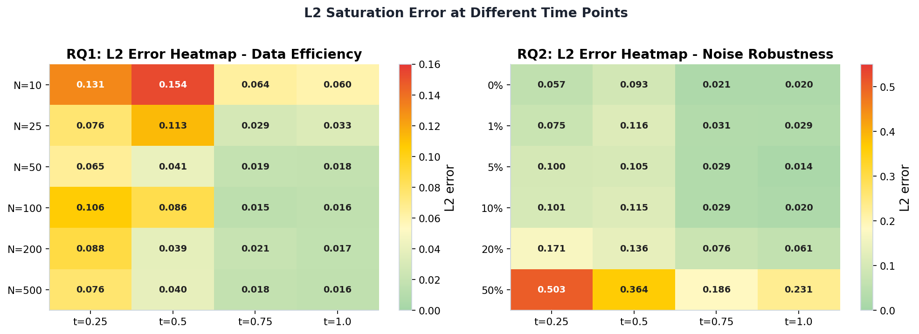
L2 Error Breakdown by Time Step
Heatmap: rows = experiment, columns = time snapshots
Observation: early times ($t=0.25$) are consistently harder - the shock is steeper. Late times ($t=1.0$) show lower absolute error across all experiments.
Congress of the Kazakhstan Mathematical Society 2026

Slide 20
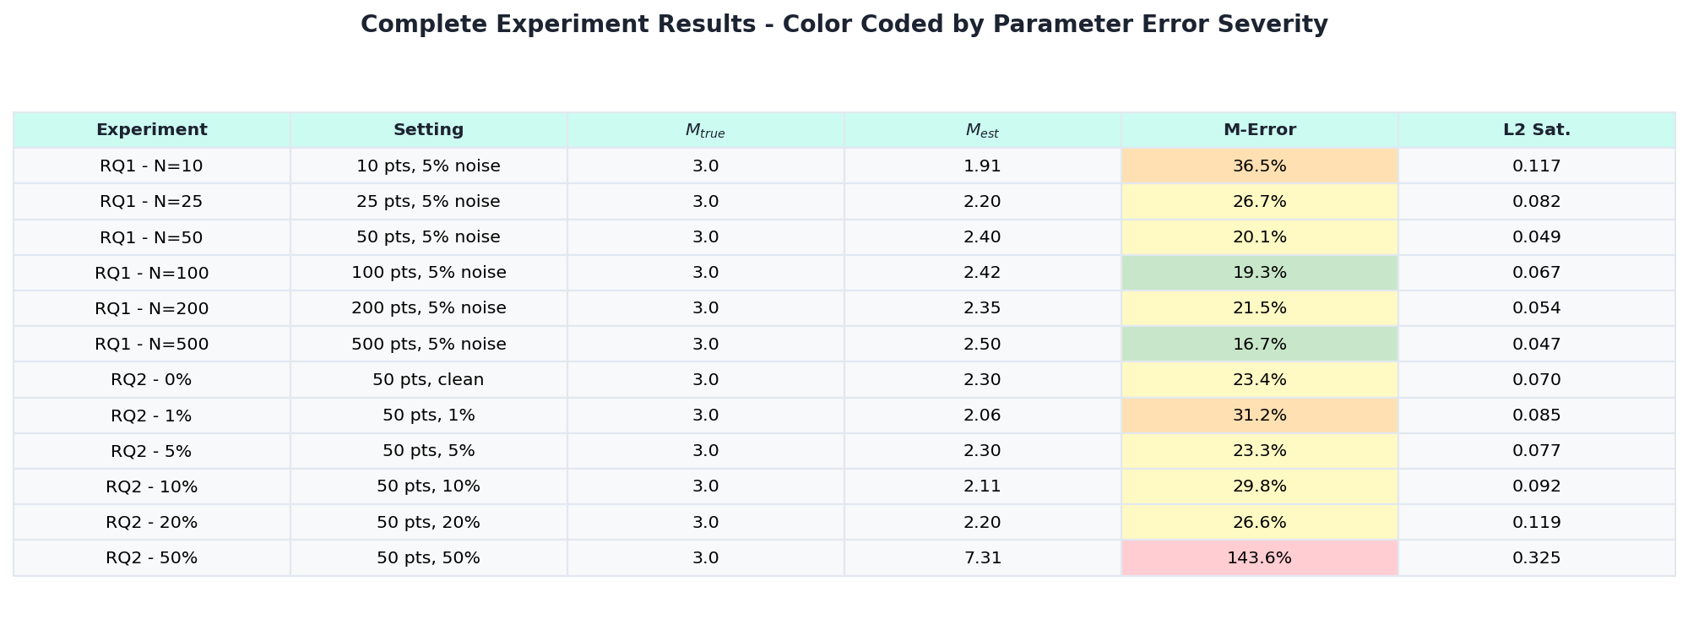
Complete Experiment Results
Color-coded by parameter error severity: green < 25%, yellow 25-31%, red > 30%
Congress of the Kazakhstan Mathematical Society 2026

Slide 21
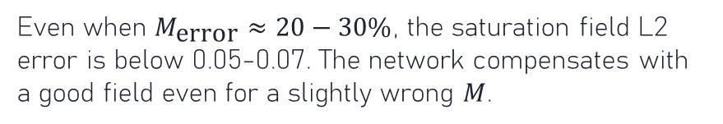
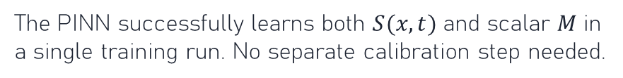
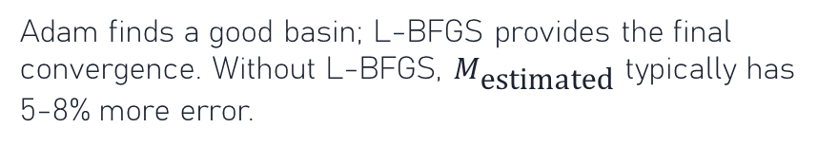
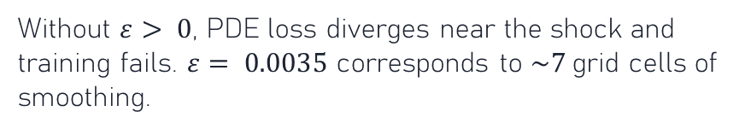
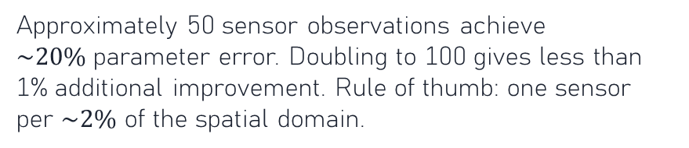
Key Insights and Discussion
1 Simultaneous recovery works
2 Saturation accuracy exceeds parameter accuracy
The PINN successfully learns both $S(x,t)$ and scalar $M$ in a single training run. No separate calibration step needed.
Even when $M_{\text{error}}≈20−30\%$, the saturation field L2 error is below 0.05-0.07. The network compensates with a good field even for a slightly wrong $M$.
3 Data efficiency threshold around N=50
4 Robustness limit: 20% noise
Approximately 50 sensor observations achieve $\sim 20\%$parameter error. Doubling to 100 gives less than 1% additional improvement. Rule of thumb: one sensor per $\sim 2\%$ of the spatial domain.
Stable recovery across 0-20% noise. The 50% failure is an extreme case (SNR < 1). Noise regularization or smoothing sensor data would extend this range.
5 Vanishing viscosity is non-negotiable
6 L-BFGS matters for M convergence
Without $ε> 0$, PDE loss diverges near the shock and training fails. $ε= 0.0035$ corresponds to $\sim 7$grid cells of smoothing.
Adam finds a good basin; L-BFGS provides the final convergence. Without L-BFGS, $M_{\text{estimated}}$ typically has 5-8% more error.
Congress of the Kazakhstan Mathematical Society 2026

Slide 22
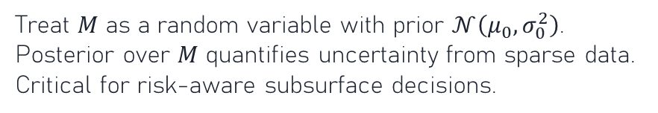
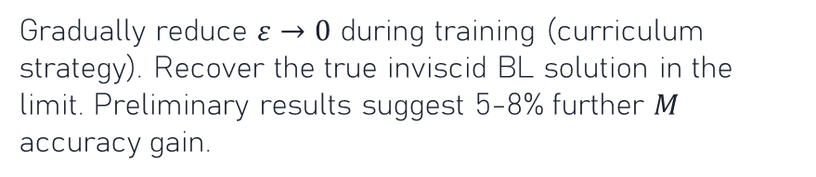
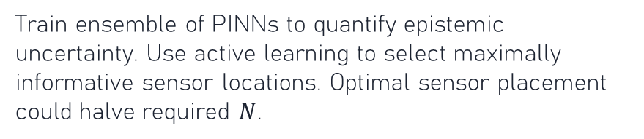
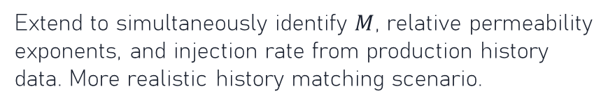
Future Directions
Vanishing viscosity annealing
Bayesian inverse PINN
Gradually reduce $ε→0$ during training (curriculum strategy). Recover the true inviscid BL solution in the limit. Preliminary results suggest 5-8% further $M$ accuracy gain.
Treat $M$ as a random variable with prior $𝒩\left(μ_{0},σ_{0}^{2}\right)$. Posterior over $M$ quantifies uncertainty from sparse data. Critical for risk-aware subsurface decisions.
Multi-parameter identification
Real field data validation
Extend to simultaneously identify $M$, relative permeability exponents, and injection rate from production history data. More realistic history matching scenario.
Apply to synthetic well-log saturation data with realistic spatial heterogeneity (layered permeability). Test transfer learning from synthetic pre-training.
2D / multi-dimensional extension
Ensemble and active learning
Train ensemble of PINNs to quantify epistemic uncertainty. Use active learning to select maximally informative sensor locations. Optimal sensor placement could halve required $N$.
Buckley-Leverett in 2D with gravity: richer shock structures. Requires domain decomposition PINN (cPINN / XPINN) for scalability.
Congress of the Kazakhstan Mathematical Society 2026

Slide 23
Thank you for your attention! Questions?

Slide 24
References
[1] Buckley and Leverett (1942)
Mechanism of fluid displacement in sands. Transactions of the AIME, 146, 107-116.
[2] Raissi, Perdikaris and Karniadakis (2019)
Physics-informed neural networks: A deep learning framework for solving forward and inverse problems involving nonlinear PDEs. J. Comput. Phys., 378, 686-707.
[3] Jagtap, Kharazmi and Karniadakis (2020)
Conservative physics-informed neural networks on discrete domains for conservation laws: Applications to forward and inverse problems. CMAME, 365, 113028.
[4] Coutinho et al. (2023)
Physics-informed neural networks with adaptive localized artificial viscosity. J. Comput. Phys., 489, 112265.
Congress of the Kazakhstan Mathematical Society 2026

