Slide 1
Corrected Legacy Sinergym Branch for HVAC MORL
From legacy thesis reproduction to competitive PPO control Theme: multi-objective HVAC control in Sinergym with corrected observation semantics, valid action parameterization, gaussian MORL reward, and RBC-guided BC warm-start.
Based on: ArticleRus legacy Sinergym branch Presentation generated from the Inverse_PINN template style.

Slide 2
Motivation and Problem Statement
Goal: rebuild the thesis-era Sinergym HVAC controller and push PPO beyond rule-based control (RBC) on the comfort-energy trade-off. Observed legacy problems before correction: - wrong temperature channel used in reward/evaluation - invalid direct setpoint action semantics - Pareto collapse across weights - article-style figures were not fully tied to live CSV outputs Main engineering task: convert the branch into an honest, live, reproducible evaluation pipeline.

Slide 3
Thesis Targets vs Current Honest Live Status
Thesis target values Mean HVAC power: 410-420 W Mean comfort penalty: ~1.8 95th percentile comfort penalty: ~0.42 Narrative target: PPO better than baseline strategies with smoother thermal dynamics.
Current corrected live result PPO power: 499.8 W RBC power: 518.24 W PPO comfort: 11 RBC comfort: 10.94 PPO in-band: 41% RBC in-band: 59% Conclusion: PPO is already better on energy, but not yet better on comfort.

Slide 4
Core Idea Implemented in sinergym_backend.py
Key architectural decisions: - name-based lookup for physical variables - MORL scalarization: comfort + energy - valid-by-construction action parameterization - ActionRateLimit + ActionSafety wrappers - logging of raw / limited / physical actions - reward vector export for live evaluation
temp_name = "Zone Air Temperature(SPACE1-1)" energy_name = "Facility Total HVAC Electricity Demand Rate(Whole Building)" reward = MORLReward( temp_low=20.0, temp_high=26.0, weights=MORLWeights(comfort=0.9, energy=0.1), )
This backend is the central idea of the presentation: instead of claiming gains from a broken legacy setup, we corrected the environment semantics first and optimized PPO only after that.

Slide 5
Corrected Observation and Action Semantics
Resolved observation channels: obs[10] = heating setpoint obs[11] = cooling setpoint obs[12] = zone air temperature obs[13] = zone humidity obs[16] = HVAC electricity demand rate This eliminated the false comfort gains caused by using setpoints instead of the real zone temperature.
action_parameterization: "midpoint_gap" normalize_action: true rate_limit: true deadband: 0.5 obs[12] -> Zone Air Temperature obs[16] -> HVAC Power
The new midpoint-gap parameterization reduced invalid actions and made PPO learn on actions that are much closer to what the environment actually executes.

Slide 6
MORL Reward Shaping
Reward families tested: - linear - exponential - gaussian - cubic Best current reward family: - gaussian - comfort weight 0.9 - energy weight 0.1 - sigma 1.0 - offset 0.2 - target temperature 22 C
scalar = w_comfort * r_comfort + w_energy * (r_energy + r_control) score = gaussian_peak * exp(-0.5 * (deviation / sigma)^2) - gaussian_offset
Gaussian reward gave the best compromise in our corrected setup. Exponential reward improved after BC warm-start, but still did not beat the gaussian baseline.

Slide 7
RBC to Behavior-Cloning Warm-Start
Why BC warm-start was necessary: - PPO from scratch often collapsed into cold / high-power regimes - RBC demonstrations anchor PPO in a safe thermal region - fine-tuning then optimizes energy around that stable comfort regime Observed effect: - in-band rose from near-failure levels to meaningful control occupancy
maybe_run_rbc_warmstart( model, env_factory=EnvFactory, env_cfg=env_cfg, warm_cfg=train_cfg["bc_warmstart"], seed=seed, out_dir=out_dir, )
Current best BC summary: - dataset size: 20,000 - epochs: 40 - final BC loss: 0.1119 BC solved the cold-start failure mode. The remaining gap to RBC is now a fine optimization problem, not a broken-training problem.

Slide 8
Experimental Protocol and Evaluation Metrics
Environment: - Eplus-5Zone-hot-continuous-v1 - corrected Zone Air Temperature channel - midpoint-gap action parameterization Policies compared: - PPO - Rule-based - Random - Zero-hold Metrics: - mean HVAC power (W) - mean comfort penalty - 95th percentile comfort penalty - in-band occupancy - representative temperature and power trajectories

Slide 9
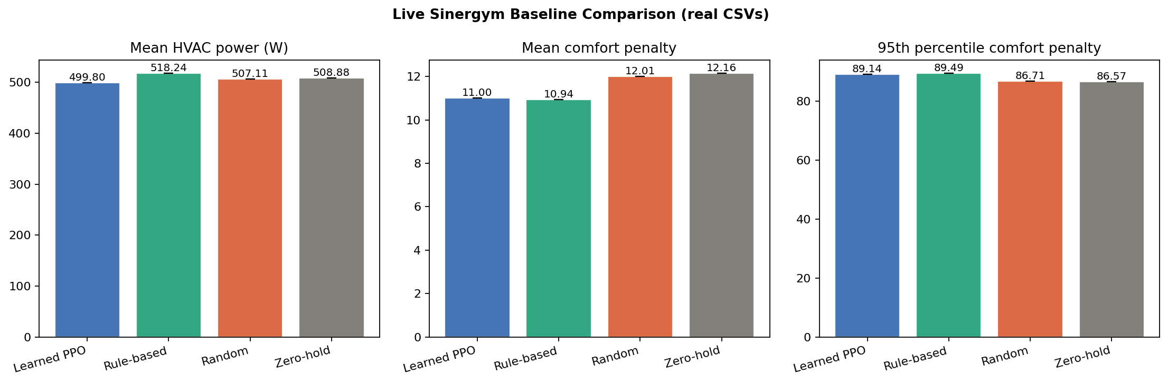
Live Baseline Comparison

Slide 10
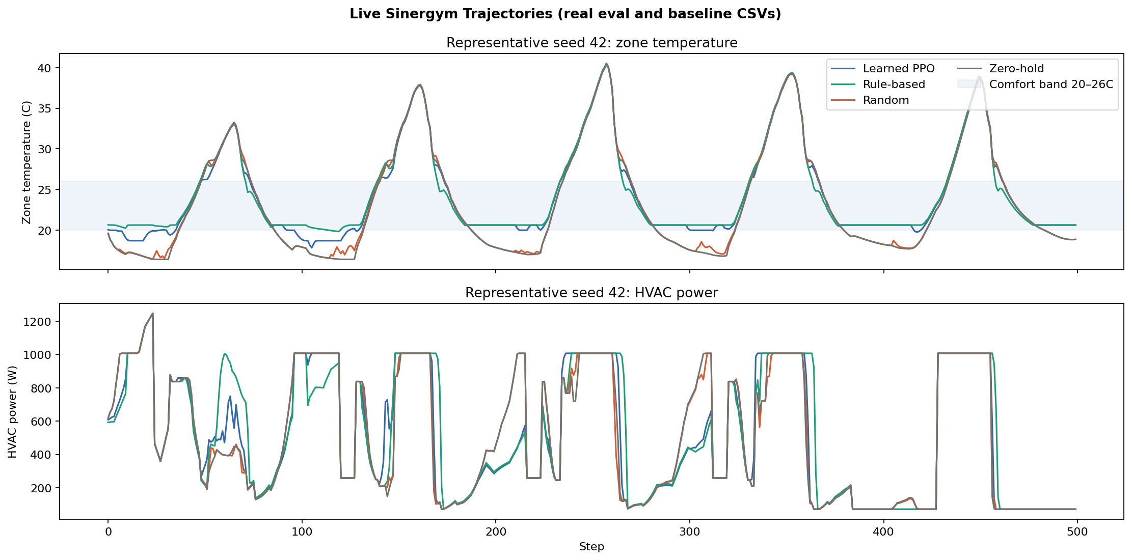
Representative PPO vs RBC Trajectories

Slide 11
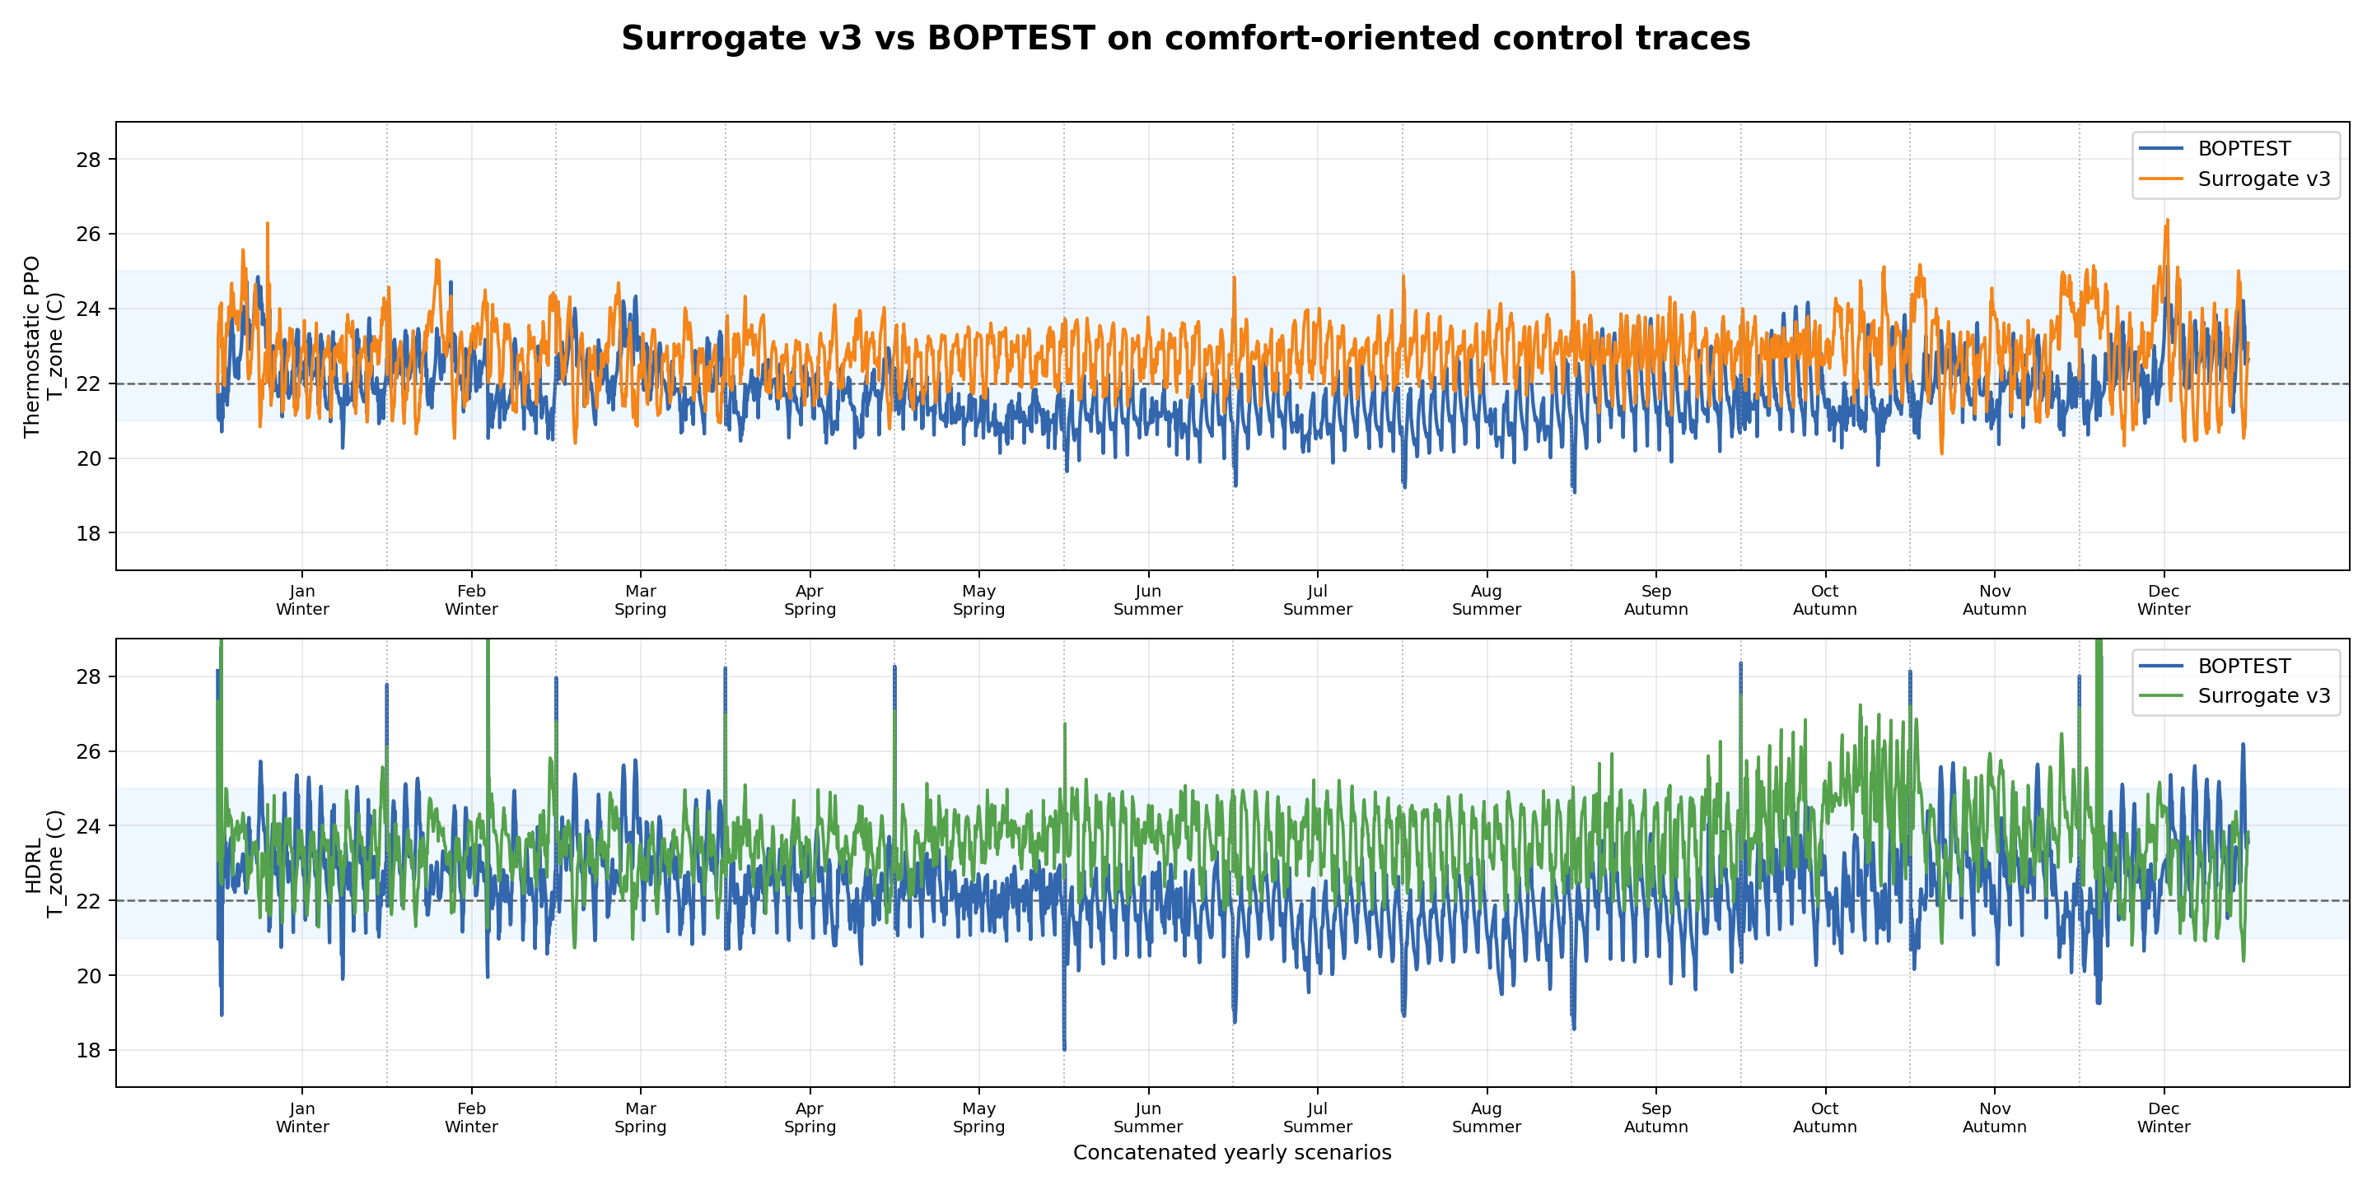
Surrogate v3 vs BOPTEST on Comfort-Oriented Traces

Slide 12
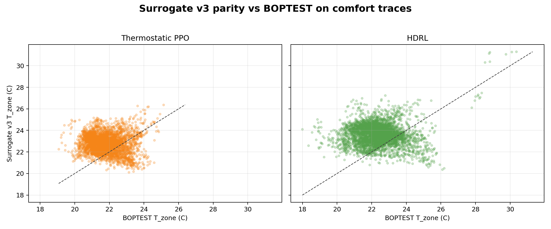
Surrogate Parity Against BOPTEST

Slide 13
Current Best Result vs Thesis Benchmark
Current best PPO Mean HVAC power: 499,8 W Mean comfort penalty: 11 95th percentile comfort penalty: 89,14 In-band: 41% Strength: Lower energy than RBC Current limitation: Comfort is still slightly worse than RBC.
Surrogate validation Thermostatic PPO: RMSE 1,59 C MAE 1,35 C Bias +1 C HDRL: RMSE 1,89 C MAE 1,59 C Bias +1,21 C

Slide 14
Conclusions and Next Steps
Main achievements: - rebuilt the legacy Sinergym branch into an honest live evaluation pipeline - fixed observation and action semantics - established gaussian MORL reward as the best reward family - BC warm-start made PPO competitive with RBC Current status: - PPO already beats RBC on energy - PPO is close to RBC on comfort, but not yet better Immediate next step: - small sweep over BC intensity and PPO learning rate within the current gaussian setup to push PPO past RBC on both axes.

