Slide 1
HVAC Building Energy Management via Multi-Objective Deep Reinforcement Learning
Project defense presentation based on defensePart1.pdf, defensePart2.pdf, MorlProjectFinalv3.pdf, and the latest validated results from the HVAC_DRL_MORL repository.
Almaz Sapargali | DigitAlem LLP | Project IRN AP23488794
March 2026

Slide 2
Executive Summary
- Phase 0 stabilized MORL-PPO and produced the first Pareto front with a reported 28% energy reduction.
- Phase 1 introduced a physics-informed RC Neural ODE surrogate with 32,313x measured speedup and RMSE = 0.163 C in the report.
- Phase 2 solved the inverse calibration problem and improved RMSE by 79%.
- Phase 3 tested eleven MORL experiments, then the project continued with a direct-Tsup redesign that produced the strongest current comfort baseline.
- Today the validated benchmark picture is: Standard PI = energy reference, Thermostatic PPO = comfort reference, HDRL = structured trade-off prototype.
All yearly numbers in the current continuation are computed on 12 representative 336-hour scenario windows.

Slide 3
Problem Statement and Research Question
- HVAC control is inherently multi-objective: comfort, energy, and safety must be balanced at the same time.
- Purely model-based control is often accurate but can be computationally expensive or hard to adapt.
- Purely model-free RL is flexible, but direct BOPTEST training is slow and sample-inefficient.
- The core research question is whether a physics-informed and surrogate-accelerated RL pipeline can remain fast, accurate, and structurally safe enough for deployment-oriented control.

Slide 4
Research Roadmap: Phases 0 to 3
- Phase 0: MORL-PPO stabilization and reward/observation debugging.
- Phase 1: RC Neural ODE surrogate for fast, differentiable rollouts.
- Phase 2: inverse-problem calibration for physical fidelity.
- Phase 3: structured controller experiments including reward shaping, GRU forecasts, shielding, SAC, HDRL, real weather, emergency heating, expanded action space, and direct Tsup control.

Slide 5
Reference Papers and Our Improvement: Wang + Liao
Wang et al. (2025)
Liao et al. (2025)
- Wang et al. (2025): safety metric m_s = r_time + r_sev and the idea of an external safety layer for DRL HVAC control.
- Original limitation: MPC-based safety correction is accurate but too slow for edge deployment, around 2.67 s per decision in the report discussion.
- Our improvement: replace heavy online MPC prediction with a Neural ODE surrogate and short-horizon surrogate filtering.
- Resulting value: safety-aware architecture becomes computationally realistic for edge-oriented deployment.
- Liao et al. (2025): hierarchical DRL logic with mode specialization across operating regimes or seasons.
- Original insight adopted: hierarchy helps because one flat policy is weak across all seasons.
- Our improvement: add a third supervisory layer, Emergency Heating Mode, for hard interception under extreme cold.
- This solved the winter crash regime that the learned hierarchy alone could not eliminate.

Slide 6
Reference Papers and Our Improvement: Gao + Hedayat
Gao et al. (2024)
Hedayat et al. (2025)
- Gao et al. (2024): thermostatic benchmark focused on holding a nominal indoor target around 22 C.
- What we adopted: the idea of a one-objective comfort-tracking benchmark as an ablation study.
- Our improvement: direct-Tsup Neural ODE surrogate reaches comparable order of accuracy with a much simpler forecast mechanism than 24 h GRU processing.
- Current direct-Tsup thermostatic PPO result: mean RMSE22 = 0,970 C, with the strongest current repository-level comfort performance.
- Hedayat et al. (2025): low-level control and physically grounded HVAC learning.
- What we adopted: physics-aware control design and movement toward lower-level actuation variables.
- Our improvement: go beyond physical regularization and identify a structural interface gap caused by the built-in PI controller.
- Breakthrough: switch from indirect setpoint control to direct supply-air temperature control and remove the internal PI bottleneck.

Slide 7
How This Work Extends the State of the Art
- Many SOTA papers report strong performance on narrow scenarios such as peak-cooling weeks or idealized comfort windows.
- Our project adds three harder dimensions at the same time: computational speed, seasonal robustness, and diagnosis of control-interface mismatch.
- Key repository-level strengths today: Neural ODE speed, physically calibrated surrogate, explicit 12-scenario seasonal validation, and honest controller benchmarking against Standard PI, Thermostatic PPO, and HDRL.
- Main scientific message: the bottleneck was not only the RL algorithm; it was the control interface and the hidden PI layer inside BOPTEST.
Q1 positioning: this is not only a better controller study, but also a systems-level diagnosis of why certain DRL pipelines fail.

Slide 8
Phase 0: MORL-PPO Stabilization
- Objective: establish a working multi-objective PPO agent on BOPTEST with vector rewards for comfort and energy.
- Problem P0.1: scale dominance in the scalarized reward; solution: rescale energy by 1/Pmax.
- Problem P0.2: observation-space mismatch; solution: use Box[-1,1] consistently.
- Result from the report: 28% energy reduction and a monotonic Pareto front across comfort-energy weights.

Slide 9
Phase 1: RC Neural ODE Surrogate
Architecture
Key fixes
- Physics-informed residual thermal update instead of direct absolute-temperature prediction.
- Input features: Tzone, Tamb, hour/day cyclic terms, and action.
- Two heads: delta-T head and total-power head.
- Residual design prevents the network from canceling the HVAC signal.
- Problem P1.1: thermal capacitance too large; fixed by data-driven estimate.
- Problem P1.2: parameter drift; fixed via register_buffer.
- Problem P1.3: network canceled HVAC; fixed by direct delta-T residual formulation.

Slide 10
Phase 1 Results: Why the Surrogate Matters
- Measured speed benchmark from the report: BOPTEST 37.6 steps/s versus surrogate batch rollout 1,215,752 steps/s.
- That corresponds to a 32,313x speedup and changes experiment time from tens of hours to minutes.
- The report-level surrogate v2 result reached RMSE = 0.163 C with R2 = 0.991.
- This surrogate became the computational foundation for PPO, HDRL, safety rollouts, and rapid ablations.

Slide 11
Phase 2: Inverse Calibration
- Objective: recover thermal parameters and improve physical consistency from telemetry.
- Problem P2.1: latency collapsed the signal and made calibration ill-posed.
- Problem P2.2: linear calibration was too weak; solution: joint fine-tuning of physical parameters and neural weights.
- Result from the report: RMSE improved from 9.12 C to 1.91 C, a 79% reduction, with Czon recovered to 7.9% error.

Slide 12
Phase 3: Eleven MORL Experiments in the Report
- Experiment 1: PPO baseline with synthetic weather.
- Experiment 2: reward shaping; failed and amplified sim-to-real mismatch.
- Experiment 3: GRU weather forecast inspired by Gao et al.; partial improvement only.
- Experiment 4: runtime shielding inspired by Xu et al.; expensive and inaccurate on BOPTEST.
- Experiment 5: SAC; underperformed PPO.
- Experiments 6-10: HDRL, real weather, emergency heating, expanded 5-feature state, and BOPTEST fine-tuning.
- Experiment 11: direct Tsup control; this became the breakthrough that changed the control interface itself.
Source: defensePart1.pdf complete report.

Slide 13
Legacy Best Reported Phase 3 Result
- Best reported MORL/HDRL result before the current continuation: ms = 0.697 +- 0.368 over 12 monthly scenarios.
- The strongest reported seasonal behavior was in summer, with ms around 0.140-0.187.
- The report concluded that weather mismatch and extreme events were partly solved, but an action-response mismatch remained.
- This is why the project did not stop at the report endpoint.

Slide 14
Thermostatic Ablation and Direct-Tsup Breakthrough
- The full report also contains a thermostatic ablation study against Gao et al.'s benchmark logic.
- Key breakthrough in the report: moving from indirect thermostat-style control to direct supply-air control.
- Reported improvement: mean RMSE reduced from 4.70 C to 0.84 C; winter RMSE reduced from 8.89 C to 0.78 C.
- Interpretation in the report: the so-called structural gap was caused mainly by BOPTEST's internal PI layer, not by missing building physics.

Slide 15
Why Phase 3 Had to Continue
- The final report itself concluded that the remaining gap was structural.
- Therefore the continuation focused on changing action semantics, not just tuning PPO longer.
- The redesign goal was to unify surrogate training, RL training, and BOPTEST deployment under one physically meaningful interface.
- That interface is direct Tsup plus direct fan control.

Slide 16
Current Direct-Tsup Pipeline in the Repository
- Data collection: data/collect_tsupply_data.py, 51,200 BOPTEST samples from 4 seasons x 4 policies.
- Surrogate training: surrogate/train_surrogate_v2.py with multi-step loss and power prediction.
- Comfort-first baseline: training/train_thermostatic.py.
- Structured trade-off controller: training/train_hdrl.py.
- Energy reference: evaluation/standard_controller_baseline.py.
- Ongoing MORL and safety layer: main.py, evaluation/eval_safe_morl.py, and layers/safety/action_filter.py.

Slide 17
Current Standard PI Baseline: Validated Reference
- The built-in BOPTEST controller is now evaluated explicitly without any override signals.
- Mean fixed-target comfort versus 22 C: RMSE22 = 3,41 C.
- Mean fixed-band violation = 43,8% and mean fixed-band m_s = 0,695.
- Total energy = 1230,2 kWh = 25,63 kWh/m2.
- Interpretation: this is the low-energy reference, not the main comfort baseline.

Slide 18
Current Thermostatic PPO Baseline: Strongest Comfort Result
- Current mean RMSE22 = 0,970 C and mean MAE22 = 0,810 C.
- Within +-1 C = 65,9% and within +-0.5 C = 35,1%.
- Mean fixed-band violation = 23,5% and mean fixed-band m_s = 0,291.
- Total energy = 3037,8 kWh = 63,29 kWh/m2.
- Interpretation: this is currently the strongest validated comfort controller in the repository.

Slide 19
Current HDRL: Structured but Not Yet Dominant
- Two seasonal PPO experts trained on the direct-Tsup surrogate with a compact 5-feature state.
- Mean RMSE22 = 1,363 C and mean fixed-band violation = 12,7%.
- Mean fixed-band m_s = 0,307.
- Total energy = 3070,2 kWh = 63,96 kWh/m2.
- Interpretation: HDRL is operational and structured, but it does not yet beat the thermostatic PPO baseline on the full-year benchmark.

Slide 20
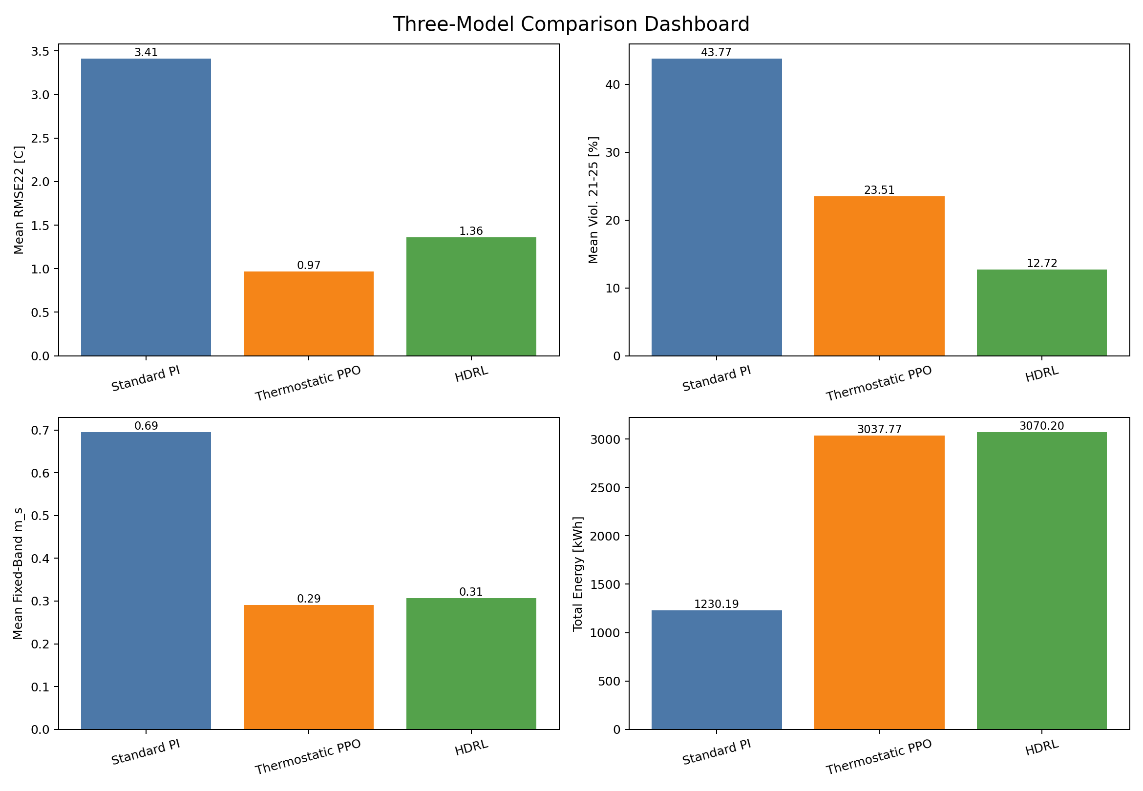
Visual Comparison: Three Validated Controllers
- Thermostatic PPO is best on fixed-target comfort metrics.
- Standard PI is best on energy.
- HDRL has lower fixed-band violation than Thermostatic PPO, but a worse RMSE22.
- This confirms that the three controllers currently occupy different parts of the comfort-energy trade-off.
Source: outputs/three_model_comparison/comparison_dashboard.png

Slide 21
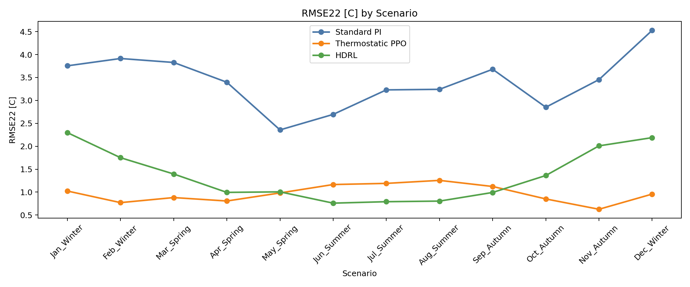
Monthly RMSE22 Comparison
- Thermostatic PPO stays consistently below the PI controller across all benchmark windows.
- HDRL remains better than PI in most windows, but still trails Thermostatic PPO on target-tracking accuracy.
- This figure makes the comfort hierarchy visually clear.
Source: outputs/three_model_comparison/comparison_monthly_rmse22.png

Slide 22
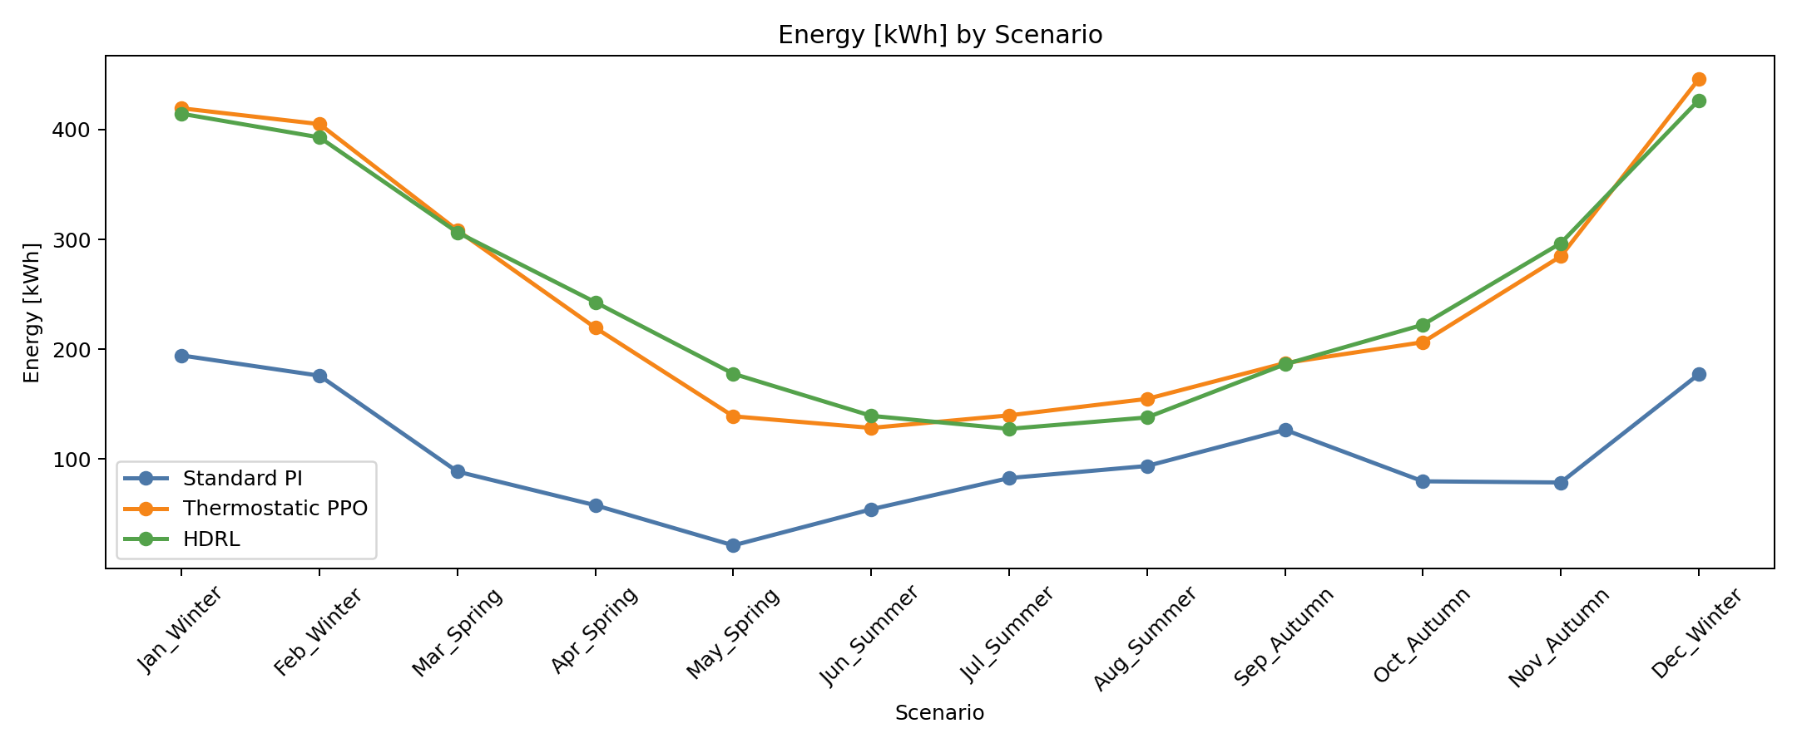
Monthly Energy Comparison
- Standard PI remains far below the RL controllers in total energy.
- HDRL occasionally improves over Thermostatic PPO in summer, but the annual gap remains small.
- This figure shows why PI must be treated as the low-energy reference baseline.
Source: outputs/three_model_comparison/comparison_monthly_energy.png

Slide 23
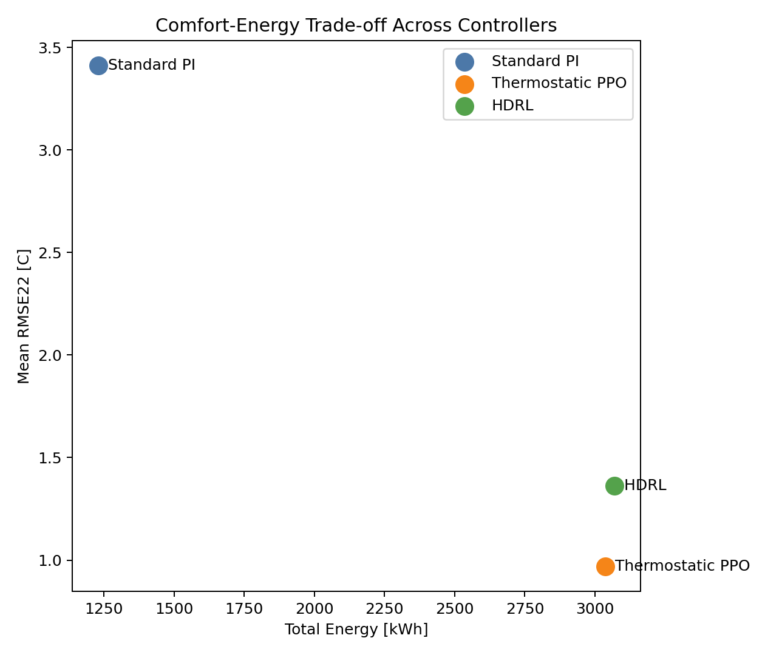
Comfort-Energy Trade-off Scatter
- The annual trade-off is now easy to interpret in one plane.
- Thermostatic PPO sits at the strongest comfort point.
- Standard PI sits at the strongest energy point.
- HDRL currently lands close to Thermostatic PPO in energy but worse in RMSE22, so it is not yet the winning trade-off controller.
Source: outputs/three_model_comparison/comparison_tradeoff_scatter.png

Slide 24
Machine-Generated Conclusion from the Current Comparison
- Best fixed-target comfort: Thermostatic PPO, mean RMSE22 = 0,970 C.
- Best energy efficiency: Standard PI, total energy = 1230,2 kWh.
- Best fixed-band violation among RL controllers: HDRL, but HDRL still has worse RMSE22 than Thermostatic PPO.
- Annual status: HDRL does not yet beat Thermostatic PPO; its annual energy is about 1.1% higher.
- Seasonal nuance: HDRL already reduces summer energy by about 4.3% relative to Thermostatic PPO.
This slide is based on outputs/three_model_comparison/comparison_conclusion.txt.

Slide 25
Why HDRL Still Trails the Thermostatic Baseline
- Thermostatic PPO is comfort-first and targets 22 C directly; HDRL optimizes comfort plus energy over the broader [21,25] C band.
- Thermostatic PPO uses a rich 17-feature observation with forecast and history; HDRL uses only a compact 5-feature current state.
- HDRL also relies on a hard ambient threshold for seasonal switching, which is too crude for shoulder seasons and mixed regimes.
- Therefore the current HDRL is a promising structured controller, but not yet the best annual controller.

Slide 26
Implemented Ideas That Were Tested and Rejected
- GRU weather forecasting inspired by Gao et al.: implemented, but Experiment 3 increased mean m_s to 0.893 and suffered from forecast mismatch.
- Runtime shielding inspired by Xu et al.: implemented, but Experiment 4 increased violations because shield quality depended too strongly on surrogate absolute accuracy.
- SAC as an off-policy alternative: implemented, but it underperformed PPO and reached around m_s = 1.063 in the report.
- Main lesson: not every SOTA ingredient survives contact with this simulator stack; several methods degraded performance because they amplified sim-to-real mismatch instead of reducing it.
These negative results are scientifically useful and strengthen the novelty claim of the final architecture.

Slide 27
MORL and Safety Layer: Current Honest Status
- MORL is already implemented in main.py and the surrogate-based safety filter is implemented in layers/safety/action_filter.py.
- The safety filter rolls out the Neural ODE surrogate over a short horizon and replaces unsafe actions with a fallback controller.
- After the direct-Tsup redesign, the main fully validated results are still Standard PI, Thermostatic PPO, and HDRL.
- For the defense, MORL should be presented as architecturally ready and ongoing, not as the final quantitative headline.

Slide 28
Main Contributions vs Current Limitations
Contributions
Limitations
- Full pipeline from BOPTEST RL to surrogate-accelerated control.
- Physics-informed RC Neural ODE with strong speed and accuracy.
- Inverse calibration for physical fidelity.
- Systematic Phase 3 experiment program with explicit problem-solution logging.
- Direct-Tsup redesign that fixed the strongest control-interface mismatch.
- HDRL still does not beat the comfort-first baseline on the annual trade-off.
- PI remains much more energy-efficient because it solves a softer scheduled-comfort task.
- MORL has not yet been fully re-evaluated on the direct-Tsup pipeline.
- The seasonal gate is still threshold-based rather than learned.

Slide 29
Next Steps
- Retrain MORL first on the direct-Tsup surrogate, then fine-tune on BOPTEST.
- Replace the hard seasonal switch with a learned gate or at least hysteresis.
- Give HDRL and MORL the same richer temporal context used by the Thermostatic PPO baseline.
- Evaluate Safe MORL on the new pipeline and extend comfort metrics toward PMV/PPD and ASHRAE 55.
- Prepare deployment-oriented validation for edge hardware and real-building sensor streams.

Slide 30
Final Defense Message
- Phase 0 stabilized the MORL formulation.
- Phase 1 delivered the core computational breakthrough through a Neural ODE surrogate.
- Phase 2 improved physical trustworthiness through inverse calibration.
- Phase 3 identified the real structural bottleneck and led to the direct-Tsup redesign.
- Today the strongest validated result is the direct-Tsup Thermostatic PPO baseline, while HDRL is a working but not yet dominant trade-off controller.
- The repository is now technically ready for the final MORL step.

Slide 31
Thank You
- Questions and discussion.
- Backup material can be generated from the same repository: LaTeX defense deck, comparison plots, yearly summaries, and evaluation scripts.
Files created in this repo: docs/project_defense_presentation.tex and docs/HVAC_DRL_MORL_defense.pptx

