Slide 1

SYSTEM ANALYSIS AND APPROACHES
MURZABEKOV ALMAZ
HSE, 10.2019

Slide 2
WHAT IS THE SYSTEM ANALYSIS?
System analysis is a scientific and methodological discipline that studies the principles, methods and means of studying complex objects by presenting them as systems and analyzing these systems.
System analysis is the process of studying a procedure or business in order to identify
its goals and purposes and create systems and procedures that will achieve them
in an efficient way".
System analysis is a process of collecting and interpreting facts, identifying the problems,
and decomposition of a system into its components.
The field of system analysis relates to requirements analysis or to operations research

Slide 3
BRIEF HISTORY OF SYSTEM ANALYSIS
The emergence of philosophical and practical ideas about systems analysis
The first rise of the idea of ​​a systems approach in ancient Greece (in the space sciences)
Theorization of system analysis ideas, the formation of the first theories
The emergence of systems analysis, the spread of a systems approach to all areas of science
Modern system analysis
[2500 BC- 2000 BC]
Term ”System”
[90BC – 160AD]
First rise in Ancient Greece
[1735-1876]
André Ampère
[XX century]
Second rise
[NOW]
Modern System Analysis
[1] Теория систем и системный анализ. - М.: Юрайт, 2013. - 624 с.
[2] История развития системного анализа – Internet link

Slide 4
HARD vs SOFT SYSTEM APPROACHES
Soft systems approaches assume:
organisational problems are ‘messy’ or poorly defined
stakeholders interpret problems differently (no objective reality)
human factors important – creative, intuitive approach to problem-solving
Hard systems approaches assume:
Well-defined problem to be solved
Technical factors foremost
Scientific approach to problem-solving
An ideal solution
HARD systems - rigid techniques and procedures to provide unambiguous solutions to well-defined data and
processing problems, focused on computer implementations
SOFT systems - a framework of tools to be used at the discretion of the analyst, focused on improvements
to organisational problems

Slide 5
SYSTEM ANALYSIS TECHNIQUES
Logical data modeling
  This is the process of identifying, modeling and documenting the data requirements of the
  system being designed. The data are separated into entities and relationships
Data Flow modeling
  This is the process of identifying, modeling and documenting how data moves around an
  information system. Data Flow Modeling examines processes, data stores, external entities
  and data flows
Entity behavior modeling
  This is the process of identifying, modeling and documenting the events that affect each entity
  and the sequence in which these events occur
Other techniques

Slide 6

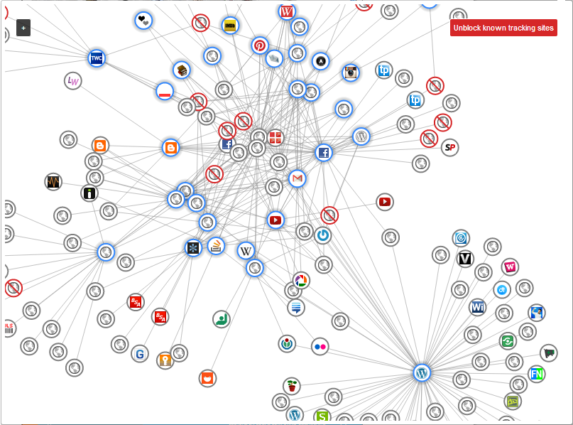
MY EXPERIENCE IN SYSTEM ANALYSIS
Sberbank project: ”Credit for 7 minutes”
  Platform for data scientists
  Graph data structures and algorithms
  Communication with stakeholders
  MVPs and researches
  Integrations with Social Networks
  Different types of modeling

Slide 7
THANK YOU!

Slide 8
REFERENCES:
«Теория систем и системный анализ» Ю. П. Сурмин
http://www.cs.stir.ac.uk/~dec/teaching/CSC9T4/lectures/HardSys.pdf
https://www.grounded.systems/2014/04/hard-systems-and-soft-systems/
https://slideplayer.com/slide/3890269/
https://gtmarket.ru/concepts/7111

