Slide 1
MASTER DATA MANAGEMENT
SYSTEM FOR ONE RUSSIAN LARGEST LOGISTIC COMPANY
MURZABEKOV ALMAZ
MOSCOW, 2020

Slide 2
INTRODUCTION
I have participated in the project for the largest logistics company in the Russian market for a long time in position Software Engineer, IT-consultant, Lead Big Data Engineer, and other related positions. And in this project, I'm going to demonstrate the results of part of the project related to the Advanced Data Management subject of study via providing the learned cases in the process of implementation of this project. All the related information about the company was depersonalized as well.

Slide 3

TOP 5 TRENDS IN LOGISTICS
Digitalization
International Tradings
  Russia-EU
  China-EU
  China-Russia-EU
BP Automatization
Changes in Markets
New Techs in Networks
Source: PWC
https://www.pwc.ru/ru/transportation-logistics/assets/obzor-tendentsiy-razvitiya-transporta-i-logistiki-v-2019.pdf

Slide 4
COMPANY DESCRIPTION
An international company with a long history of delivery and express delivery of goods, documents, a leader in the global and Russian logistics markets.
The company provides the following services:
  all types of domestic postal services
  international postal services, as well as the exchange of international mail between foreign postal operators (foreign postal administrations)
  services for the storage of mail, goods and goods, as well as storage services
  freight forwarding services
  subscription, delivery and distribution services of periodicals
  customs broker services, as well as services for declaring and customs clearance

Slide 5
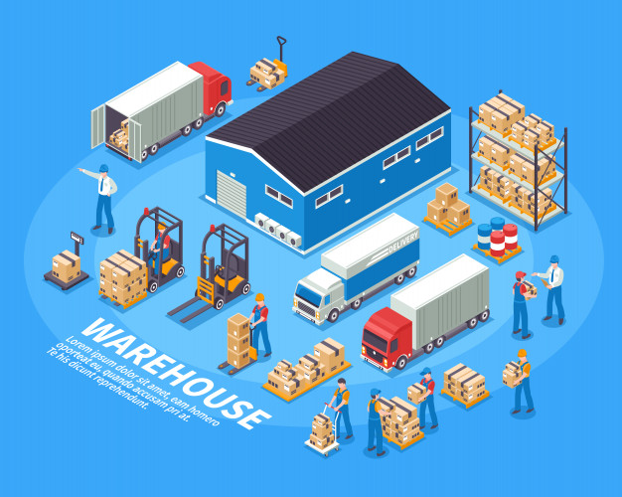
COMPANY DESCRIPTION
The short-list of company’s clients:
  Individuals (Russians and foreigners)
  Legal entities
  State & Government institutions
  International institutions
  The short-list of service providers for the company:
  Transport companies
  Finance companies
  Non-Food Retail Companies
  Printing companies
  Others

Slide 6
THE DATA LAKE PROJECT
To effectively conduct business and automate business processes, our client decided to build a Data Lake based on open-source frameworks. The main aim was to build a system for:
  Storing massive historical data
  Calculation of actual data (gold records)
  Building analytics on this data (data-marts, BI)
  Ad-hoc data study (pre ml-engineering)
  Monitoring and proactive problem solving (Situation Center)
  Building a customer profile (corporate segment)
The brief statistics about the data in this project
  The volume of historical data: 10Pb
  Daily increment: ~ 1Tb

Slide 7
FRAMEWORKS AND TOOLS
Main concept is using only open-source and free solutions for avoiding vendor-lock situation. All the components, except one, are open-source and from Apache Foundation:
  Apache Kafka
  Apache Hadoop
  Apache Flume, Flink
  Apache Hive
  Apache Spark & Spark Streaming
  Apache Cassandra
  Apache Oozie
  Apache Hue
  Vertica (vendor spec. solution)
  Yandex ClickHouse
  Pentaho
  Tabix
  Docker

Slide 8
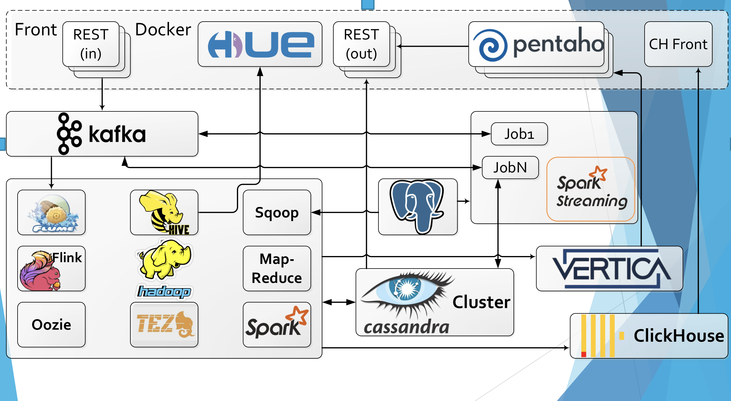
PROJECT ARCHITECTURE
LAMBDA ARCHITECTURE

Slide 9
Master Data Management subproject
In the process of structuring corporate data, often data-engineers come to the idea of denormalization this data. Often, many table columns contain repeated values, and these values might be carried out into separate tables. The MDM system (part of НСИ) must manage these entities and contain relevant data.
НСИ – Системы Управления Нормативно-Справочной Информацией

Slide 10
BUSINESS MODEL
The business model of the company is quite typical for a large logistics company. The company has extensive offices in the regions of Russia and beyond. The company carries out logistics processes on its own, in some cases it outsources logistics.
The company began to focus on the benefits of "last mile" because it gives great prospects in the business in the future, by increasing customer loyalty. A well-built "last mile" process provides long-term competitive advantages, especially in the corporate segment

Slide 11
WHO IS CONTROLLING
THE “LAST MILES”, THAT IS CONTROLLING THE WHOLE SUPPLY CHAIN

Slide 12
BUSINESS MODEL
Branches
Transportation companies
Clients
Warehouse
Clients
Branches
Transportation companies
Company BPs

Slide 13
DATA MODEL
A data model is an abstract model that organizes elements of data and standardizes how they relate to one another and to the properties of real-world entities.
A data model instance may be one of three kinds according to ANSI in 1975
  Conceptual Model
  Logical Model
  Physical Model

Slide 14
CONCEPTUAL MODEL
A conceptual schema is a high-level description of informational needs underlying the design of a database. It typically includes only the main concepts and the main relationships among them.
Master Data Management
Department Related Data
Governance Data
Regulatory Restrictions
Clients Data
Physical Logistics Data
Executive Directives

Slide 15
LOGICAL MODEL
A logical model is a data model of a specific problem domain expressed independently of a particular database management product or storage technology (physical data model) but in terms of data structures such as relational tables and columns, object-oriented classes, or XML tags.

Slide 16
SIMPLIFIED LOGICAL MODEL
The Logical model of the MDM project contains several items
Dictionary
System infos
Columns
User
Rel. Departments
Others
Restrictions
Validators
other related entities
User infos

Slide 17
PHYSICAL MODEL
A physical data model is a representation of a data design as implemented in a DBMS. In the lifecycle of a project, it typically derives from a logical data model, though it may be reverse-engineered from a given database implementation.

Slide 18
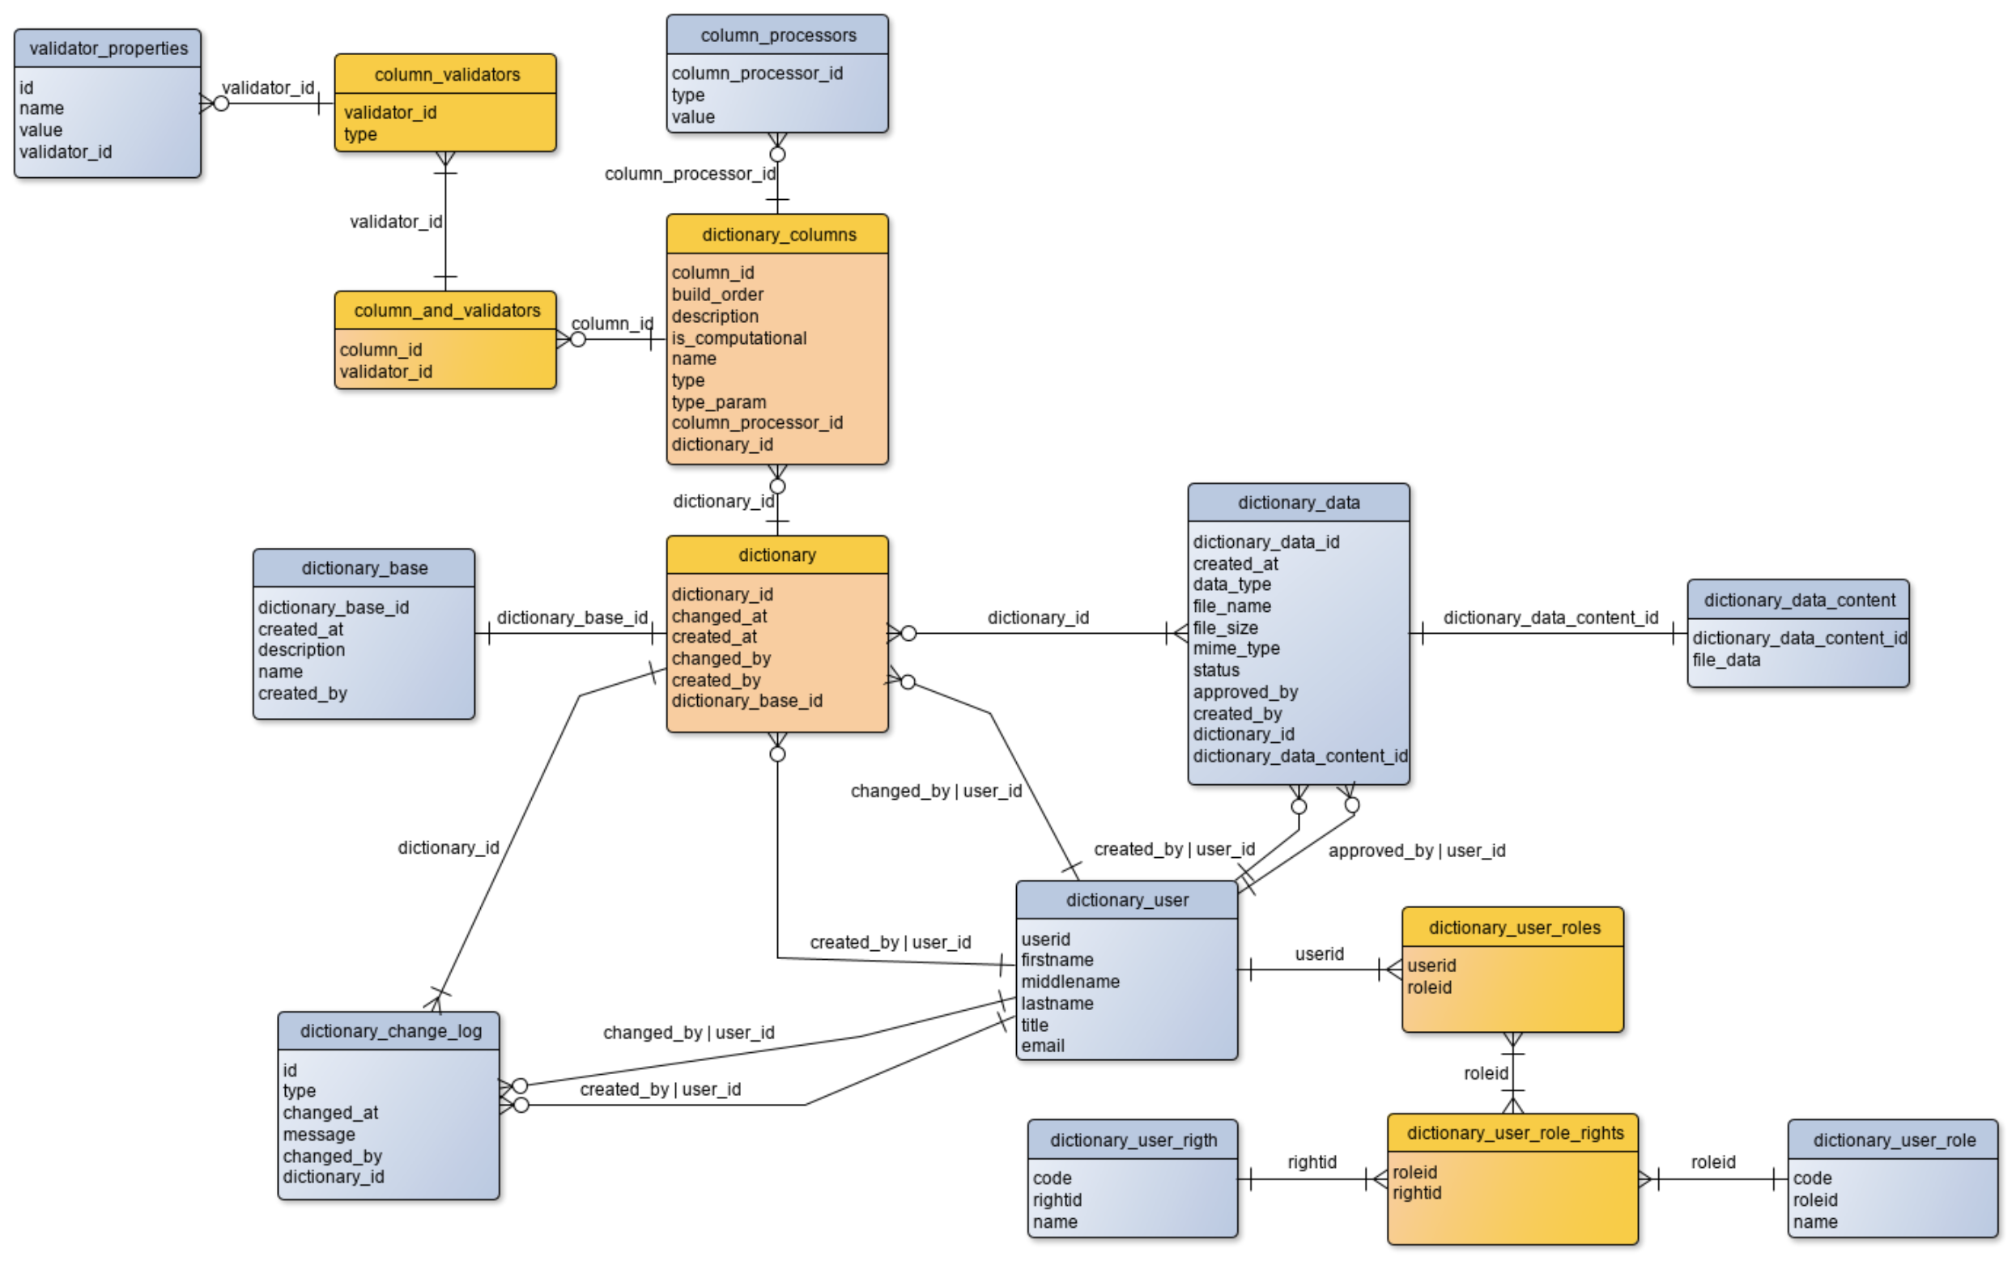
SIMPLIFIED PHYSICAL MODEL

Slide 19
DATA SOURCES
Company’s other related systems (north systems)
  Periodically ETL-processes
    Nightly daily updates
    Full updates
    Modification scripts
  Ad-hoc uploads
  Eventually uploads
Regulatory data
  Ad-hoc uploads & changes
Directives from Executives and Managers
Auto-generated data (in the project)

Slide 20
MASTER DATA
The system under development is a master data system (MDM), and also contains gold records, in terms of dictionaries, within the company data. This system is a repository of relevant reference data and supports integration with various IT components in the company through the REST-API.

Slide 21
SECURITY
Since the MDM system is an internal solution, security-related tasks lie mostly in the access control plane
There are 4 roles in the role model of the project, respectively, for each role it is necessary to provide only the necessary set of accesses and privileges. All actions not included in the role model should be prohibited and logged in the system
Critical user data must be moved to the appropriate components in the company architecture, such as Active Directory (AD).
Any changes to the security configuration must be agreed with the IS department.

Slide 22
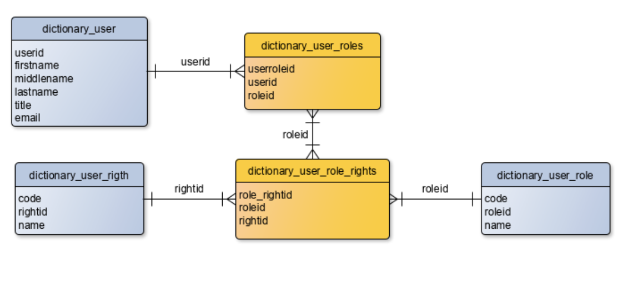
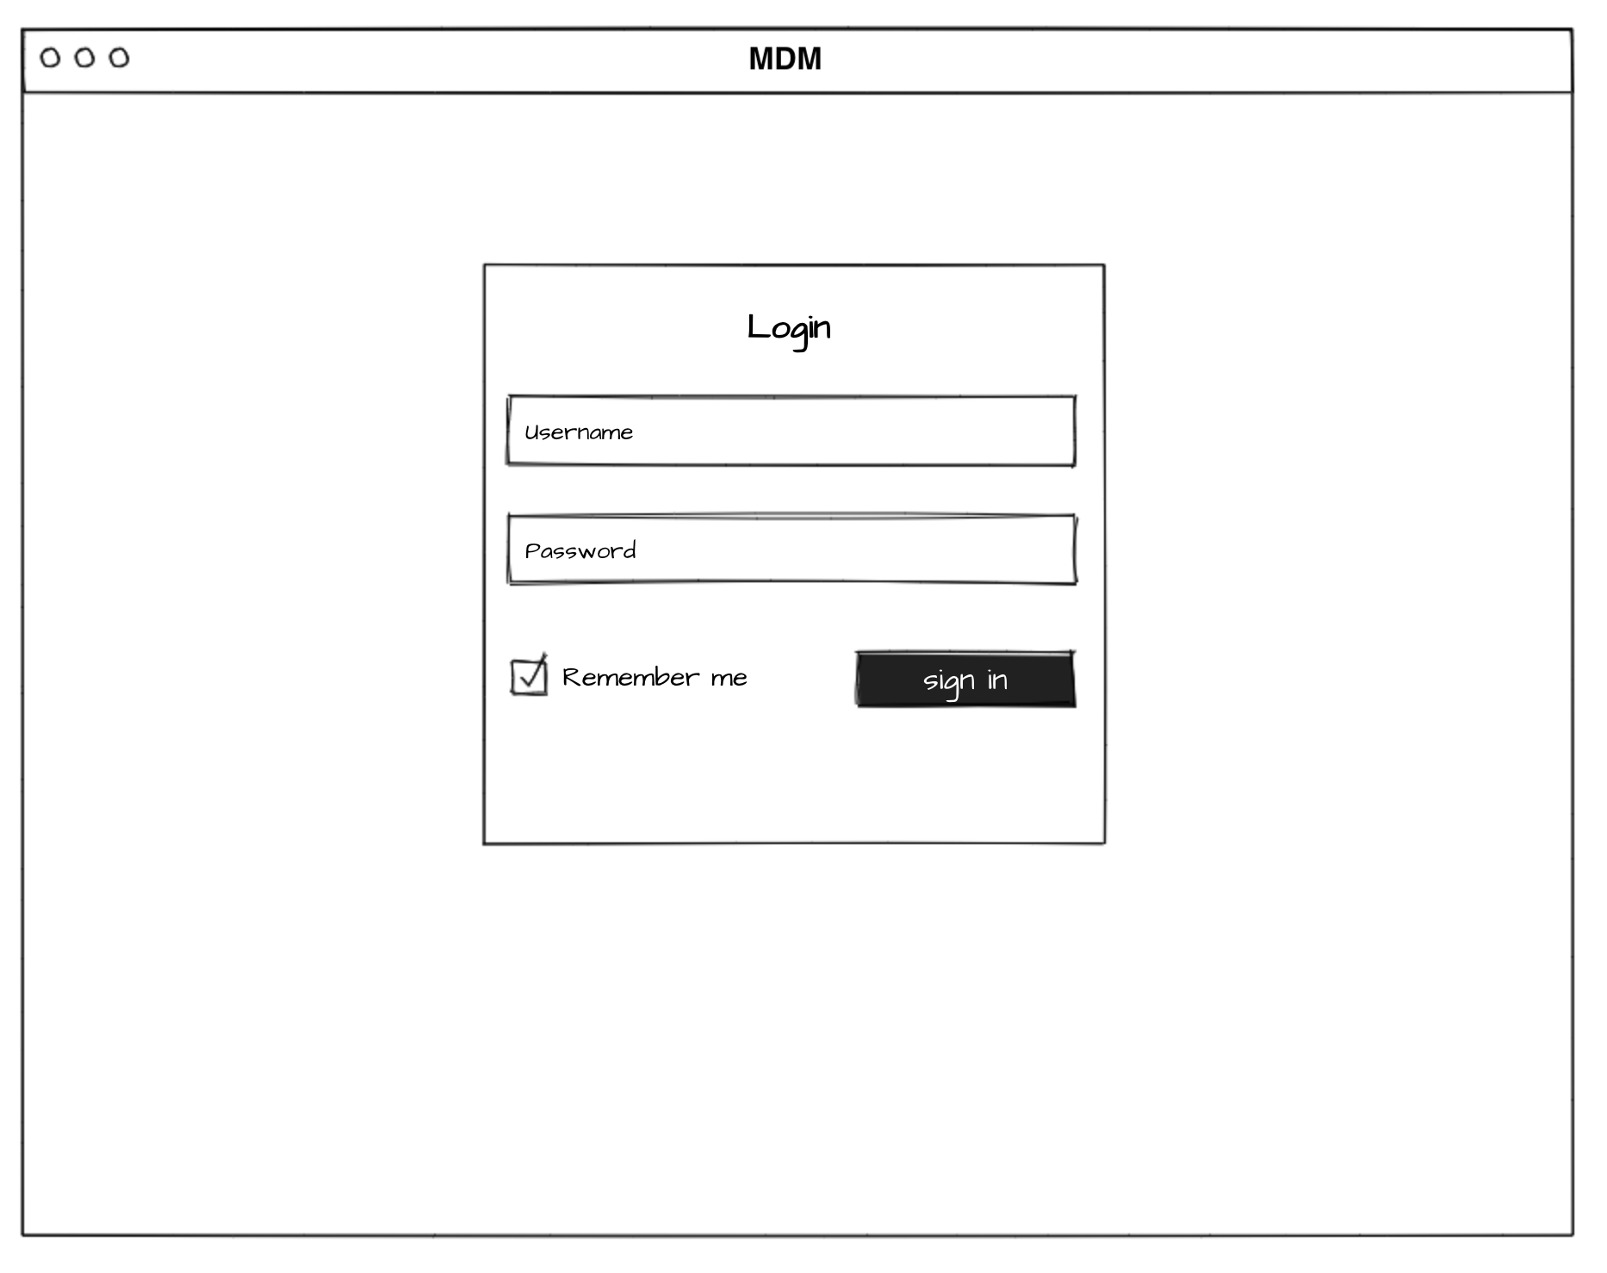
SECURITY MODEL
From the point of view of implementation, the role model is defined by the relations between various entities in the system
From the point of view of the user interface, displaying only the components of the user interface available to the current user

Slide 23
THANK YOU

