Slide 1
TWITTER-TOPS
Research seminar HW3: Group project
Almaz Murzabekov
Daria Kiseleva
Habibullah Wardak
Sidhardha Neupane
Ka Kit Law
Li Zhonghua

Slide 2
PROJECT DESCRIPTION
Team pet-project for getting hands on experience with big data frameworks and lambda architecture (LA)
implementing LA (speed, batch, serving layers)
analyzing tweets (batch & streaming processing)
displaying on Tableau BI: top #, users, emerging trends, etc)
Sample data
1.4gb raw json data (tweets)

Slide 3
PROJECT DESCRIPTIONS (cntd)
Project milestones
  Stage 1 (~end of march 2020)
  Stage 2 (~end of april 2020)
Project features
  Top users
  Top hashtags
  Top activities, etc
Project activities
  Meetings (coding-nights, hakatons, beer & pizza nights, etc)
  Commitments

Slide 4
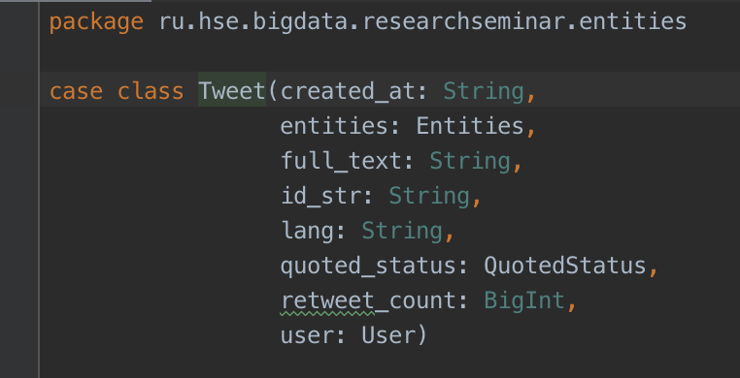
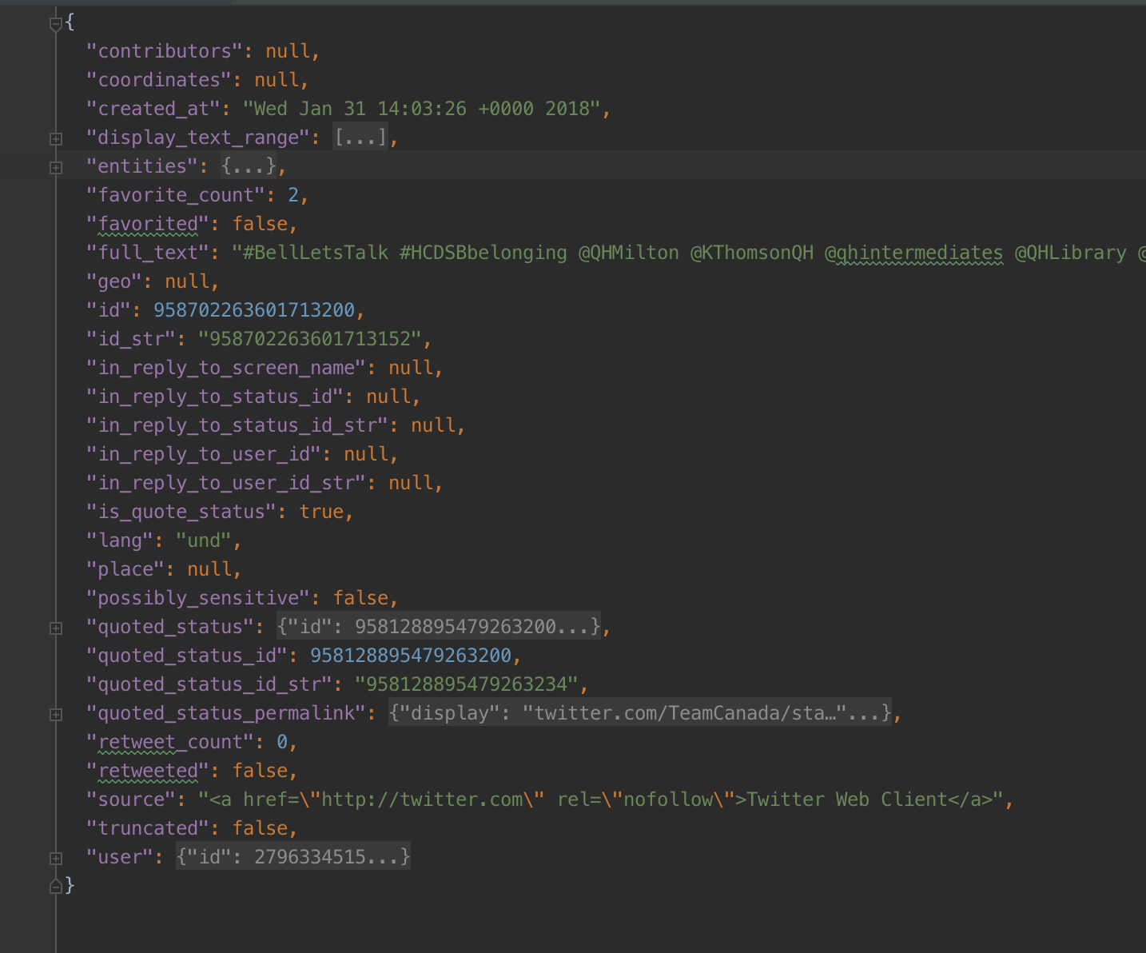
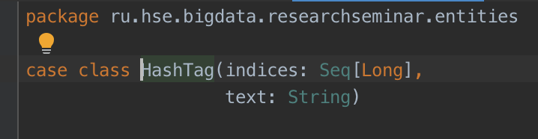
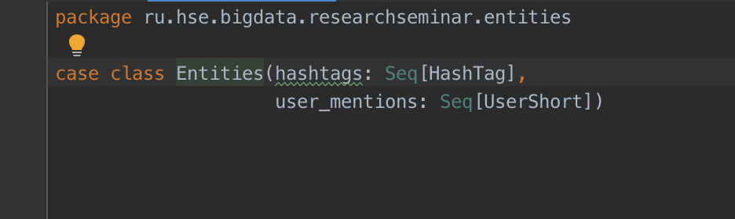
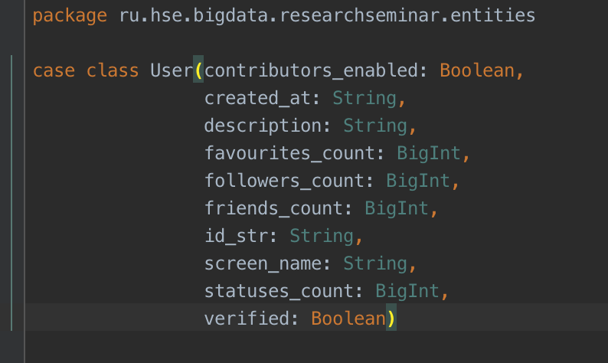
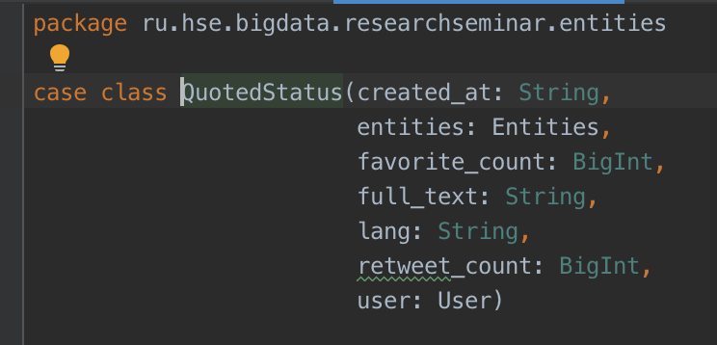
TWEET CONTENT

Slide 5
STAGE 1: EXPLORING THE DATASET
Tweets
SPARK
Tableau

Slide 6
LIVE DEMO: STAGE 1

Slide 7
STAGE 2: TOP LEVEL ARCHITECTURE
Tweets
HDFS
BATCH
HIVE
BI
KAFKA
STREAMING
docker-images

Slide 8
FRAMEWORKS & TOOLS
HORTONWORKS DATA PLATFORM HDP (sandbox)
  APACHE HADOOP
  APACHE HIVE
  APACHE SPARK (BATCH & STREAMING)
KAFKA & KAFKA-HDFS CONNECTOR
TABLEAU BI
TOOLS
  Python (3.x+)
  Docker images, docker compose
  IntelliJ Idea: Community edition, others IDE
  Git, git client

Slide 9
PROJECT MODULES
Tweets
Twitter-API simulator
kafka2hdfs
HDFS
BATCH
HIVE
BI
KAFKA
STREAMING

Slide 10
PROJECT MODULES
Tweets
Twitter-API simulator
kafka2hdfs
HDFS
BATCH
HIVE
BI
KAFKA
STREAMING

Slide 11
TWITTER API SIMULATOR
python program that read tweets from file and put them to the kafka topic
params:
  kafka connection params
  number of tweets per second
  noise factor, number in percentage that represents the randomness of tweet stream
Dev team: Habibullah, Almaz
Twitter-API simulator
kafka2hdfs
HDFS
BATCH
HIVE
BI
KAFKA
STREAMING

Slide 12
KAFKA-2-HDFS
Configuration of kafka-2-hdfs tool for uploading tweets from kafka topic to hdfs folder (partitioned by date)
Dev team: Habibullah, Li Zhonghua
Twitter-API simulator
kafka2hdfs
HDFS
BATCH
HIVE
BI
KAFKA
STREAMING

Slide 13
HDFS + SPARK BATCH + HIVE
read tweets from hdfs
compute statistics (aka features)
save as hive table
Dev team: Sid, Ka Kit Law, Almaz
Twitter-API simulator
kafka2hdfs
HDFS
BATCH
HIVE
BI
KAFKA
STREAMING

Slide 14
KAFKA + SPARK STREAMING + HIVE
read tweets from kafka topic
compute statistics
save as hive table (separate table from batch)
Dev team: Ka Kit Law, Almaz
Twitter-API simulator
kafka2hdfs
HDFS
BATCH
HIVE
BI
KAFKA
STREAMING

Slide 15
HIVE (SERVING LAYER)
union/join/group - batch and streaming tables into one table (via sql-view)
hive sql
Dev team: Li Zhonghua, Almaz
Twitter-API simulator
kafka2hdfs
HDFS
BATCH
HIVE
BI
KAFKA
STREAMING

Slide 16
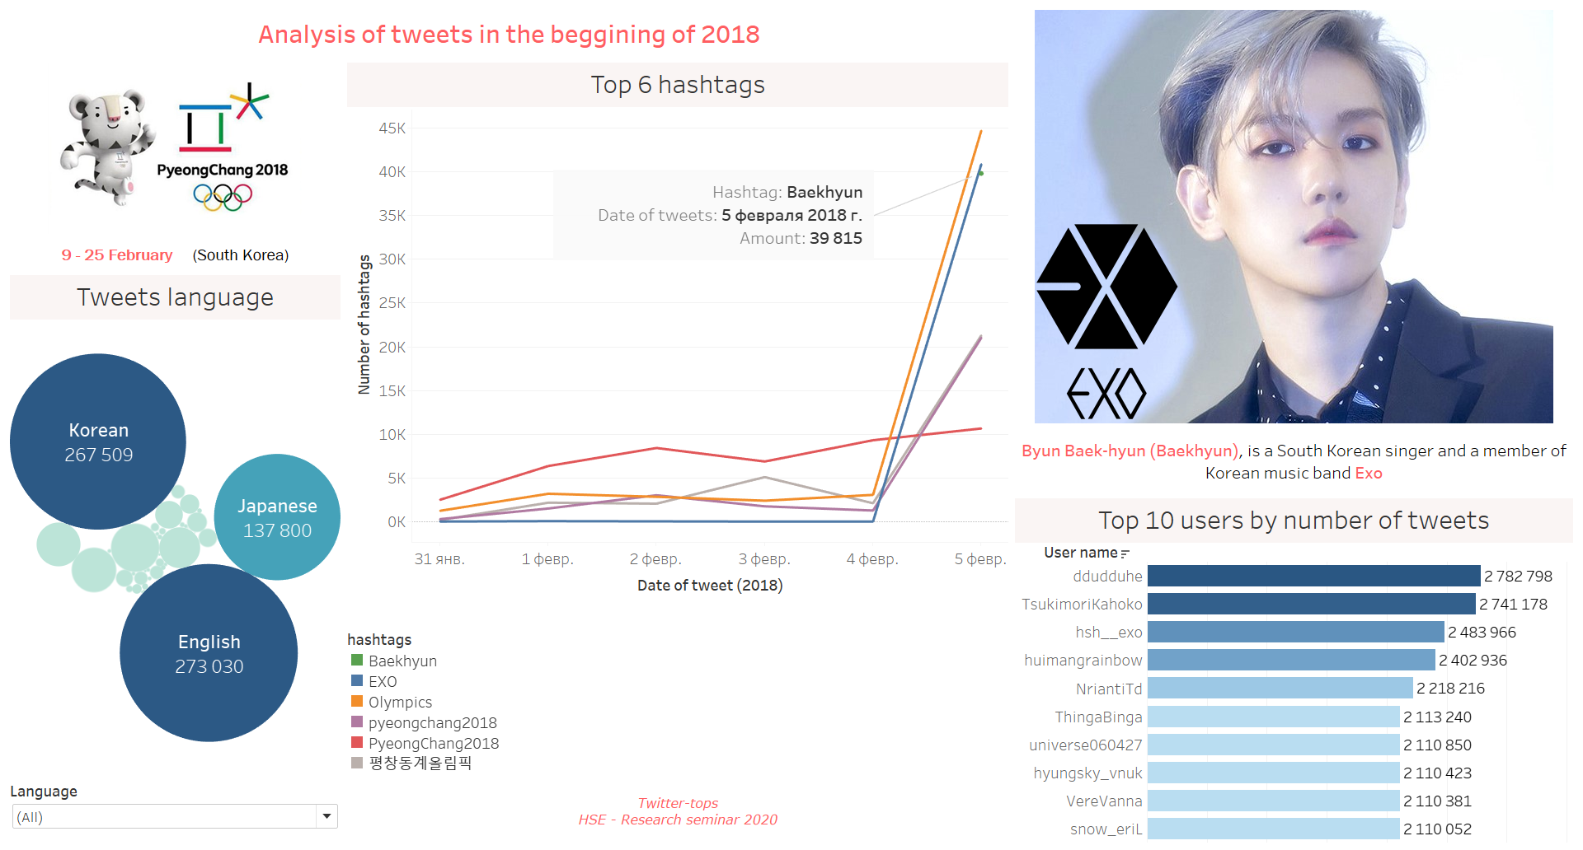
BUSINESS INTELLIGENCE
Tableau public: URL
Twitter-API simulator
kafka2hdfs
HDFS
BATCH
HIVE
BI
KAFKA
STREAMING

Slide 17
LIVE DEMO: STAGE 2

Slide 18
RESOURCES
GitHub: https://github.com/rs-hse/research-seminar-project
Tableau Server: https://public.tableau.com/profile/dasha1540#!/vizhome/Tweets_15861851167550/Analysisoftweetsinthebegginingof2018
Lambda Architecture: https://en.wikipedia.org/wiki/Lambda_architecture
Hortonworks Data Platform (HDP®): https://www.cloudera.com/downloads/hdp.html
Sandbox Deployment and Install Guide: https://www.cloudera.com/tutorials/sandbox-deployment-and-install-guide/3.html

Slide 19
QA

