Slide 1
Net Present Value and other Investment Rules

Slide 2
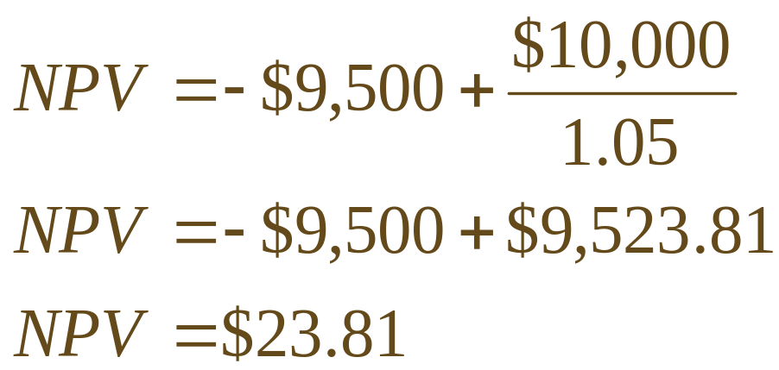
Net Present Value
The Net Present Value (NPV) of an investment is the present value of the expected cash flows, less the cost of the investment.
Suppose an investment that promises to pay $10,000 in one year is offered for sale for $9,500. Your interest rate is 5%. Should you buy?
Yes!

Slide 3
Net Present Value (cntd)
In the one-period case, the formula for NPV can be written as:
NPV = –Cost + PV
If we had not undertaken the positive NPV project considered on the last slide, and instead invested our $9,500 elsewhere at 5-percent, our FV would be less than the $10,000 the investment promised and we would be unambiguously worse off in FV terms as well:
$9,500×(1.05) = $9,975 < $10,000.

Slide 4
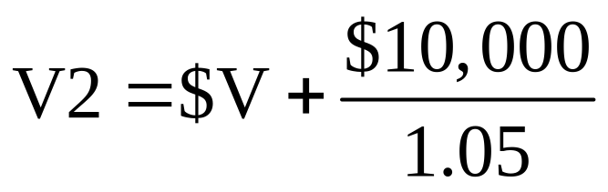
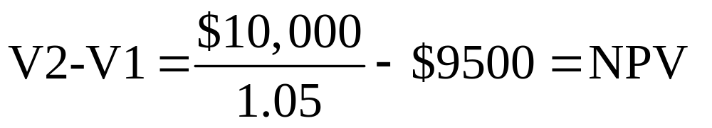
The NPV contributes to the firm’s value
The firm’s value without the project:
V1=$V+$9500(in cash)
The firm’s value with the project:
The difference between values of the firm is:

Slide 5
The Net Present Value (NPV) Rule
Net Present Value (NPV) =
Total PV of future CF’s + Initial Investment
Estimating NPV:
  1. Estimate future cash flows: how much? and when?
  2. Estimate discount rate
  3. Estimate initial costs

Slide 6
NPV Criteria
Minimum Acceptance Criteria: Accept if NPV > 0
Ranking Criteria: Choose the highest NPV

Slide 7
Why Use Net Present Value?
Accepting positive NPV projects benefits shareholders.
NPV uses cash flows Cash flows from a project can be used for other corporate purposes (e.g., dividend payments, other capital-budgeting projects, or payments of corporate interest). By contrast, earnings are an artificial construct.
NPV uses all the cash flows of the project Other approaches may ignore cash flows beyond a particular date
NPV discounts the cash flows properly Other approaches may ignore the time value of money when handling cash flows.

Slide 8
The Payback Period Rule
How long does it take the project to “pay back” its initial investment?
Payback Period = number of years to recover initial costs
Minimum Acceptance Criteria:
  set by management
Ranking Criteria:
  set by management

Slide 9
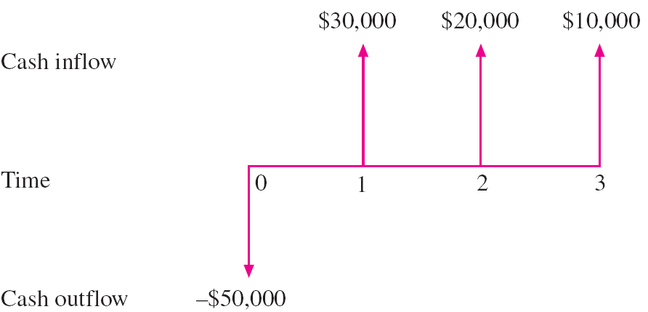
The Payback Period Rule
The Payback Period = 2 years

Slide 10
The Payback Period Rule
Disadvantages:
  Ignores the time value of money
  Ignores cash flows after the payback period
  Biased against long-term projects
  Requires an arbitrary acceptance criteria
  A project accepted based on the payback criteria may not have a positive NPV
Advantages:
  Easy to understand
  Biased toward liquidity

Slide 11
The Discounted Payback Period Rule
How long does it take the project to “pay back” its initial investment taking the time value of money into account?
By the time you have discounted the cash flows, you might as well calculate the NPV.

Slide 12
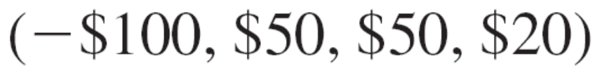
The Discounted Payback Period Rule
Initial CF:
Discounted CF (discount rate = 10%):
The DPB period = 3 years (roughly)
The DPB period = 2+($100-$45.45-$41.32)/$15.03=2.88 years

Slide 13
The Internal Rate of Return Rule (IRR)
IRR: the discount that sets NPV to zero
Minimum Acceptance Criteria:
  Accept if the IRR exceeds the required return.
Ranking Criteria:
  Select alternative with the highest IRR
Reinvestment assumption:
  All future cash flows assumed reinvested at the IRR.

Slide 14
Internal Rate of Return (IRR)
Disadvantages:
  Does not distinguish between investing and borrowing.
  IRR may not exist or there may be multiple IRR
  Problems with mutually exclusive investments
Advantages:
  Easy to understand and communicate

Slide 15
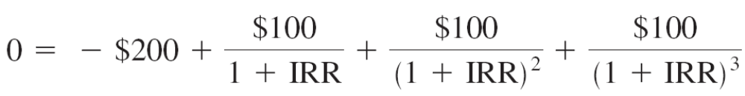
Example: IRR
Consider the following project:
$50
$100
$150
0
1
2
3
-$200
The internal rate of return for this project is 19.44%

Slide 16
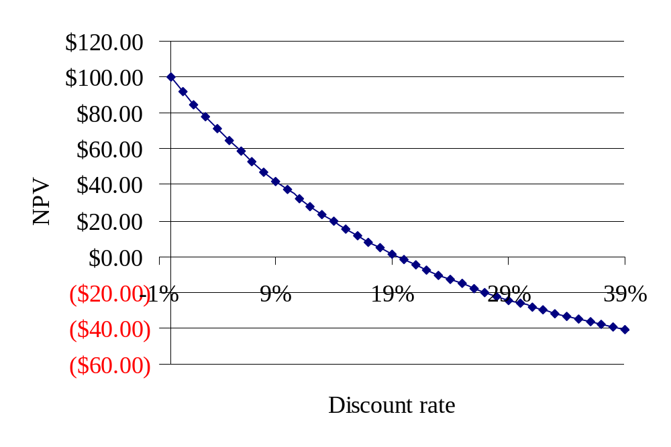
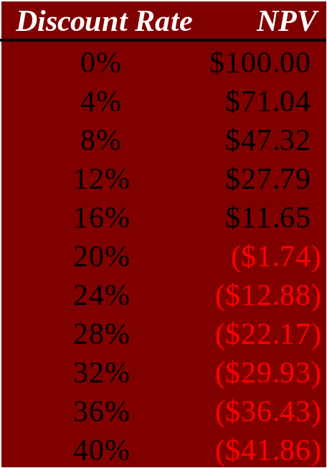
The NPV Payoff Profile
If we graph NPV versus discount rate, we can see the IRR as the x-axis intercept.
IRR = 19.44%

Slide 17
Problems with the IRR Approach
Apply to any project:
Multiple IRRs.
Are We Borrowing or Lending?
Specific to mutually exclusive projects:
The Scale Problem.
The Timing Problem.

Slide 18
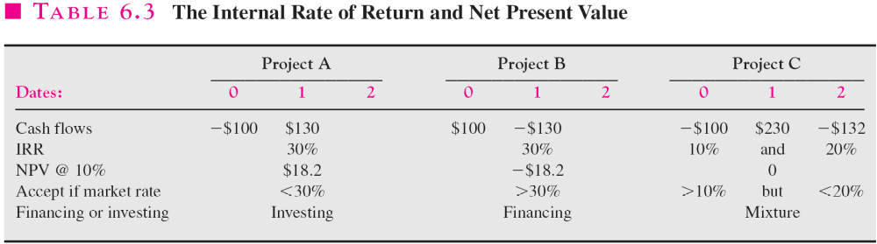
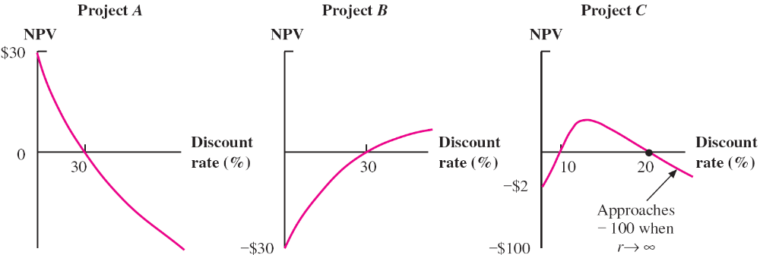
Problems with the IRR Approach

Slide 19
Remedies for Multiple IRRs
If the first CF is outflow and subsequent CF are inflows the IRR is unique
Use NPV analysis
Modified IRR

Slide 20
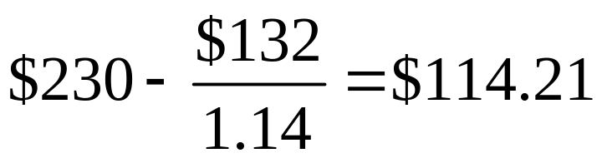
Modified IRR
a) Take a discount rate, say, 14%.
b) Discount the last outflow and add it to the last-but-one outflow to create a positive quantity
c) A new CF stream (-$100, $114.21) has a unique IRR=14.21%
d) A drawback – the need for an external discounting rate, contrary to original IRR approach

Slide 21
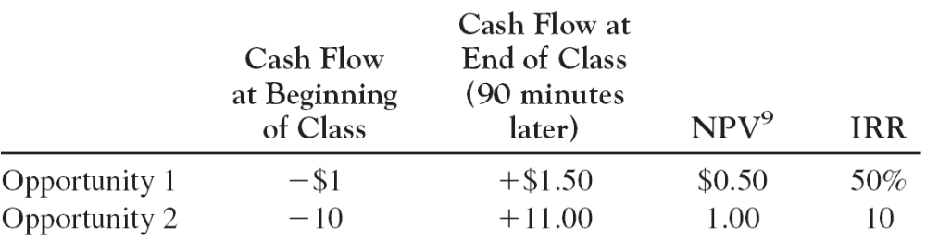
The Scale Problem (mutually exclusive projects)
According to the IRR, choose Op. 1
According to NPV, choose Op. 2
The IRR misleads in this case

Slide 22
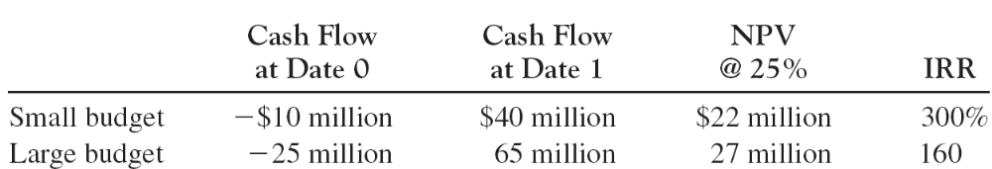
Resolving the Scale Problem (mutually exclusive projects)
What should be done to convince the investor who believes only in the IRR to accept Large project ?
We should calculate the incremental CF and incremental IRR.

Slide 23
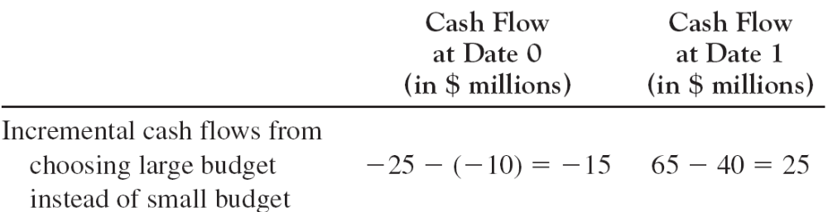
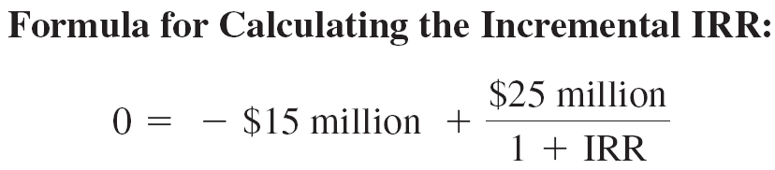
Resolving the Scale Problem (mutually exclusive projects, cntd)
IRR=66.67%> 25% discount rate for NPV calculation

Slide 24
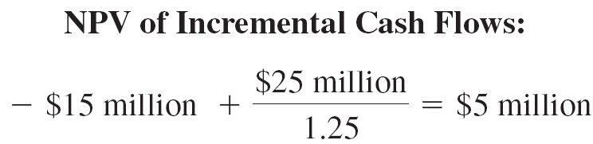
Resolving the Scale Problem (mutually exclusive projects, cntd)
A positive incremental NPV is also voting for the Large project

Slide 25
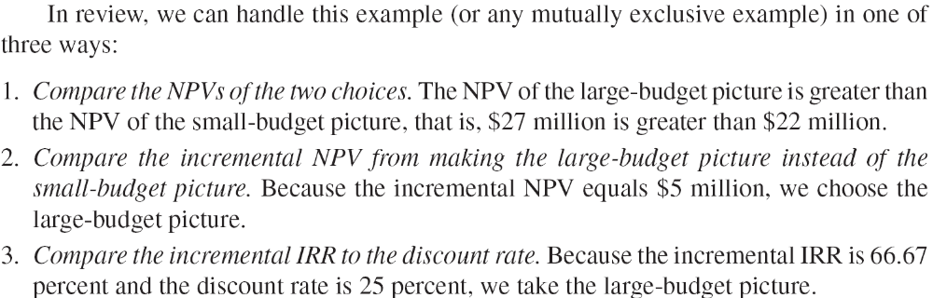
Resolving the Scale Problem (mutually exclusive projects, summary)

Slide 26
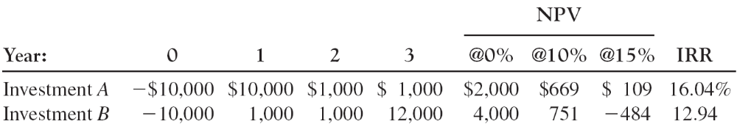
The Timing Problem
What should be chosen?
Method 1. Compare the NPVs of the projects

Slide 27
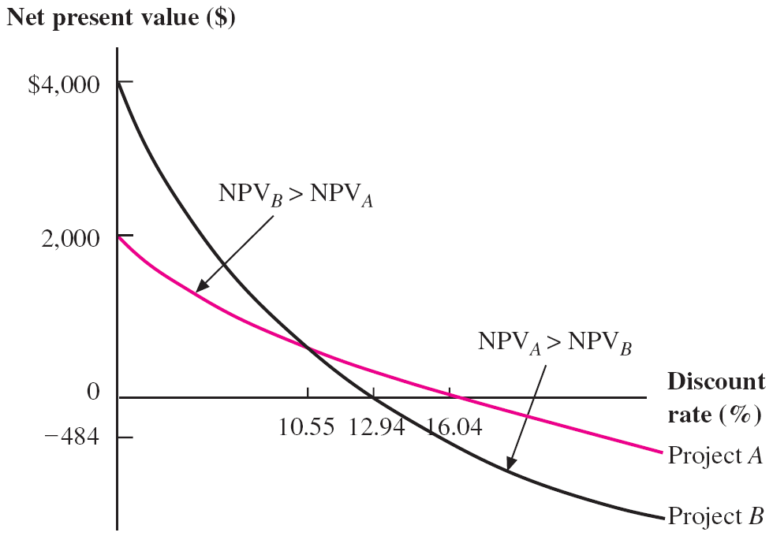
The Timing Problem (cntd)
What should be chosen?
Depends on the discount rate

Slide 28
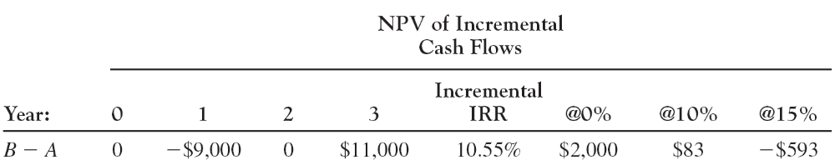
The Timing Problem (cntd)
What should be chosen?
Method 2. Compare incremental IRR to discount rate
Method 3. Calculate NPV on incremental cash flows

Slide 29
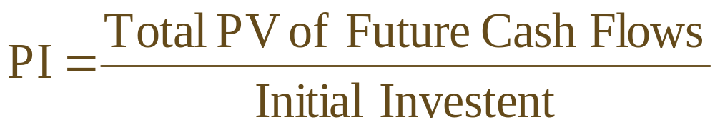
The Profitability Index (PI) Rule
Minimum Acceptance Criteria:
  Accept if PI > 1
Ranking Criteria:
  Select alternative with highest PI

Slide 30
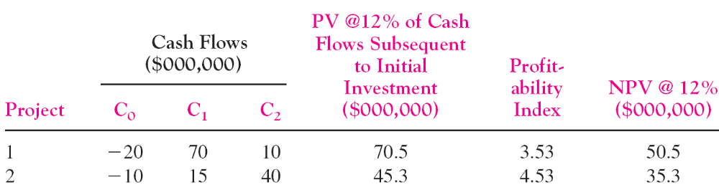
The Profitability Index (PI) Rule
Like the IRR approach, problems with mutually exclusive projects

Slide 31
Profitability Index
Disadvantages:
  Problems with mutually exclusive investments
Advantages:
  May be useful when available investment funds are limited
  Easy to understand and communicate
  Correct decision when evaluating independent projects

Slide 32
The Practice of Capital Budgeting
Varies by industry:
  Some firms use payback, others use accounting rate of return.
The most frequently used technique for large corporations is IRR or NPV.

Slide 33
Example of Investment Rules
Compute the IRR, NPV, PI, and payback period for the following two projects. Assume the required return is 10%.
Year Project A Project B
0 -$200 -$150
1 $200 $50
2 $800 $100
3 -$800 $150

Slide 34
Example of Investment Rules
Project A Project B
CF₀ -$200.00 -$150.00
PV₀ of CF₁₋₃ $241.92 $240.80
NPV = $41.92 $90.80
IRR = 0%, 100% 36.19%
PI = 1.2096 1.6053

Slide 35
Example of Investment Rules
Payback Period:
Project A Project B
Time CF Cum. CF CF Cum. CF
0 -200 -200 -150 -150
1 200 0 50 -100
2 800 800 100 0
3 -800 0 150 150
Payback period for project B = 2 years.
Payback period for project A = 1 or 3 years?

Slide 36
Relationship Between NPV and IRR
Discount rate NPV for A NPV for B
-10% -87.52 234.77
0% 0.00 150.00
20% 59.26 47.92
40% 59.48 -8.60
60% 42.19 -43.07
80% 20.85 -65.64
100% 0.00 -81.25
120% -18.93 -92.52

Slide 37
NPV Profiles
$400
NPV
$300
IRR ₁(A)
IRR ₂(A)
IRR (B)
$200
$100
$0
-15%
0%
15%
30%
45%
70%
100%
130%
160%
190%
($100)
($200)
Project A
Discount rates
Cross-over Rate
Project B

