Slide 1
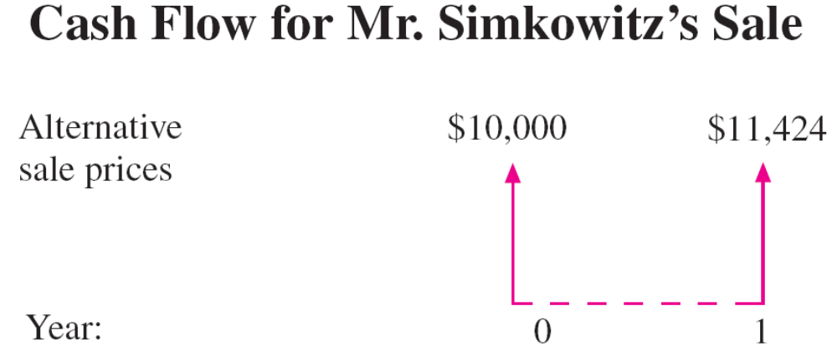
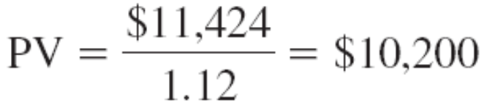
The PV calculation
The risk-free rate of return is 12%.

Slide 2
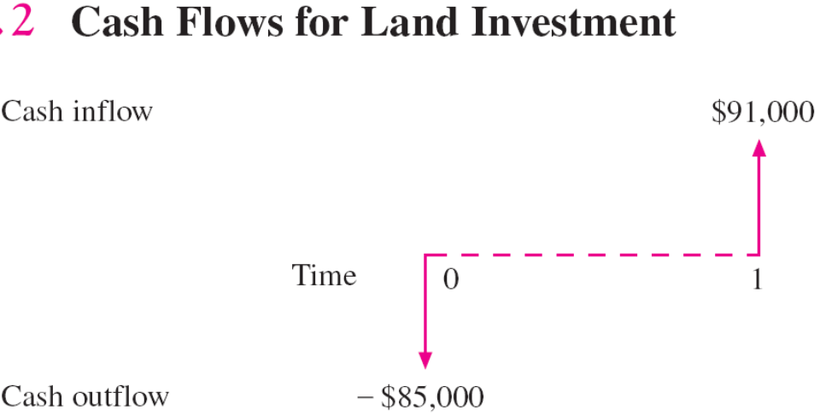

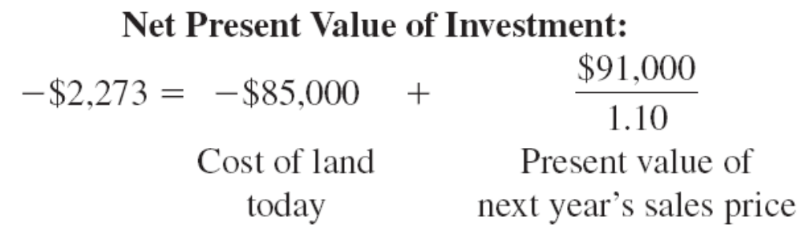
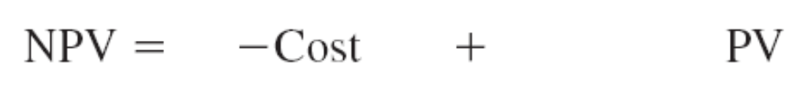
The Net Present Value
The risk-free rate of return is 10%.

Slide 3
Multiple CFs – the NPV calculation
Year 0 | -$50000
Year 1 | 25000
Year 2 | 20000
Year 3 | 15000
The risk-free rate of return is 7%.

Slide 4
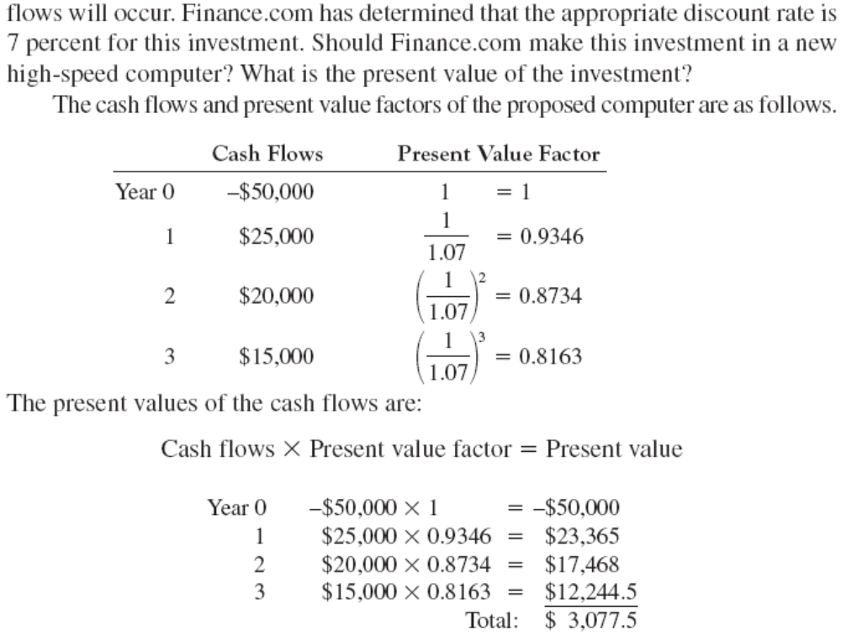

Multiple CFs – the NPV calculation

Slide 5
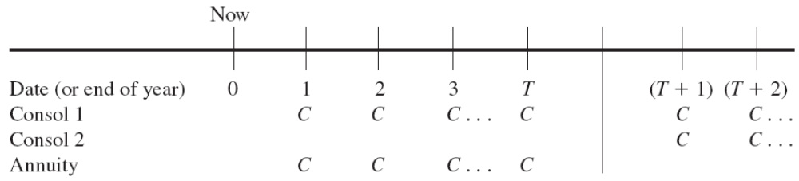
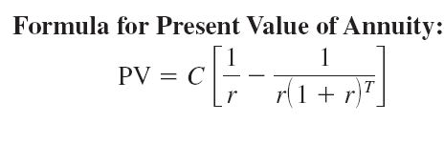
Annuity

Slide 6
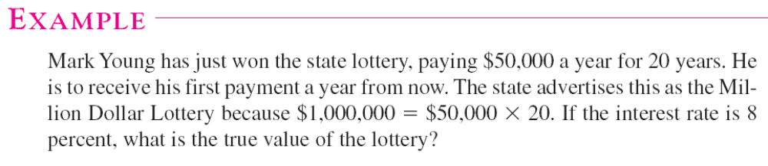
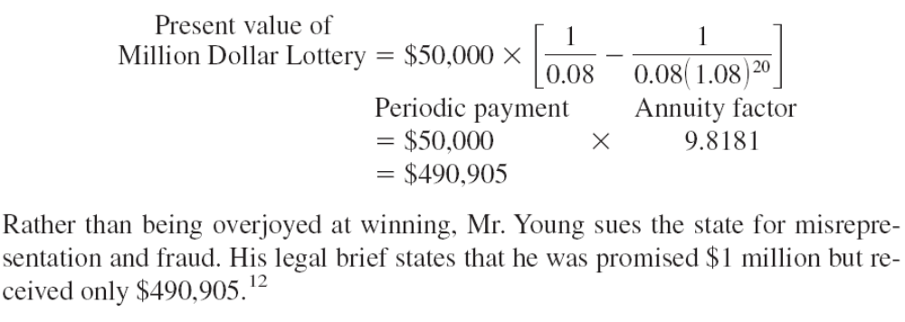
Annuity Example

Slide 7
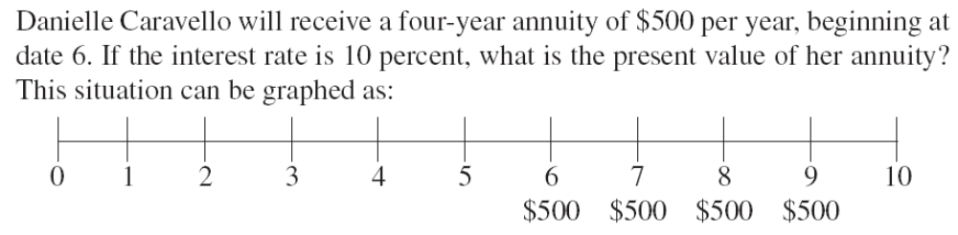
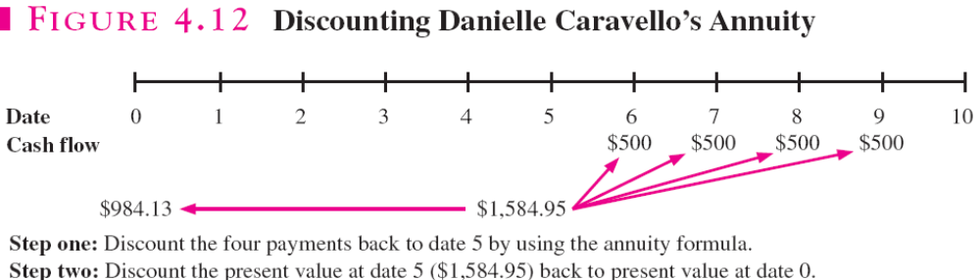
Delayed Annuity

Slide 8
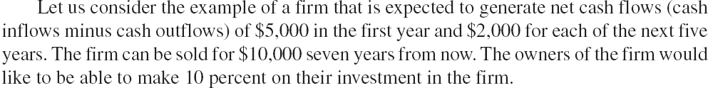
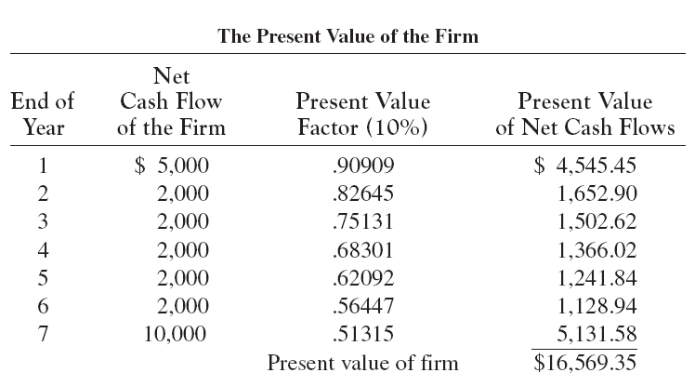
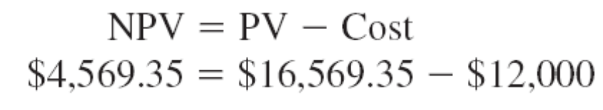
NPV Investment Rule

Slide 9
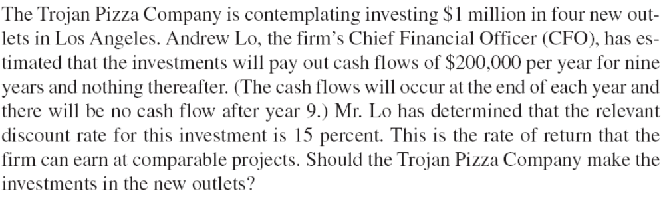
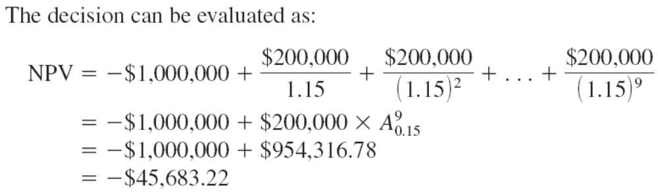
Another example

Slide 10
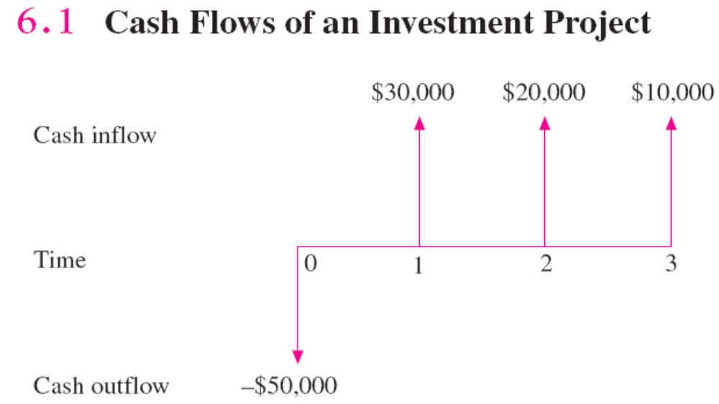
The Payback Period Rule
The Payback Period = 2.
The PBP Investment Rule: if the PBP < a predetermined cutoff, accept the project, reject otherwise

Slide 11
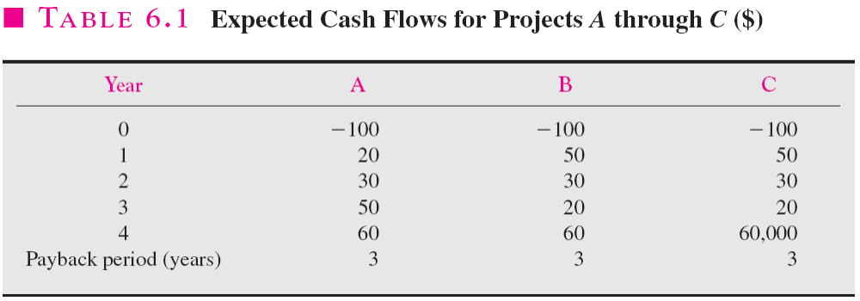
Problems with the PB method
An arbitrary cutoff point
Ignores the TVM
Ignores inflows after the PBP

Slide 12
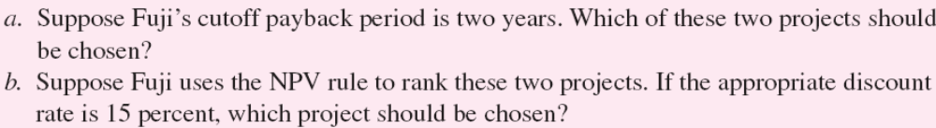

The PBP vs the NPV for Fuji Software, Inc. (1)
Year | Project A | Project B
0 | -$10000 | -$12000
1 | 6500 | 7000
2 | 4000 | 4000
3 | 1800 | 5000
Project A:

Slide 13
The PBP vs the NPV for Fuji Software, Inc.(cntd)

Slide 14
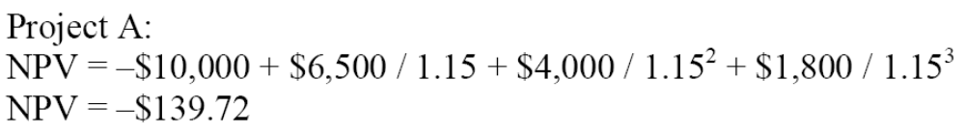
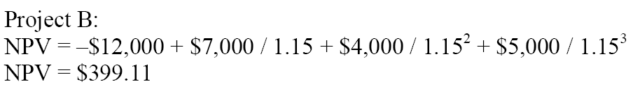
The PBP vs the NPV for Fuji Software, Inc.(cntd)
The NPV calculation

Slide 15
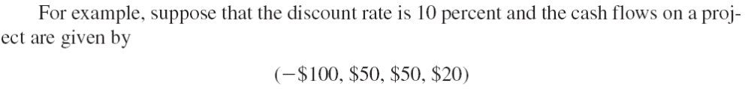
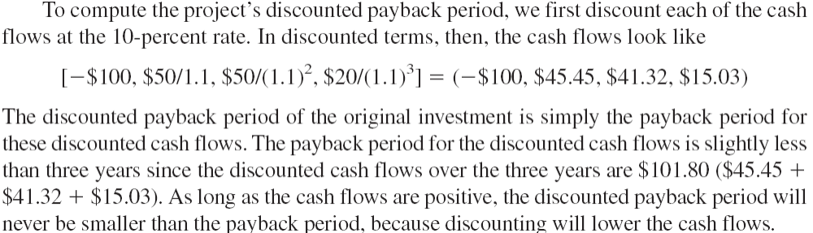
Discounted PBP

Slide 16
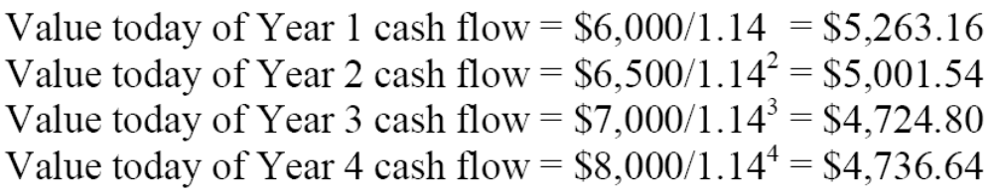
Calculating Discounted Payback (3)
Year | Project A | Project B | Project C
0 | -$8000 | -$13000 | -$18000
1 | 6000 | 6000 | 6000
2 | 6500 | 6500 | 6500
3 | 7000 | 7000 | 7000
4 | 8000 | 8000 | 8000

Slide 17
Calculating Discounted Payback (cntd)
Project A:
Project B:

Slide 18
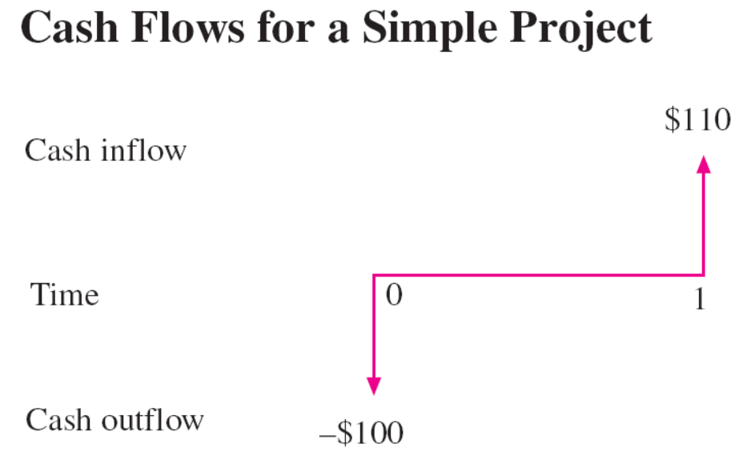

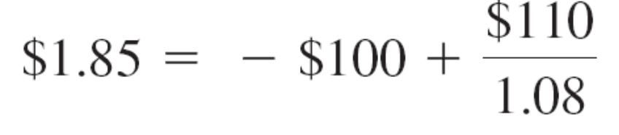
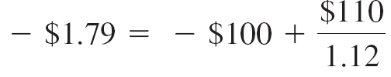
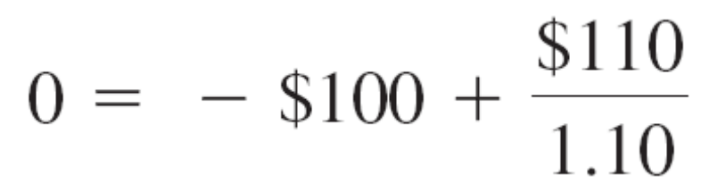
The Internal Rate of Return (IRR)

Slide 19
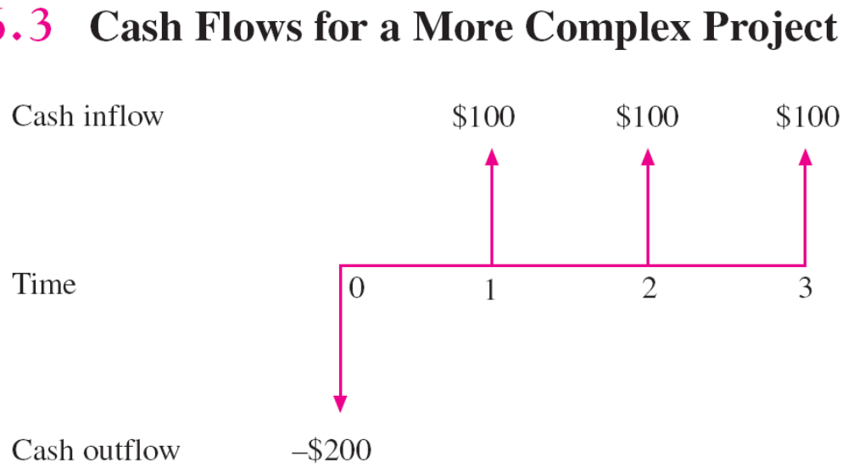
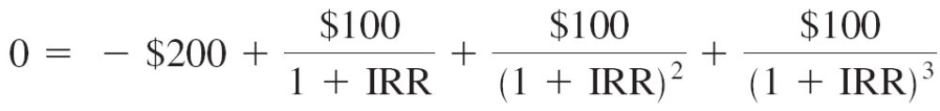
The Internal Rate of Return (IRR) cntd

Slide 20
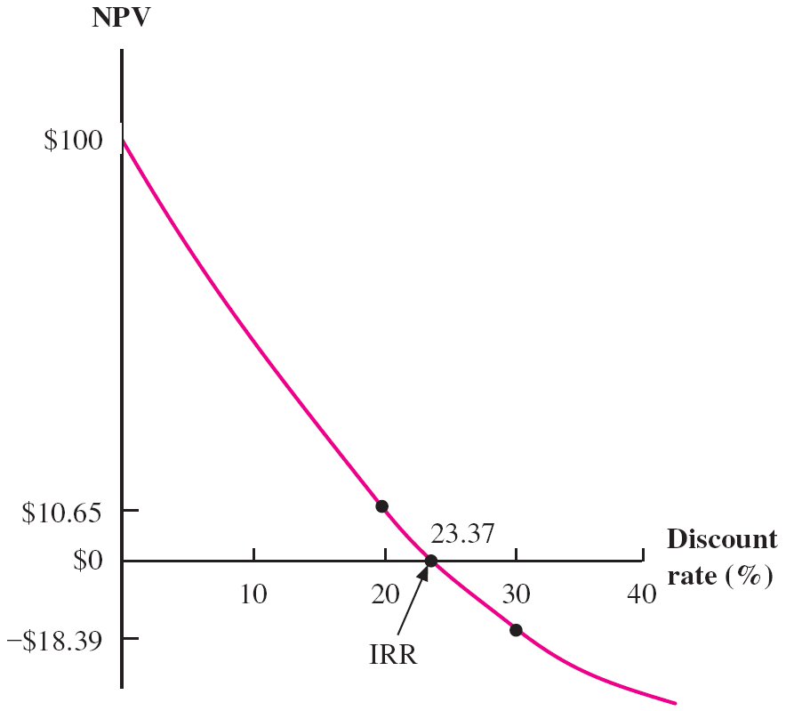
The Internal Rate of Return (IRR) cntd
The discount rate is 10%. Should you accept the project?

Slide 21
Problems with IRR (financing, not investing, 10)
Year | Project
0 | $8,000
1 | -4,400
2 | -2,700
3 | -1,900
4 | -1,500
IRR - ?
The discount rate is 10%. Should you accept the project?
The same for r=20%
The NPV for r=10%, for 20%?
Is the NPV rule consistent with that of the IRR rule?

Slide 22

Problems with IRR(financing, solution, cntd)
IRR:
Should we accept the offer, the discount rate being equal to 20% ???

Slide 23
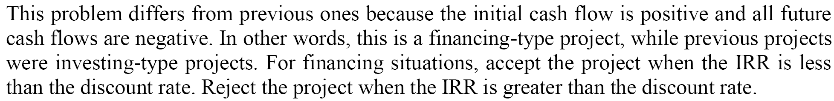
Problems with IRR (financing, solution, cntd)
Certainly not
Should we accept the offer, the discount rate being equal 20% ??? Yes, we should.

Slide 24
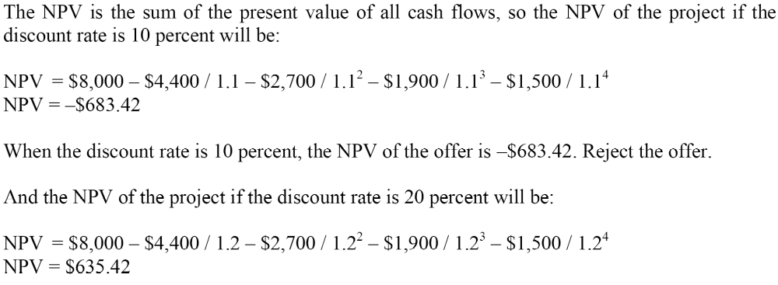
Problems with IRR(financing, solution, cntd)
What about NPV?
Both approaches (NPV and IRR) suggest the same. Not always!!!

Slide 25
NPV versus IRR (The Scale Problem, Incremental IRR, 11)
If you are an IRR proponent, what is your choice?
Since you are aware of the scale problem, compute the incremental IRR.
Compute the NPV of both projects. What’s your choice? Is it consistent with the incremental IRR rule?
Year | Deepwater Fishing | New Submarine Ride
0 | -$750,000 | -$2,100,000
1 | 310,000 | 1,200,000
2 | 430,000 | 760,000
3 | 330,000 | 850,000
The required discount rate is 14%

Slide 26
NPV versus IRR (The Scale Problem, Incremental IRR, cntd)
IRR calculation

Slide 27
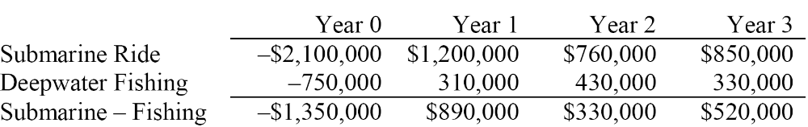

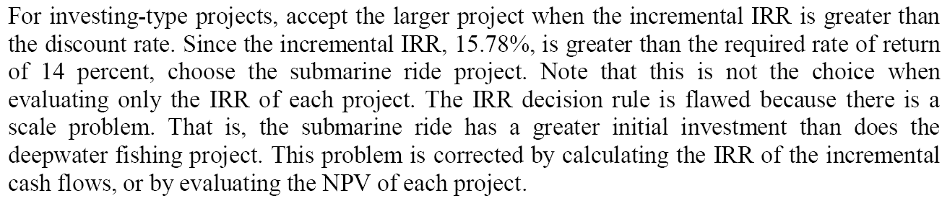
NPV versus IRR (The Scale Problem, Incremental IRR, cntd)
Incremental CFs
Incremental IRR > required rate of return

Slide 28
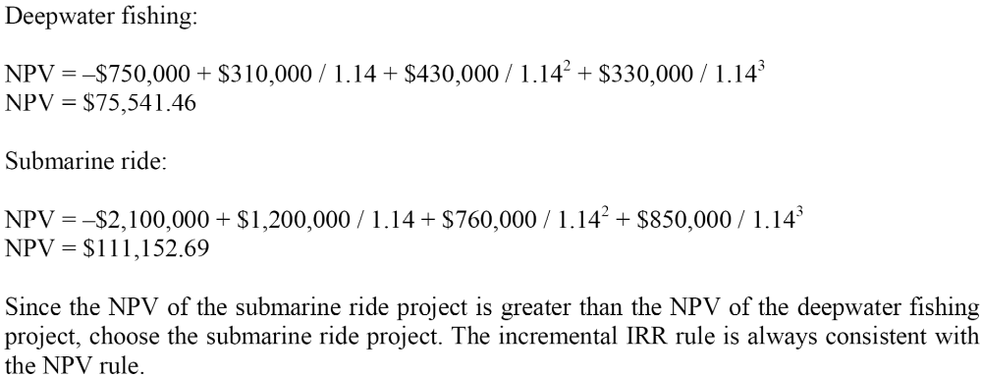
NPV versus IRR (The Scale Problem, Incremental IRR, cntd)
NPV calculation

Slide 29
Multiple IRRs
Year | Project
0 | -$100
1 | 230
2 | -132
IRR - ? Solve a quadratic equation
NPV at 5,15,30% -?

Slide 30
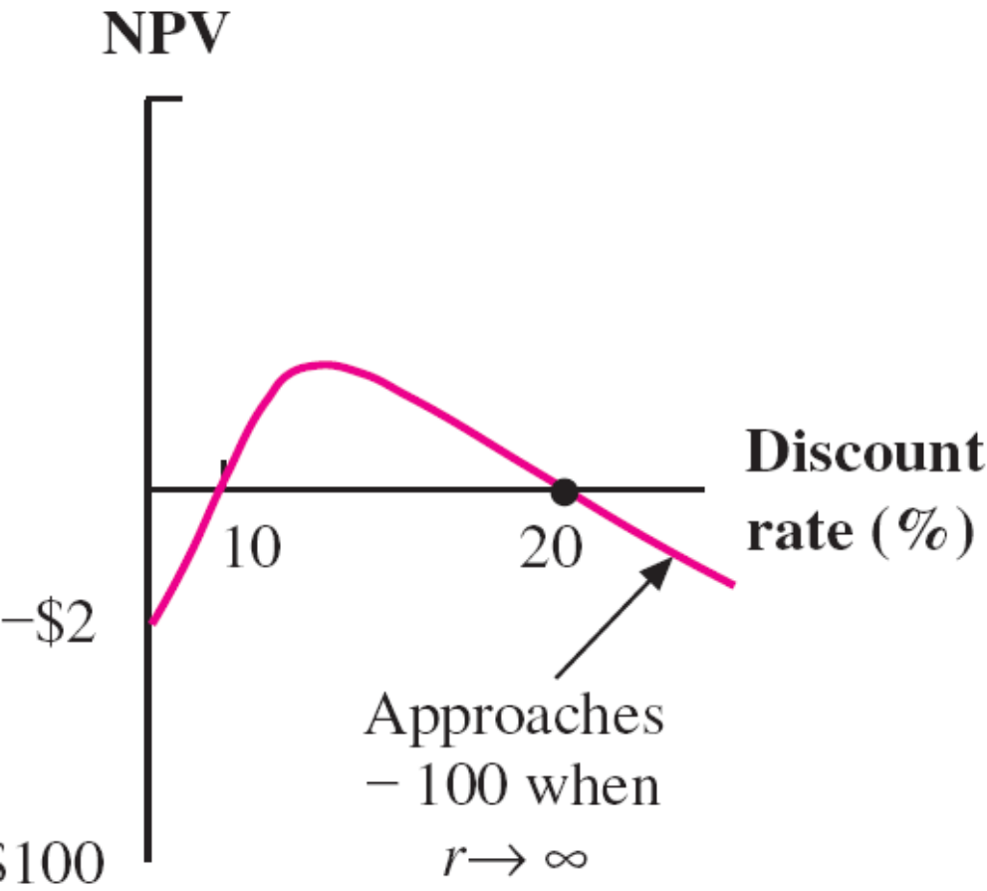
Multiple IRRs (cntd)
Project A:

Slide 31
Profitability Index (12)
The required return is 10%. 1)You apply profitability decision rule. What’s your choice?
2) Based on the NPV rule, what’s your decision?
Year | Project 1 | Project 2
0 | -$40,000 | -$15,000
1 | 21,000 | 8,500
2 | 21,000 | 8,500
3 | 21,000 | 8,500

Slide 32
Profitability Index (cntd)

