Slide 1
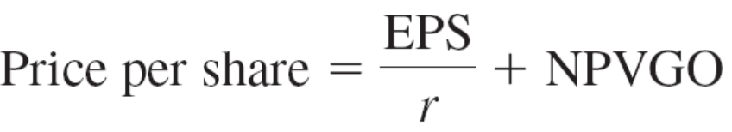
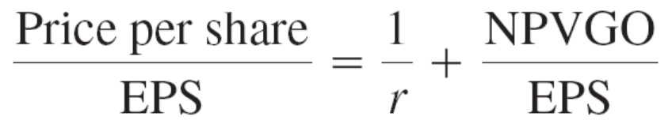
Price-Earnings Ratio
Dividing by EPS yields PE
Factors affecting PE
Growth Opportunities (high tech stocks versus utilities companies) – the major factor
Risk. Low risk stocks have high PE (negatively related to the firm’s discount rate). Lower risk – higher price ready to pay
Accounting practices. Conservative accounting practice leads to high PE

Slide 2
Price-Earnings Ratios (2008)
Anadarko Petrolium | Oil production | 11.76
Pfizer | Pharmaceuticals | 13.98
Ryder | Truck rentals | 14.99
S&P500 | n/a | 23.78
Abercrombie & Fitch | Clothing rental | 10.52
Starbucks | Expensive coffee | 22.96
Adobe Systems | Software | 27.52

Slide 3
The Capital Asset Pricing Model (CAPM)
Chapter 10

Slide 4
Individual Securities
The characteristics of individual securities that are of interest are the:
  Expected Return
  Variance and Standard Deviation
  Covariance and Correlation

Slide 5
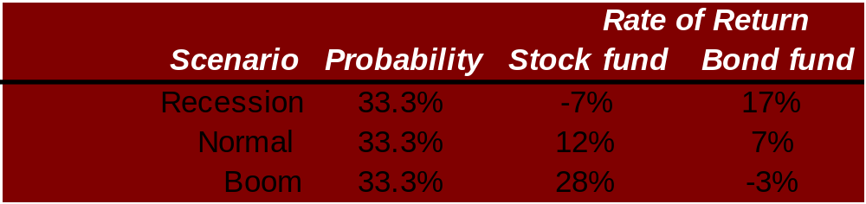
Expected Return, Variance, and Covariance
Consider the following two risky asset world. There is a 1/3 chance of each state of the economy and the only assets are a stock fund and a bond fund.

Slide 6
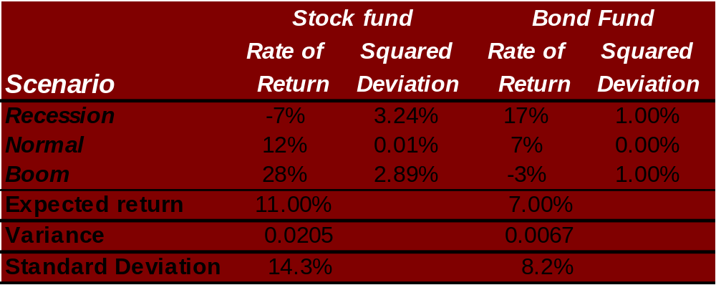
Expected Return, Variance, and Covariance

Slide 7
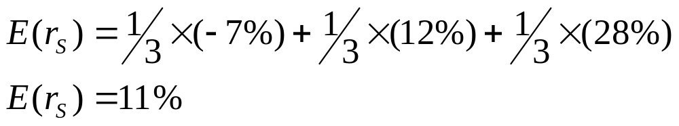
Expected Return, Variance, and Covariance

Slide 8
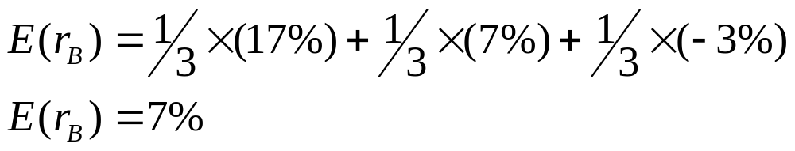
Expected Return, Variance, and Covariance

Slide 9
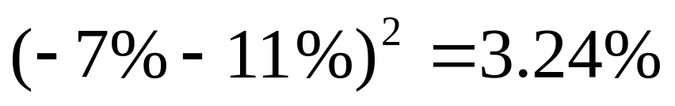
Expected Return, Variance, and Covariance

Slide 10
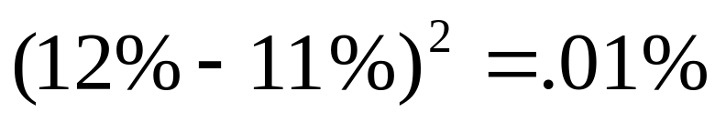
Expected Return, Variance, and Covariance

Slide 11
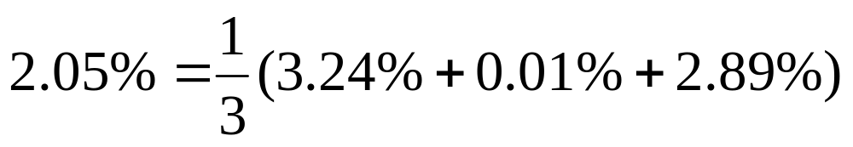
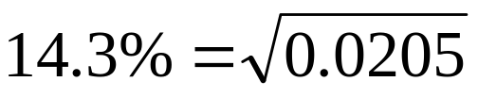
10.2 Expected Return, Variance, and Covariance

Slide 12
The Return and Risk for Portfolios
Note that stocks have a higher expected return than bonds and higher risk. Let us turn now to the risk-return tradeoff of a portfolio that is 50% invested in bonds and 50% invested in stocks.

Slide 13
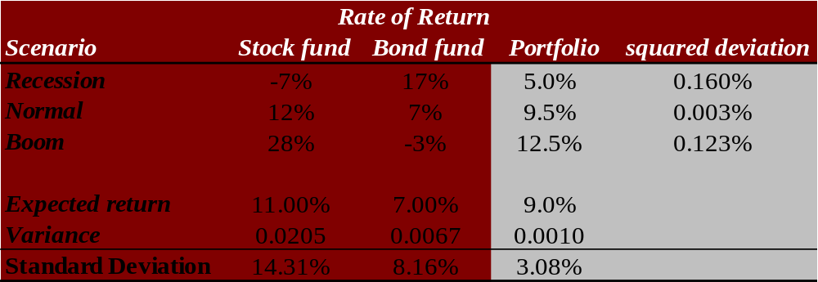
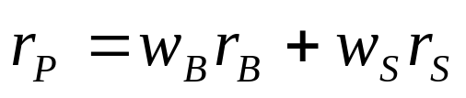
The Return and Risk for Portfolios
The rate of return on the portfolio is a weighted average of the returns on the stocks and bonds in the portfolio:

Slide 14


The Return and Risk for Portfolios
The expected rate of return on the portfolio is a weighted average of the expected returns on the securities in the portfolio.

Slide 15
The Return and Risk for Portfolios
The variance of the rate of return on the two risky assets portfolio is
where ρ_{BS} is the correlation coefficient between the returns on the stock and bond funds.

Slide 16
10.3 The Return and Risk for Portfolios
Observe the decrease in risk that diversification offers.
An equally weighted portfolio (50% in stocks and 50% in bonds) has less risk than stocks or bonds held in isolation.

Slide 17
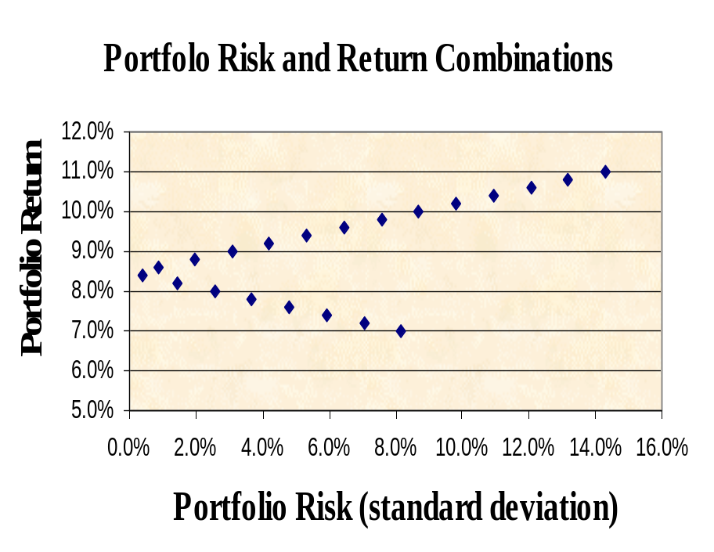
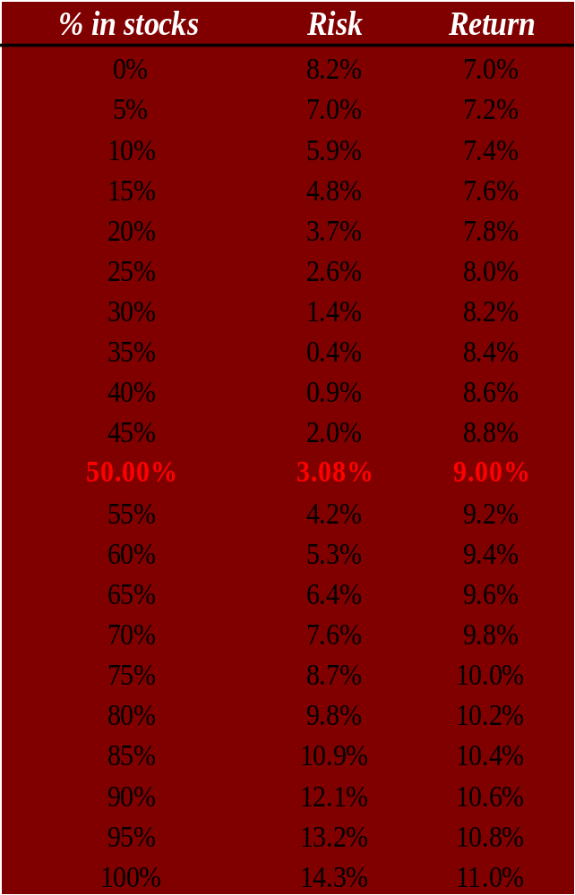
10.4 The Efficient Set for Two Assets
100% stocks
100% bonds
We can consider other portfolio weights besides 50% in stocks and 50% in bonds …

Slide 18
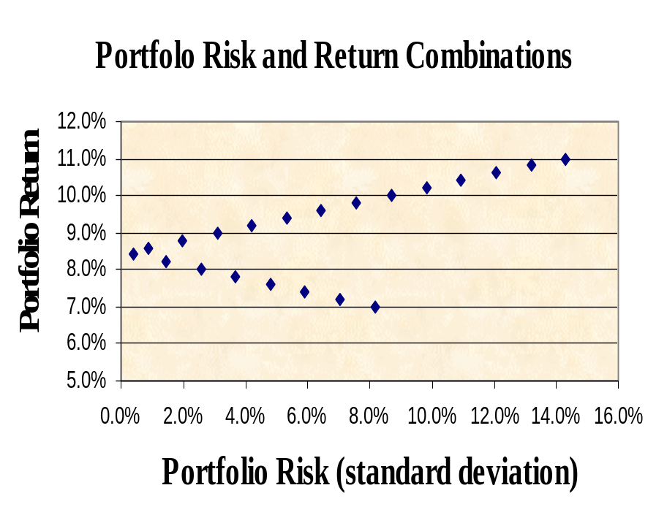
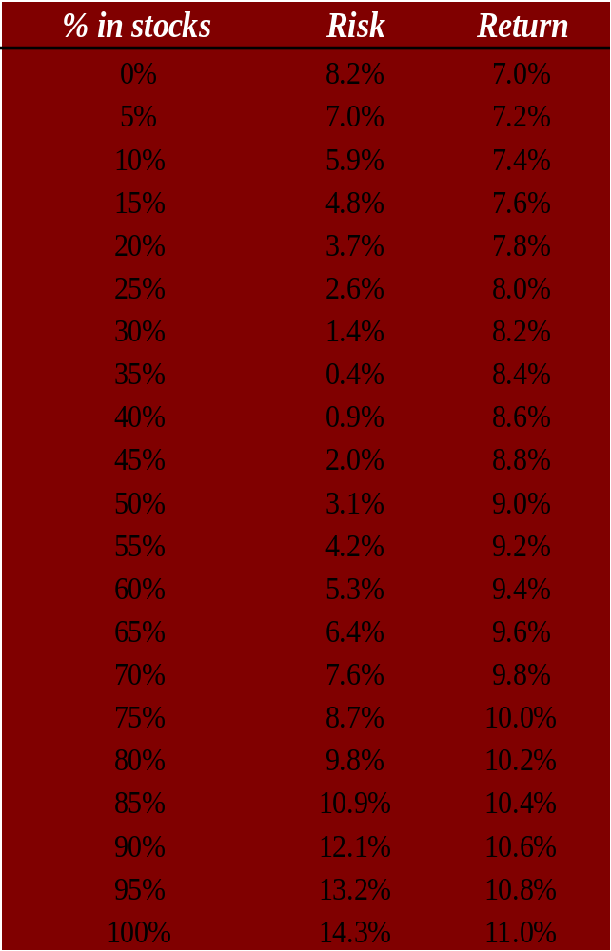
10.4 The Efficient Set for Two Assets
100% stocks
100% bonds
Note that some portfolios are “better” than others. They have higher returns for the same level of risk or less.

Slide 19
Two-Security Portfolios with Various Correlations
return
ρ = -1.0
100% stocks
ρ = 1.0
ρ = 0.2
100% bonds
σ

Slide 20
Portfolio Risk/Return Two Securities: Correlation Effects
Relationship depends on correlation coefficient
-1.0 < ρ < +1.0
The smaller the correlation, the greater the risk reduction potential
If ρ = +1.0, no risk reduction is possible

Slide 21
The Efficient Set for Many Securities
return
Individual Assets
σ_{P}
Consider a world with many risky assets; we can still identify the opportunity set of risk-return combinations of various portfolios.

Slide 22
The Efficient Set for Many Securities
return
minimum variance portfolio
Individual Assets
σ_{P}
Given the opportunity set we can identify the
minimum variance portfolio.

Slide 23
The Efficient Set for Many Securities
return
efficient frontier
minimum variance portfolio
Individual Assets
σ_{P}
The section of the opportunity set above the minimum variance portfolio is the efficient frontier.

Slide 24
Optimal Risky Portfolio with a Risk-Free Asset
return
100% stocks
r_{f}
100% bonds
σ
In addition to stocks and bonds, consider a world that also has risk-free securities like T-bills

Slide 25
Riskless Borrowing and Lending
return
CML
100% stocks
Balanced fund
r_{f}
100% bonds
σ
Now investors can allocate their money across the T-bills and a balanced mutual fund

Slide 26
The Capital Market Line
Assumptions:
  Rational Investors:
    More return is preferred to less.
    Less risk is preferred to more.
  Homogeneous expectations
  Riskless borrowing and lending.

Slide 27
Riskless Borrowing and Lending
return
CML
efficient frontier
r_{f}
σ_{P}
With a risk-free asset available and the efficient frontier identified, we choose the capital allocation line with the steepest slope

Slide 28
Market Equilibrium
return
CML
efficient frontier
M
r_{f}
σ_{P}
With the capital allocation line identified, all investors choose a point along the line—some combination of the risk-free asset and the market portfolio M. In a world with homogeneous expectations, M is the same for all investors.

Slide 29
The Separation Property
return
CML
efficient frontier
M
r_{f}
σ_{P}
The Separation Property states that the market portfolio, M, is the same for all investors—they can separate their risk aversion from their choice of the market portfolio.

Slide 30
The Separation Property
return
CML
efficient frontier
M
r_{f}
σ_{P}
Investor risk aversion is revealed in their choice of where to stay along the capital allocation line—not in their choice of the line.

Slide 31
Market Equilibrium
return
CML
100% stocks
Balanced fund
r_{f}
100% bonds
σ
Just where the investor chooses along the Capital Market Line
depends on his risk tolerance. The big point though is that all
investors have the same CML.

Slide 32
Market Equilibrium
return
CML
100% stocks
Optimal Risky Porfolio
r_{f}
100% bonds
σ
All investors have the same CML because they all have
the same optimal risky portfolio given the risk-free rate.

Slide 33
The Separation Property
return
CML
100% stocks
Optimal Risky Porfolio
r_{f}
100% bonds
σ
The separation property implies that portfolio choice can be separated into two tasks: (1) determine the optimal risky portfolio, and (2) selecting a point on the CML.

Slide 34


Optimal Risky Portfolio with a Risk-Free Asset
CML₁
CML₀
return
100% stocks
First Optimal Risky Portfolio
Second Optimal Risky Portfolio
100% bonds
σ
The optimal risky portfolio depends on the
risk-free rate as well as the risky assets.

Slide 35
Expected versus Unexpected Returns
Realized returns are generally not equal to expected returns
There is the expected component and the unexpected component
  At any point in time, the unexpected return can be either positive or negative
  Over time, the average of the unexpected component is zero

Slide 36
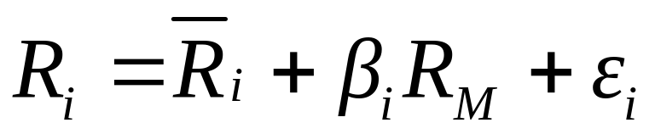
Returns
Total Return = expected return + unexpected return
Unexpected return = systematic portion + unsystematic portion
Therefore, total return can be expressed as follows:
Total Return = expected return + systematic portion + unsystematic portion

Slide 37
Total Risk
Total risk = systematic risk + unsystematic risk
The standard deviation of returns is a measure of total risk
For well diversified portfolios, unsystematic risk is very small
Consequently, the total risk for a diversified portfolio is essentially equivalent to the systematic risk

Slide 38

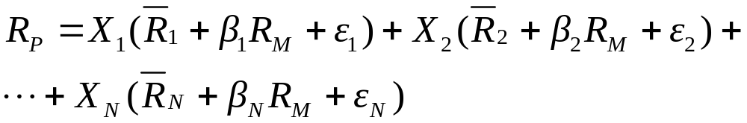
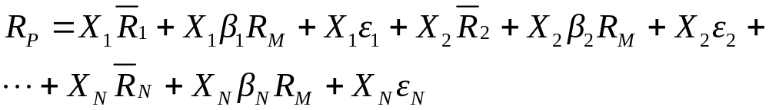
Portfolios and Diversification
We know that the portfolio return is the weighted average of the returns on the individual assets in the portfolio:

Slide 39
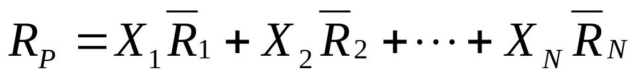
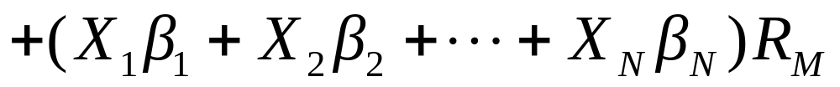
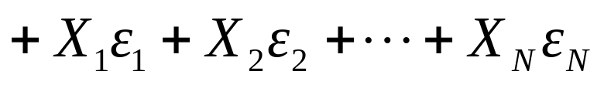
Portfolios and Diversification
The return on any portfolio is determined by three sets of parameters:
  The weighed average of expected returns.
  The weighted average of the betas times the factor.
  The weighted average of the unsystematic risks.
In a large portfolio, the third row of this equation disappears as the unsystematic risk is diversified away.
Notes:
The unsystematic risk is diversified away because the variance of row three tends to 0 as N goes to infinity.

Slide 40
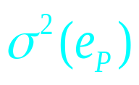
Diversification
Portfolio’s variance:
Variance of the equally weighted portfolio of firm-specific components:
When n gets larger, becomes negligible

Slide 41
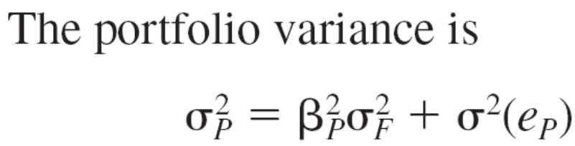
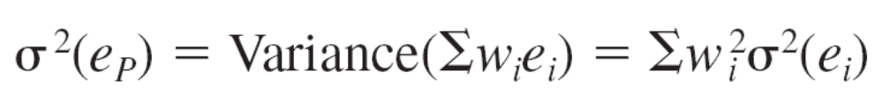
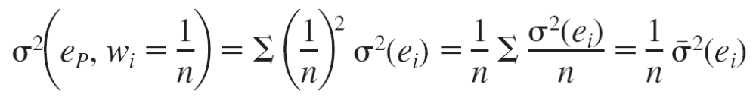
Diversification

Slide 42
Total Risk for well-diversified portfolios
Total risk = systematic risk + unsystematic risk
The standard deviation of returns is a measure of total risk
For well diversified portfolios, unsystematic risk is very small
Consequently, the total risk for a diversified portfolio is essentially equivalent to the systematic risk

Slide 43
Portfolio Risk as a Function of the Number of Stocks in the Portfolio
In a large portfolio the variance terms are effectively diversified away, but the covariance terms are not.
σ
Diversifiable Risk; Nonsystematic Risk; Firm Specific Risk; Unique Risk
Portfolio risk
Nondiversifiable risk; Systematic Risk; Market Risk
n
Thus diversification can eliminate some, but not all of the risk of individual securities.

Slide 44
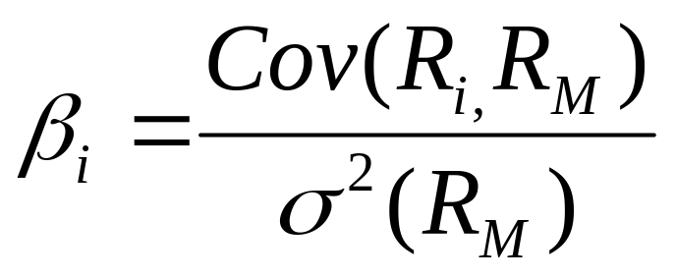
Definition of Risk When Investors Hold the Market Portfolio
The best measure of the risk of a security in a large portfolio is the beta (β)of the security. Other components of risk are not important in this case. A large portfolio is a market portfolio held by every investor.
Beta measures the responsiveness of a security to movements in the market portfolio.

Slide 45
Total versus Systematic Risk
Consider the following information:
  Standard Deviation Beta
  Security C 20% 1.25
  Security K 30% 0.95
Which security has more total risk?
Which security has more systematic risk?
Which security should have the higher expected return?
Notes:
Security K has the higher total risk
Security C has the higher systematic risk
Security C should have the higher expected return

Slide 46
Estimating β with regression
Security Returns
Characteristic Line
Slope = β_{i}
Return on market %
R_{i} = α _{i} + β_{i}R_{m} + e_{i}

Slide 47
Beta
Reuters
Yahoo

Slide 48
The Formula for Beta
Your estimate of beta will depend upon your choice of a proxy for the market portfolio.

Slide 49
Beta of a Portfolio
Stock | Amount Invested | Portfolio weights | Beta
IBM | $6,000 | 50% | 0.90 | 0.450
GM | $4,000 | 33% | 1.10 | 0.367
Walmart | $2,000 | 17% | 1.30 | 0.217
Portfolio | $12,000 | 100% |  | 1.03
The beta of a portfolio is a weighted average of the beta’s of the stocks in the portfolio.
Mutual Fund Betas

Slide 50
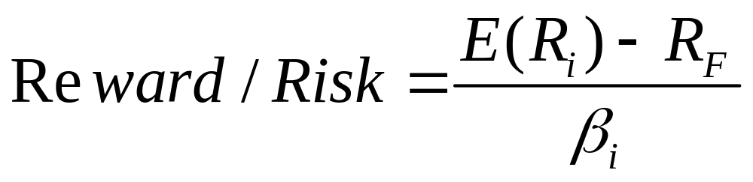
Relationship of Risk to Reward
The fundamental conclusion is that the ratio of the risk premium to beta is the same for every asset.
  In other words, the reward-to-risk ratio is constant and equal to:

Slide 51
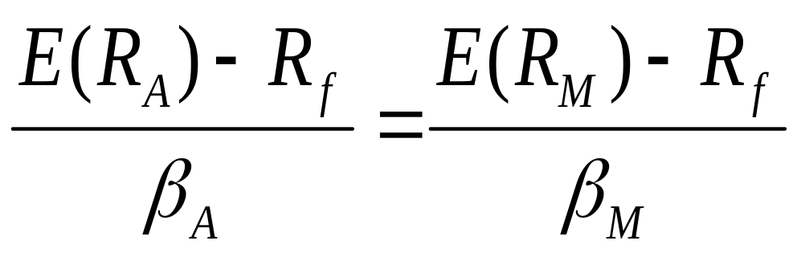
Market Equilibrium
In equilibrium, all assets and portfolios must have the same reward-to-risk ratio and they all must equal the reward-to-risk ratio for the market

Slide 52
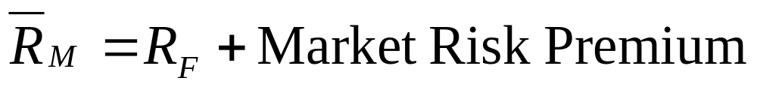
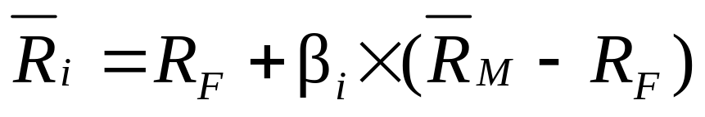
Relationship between Risk and Expected Return (CAPM)
Expected Return on the Market:
Expected return on an individual security:
Market Risk Premium
This applies to individual securities held within well-diversified
portfolios.

Slide 53
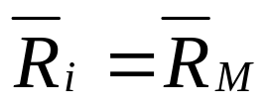
Expected Return on an Individual Security
This formula is called the Capital Asset Pricing Model (CAPM)
Expected return on a security
Risk-free rate
Beta of the security
Market risk premium
=
+
×
Assume β_{i} = 0, then the expected return is R_{F}.
Assume β_{i} = 1, then

Slide 54
Five simple ideas of the CAPM
Investors can eliminate some risks—such as the risk that workers will strike, or that a firm's boss will quit- by diversifying across many regions and sectors.
Some risks, such as that of a global recession, cannot be eliminated through diversification. So even a basket of all of the stocks in a stock market will still be risky.
People must be rewarded for investing in such a risky basket by earning returns above those that they can get on safer assets, such as Treasury bills.
The rewards on a specific investment depend only on the extent to which it affects the market basket's risk.
Conveniently, that contribution to the market basket's risk can be captured by a single measure— dubbed "beta"—which expresses the relationship between the investment's risk and the market's.
Notes:
1) И 2) пункты – демонстрация на примере диверсификации n активов. Все что с сигма уходит с ростом n, все что с ро, остается. Сигма – это firm specific risk. Ро – это market risk. 3-й пункт очевиден. 4-й пукнт – все инвесторы сформировали рыночный портфель, т.е. купили рисковые активы. За покупку рискового актива надо вознаграждаться (в смысле, д.б. риск-премия). Сколько? Т.К. данный актив в рыночном портфеле, надо посмотреть, какую доля риска в рыночный потрфель он привносит. Бета и есть отношение доли риска актива к риску рыночного портфеля в целом.

Slide 55
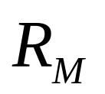
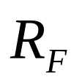
Relationship Between Risk & Expected Return
Expected return
1.0
β
The slope of the security market line is equal to the market risk premium; i.e., the reward for bearing an average amount of systematic risk.

Slide 56
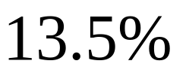
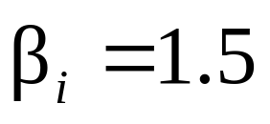
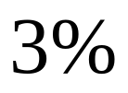
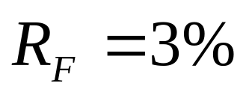
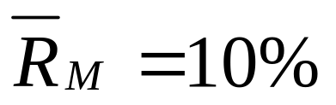
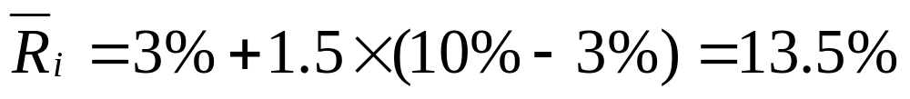
Relationship Between Risk & Expected Return
Expected return
1.5
β

Slide 57

Summary and Conclusions
This chapter sets forth the principles of modern portfolio theory.
The expected return and variance on a portfolio of two securities A and B are given by
By varying w_{A}, one can trace out the efficient set of portfolios. We graphed the efficient set for the two-asset case as a curve, pointing out that the degree of curvature reflects the diversification effect: the lower the correlation between the two securities, the greater the diversification.
The same general shape holds in a world of many assets.

Slide 58
Summary and Conclusions
The efficient set of risky assets can be combined with riskless borrowing and lending. In this case, a rational investor will always choose to hold the portfolio of risky securities represented by the market portfolio.
return
CML
Then with borrowing or lending, the investor selects a point along the CML.
efficient frontier
M
r_{f}
σ_{P}

Slide 59
Summary and Conclusions
The contribution of a security to the risk of a well-diversified portfolio is proportional to the covariance of the security's return with the market’s return. This contribution is called the beta.
The CAPM states that the expected return on a security is positively related to the security’s beta:

Slide 60
Expected (Ex-ante) Return, Variance and Covariance
Expected Return: E(R) = Σ (p_{s} x R_{s})
Variance: σ² = Σ {p_{s} x [R_{s} - E(R)]²}
Standard Deviation = σ
Covariance: σ_{AB} = Σ {p_{s} x [R_{s,A} - E(R_{A})] x [R_{s,B} - E(R_{B})]}
Correlation Coefficient: ρ_{AB} = σ_{AB} / (σ_{A} σ_{B})

Slide 61
Risk and Return Example
State Prob. T-Bills IBM HM XYZ Market Port.
Recession 0.05 8.0% (22.0%) 28.0% 10.0% (13.0%)
Below Avg. 0.20 8.0 (2.0) 14.7 (10.0) 1.0
Average 0.50 8.0 20.0 0.0 7.0 15.0
Above Avg. 0.20 8.0 35.0 (10.0) 45.0 29.0
Boom 0.05 8.0 50.0 (20.0) 30.0 43.0
E(R)=
=

Slide 62
Expected Return and Risk of IBM
E(R_{IBM})= 0.05*(-22)+0.20*(-2) +0.50*(20)+0.20*(35)+0.05*(50) = 18%
σ_{IBM}² = 0.05*(-22-18)²+0.20*(-2-18)² +0.50*(20-18)²+0.20*(35-18)² +0.05*(5018)² = 271
σ_{IBM} =16.5%

Slide 63
Covariance and Correlation
COV _{IBM&XYZ} = 0.05*(-22-18)(10-12.5)+
0.20*(-2-18)(-10-12.5)+0.50*(20-18)(7-12.5)+
0.20*(35-18)(45-12.5)+0.05*(50-18)(30-12.5) =194
Correlation = 194/(16.5)(18.5)=.6355

Slide 64
Risk and Return for Portfolios (2 assets)
Expected Return of a Portfolio:
E(R_{p}) = X_{A}E(R)_{A} + X_{B} E(R)_{B}
Variance of a Portfolio:
σ_{p}² = X_{A}²σ_{A}² + X_{B}²σ_{B}² + 2 X_{A} X_{B} σ_{AB}

