Slide 1
TWITTER-TOPS
Research seminar HW3: Group project
Almaz Murzabekov
Daria Kiseleva
Habibullah Wardak
Sidhardha Neupane
Ka Kit Law
Li Zhonghua

Slide 2
PROJECT DESCRIPTION
Team-pet project for dealing with big data processing and lambda architecture
analyzing tweets
display top #, users, etc
display emerging trends
Sample data
1.4gb raw json data (tweets)

Slide 3
PROJECT DESCRIPTIONS (cntd)
Project milestones
  Stage 1
  Stage 2
Project features
  Top users
  Top hashtags
  Top activities, etc
Project activities
  Meetings (Coding-nights, hakatons, beer & pizza nights, etc)
  Commitments

Slide 4
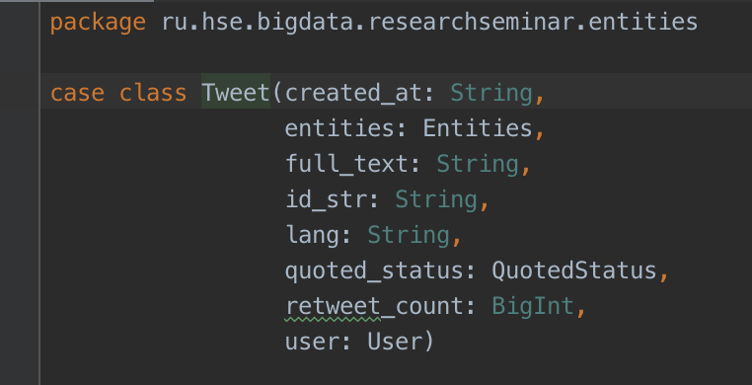
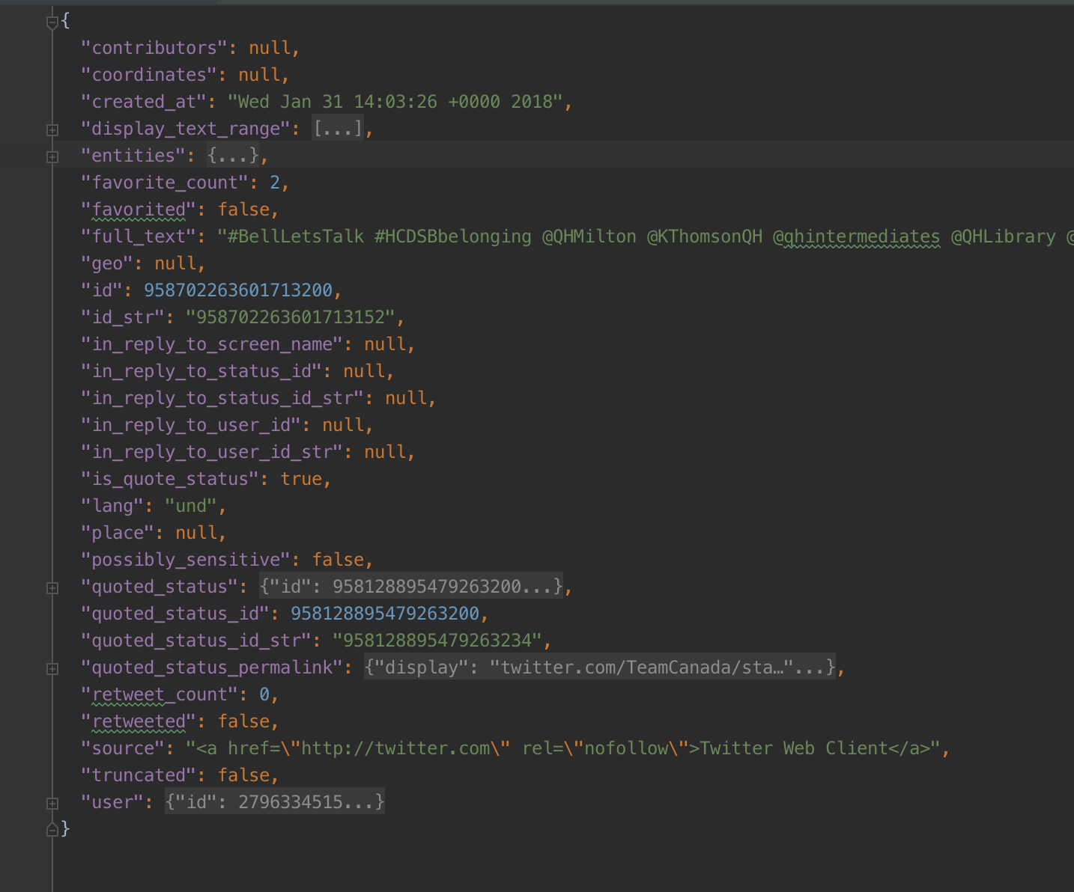
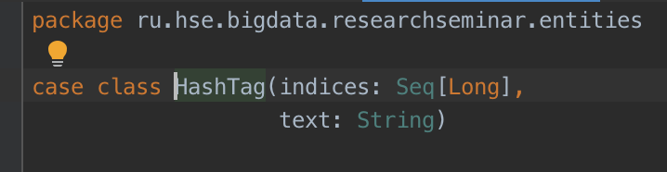
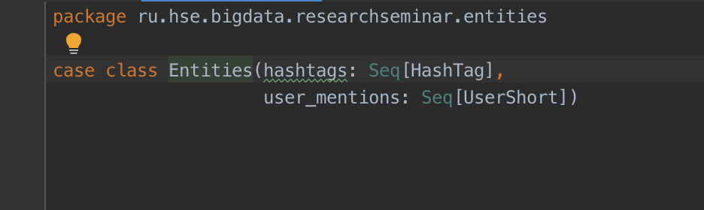
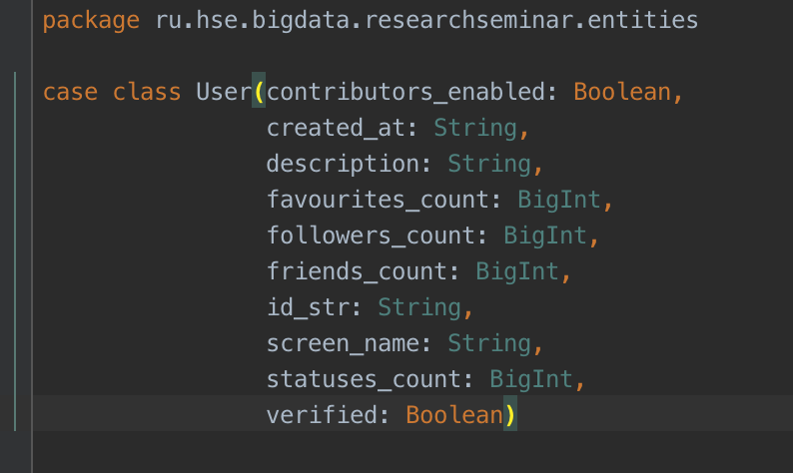
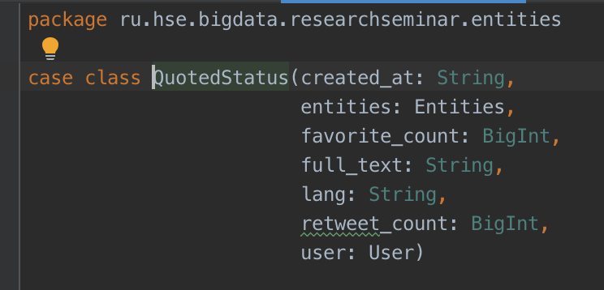
TWEET CONTENT

Slide 5
STAGE 1: EXPLORING THE DATASET
Tweets
SPARK
Tableau

Slide 6
LIVE DEMO: STAGE 1

Slide 7
STAGE 2: TOP LEVEL ARCHITECTURE
Tweets
HDFS
BATCH
HIVE
BI
KAFKA
STREAMING
docker-images

Slide 8
FRAMEWORKS & TOOLS
HORTONWORKS DATA PLATFORM HDP (sandbox)
  APACHE HADOOP
  APACHE HIVE
  APACHE SPARK (BATCH & STREAMING)
KAFKA & KAFKA-HDFS CONNECTOR
TABLEAU
TOOLS
  Python (3.x+)
  Docker images, docker compose
  IntelliJ Idea: Community edition, others IDE
  Git, git client

Slide 9
PROJECT MODULES
Tweets
Twitter-API simulator
kafka2hdfs
HDFS
BATCH
HIVE
BI
KAFKA
STREAMING

Slide 10
TWITTER API SIMULATOR
python program that read tweets from file and put them to the kafka topic
params:
  kafka connection params
  number of tweets per second
  noise factor, number in percentage that represents the randomness of tweet stream
Dev team: Habibullah, Almaz

Slide 11
KAFKA-2-HDFS
Configuration of kafka-2-hdfs tool for uploading tweets from kafka topic to hdfs folder (partitioned by date)
Dev team: Habibullah, Li Zhonghua

Slide 12
HDFS + SPARK BATCH + HIVE
read tweets from hdfs
compute statistics (aka features)
save as hive table
Dev team: Sid, Ka Kit Law, Almaz

Slide 13
KAFKA + SPARK STREAMING + HIVE
read tweets from kafka topic
compute statistics
save as hive table (separate table from batch)
Dev team: Ka Kit Law, Almaz

Slide 14
HIVE (SERVING LAYER)
union/join/group - batch and streaming tables into one table (via sql-view)
hive sql
Dev team: Li Zhonghua, Almaz

Slide 15
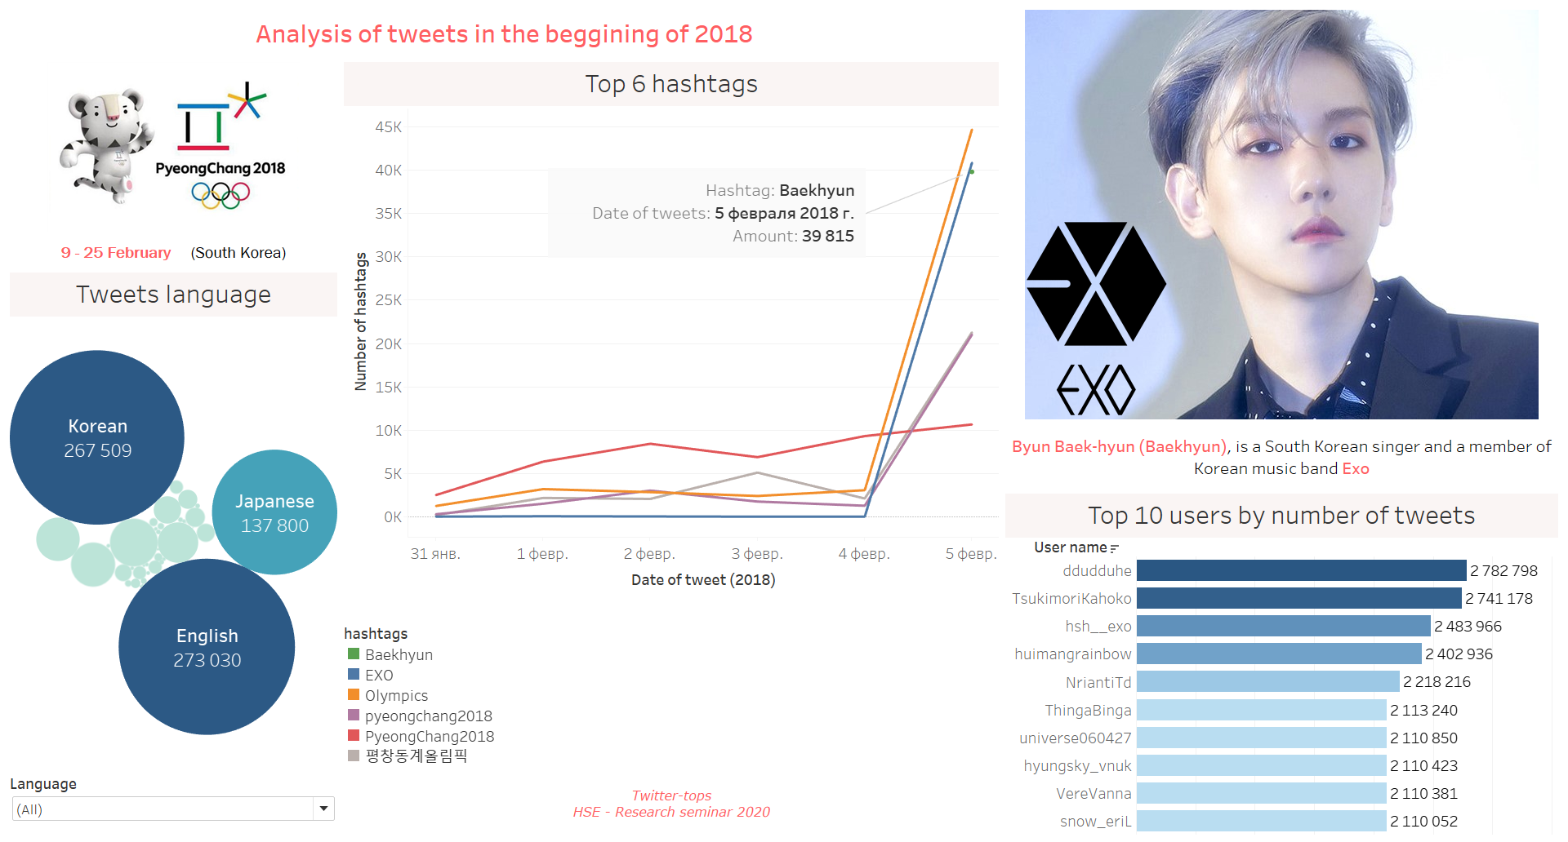
BUSINESS INTELLIGENCE
TABLEAU PUBLIC
Stage 1

Slide 16

BUSINESS INTELLIGENCE
Analysis EXO

Slide 17
LIVE DEMO: STAGE 2

Slide 18
QA

