Slide 1
Real-Time Neural MPC: Deep Learning Model Predictive Control for Quadrotors and Agile Robotic Platforms
Tim Salzmann, Elia Kaufmann, Jon Arrizabalaga, Marco Pavone, et al.
IEEE ROBOTICS AND AUTOMATION LETTERS, 2023
Reem Al-Mazroa
RTN-MPC using the bicycle model

Slide 2
Problem Algorithm
MPC makes robots smart and precise
Why not?
Speed
Need for accurate models
Constraints
Solution: NNs
RTN‑MPC
NN in MPC loop
Local approximations
Gradient‐based optimization
Real‑time iteration
Scalable models
Notes:
paper talk abt mpc + deep learning
weve used mpc. it’s great and makes robotics precise
can’t use it in agile robots (move quickly and easily accounting for disturbances (internal sensros or external enviorment)
so why can’t we use it
speed computation heavy
mpc relies on having a model of robot and env to predict behavior. hard to get that for complex systems like quadrotors
which alsos like to operate at the edge of their capabilities
paper is proposing adding NNs to the mpc loop
It uses local approximations—so instead of running the full, heavy network all the time, it computes gradients and Jacobians on the fly.
Then it uses gradient‑based optimization and a real‑time iteration scheme to update the control inputs quickly.

Slide 3
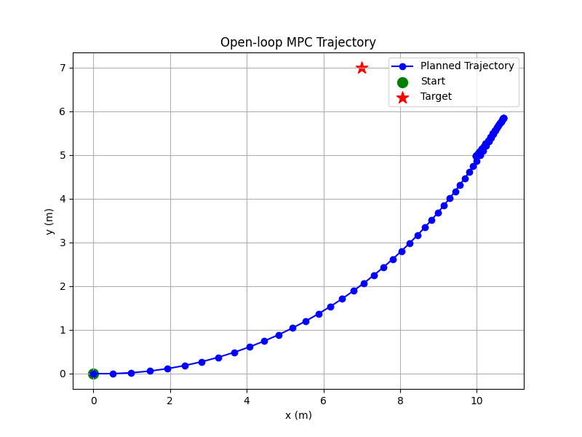
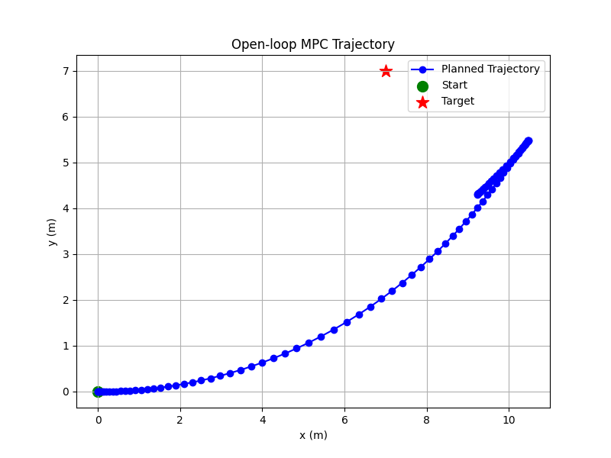
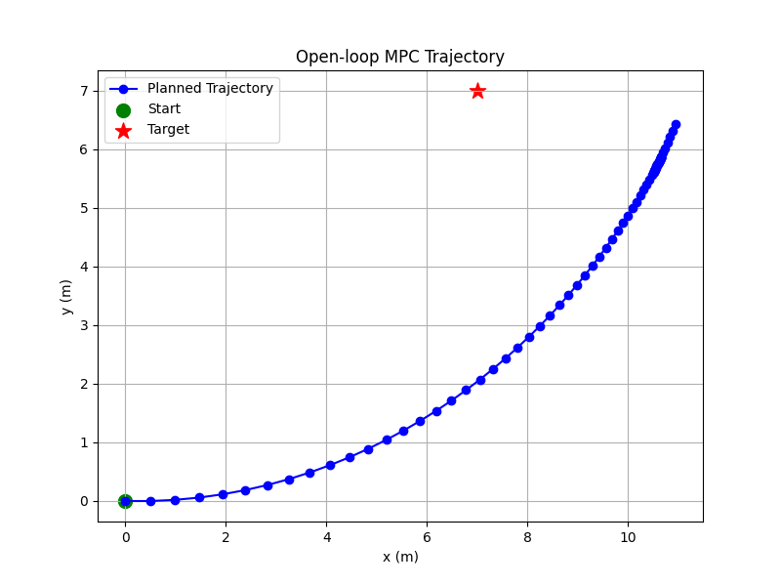
Results: open-loop
start: [0, 0, 0, 0]
goal: [7, 7, 0, 0]
**Not using a quadrotor**
Notes:
so, is it effective.
This is it running open loop
I’m using the bicycle model not a quadrotor because I’m one engineer
nonlinear and underactuated
and has control limits

Slide 4
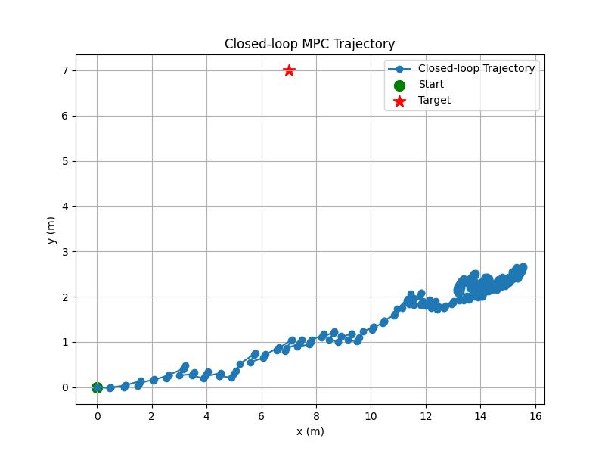
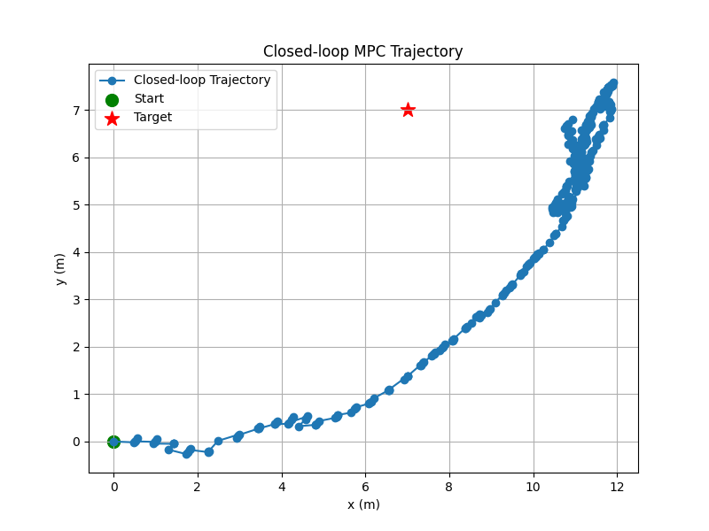
Results: closed-loop
start: [0, 0, 0, 0]
goal: [7, 7, 0, 0]
No NN With NN
**Not using a quadrotor**
Notes:
when we run in closed loop
re‑plans at every time step
When we enabled the neural network correction, our controller managed to reduce the tracking error significantly

Slide 5
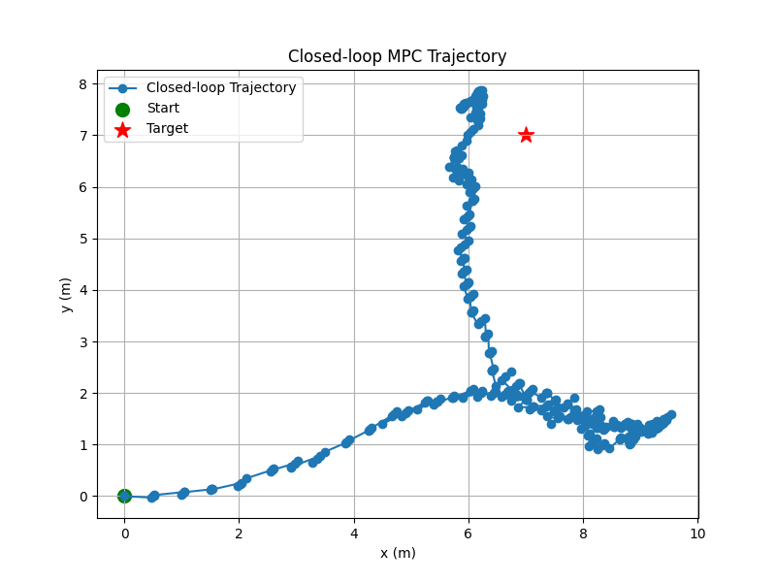
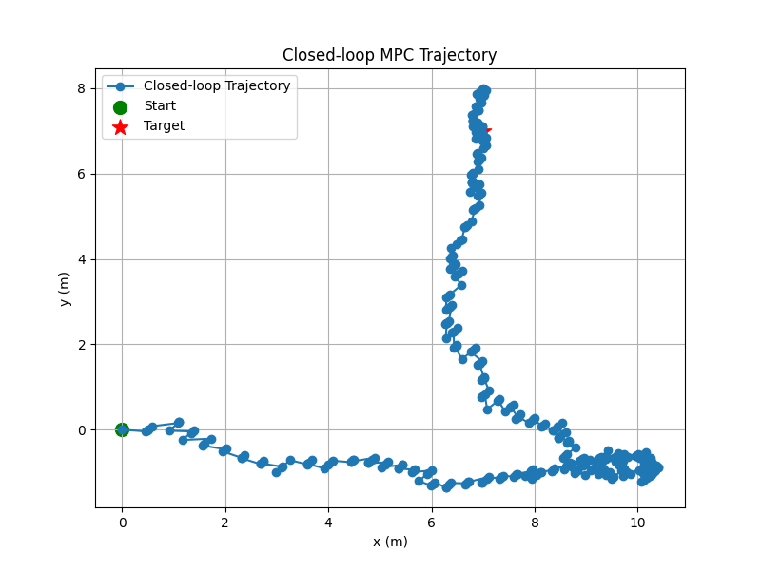
Results: closed-loop w/ terminal cost
start: [0, 0, 0, 0]
goal: [7, 7, 0, 0]
No NN With NN
**Not using a quadrotor**
Notes:
tuning the cost function and horizon
we achieve convergence
so it’s great. main consideration is lack of interpretability because we’re using an NN
concern for safety critical systems where we need to be sure it's making the right decision for the right reasons

Slide 6
Takeaways
NN correction = precision final state
Tuned cost & horizon = smooth convergence
Scalable method → from cars to drones
Notes:
so what we did is
instead of having a perfect mathematical model of the dynamics, NNs will learn the dynamics from data
show that integrating NN models into MPC can really boost performance, which aligns with what the paper presented

