Slide 1
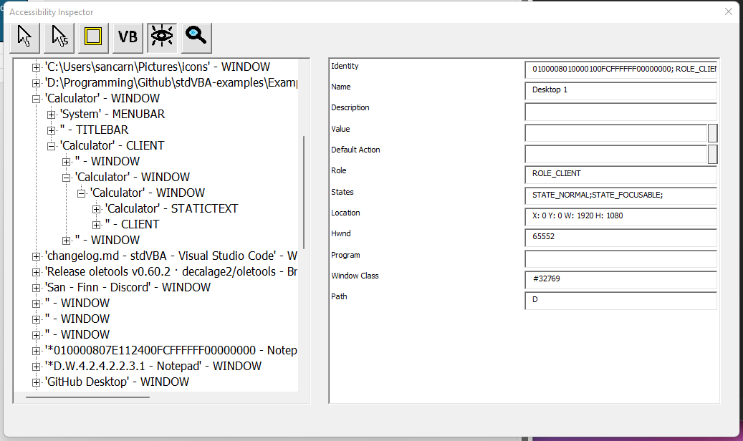
Info from mouse w/ 5s countdown
Generate selector command
Show only visible elements
Highlight
Info from mouse
Perform text based tree search
Set value of selected element
Visible Accessibility Tree
Perform default action of selected element
Accessibility information displayed

