Slide 1

tellar Robotics Presents: java and robots! Part 1

Slide 2

Agenda
What’s Java
Syntax
Variables and Arrays
Conditional Statements
Loops
Functions
Guessing Game

Slide 3

Syntax… What does that even mean?

Slide 4
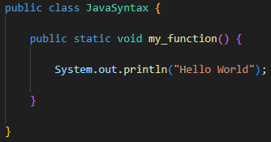
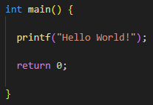


Slide 5
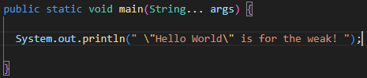
Finally, We Get to write a program!

Slide 6
Variables and Arrays
Don’t fret, they’re a lot easier than algebra.

Slide 7
Effective delivery techniques
This is a powerful tool in public speaking. It involves varying pitch, tone, and volume to convey emotion, emphasize points, and maintain interest:
Pitch variation
Tone inflection
Volume control
Effective body language enhances your message, making it more impactful and memorable:
Meaningful eye contact
Purposeful gestures
Maintain good posture
Control your expressions

Slide 8
Navigating Q&A sessions
Know your material in advance
Anticipate common questions
Rehearse your responses
Maintaining composure during the Q&A session is essential for projecting confidence and authority. Consider the following tips for staying composed:
Stay calm
Actively listen
Pause and reflect
Maintain eye contact

Slide 9

Speaking impact
Your ability to communicate effectively will leave a lasting impact on your audience
Effectively communicating involves not only delivering a message but also resonating with the experiences, values, and emotions of those listening

Slide 10
Dynamic delivery
Learn to infuse energy into your delivery to leave a lasting impression
One of the goals of effective communication is to motivate your audience
Metric | Measurement | Target | Actual
Audience attendance | # of attendees | 150 | 120
Engagement duration | Minutes | 60 | 75
Q&A interaction | # of questions | 10 | 15
Positive feedback | Percentage (%) | 90 | 95
Rate of information retention | Percentage (%) | 80 | 85

Slide 11
Final tips & takeaways
Consistent rehearsal
Strengthen your familiarity
Refine delivery style
Pacing, tone, and emphasis
Timing and transitions
Aim for seamless, professional delivery
Practice audience
Enlist colleagues to listen & provide feedback
Seek feedback
Reflect on performance
Explore new techniques
Set personal goals
Iterate and adapt

Slide 12
Navigating Q&A sessions
Impact factor | Measurement | Target | Achieved
Audience interaction | Percentage (%) | 85 | 88
Knowledge retention | Percentage (%) | 75 | 80
Post-presentation surveys | Average rating | 4.2 | 4.5
Referral rate | Percentage (%) | 10 | 12
Collaboration opportunities | # of opportunities | 8 | 10

Slide 13
Thank you
Brita Tamm
502-555-0152
brita@firstupconsultants.com
www.firstupconsultants.com

