Slide 1

tellar Robotics Presents: java and robots! Part 1

Slide 2

Agenda
What Is Java
Syntax
Variables and Arrays
Conditional Statements
Loops
Functions
Guessing Game

Slide 3
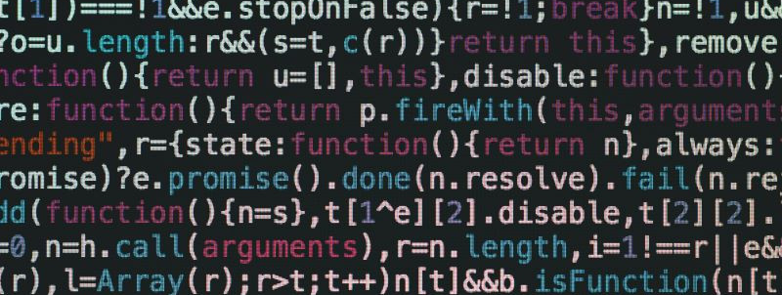
Syntax… What does that even mean?

Slide 4
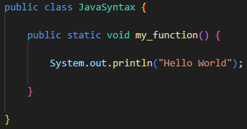
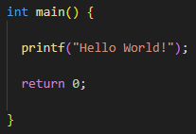


Slide 5
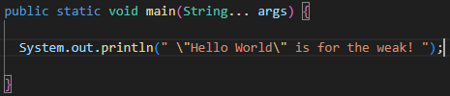
Finally, We Get to write a program!

Slide 6
Variables and Arrays
Don’t fret, they’re a lot easier than in algebra.

Slide 7

The Fundamental variable
A Variable…
Is a digital container that you can put data in.
Allows you to reference the same data in multiple parts of your code.
Can contain different types of data.
Allows for the data in it to change (it varies).
“I live in a box”
My Variable

Slide 8
Variables in java
Name of the variable (usually camel case)
String myVariable = “This box is cramped” ;
Type of data the variable will store
Contents of the variable
End of statement

Slide 9
Arrays
Curly brackets define the beginning and end of the array structure
String[] myArray = {“Logo", "BMW", “Chalk"} ;
Square brackets are put on the end of the data type to tell Java that the variable contains an array
Commas separate each element in the array

Slide 10
Conditional Statements and loops
Enable your code to make decisions.

Slide 11
If Statements
If Statements allow code to run when a condition is met and vice versa.
Your 1000% Crazy
True
Then are birds real?
True
False
Is the Earth Flat?
Your Mostly Crazy
False
Your just wrong!

Slide 12
IF Statements in java
A conditional expression is put inside the pair of parenthesis
If (1 + 1 == 2) {
System.out.println(“Perfect Harmony”);
}
else {
System.out.println(“World Explodes”);
}
Code inside the curly brackets is only run if the condition is true
“Else” blocks can be put after the “If” block. The “Else” block will run if the condition in the “if” block is NOT true”

Slide 13
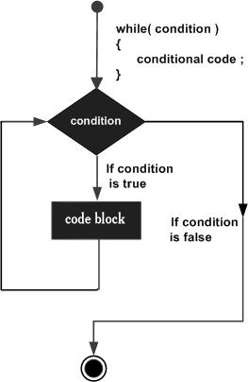
Loops (while loops)
Just like “if” statements, we put a conditional expression inside the parentheses
while (annoying == true) {
imNotTouchingYou();
}

Slide 14



Functions
fastFoodFryer(chicken, motorOil);

Slide 15
Final tips & takeaways
Consistent rehearsal
Strengthen your familiarity
Refine delivery style
Pacing, tone, and emphasis
Timing and transitions
Aim for seamless, professional delivery
Practice audience
Enlist colleagues to listen & provide feedback
Seek feedback
Reflect on performance
Explore new techniques
Set personal goals
Iterate and adapt

Slide 16
Navigating Q&A sessions
Impact factor | Measurement | Target | Achieved
Audience interaction | Percentage (%) | 85 | 88
Knowledge retention | Percentage (%) | 75 | 80
Post-presentation surveys | Average rating | 4.2 | 4.5
Referral rate | Percentage (%) | 10 | 12
Collaboration opportunities | # of opportunities | 8 | 10

Slide 17
Thank you
Brita Tamm
502-555-0152
brita@firstupconsultants.com
www.firstupconsultants.com

