Slide 1

tellar Robotics Presents: java and robots! Part 2

Slide 2

Agenda
Object Oriented Programming Paradigm
Working With Libraries
WPILib/Interfacing With The Robot
Programming The Drivetrain
Programming Pneumatics

Slide 3
Object Oriented Programming

Slide 4




classes and objects
Multiple objects can be constructed from a single class and can each have their own unique attributes, for instance, color.
Classes can be viewed as like a blueprint. They are templates used to construct objects.

Slide 5
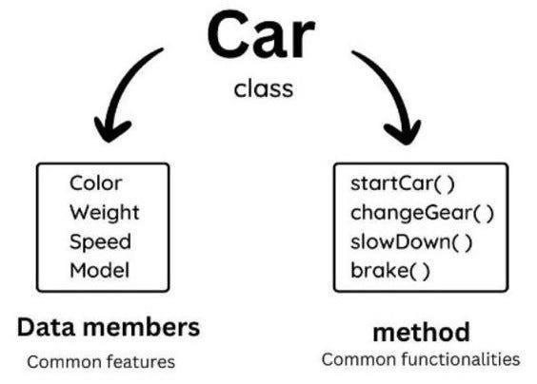
What's in a class?
Classes consist of common variables and functions; we call these attributes and methods.
AKA Attributes

Slide 6
Main
Main differs from other classes in that it is used to run the central program. This program utilizes the other classes you have created to achieve the final result of your code.
Illustrate the main() function inside of the Main class as taking other classes and using them inside of the main program.
Show other classes as data existing to be used in the main program.

Slide 7
Methods
Methods are functions that are created in a class. Objects created from a class will inherit all its methods.
public class MyRobotClass {
Methods:
Create an object called “robot” from our class:
myRobotClass robot = new myRobotClass();
void sayHi() {
Sys.out.print(“Hi”);
}
Call the “printText” method from the object:
robot.sayHi();
Output:
Hi
}

Slide 8


Attributes
public class Robot {
Attributes:
Attributes can be uniquely defined for each object created from the class.
String model;
String color;
}
robot2.model = “R2D2”;
robot2.color = “Blue”;
robot1.model = “C3PO”;
robot1.color = “Gold”;

Slide 9
Constructors
Constructors allow you to pass in arguments to a newly created object. This allows you to uniquely configure the object.
public class Robot {
int robotSpeed;
public void Robot(int speed) {
robotSpeed = speed;
}
private void go() {
Sys.out.print(robotSpeed);
}
}
Create object and pass in our speed:
Robot bot = new Robot(5);
Call the object’s “go” method:
bot.go();
Output:
5

Slide 10




Public and Private: Access Modifiers
class samsClub {
class speedWay {
private void gasStation {
Sys.out.print(“Pumping Gas”);
}
public void gasStation {
Sys.out.print(“Pumping Gas”);
}
}
}

Slide 12
ACCESS MODIFIERS
Show scope of public vs. private attributes/methods.
Roughly explain concept of the instance modifying private attributes while other classes can modify public attributes.

Slide 13
Variables and Arrays
Don’t fret, they’re a lot easier than in algebra.

Slide 14

The Fundamental variable
A Variable…
Is a digital container that you can put data in.
Allows you to reference the same data in multiple parts of your code.
Can contain different types of data.
Allows for the data in it to change (it varies).
“I live in a box”
My Variable

Slide 15
Variables in java
Name of the variable (usually camel case)
String myVariable = “This box is cramped” ;
Contents of the variable
Type of data the variable will store
End of statement

Slide 16
Arrays
Curly brackets define the beginning and end of the array structure
String[] myArray = {“Logo", "BMW", “Chalk"} ;
Square brackets are put on the end of the data type to tell Java that the variable contains an array
Commas separate each element in the array

Slide 17
Conditional Statements and loops
Enable your code to make decisions.

Slide 18
If Statements
If Statements allow code to run when a condition is met and vice versa.
Your 1000% Crazy
True
Then are birds real?
True
False
Is the Earth Flat?
Your Mostly Crazy
False
Your just wrong!

Slide 19
IF Statements in java
A conditional expression is put inside the pair of parenthesis
If (1 + 1 == 2) {
System.out.println(“Perfect Harmony”);
}
else {
System.out.println(“World Explodes”);
}
Code inside the curly brackets is only run if the condition is true
“Else” blocks can be put after the “If” block. The “Else” block will run if the condition in the “if” block is NOT true”

Slide 20
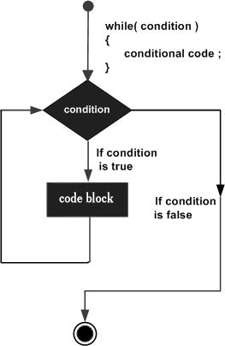
Loops (while loops)
Just like “if” statements, we put a conditional expression inside the parentheses
while (annoying == true) {
imNotTouchingYou();
}

Slide 21
Functions
Make your code modular and reusable

Slide 22



Functions
Functions are blocks of code that accomplish a specific task.
Functions can be called multiple times in your code
fastFoodFryer(chicken, motorOil);

Slide 23
Functions in java
The type of data the function returns
The input the function requires
int addFive(int inputNumber) {
return inputNumber + 5;
}
We are passing "myNumber" to the function when we call it.
The result will be the sum of the number we pass in and 5
int result;
int myNumber = 3;
result = addFive(myNumber);

Slide 24
Guessing Game

Slide 25
That’s all
If you'd like to review the concepts we covered in part 1 again, you can visit www.fuzzlabs.net for a quick refresher.

