Slide 1

tellar Robotics Presents: java and robots! Part 2

Slide 2

Agenda
Object Oriented Programming Paradigm
Working With Libraries
WPILib/Interfacing With The Robot
Programming The Drivetrain
Programming Pneumatics

Slide 3
Object Oriented Programming

Slide 4




classes and objects
Multiple objects can be constructed from a single class and can each have their own unique attributes, for instance, color.
Classes can be viewed as like a blueprint. They are templates used to construct objects.

Slide 5
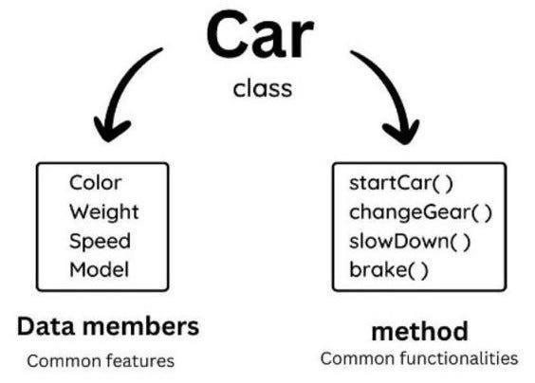
What's in a class?
Classes consist of common variables and functions; we call these attributes and methods.
AKA Attributes

Slide 6
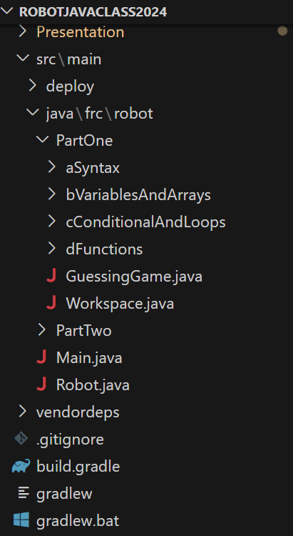
The main class
The Main class is the starting point of your program. Java will run this class automatically when your program starts.
The main class must start with a capital.
Java runs the lowercase main function inside of the Main class.
class Main {
public static void main(String… args) {
myClass.myFunction();
}
}
Your code will always start inside the main function.

Slide 7
Methods
Methods are functions that are created in a class. Objects created from a class will inherit all its methods.
public class MyRobotClass {
Methods:
Create an object called “robot” from our class:
myRobotClass robot = new myRobotClass();
void sayHi() {
Sys.out.print(“Hi”);
}
Call the “printText” method from the object:
robot.sayHi();
Output:
Hi
}

Slide 8


Attributes
public class Robot {
Attributes:
Attributes can be uniquely defined for each object created from the class.
String model;
String color;
}
robot2.model = “R2D2”;
robot2.color = “Blue”;
robot1.model = “C3PO”;
robot1.color = “Gold”;

Slide 9
Constructors
Constructors allow you to pass in arguments to a newly created object. This allows you to uniquely configure the object.
public class Robot {
int robotSpeed;
public void Robot(int speed) {
robotSpeed = speed;
}
private void go() {
Sys.out.print(robotSpeed);
}
}
Create object and pass in our speed:
Robot bot = new Robot(5);
Call the object’s “go” method:
bot.go();
Output:
5

Slide 10




Public and Private: Access Modifiers
class samsClub {
class speedWay {
private void gasStation {
Sys.out.print(“Pumping Gas”);
}
public void gasStation {
Sys.out.print(“Pumping Gas”);
}
}
}

Slide 11
Let’s build some robot code!

Slide 12
That’s all!

Slide 13
Main
Main differs from other classes in that it is used to run the central program. This program utilizes the other classes you have created to achieve the final result of your code.
Illustrate the main() function inside of the Main class as taking other classes and using them inside of the main program.
Show other classes as data existing to be used in the main program.

Slide 14
ACCESS MODIFIERS
Show scope of public vs. private attributes/methods.
Roughly explain concept of the instance modifying private attributes while other classes can modify public attributes.

