Slide 1


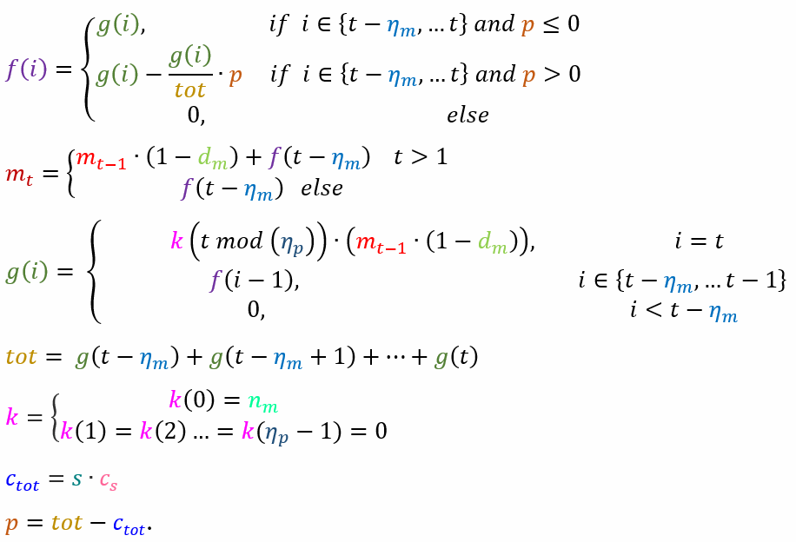
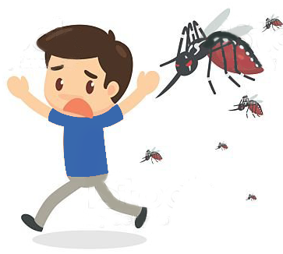
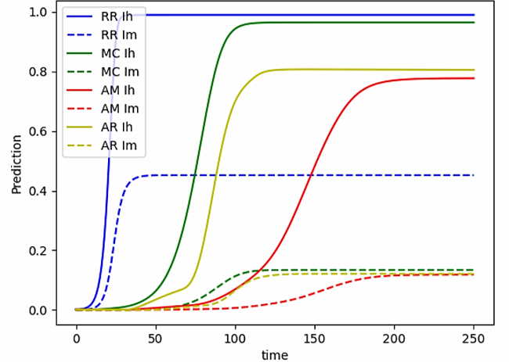



Malaria Prediction Model
Almog Jakov, Itay Rafee and Neta Roth
Elizabeth Itzkovich
42
Contribution & Project Goal
The goal of the project is to implement standard prediction models for malaria, also to evaluate the mosquito population measure more accurately, since it is fixed in such models. We collaborated with the ZzappMalaria company, the developer of a mobile-app and managerial dashboard that helps eliminate malaria and has won IBM Watson AI XPRIZE Competition in 2022.
Introduction
Malaria is a tropical infectious disease caused by Plasmodium parasites. It is one of the leading causes of death in the world, especially among children. One of the treatment methods available today is an attempt to predict the spread of the disease using mathematical models. Such models today include the Ross model, the McDonald model and the Anderson-May model among others. The main problem with such models is that they do not take into account the change in the Plasmodium parasite population whose growth rate is affected by many factors.
Methods & Alternatives
In the project, we implemented 3 models:
The Ross Model: Predicts the rate of infected humans using 2 primary parameters – newly infected humans and recovering. The model also predicts the rate of infected mosquitoes using 2 primary parameters - newly infected mosquitoes and mosquito mortality.
MacDonald model: Extends the Ross model to predicts the proportion of infected humans and the proportion of infected mosquitoes using the mosquito incubation period parameter. It also adds an equation to predict the percentage of exposed mosquitoes.
Anderson-May model: Extends the McDonald model. It adds an equation to predict the percentage of exposed people given the human incubation period parameter.
Selected Approach
We have developed an equation for predicting the ratio of live mosquitoes with the help of several main parameters that affect their growth rate: Probability of death, Time of egg development for an adult mosquito, Duration of pregnancy, Number of swamps available, Possible capacity in each swamp.
We assumed that when a mosquito completes the period of pregnancy it gets pregnant again immediately, in addition, we assumed that any female mosquito gets pregnant as soon as it becomes adult. We "diluted" the number of mosquitoes in the swamps (if it bypassed the possible capacity) equally.
Solution Description
$d_{m}$ - Mosquitoes death probability on a given day.
$η_{m}$ - Period taken for an egg to become an adult.
$η_{p}$ - Duration of pregnancy.
$n_{m}$ - Number of female mosquitoes born per pregnancy.
$s$- Number of swamps.
$c_{S}$ - Capacity of mosquitoes per swamp.
$c_{tot}$ - Capacity of all mosquitoes at all swamps.
$k$ - Number of female mosquitoes born on a given day
per female mosquito.
$g\left(t\right)$- Number of female mosquitoes being laid in a
swamp on a given day before dilution.
$tot$- Number of female mosquitoes in the swamps
before dilution.
$p$ - Number of female mosquitoes that needed to be
diluted in each day.
$f(t)$ - Number of female mosquitoes being laid in a
swamp on a given day after dilution.
$m(t)$ - Number of mosquitoes on a given day.
More Info

