Slide 1

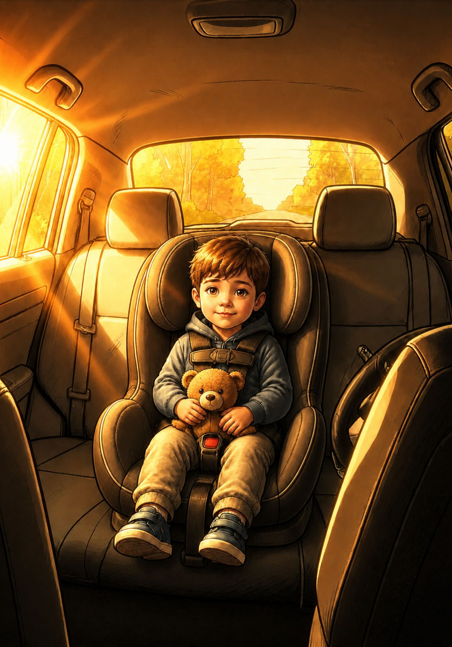


C.A.R.E
Car Alert & Reminder Eye
An extra eye watching the back seat for you.
Linoy Kasuker & Almog Gabay
Notes:
1

Slide 2


THIS HAPPENED THIS MONTH.
Two incidents. Two weeks. One preventable danger.
AUGUST 9, 2026
AUGUST 21, 2026
This is NOT a problem from the past.
Notes:
2

Slide 3
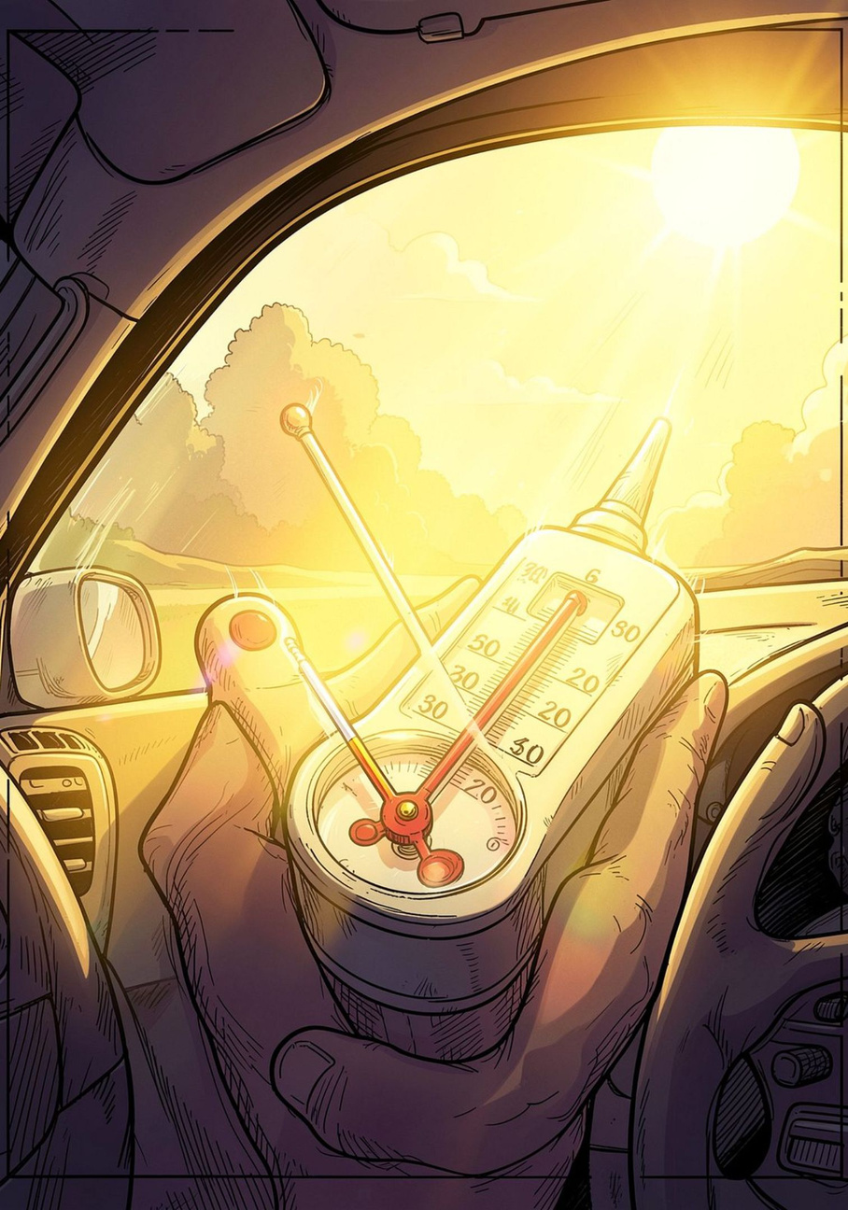

MINUTES MATTER
RISING HEAT
VULNERABLE
+11°C IN JUST 10 MINUTES
Vehicle temperatures can rise dangerously fast.
FASTER × 5-3
A child's body heats up faster than an adult's.
SILENT DANGER
A sleeping child may be difficult to notice.
Notes:
3

Slide 4
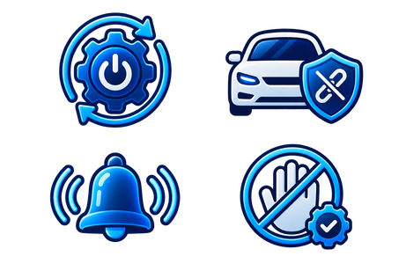

THE SOLUTION
MEET C.A.R.E
An autonomous safety system that scans the vehicle after shutdown and alerts the driver when a possible presence is detected.
AUTOMATIC
STANDALONE
Activates automatically after vehicle shutdown.
Works independently of the vehicle's built-in systems.
REAL-TIME ALERT
NO DRIVER ACTION REQUIRED
Alerts the driver when a possible presence is detected.
C.A.R.E runs without requiring the driver to activate it.
Notes:
4

Slide 5

SYSTEM FLOW
HOW C.A.R.E WORKS
CAR OFF
SCAN
DETECT
ALERT
Vehicle shuts down
PIR + Camera
Either source detects
Driver is notified
The entire process runs automatically after vehicle shutdown - no driver activation required.
Notes:
5

Slide 6
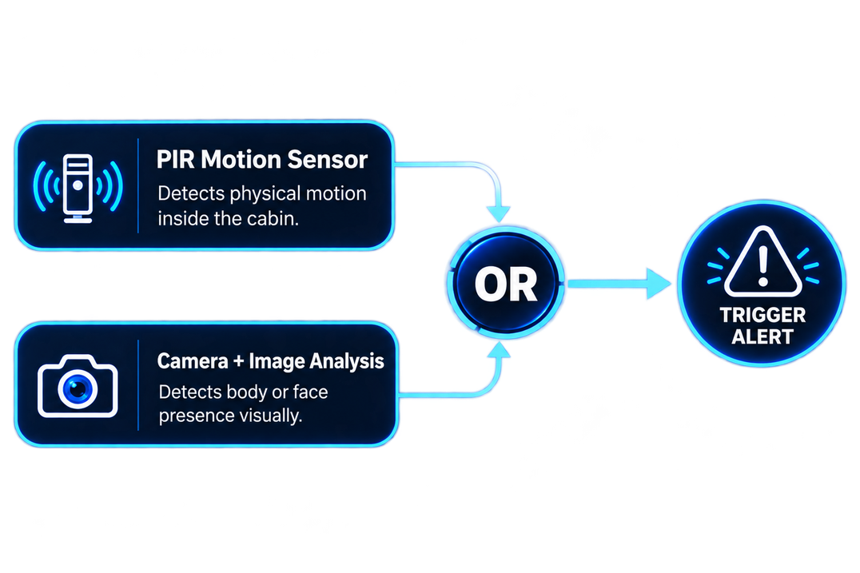


DETECTION LOGIC
TWO DETECTION SOURCES
Either source can trigger the alert.
The two detection inputs operate independently.
PIR Motion Sensor
Camera + Image Analysis
Detects physical motion inside the vehicle.
Detects body or face presence visually
OR logic — not AND. One trigger is all it takes.
Notes:
6

Slide 7

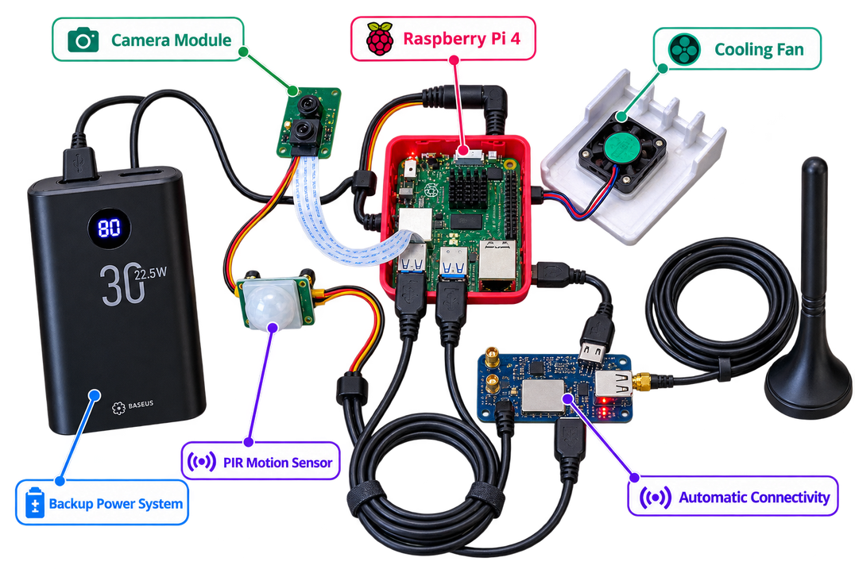
HARDWARE
THE SYSTEM WE BUILT
01
Raspberry Pi 4
Main processing unit
02
Camera Module
Captures images for visual analysis
03
PIR Motion Sensor
Provides independent motion detection
04
AUTOMATIC CONNECTIVITY
Uses known Wi-Fi when available; otherwise switches to the cellular network.
05
Cooling Fan
Keeps the system cool during operation
06
Backup Power System
Recharges while driving and powers C.A.R.E after vehicle shutdown.
Notes:
7

Slide 8
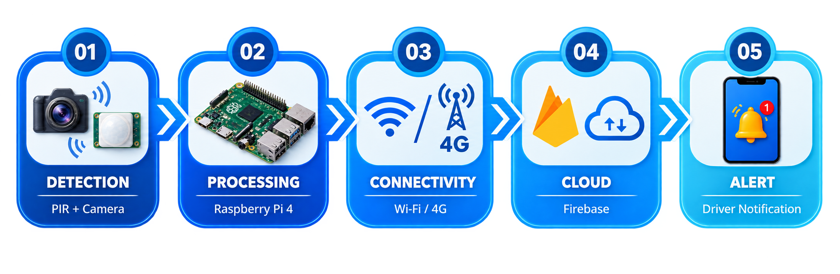
SYSTEM ARCHITECTURE
FROM DETECTION TO ALERT
From detection to driver alert — automatically.
Notes:
8

Slide 9
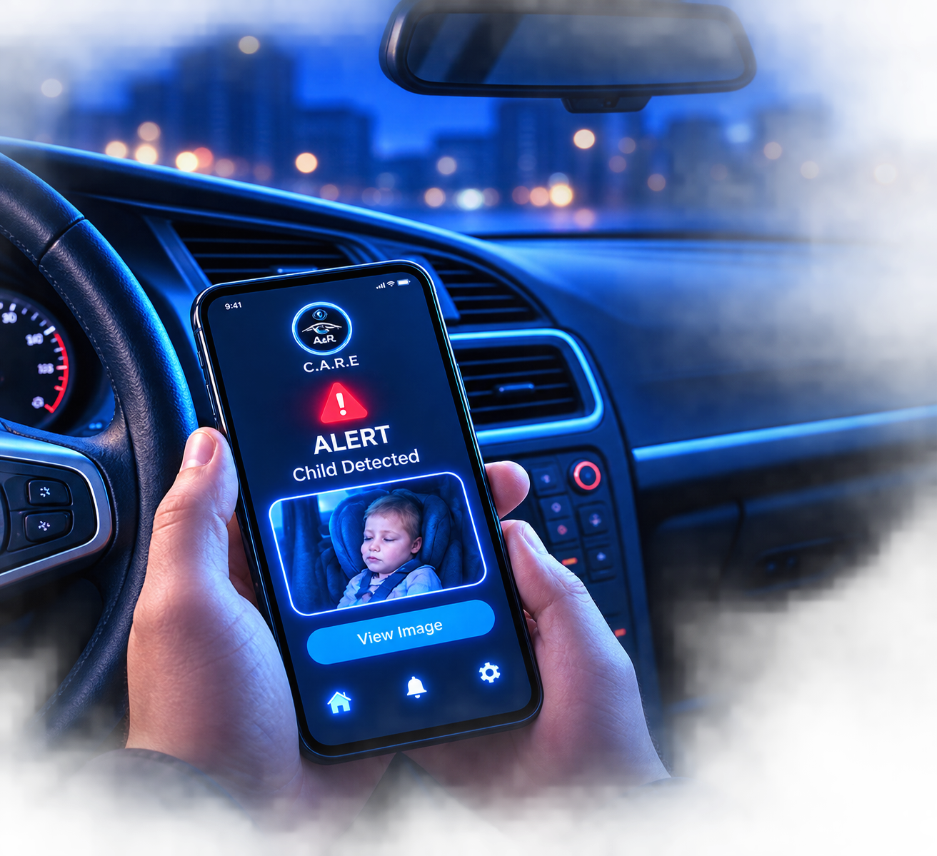
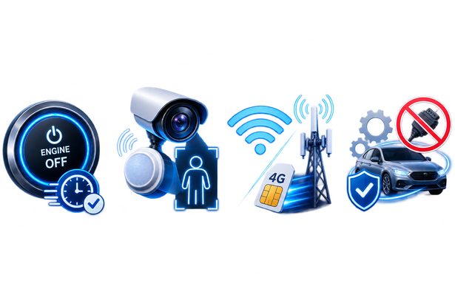
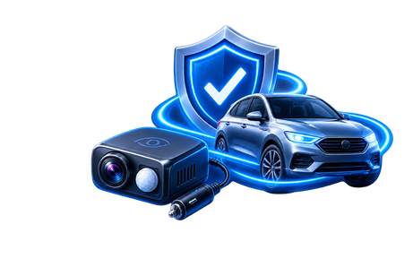
WHY C.A.R.E?
AUTONOMOUS
Activates automatically after vehicle shutdown - no driver action
required.
DUAL DETECTION
PIR motion sensing and image analysis operate independently.
RELIABLE CONNECTIVITY
Uses known Wi-Fi when available, with 4G cellular fallback.
UNIVERSAL DESIGN
Standalone — no integration with the vehicle’s built-in systems.
An extra layer of protection, without changing driver behavior.
Notes:
9

Slide 10
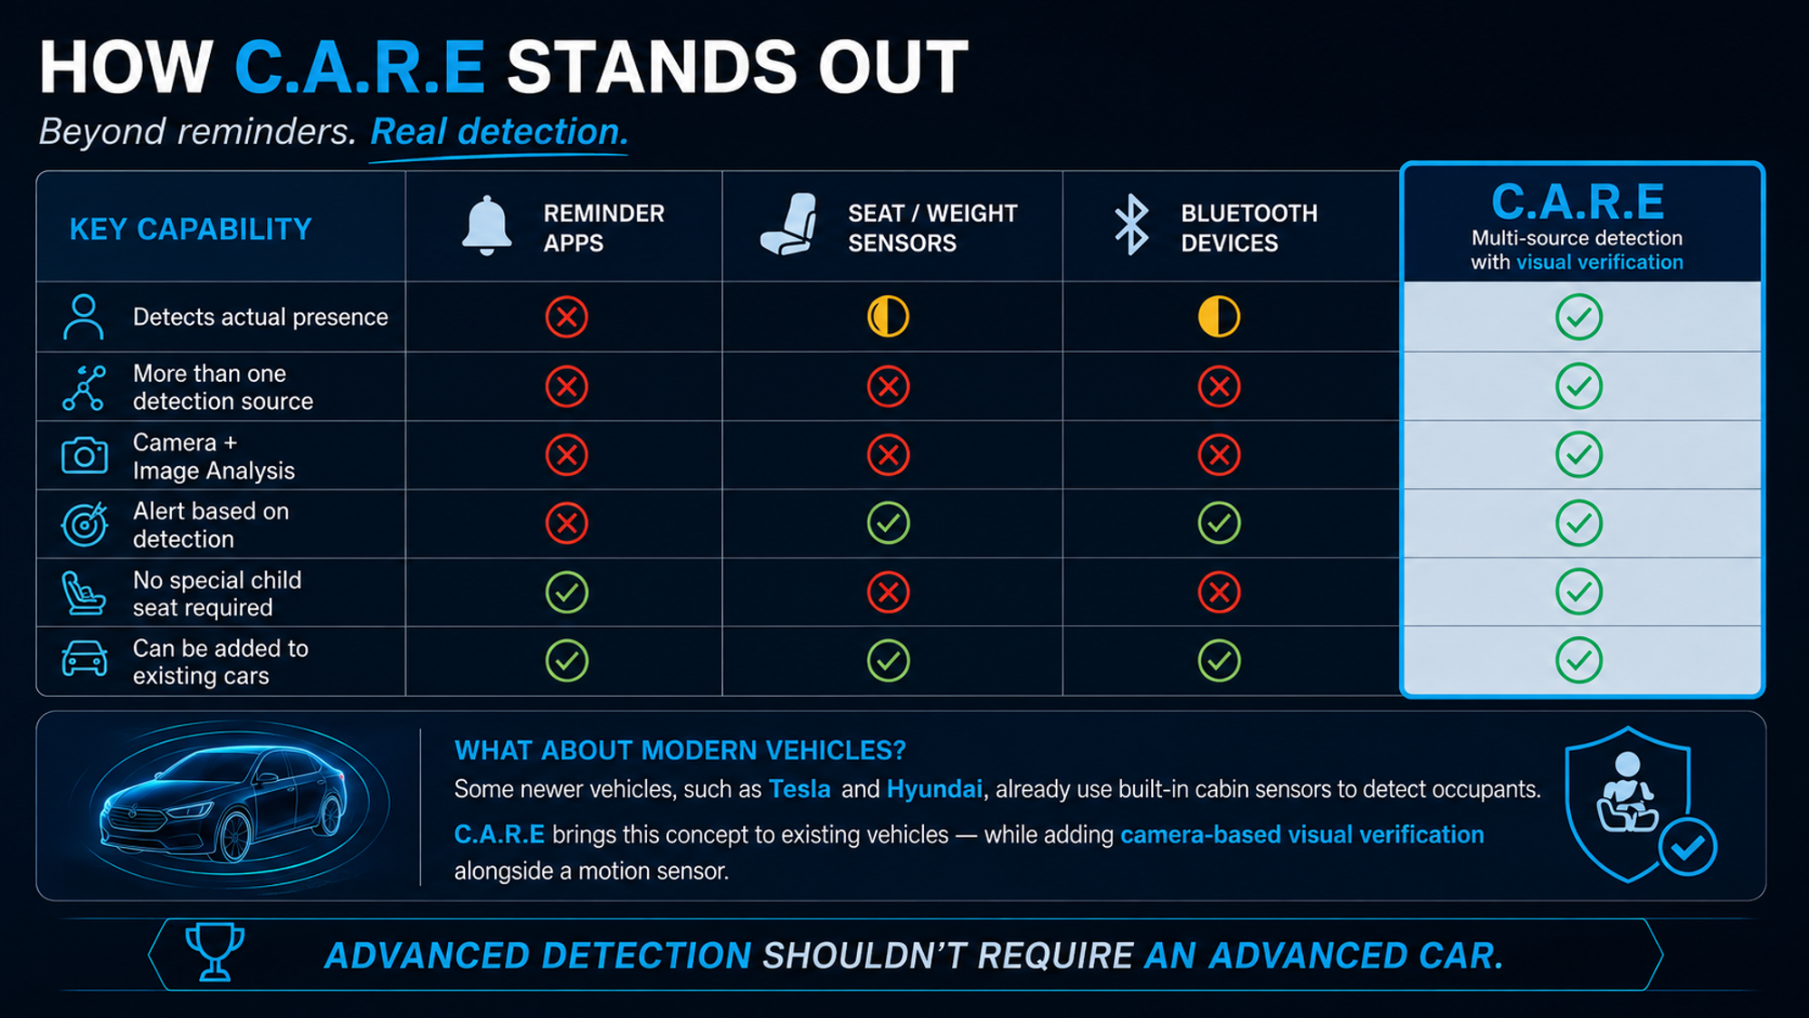
Notes:
9

Slide 11

Notes:
10

