Slide 1

C.A.R.E
Car Alert & Reminder Eye
"An extra eye watching the back seat for you."
Linoy Kasuker & Almog Gabay

Slide 2
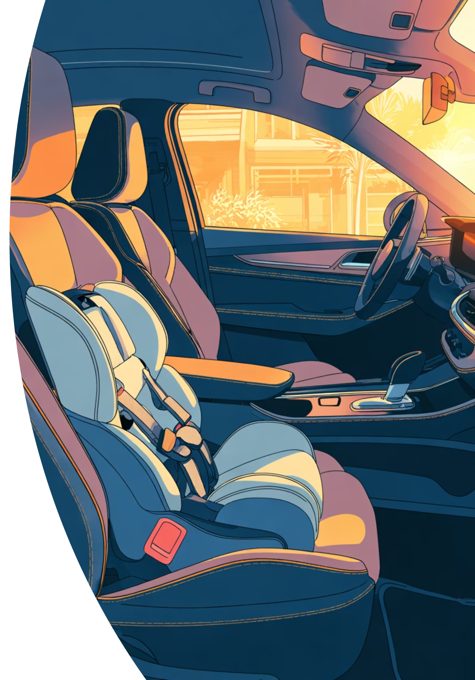
The Problem: Forgotten Baby Syndrome
Every year, children and pets are left behind in vehicles - not because of neglect, but because of stress, exhaustion, or an unexpected change in daily routine. The consequences can be fatal within minutes.
The Danger
Why Existing Solutions Fall Short
Car interior heat rises rapidly once doors close
Can cause dehydration and death within minutes.
Sleeping children are nearly silent - easy to miss
Built-in systems only available in expensive new vehicles
A generic "Check Back Seat" alert even when the vehicle is empty, causing drivers to ignore them
Complex installation or app dependency creates friction

Slide 3
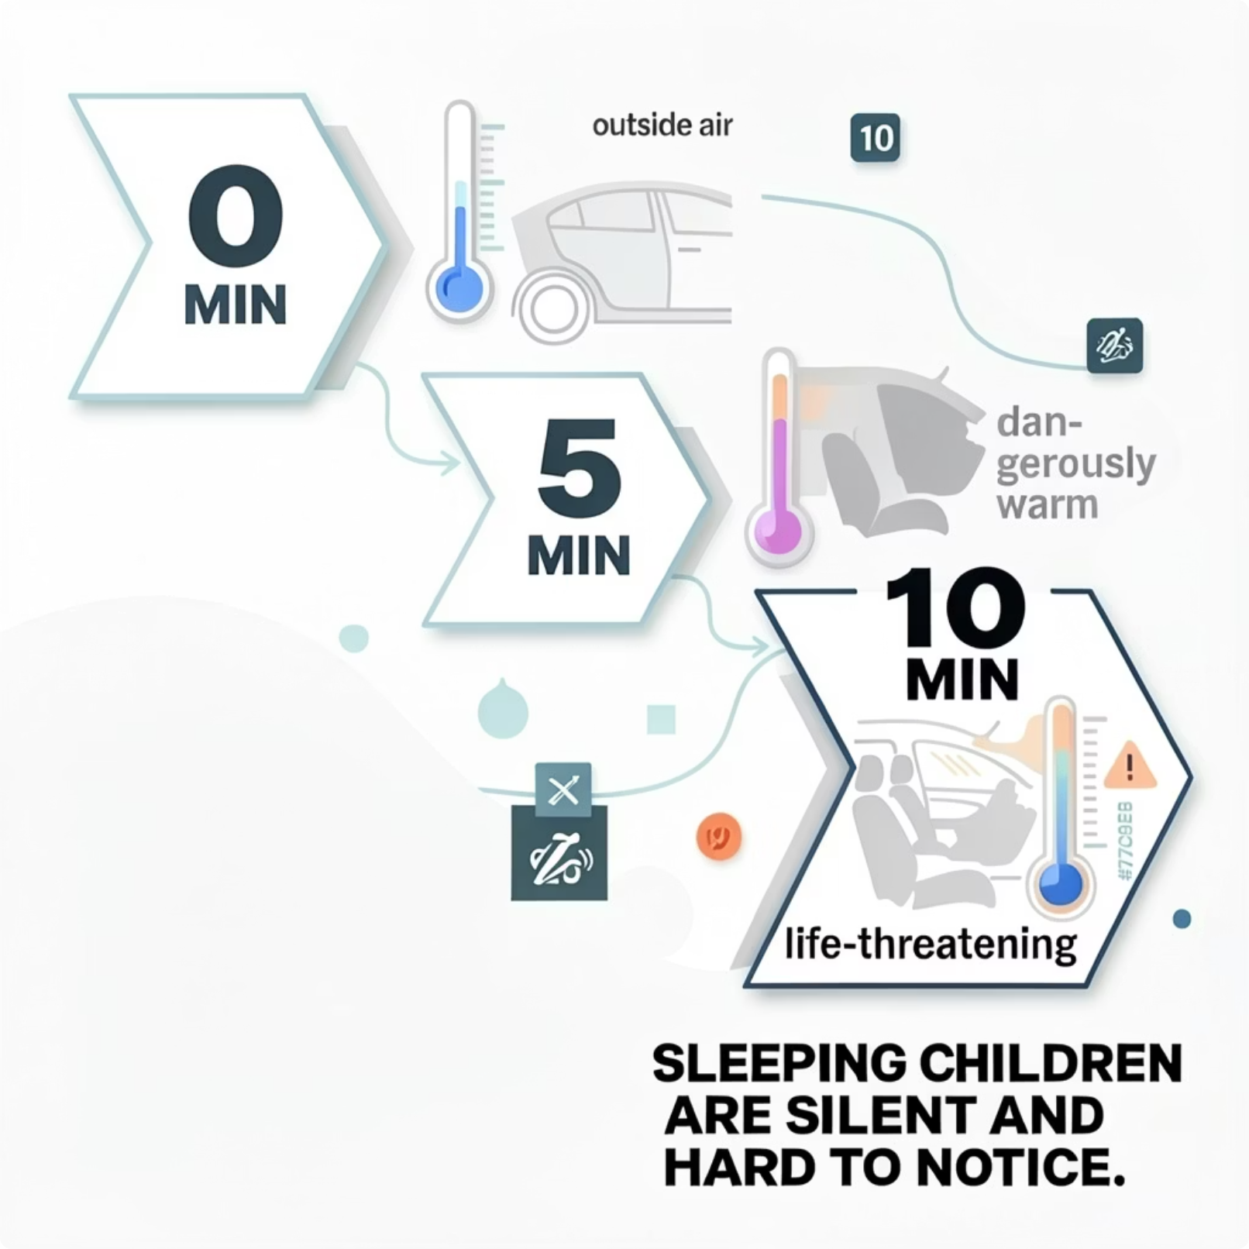
Why This Matters: The Numbers
Key Facts
Dozens of Deaths Yearly
Children die worldwide each year from vehicular heatstroke - a preventable tragedy.
+65°C in 10 Minutes
Temperature inside a closed car can spike by over 65°C in less than 10 minutes.
Body temperature rising
Body temperature rising above 40°C is defined as heatstroke and can be fatal.

Slide 4



The Stark Reality: News Reports
From knesset.gov.il

Slide 5

How C.A.R.E Works
smart, standalone automotive safety system designed to prevent fatalities and injuries resulting from children or pets being forgotten in closed vehicles.
Detect
Monitor
Alert
C.A.R.E's dual-verification technology cross-checks sensor data before triggering an alert - minimizing false alarms while ensuring no child or pet is ever missed.

Slide 6


Why Choose C.A.R.E?
Making every car safer with smart technology
Plug & Play USB
Connects instantly to any standard USB port. No technician, no tools, no hassle.
Works in Any Vehicle
Compatible with all makes and models - from compact cars to minivans and SUVs.
Dual Verification
Cross-checks multiple sensors before alerting - reducing false alarms dramatically.
Kids & Pets Protected
Detects any living presence in the back seat - children, infants, and animals alike.
C.A.R.E is the affordable, universal safety solution every parent and pet owner deserves - ready to use straight out of the box.

