Slide 1
T-Shirt Size Prediction

Slide 2
Submitted to:
Sabrina Jesmin
Lecturer
State University of Bangladesh
Submitted by:
Md. Al-moontasir
ID: UG02-47-18-026

Slide 3
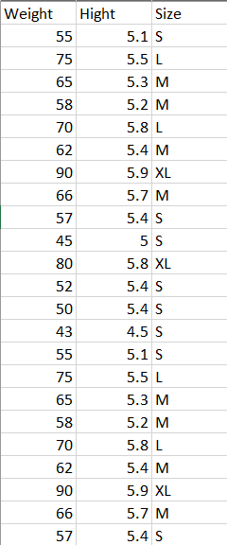
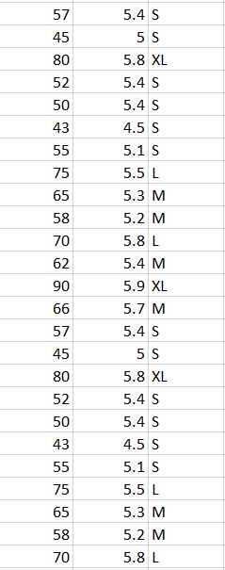
Dataset

Slide 4
Decision Tree Algorithm
Height | Weight | Size
5 | 56 | S
5.5 | 56 | M
6 | 65 | L
5.5 | 56 | S
6 | 65 | L
H | W | S
5.5 | 65 | L
5.5 | 65 | L
is weight = 56 ?
H | W | S
5 | 56 | S
5.5 | 56 | M
5.5 | 56 | S
False
True
is height = 5.5 ?
100% L
Leaf
H | W | S
5 | 56 | S
H | W | S
5.5 | 56 | M
5.5 | 56 | S
True
False
50% M
100% S
Leaf
Leaf
50% S

Slide 5
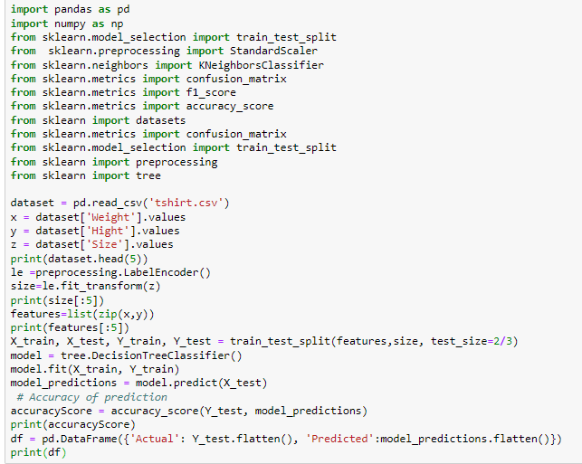
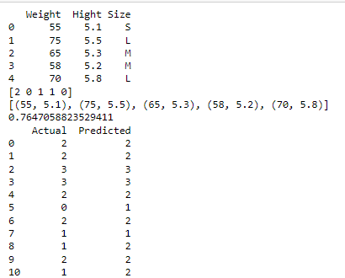
Decision Tree Algorithm
Code:
Output:

Slide 6
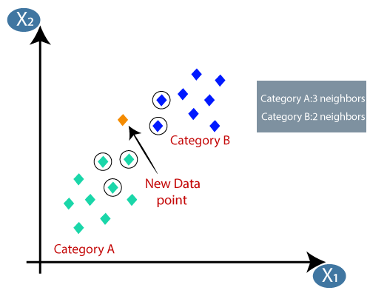
K Nearest Neighbor Algorithm
K in KNN
How do we choose K?
How KNN algorithm works?

Slide 7
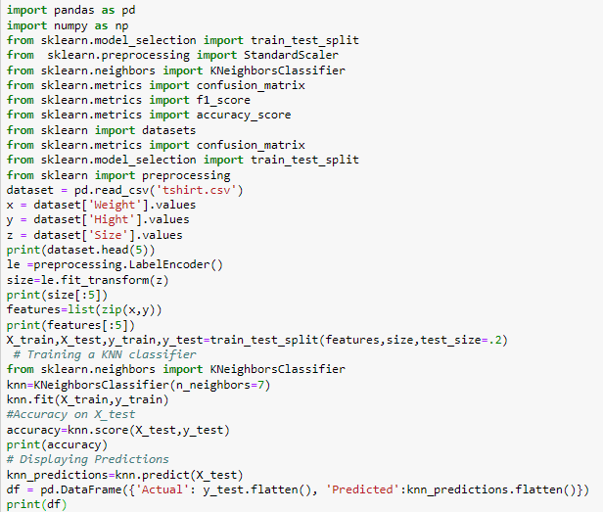
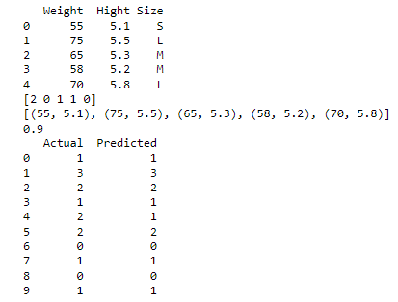
K Nearest Neighbor Algorithm
Code:
Output:

Slide 8
Result Analysis
K Nearest Neighbor Algorithm
Decision Tree Algorithm

Slide 9
Conclusion
After working on these algorithm, we both learn many important things. This project help us to understand how machine learn and take decision on various situation.
THANK YOU

