Slide 1

Job Scheduling Simulator
Matt Hunt
huntm2@go.Stockton.edu

Slide 2
Introduction
The Job Scheduling Simulator is a program that allows the user to input job data and then execute 4 different job scheduling algorithms on the created jobs
The result is the finishing time, waiting time, and turnaround time for each job, as well as the average waiting time and average turnaround time
The user has the ability the select how many jobs they want to create, what is the arrival time for that job, as well as how long is the CPU cycle for that job
The user can keep running the different algorithms until they quit the system

Slide 3
Installation and setup
Requirement: Java version 8 or higher
In order to install this program on your own computer please copy the files from the flash drive onto wherever you wish to store them on your own system
Note: it is important to keep all files inside the same directory, especially the .jar and .bat files
Note: make sure folder that files are installed in does not have a space in the name (ex: folder named “folder 1” instead of “folder1”) for some reason if the folder name has a space in it the .bat file has trouble running the .jar file
Once stored where you wish, double click to run the runJobSchedulingSim.bat file. This .bat file has the commands needed to run the program from the windows cmd

Slide 4
Installation and setup
If for some reason the .bat file fails to run the program, you will need to manually run the program from the windows cmd
Note: (java is multiplatform, these same commands should work on linux and mac as well)
On windows, open the cmd and change to the directory that you installed the JobSchedulingSim.jar file in
(EX: If installed in documents, type: cd Documents/JobSchedulingSim.jar
Once in the directory, run the command: java -jar JobSchedulingSim.jar

Slide 5
Features
When the program loads, the first thing it asks for is what algorithm you wish to run
The choices are: type “fcfs” for first come first serve, “sjn” for shortest job next, “srt” for shortest remaining time, and “rr” for round robin
User can also enter “q” at this stage which will terminate the program
After algorithm is selected, user will be asked for how many jobs they wish to create, then for the name, arrival time, and cpu cycle of each job
For round robin, the user is also asked to provide the time quantum

Slide 6
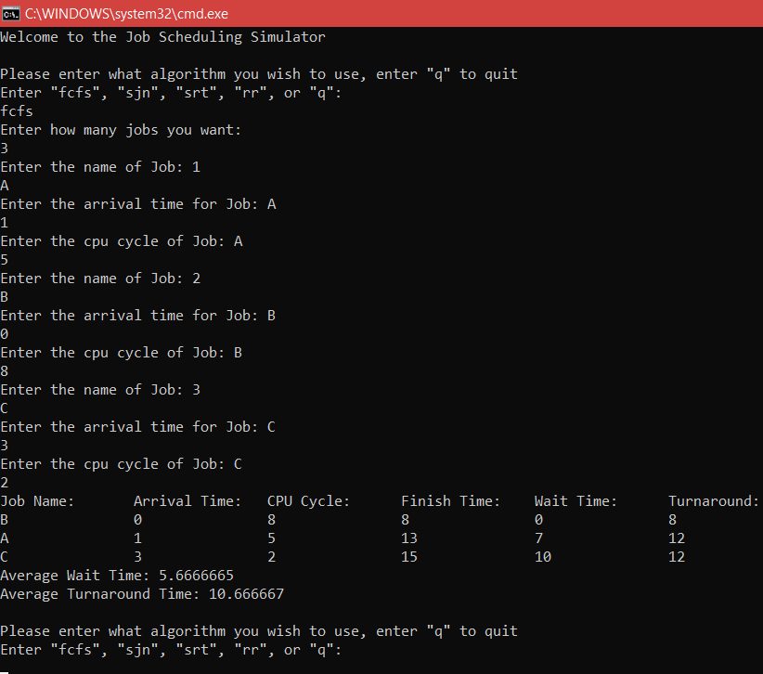
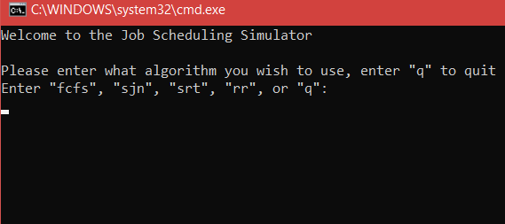

Slide 7
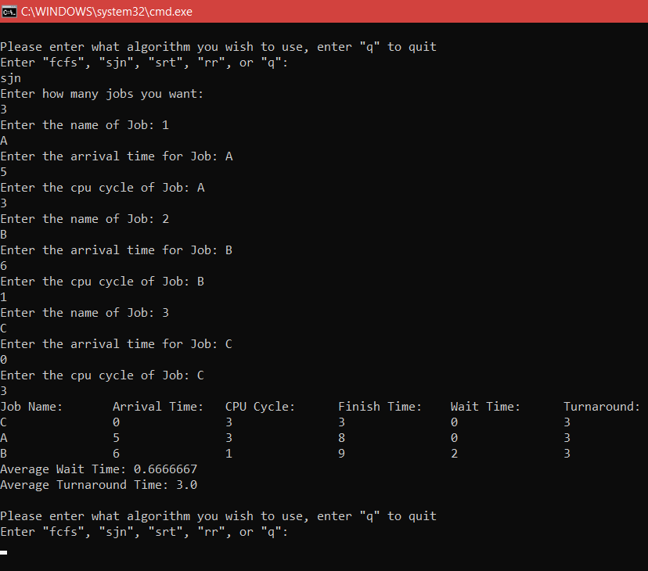
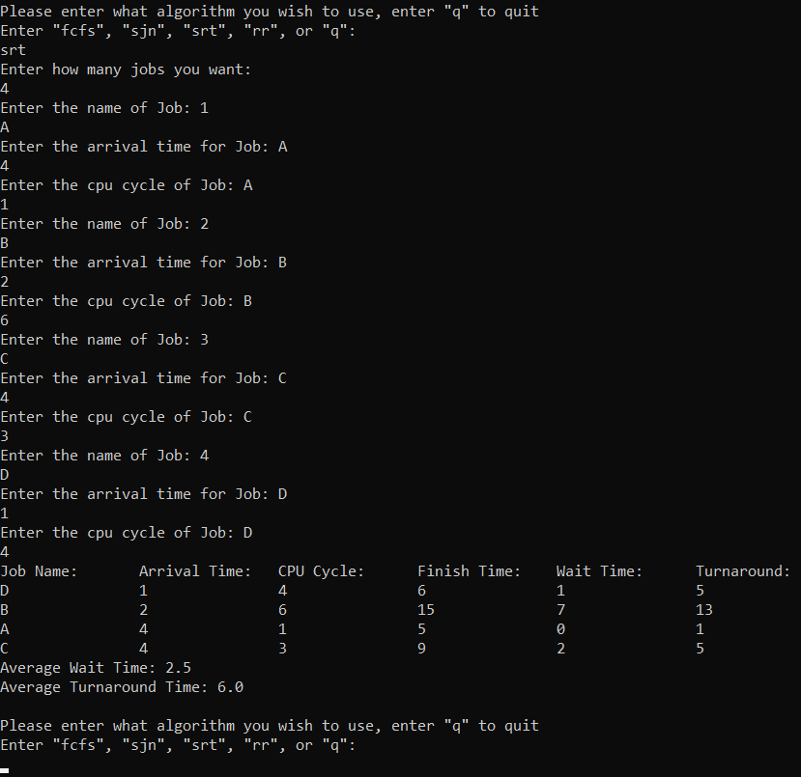

Slide 8
