Slide 1
Sleeping Barber Problem
Matt Hunt
huntm2@go.Stockton.edu

Slide 2
Introduction
This program is a simulation of how to coordinate a barber and customers in a barber shop
This program acts as a solution to the sleeping barber problem
The barber will only cut hair when there is a customer in the shop
The customer will cut their hair cut if no one else is in the shop and the barber is asleep
Starvation and deadlock are avoided by having the barber and customer check the conditions one at a time and have them run on different threads
The threads will sleep, notify, and wait at different times to signal different parts of the checks

Slide 3
Installation and setup
Requirement: Java version 8 or higher
In order to install this program on your own computer please copy the files from the flash drive onto wherever you wish to store them on your own system
Note: it is important to keep all files inside the same directory, especially the .jar and .bat files
Note: make sure folder that files are installed in does not have a space in the name (ex: folder named “folder 1” instead of “folder1”) for some reason if the folder name has a space in it the .bat file has trouble running the .jar file
Once stored where you wish, double click to run the runSleepingBarberProblem.bat file. This .bat file has the commands needed to run the program from the windows cmd

Slide 4
Installation and setup
If for some reason the .bat file fails to run the program, you will need to manually run the program from the windows cmd
Note: (java is multiplatform, these same commands should work on linux and mac as well)
On windows, open the cmd and change to the directory that you installed the SleepingBarberProblem.jar file in
(EX: If installed in documents, type: cd Documents/SleepingBarberProblem.jar
Once in the directory, run the command: java -jar SleepingBarberProblem.jar

Slide 5
Barber
Barber will check to see if there are any customers
If no customers barber will fall asleep
If there is a customer barber will cut their hair
If there is more than one customer the barber will cut in the order of arrival to the shop (first person to enter gets cut first)
Once the barber is finished cutting hair barber will check for customers again and the process repeats
This program has this process repeat in an infinite loop to simulate a constant stream of customers coming into the shop

Slide 6
Customer
Customer walks into the shop and checks to see if the barber is asleep
If the barber is asleep the customer walks them up and they get a haircut
If the barber is awake and cutting another customer’s hair then the customer checks to see if there are any chairs open
If there are chairs available the customer sits down and waits for their turn for a haircut
If the customer enters the shop and there are no seats available then the customer leaves

Slide 7
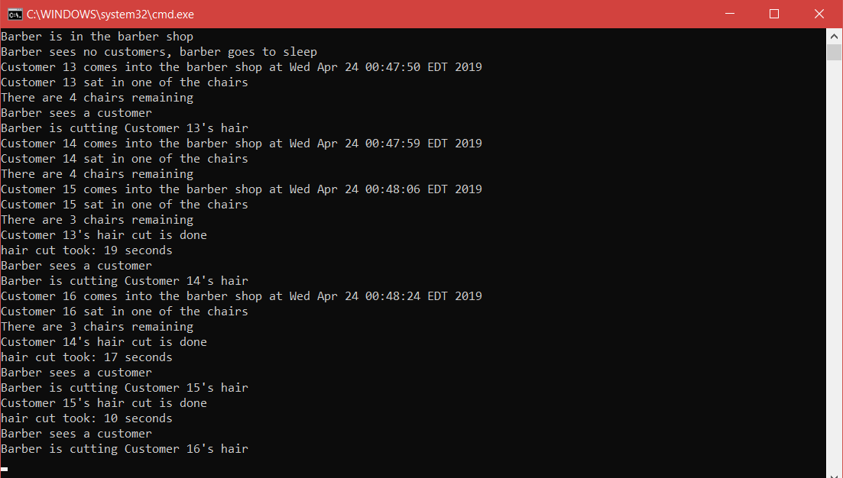
Example
Example output of the program
Important Note: the program runs on an infinite loop to simulate a constant stream of customers coming into the shop
In order to stop the program once it starts running please press ctrl + c then it will ask if you want to terminate the program, enter y to exit

