Slide 1
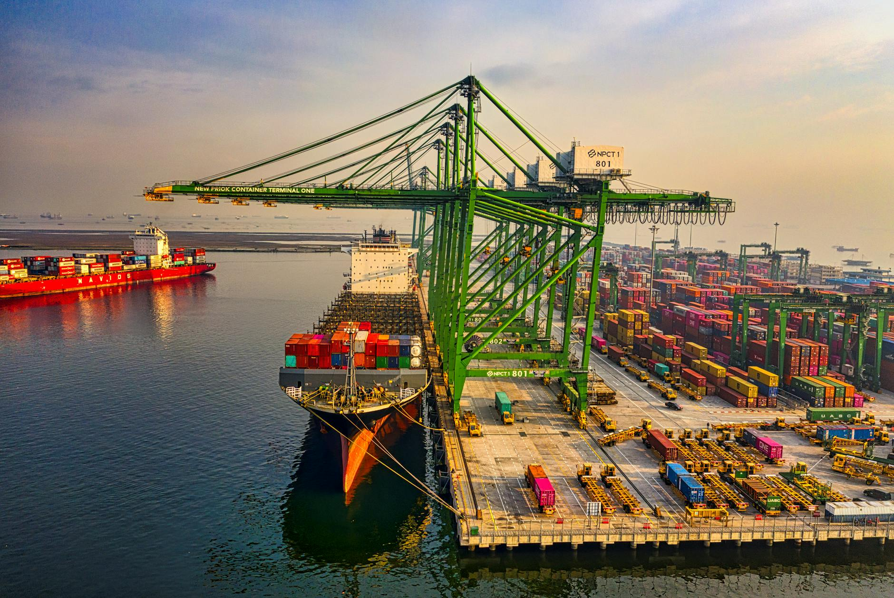
PROJECT X | EXECUTIVE SUMMARY
Investment Thesis
Project X is a leading Indian logistics and supply chain management company with over 30 years of experience, specializing in express distribution, warehousing, and transportation solutions, leveraging advanced technology and committed to sustainability.
• Leading logistics provider in India covering 99% of districts with ambitious plans to be a top-three player in express logistics, within a sector projected to grow at a ~14% CAGR.
• Leveraging advanced technology for real-time tracking, driving operational efficiency, and committed to sustainability through initiatives like 500+ alternate fuel vehicles and 25,310 tons of CO2 emissions saved.
• Demonstrated recent financial improvements with a remarkable Q3 EBITDA margin growth to 5.5% and a significant quarterly net profit increase.
GLOBAL REACH
45+ Countries
INDUSTRY RANK
Top 10
WORKFORCE
500+
Strictly Private & Confidential – Prepared by Kelp M&A Team
1

Slide 2
FINANCIAL & OPERATIONAL PROFILE
REVENUE (LATEST)
INR 15,100.1 M (2025)
EBITDA
INR 645.1 M (2025)
Strictly Private & Confidential – Prepared by Kelp M&A Team
2

Slide 3
KEY INVESTMENT HIGHLIGHTS
Growth opportunities within the express logistics sector (14% CAGR) and Project X's strategic expansion plans.
01
Improving profitability evidenced by a significant increase in EBITDA margin to 5.5%.
02
Extensive operational scale with over 30 years of experience, 344 million packages delivered, and a reach across 99% of India's districts.
03
Strictly Private & Confidential – Prepared by Kelp M&A Team
3

