Slide 1


Chatbot
For the deaf community

Slide 2


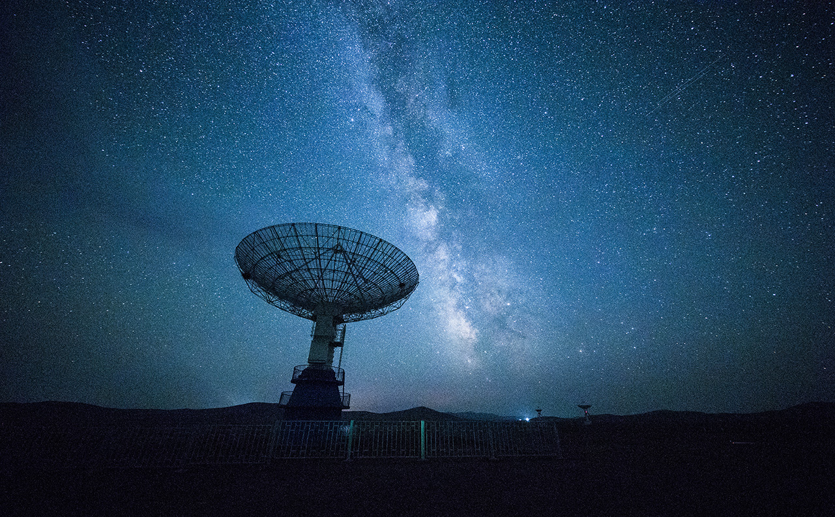
OUTLINE
Scrapping Data
Cleaning the data
Model Training
Chatbot

Slide 3
Beautifulsoup & Selenium
Create a list of websites that has information about the deaf community
Scrap the website, collect the data, clean it
Break it down into sentences and add labels to each sentence

Slide 4
DATASET PREPROCESSING
Data Cleaniing
Lemmitization
Stopwords
tokkenization

Slide 5
Model architecture
Testing different modes and comparing accuracy level
Save the model with highest accuracy
Break down the dataset into train and test data

Slide 6
Chatbot
Trained model is expected to work as intended and as predicted previously
Depending on the question, the chatbot will return the most related answer based on the training.

Slide 7

Thank You!
Fatimah Al Musawi
9000400

