Slide 1

Notes:
Welcome to Lunch and Learn 2.

Slide 2
Making a 2D Game
A 2D Scene
What is a Sprite
Tile Maps/Palettes
Character Controller
Camera Control & Animations
Demo
End of Lunch and Learn 2
Notes:
This is todays Agenda.
We are going to take a look at what a 2d scene is, and also talk about sprites and tile maps.
We are going to talk about what a character controller is followed by creating animations for our scene.
Lastly, we are going to demo our scene.

Slide 3
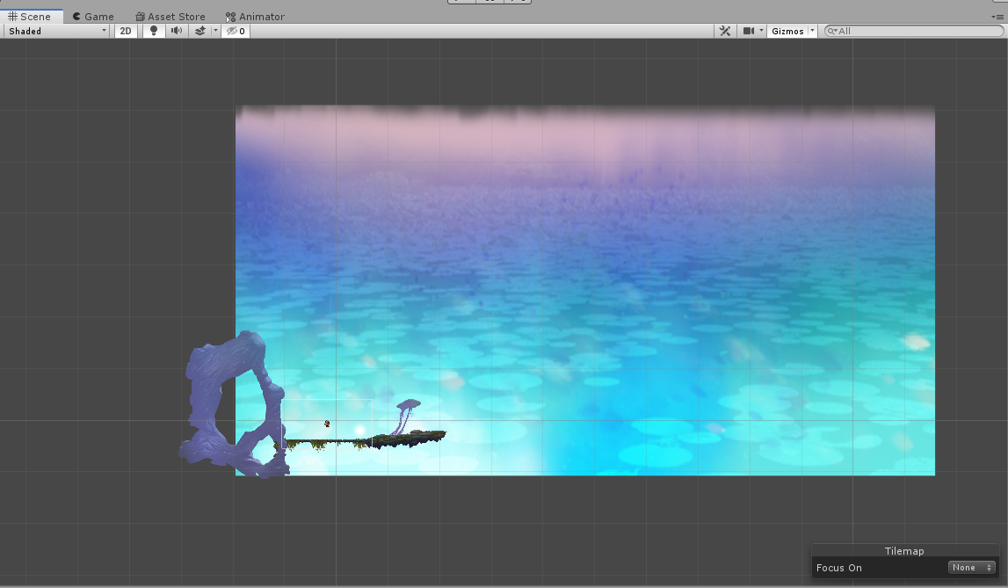
2D-Scenes
Camera Perspective
Imported Images
2D Sorting
Notes:
When in working with a 2D scene the camera perspective is set to Orthographic in other words it’s a right side (X,Y) view of the scene.
Any images you import are assumed to be 2D images (Sprites) and set to Sprite mode.
Unity also provides the option to layer sprites on top of another.

Slide 4
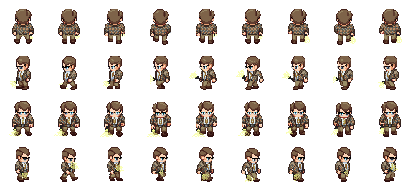
Sprites
Graphic objects in 2D scenes are known as Sprites.
Sprite Render
2D physics
Notes:
Sprites are basically just standard textures.
Sprites are rendered using unitys sprite render. In a 3 dimensional scene objects are rendered using the mesh render.
Unity uses a separate physics engine for handling 2D physics, The physics components are appended with “2D” in the component name.

Slide 5
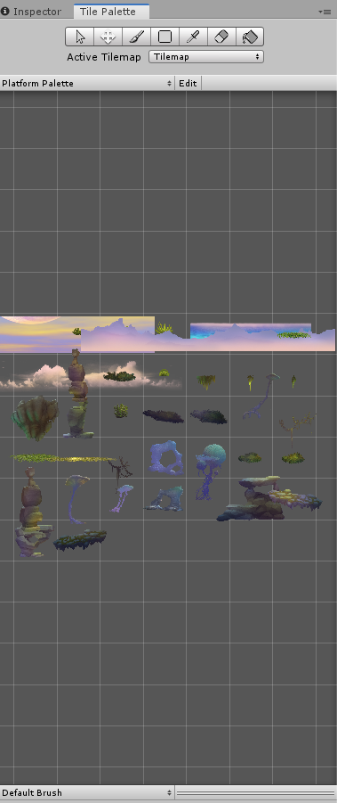
Tile Maps/Palettes
What is a Tile Map?
Tile Palette
Work Flow
Create a Tile Map
Create Tile assets
Create Tile Palette
Paint
Notes:
A Tilemap component is a system which handles Tile Assets for creating 2D levels.
Once a tile map is created a grid is placed on a 2d scene which allows to paint tiles to the environment.
The Tile Palette is the tool that stores tile assets.
The general workflow to create and paint a tile map is to first create the map, then create the tile assets, next would be to create the tile palette and lastly paint on the tile map with your tile palette.

Slide 6
Character Controller
What is a Character controller?
Features
Constrained by collisions
Notes:
A character controller is a script that allows a character to move on the x and y plane.
The controller can have different properties such as jump strength, run speed, and gravity.
A character controller is constrained by collisions.

Slide 7
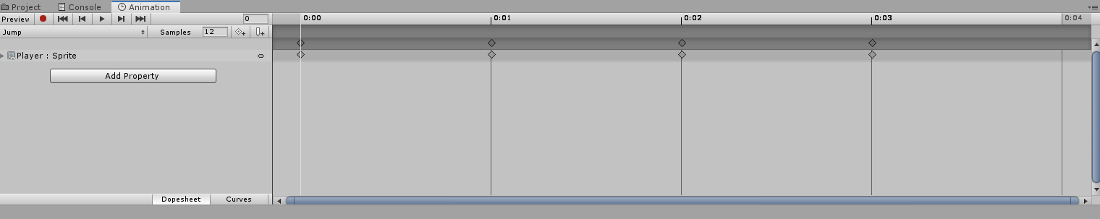
Camera Control & Animations
Camera Control
Keystore Animations
Properties
Notes:
In order for the camera to follow a main character the camera must be child the player object.
Unity uses the concept of Keystore animations. Which means when you record a change to a object unity interprets the next changes to the object.
A property can be added from the animation window. A property can be scaling, moving or rotating an object.

Slide 8
Demo

Slide 9
End Of Lunch And Learn 2

