Slide 1
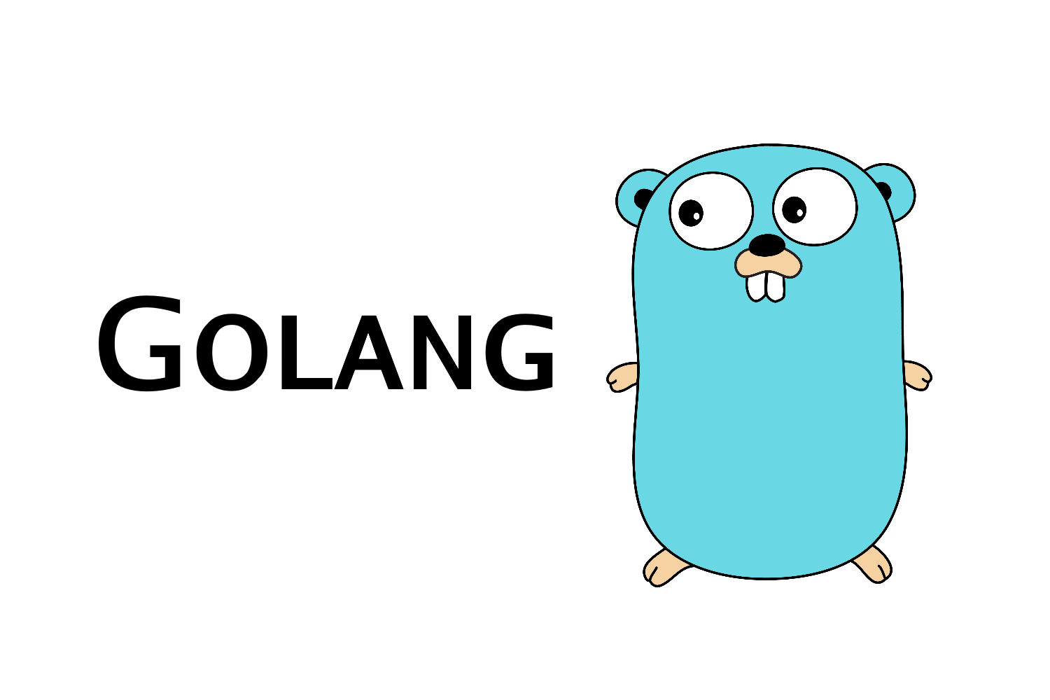

Slide 2
Installing GO!
Main Site:
https://golang.org/
Download Link:
https://golang.org/dl/
Download Tutorial using homebrew:
https://ahmadawais.com/install-go-lang-on-macos-with-homebrew/
Notes:
The main site of golang is golang.org. We need to download the correct verision from golang.org/dl/
Homebrew install is optional for macs.

Slide 3
Installing Visual Studio code
We need a code editor.
https://code.visualstudio.com/

Slide 4
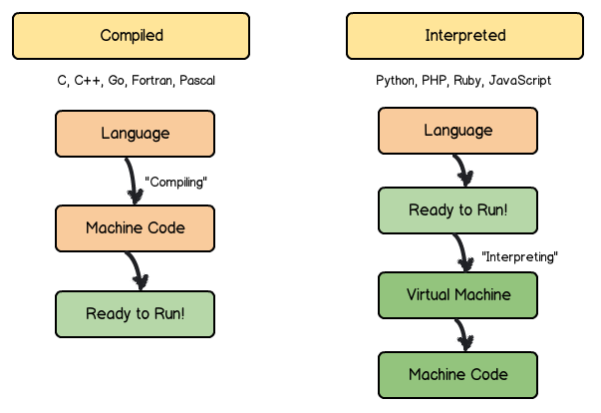
Whats Go?
Best Source to find more on Go: https://golang.org/doc/faq
Documentation: https://golang.org/doc/
Built by google!
Compiled Language:
Notes:
The best place to find information about go is the FAQs. Documentation to go is just /doc
Built by google in 2008.
Go is a low level language, it doesn’t need an interpreter to run. It is comparable to C, and C++.

Slide 5
Companies that use go.
Google – Many projects
MongoDB - Tools for administration
Twitch.tv - IRC-based chat system(Migrated from python)
Netflix - Portions of there server architecture

Slide 6

It’s Open-source
https://go.googlesource.com/go
Current Version: 1.12
Notes:
Go has a large community of backers working on the project with the current version at 1.12.

Slide 7
Lets start coding…
App 1: HelloWorld.go
App 2: HelloLocalhost.go
App 3: Dance.go

Slide 8
A tour of golang.
https://tour.golang.org/welcome/1
Notes:
If we have time we can go through the tour of go.

Slide 9
Sources/Credit:
https://medium.freecodecamp.org/learning-go-from-zero-to-hero-d2a3223b3d86
https://code.visualstudio.com/
https://medium.com/@astermanuelg/blurred-lines-is-ruby-an-interpreted-language-2d3d6bca3d37
https://www.youtube.com/watch?v=G3PvTWRIhZA&list=PLQVvvaa0QuDeF3hP0wQoSxpkqgRcgxMqX&index=1

