Slide 1
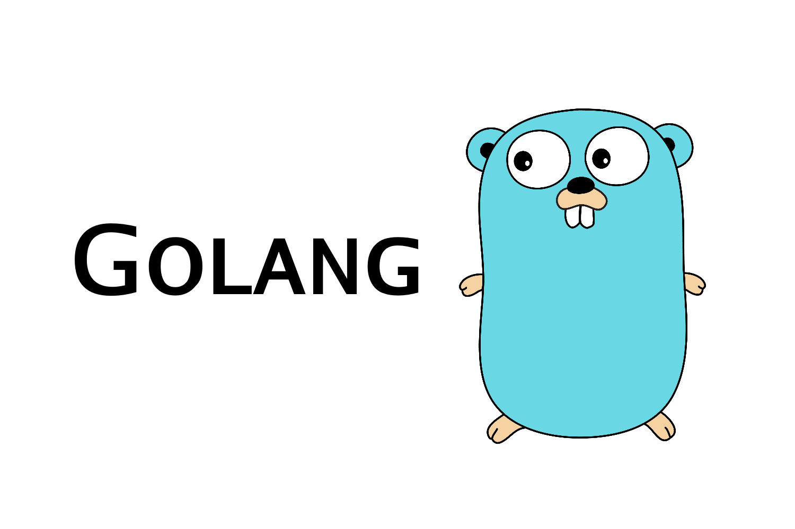

Slide 2
Agenda
Packages
Structs
Interfaces
os/exec
Cgo
Delve – Debugging point.go
Golang Development Frameworks
Notes:
The agenda today will cover 7 topics
Packages, pointers os/exec, Cgo, delve the debugging tool and the variety of golang development frameworks.

Slide 3
Packages
A package is just a directory with files of code.
Package Example:
Aliases
import "fmt"
“fmt” is the package name.
import format "fmt“
format.Printf(“%s”, stdout)
Notes:
-Golang allows for multiple files under the same folder with the same package name.
-Golang does not allow for multiple package names under the same directory.
-In other words One package per directory.
-A directory should only have one package main although it doesn’t throw a compilation error.
Examples to cover: util, mathPackage, package_tutorial
Package_tutorial – The package tutorial uses 3 packages lets cover the first package util.
Util – By convention package names are named the same thing as the directory name.

Slide 4
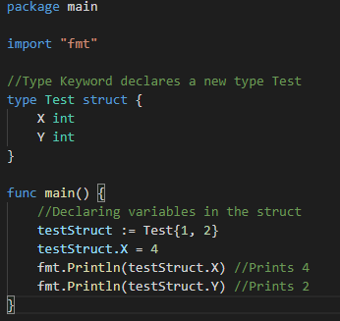
Structs
Golang allows for an object orient style of programming.
A struct is a collection of fields.
Notes:
-Golang is not a pure object oriented programming language. It does not provide classes.
-Side notes:
Yes and no. Although Go has types and methods and allows an object-oriented style of programming, there is no type hierarchy. The concept of “interface” in Go provides a different approach that we believe is easy to use and in some ways more general. There are also ways to embed types in other types to provide something analogous—but not identical—to subclassing. Moreover, methods in Go are more general than in C++ or Java: they can be defined for any sort of data, even built-in types such as plain, “unboxed” integers. They are not restricted to structs (classes).

Slide 5
Interfaces
An interface type is defined as a set of method signatures.
Example:
Shapes.go
Notes:
Lets take a look at shapes.go

Slide 6
os/exec
Golang offers the ability to run external commands.
Functions that are used:
date.go
ls.go
func Command(name string, arg ...string) *Cmd
func (c *Cmd) Output() ([]byte, error)
func (c *Cmd) Run() error
Notes:
Let’s discuss the topic of os and exec (egg-sec).
Golang offers the ability to run external commands.
These are some functions that we will use to call the date command and ls command.
Command returns the Cmd struct to execute the named program with given arguments.
Output runs the command and returns its standard output and any errors .

Slide 7
Cgo
Enables the creation of Go packages that call C code.
Documentation: https://golang.org/cmd/cgo/
Example: Webview
Notes:
The documentation for using Cgo exists on the golang.org. A time you would need this is when C has implemented a feature that doesn’t exist in golang an example is a webview.
I found this out when I attempted to create a web browser using golang. https://github.com/zserge/webview

Slide 8
Delve
Delve the debugger for Golang
https://github.com/go-delve/d
Debugging point.go
Notes:
-Delve is the most popular open source debugger for golang programming language.
-The source code is hosted on github.
-Let’s practice by debugging point.go
https://github.com/go-delve/delve
Start the debugger | dlv debug
Set a breakpoint | break point.go:8
List the breakpoints | breakpoints
Goto breakpoint | continue
Setover | n
To print a variable | print (varName)
Restart process | r
Or just use the vscode GUI Debugger.

Slide 9
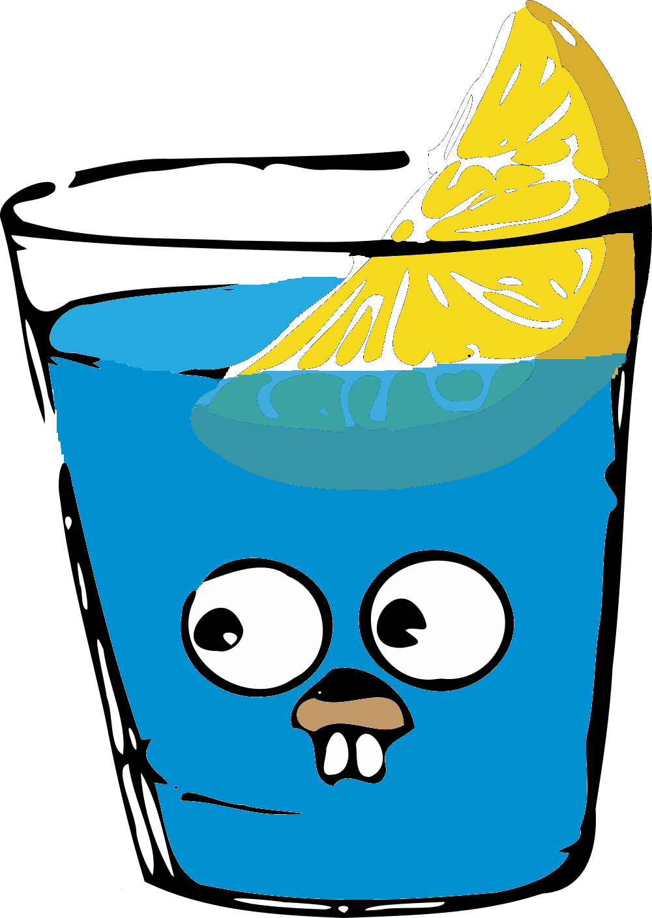
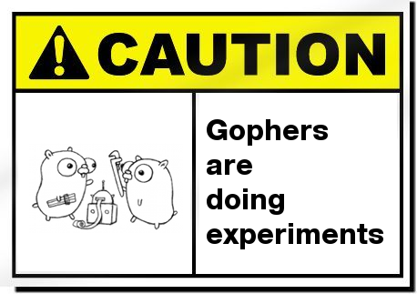
Golang Development Frameworks
Gin Gonic
GXUI, Fyne
GoMobile
Notes:
- Gin Gonic - is a HTTP web framework used to make Rest API and other web services.
- GXUI - is a cross platform UI library used to make desktop applications.
- gomobile – Cross platform mobile development framework. Used to build android and iOS apps in golang.
https://godoc.org/golang.org/x/mobile/cmd/gomobile

Slide 10
Up next:
Create: GUI app using Fyne Or Qt
Create: Todo-List Web Application
Create: Console application that pipes with other terminal commands
Create: Mobile App using GoMobile
Notes:
Create: GUI app using Fyne
Create: Todo-List Web Application
Create: Console application that pipes with other terminal commands – So for example prettify the html or json result from the curl command.
Create: Mobile App using GoMobile

