Slide 1
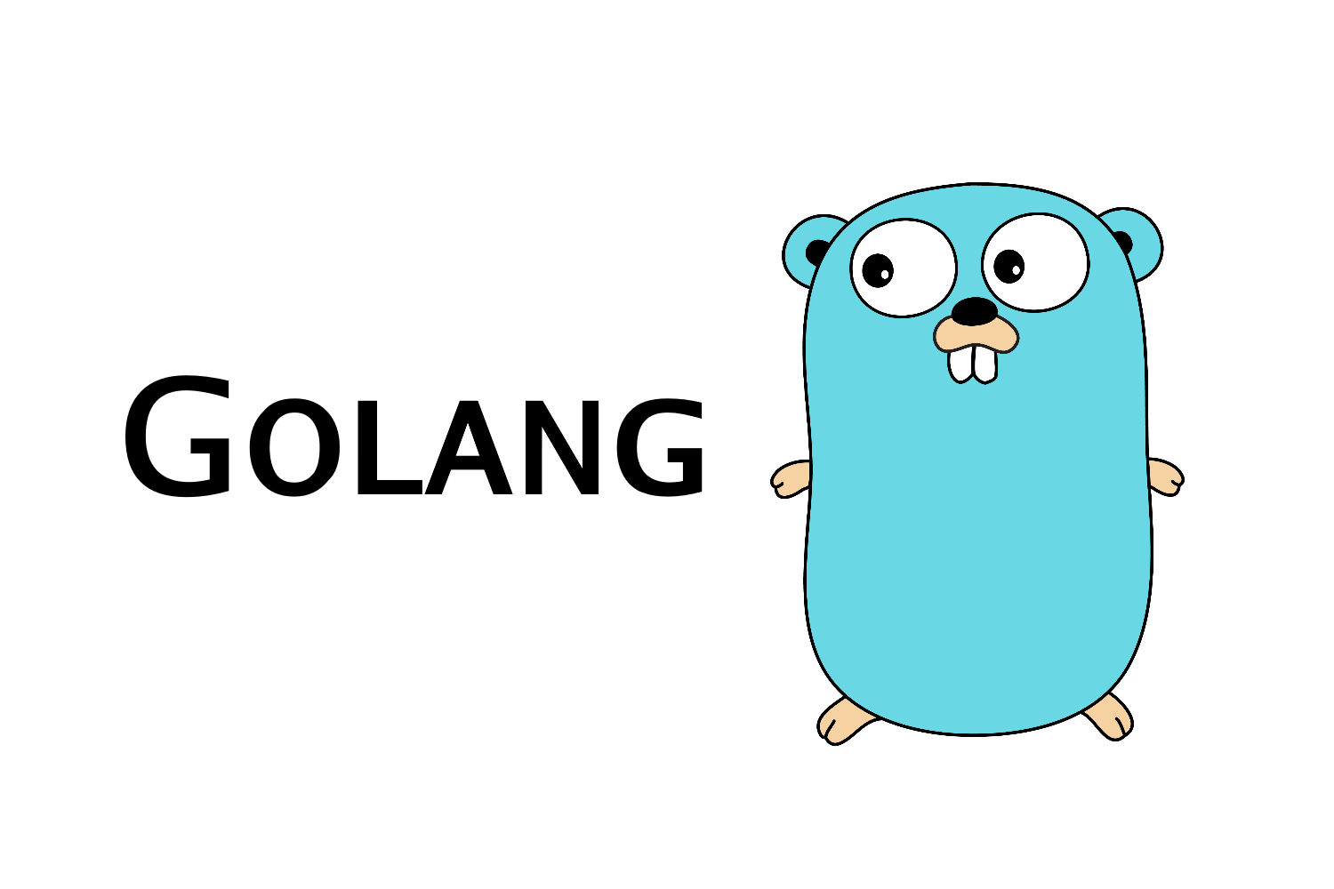

Slide 2
Packages
A package is just a directory with files of code.
Package Example:
Aliases
import "fmt"
“fmt” is the package name.
import format "fmt“
format.Printf(“%s”, stdout)
Notes:
-Golang allows for multiple files under the same folder with the same package name.
-Golang does not allow for multiple package names under the same directory.
-In other words One package per directory.
-A directory should only have one package main although it doesn’t throw a compilation error.
Examples to cover: util, mathPackage, package_tutorial
Package_tutorial – The package tutorial uses 3 packages lets cover the first package util.
Util – By convention package names are named the same thing as the directory name.

Slide 3
Pointers

Slide 4
Delve
Delve the debugger for Golang
https://github.com/go-delve/d
Debugging point.go
Notes:
-Delve is the most popular open source debugger for golang programming language.
-The source code is hosted on github.
-Let’s practice by debugging point.go

Slide 5
os/exec
Golang offers the ability to run external commands.
Functions that are used:
date.go
ls.go
func Command(name string, arg ...string) *Cmd
func (c *Cmd) Output() ([]byte, error)
func (c *Cmd) Run() error
Notes:
Let’s discuss the topic of os and exec (egg-sec).
Golang offers the ability to run external commands.
These are some functions that we will use to call the date command and ls command.
Command returns the Cmd struct to execute the named program with given arguments.
Output runs the command and returns its standard output and any errors .

