Slide 1
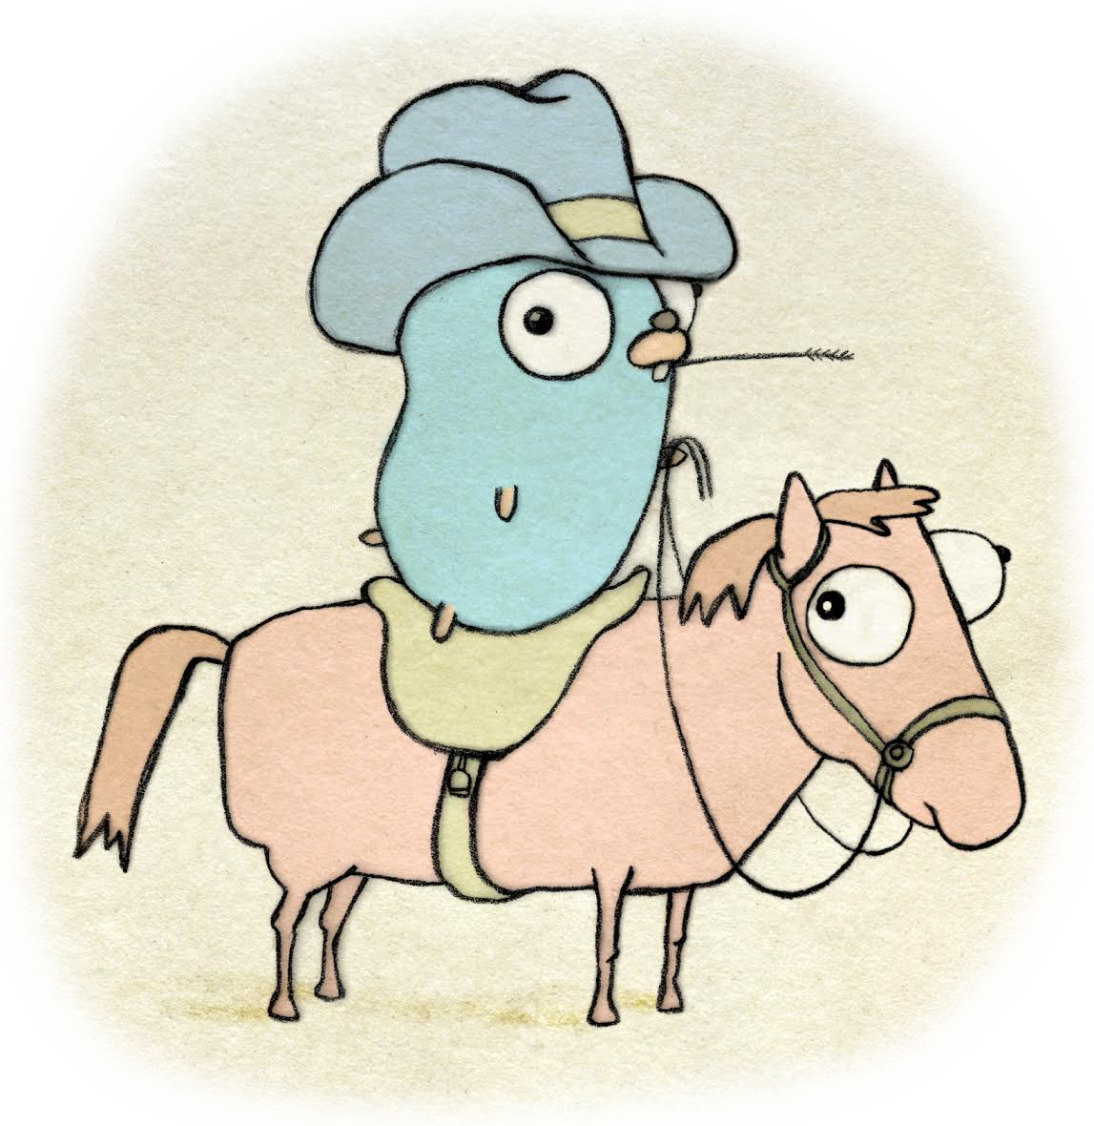

GoMobile
and gobuffalo
Notes:
Welcome to the 3rd lunch and learn for golang. Todays topic is gomobile, and gobuffalo

Slide 2
Agenda
Overview
Features/Getting Started
Demo gomobile
Testing
GoBuffalo
Conclusion

Slide 3
Overview
Package app
`gomobile build`
Event processing in Native Apps
import "golang.org/x/mobile/app"
Notes:
Package app lets you write portable all-Go apps for Android and iOS.
Apps written entirely in Go have a main function, and is built with `gomobile build`, which directly produces runnable outputs for Android and iOS.
The Go runtime is initialized on Android when NativeActivity onCreate is called, and on iOS when the process starts.

Slide 4
Features/Getting Started
Features:
Native applications/SDK applications
Some packages:
event/lifecycle
exp/sensor
cmd/gobind
Getting Started:
go get golang.org/x/mobile/cmd/gomobile
Notes:
Native applications can be written entirely with gomobile there is also the SDK where you can bind go to java and objective-c.
Package lifecycle defines an event for an app's lifecycle.
Package sensor provides sensor events from various movement sensors.
Gobind generates language bindings that make it possible to call Go functions from Java and Objective-C.
To get started with gomobile you need to install the go mobile tools.

Slide 5
Demo
https://github.com/golang/mobile/tree/master/example/network
network.go

Slide 6
Testing
import "golang.org/x/mobile/app/internal/apptest"
Package apptest
Incomplete – Currently only supports iOS
Notes:
https://godoc.org/golang.org/x/mobile/app/internal/apptest
Package apptest provides utilities for testing an app.
According to there website the testing utility “Is extremely incomplete, hence it being internal. For starters, it should support iOS.”
With this I wanted to talk about the verdict of if I would choose to use gomobile.
Would I choose gomobile over what is currently the majority language of java, kotlin, swift, or OBJ C. no because of limited support for this library.
Currently its only been 4 years in development and the last update to the code base was 2months ago.

Slide 7
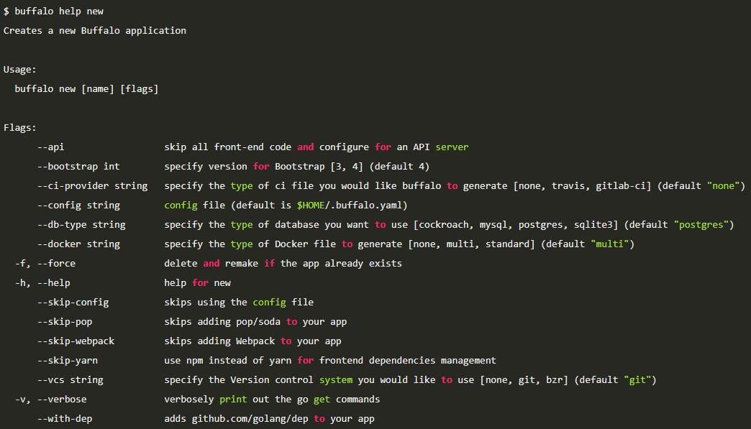
GoBuffalo
Rapid Web Development
Actions
Templates
Demoing GameOfBuffalo
Notes:
-Gobuffalo is a web framework for the golang language and is used for rapid web development.
-To generate a new buffalo project, run the `buffalo new (name of site)` cmd.
-Running the buffalo dev cmd starts the server on a default port.
-Actions is a directory where all of you go code goes, inside an action file is a mapping of an http verb(get,put,post), a route, and a handler
-Templates is the directory where all of your html goes.
-GoBuffalo is golangs version of ruby on rails.
Some common commands I wanted to demo is
-buffalo generate --help // The buffalo generate command will allow you to generate action files, docker files, and other code files.
-buffalo generate resource //generates models, locales, setups crud pages, and a handler.
-buffalo db create –a: this will create the databases defined in the database.yml file
-buffalo dev: to run the buffalo app in dev mode.

Slide 8
End of Lunch and Learn 3

