Slide 1

Database Management System
Author: Al Noman Robin
robinalnoman@gmail.com
Date: 11.01.2026

Slide 2
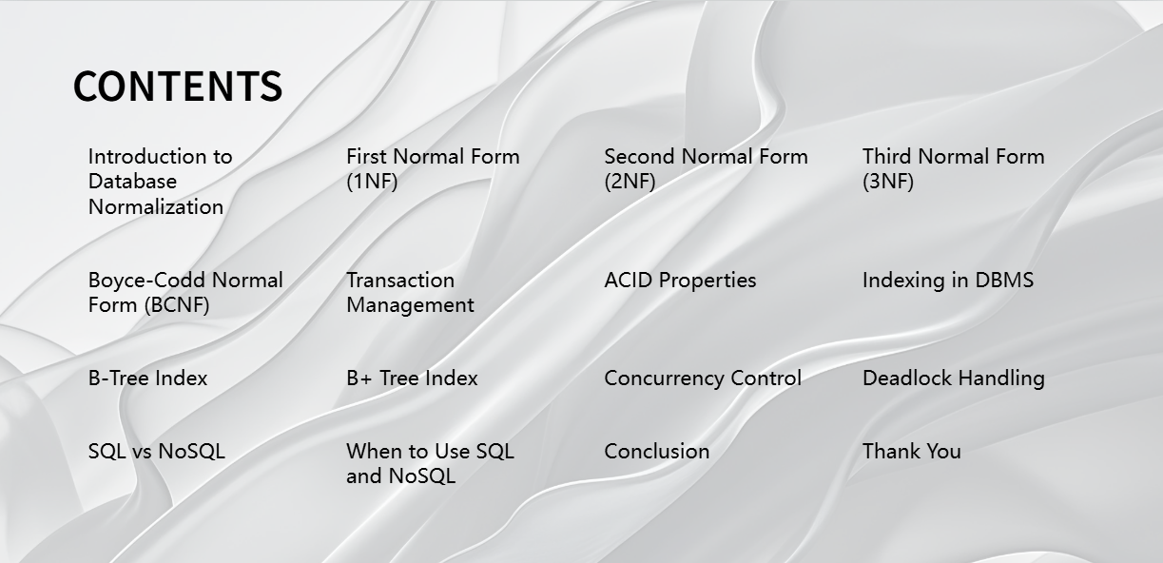

Slide 3
1. Introduction to Database Normalization
Database Normalization is a process of organizing data in a database. The main goals are:
Reduce data redundancy
1
2
Eliminate data inconsistency
3
Improve data integrity
Normalization is done through different normal forms.

Slide 4
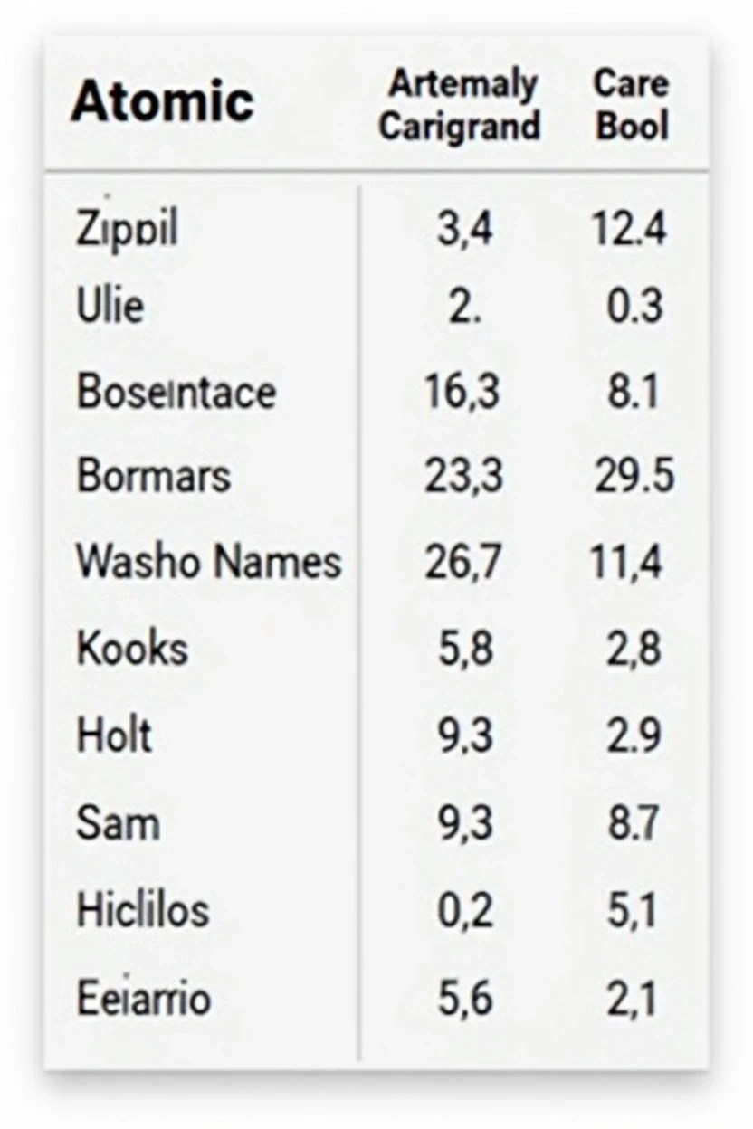
2. First Normal Form (1NF)
Rules
• Each field contains atomic (indivisible) values.
• No repeating groups or multivalued attributes.
• Each column must have a unique name.
Example
• ❌ Phone: 017xx, 018xx
• ✅ Phone1, Phone2 in separate columns.

Slide 5
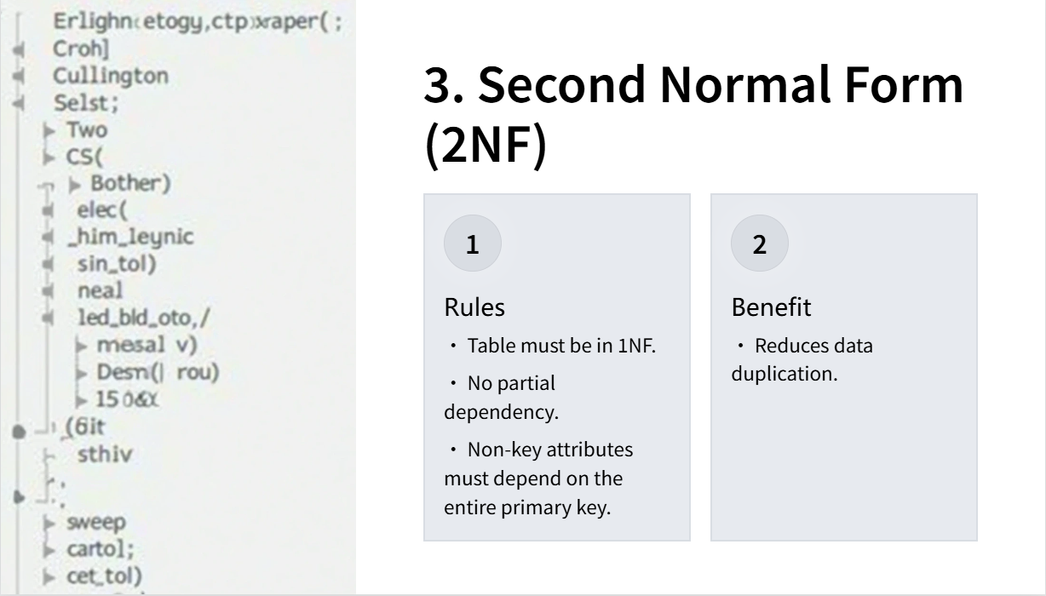

Slide 6
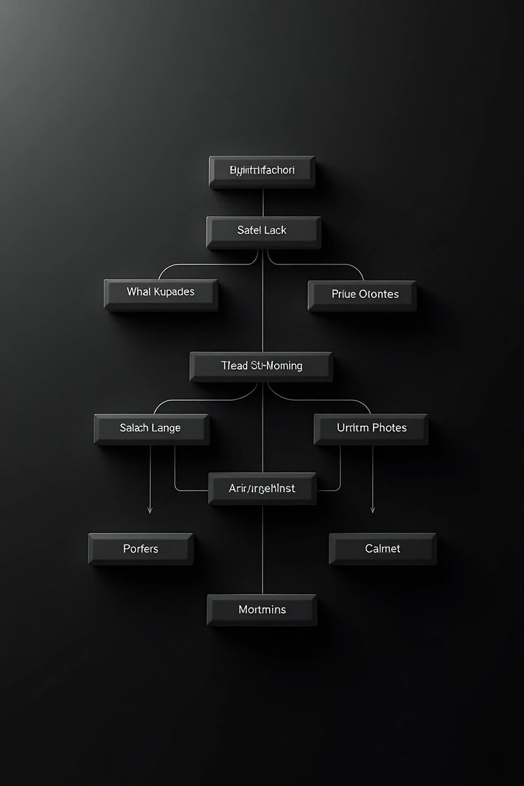
4. Third Normal Form (3NF)
Rules
• Table must be in 2NF.
• No transitive dependency.
• Non-key attributes should not depend on other non-key attributes.
Benefit
• Improves data consistency.

Slide 7
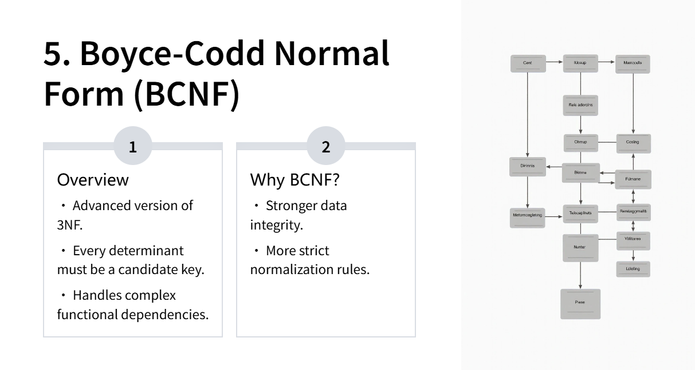

Slide 8

6. Transaction Management
A transaction is a logical unit of work in a database. It may contain one or more database operations. For example, in an ATM transaction:
Debit amount.
Update account balance.
If any step fails, the transaction is rolled back.

Slide 9
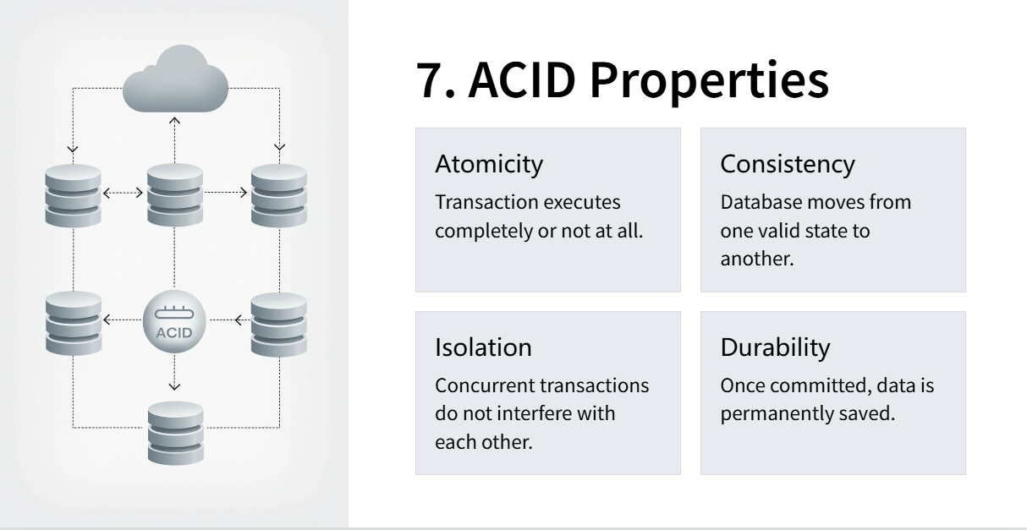

Slide 10

8. Indexing in DBMS
Indexing is a technique to retrieve data faster. It creates a data structure for quick searching. The advantages include:

Slide 11

9. B-Tree Index
01. Overview
• Balanced tree data structure.
• Data stored in sorted order.
• Each node can have multiple keys and children.
02. Applications
• Database indexing.
• File systems.

Slide 12

10. B+ Tree Index
Overview
• Improved version of B-tree.
• All data stored only in leaf nodes.
• Leaf nodes are linked together.
Advantages
• Faster range queries.
• Most commonly used indexing method in DBMS.

Slide 13
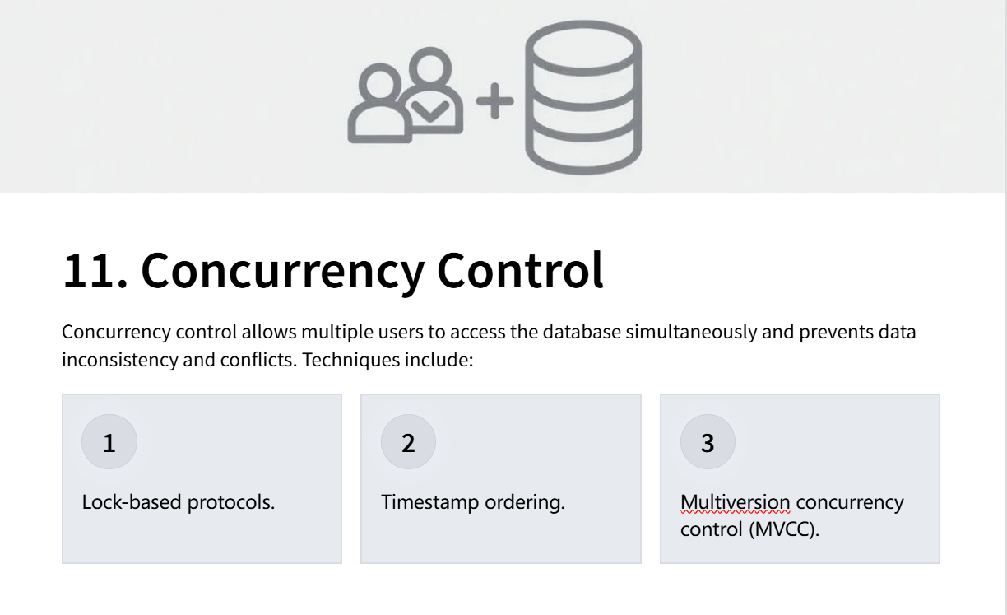

Slide 14

12. Deadlock Handling
Overview
• Deadlock: Situation where two or more transactions wait indefinitely for resources held by each other.
Handling Methods
• Deadlock prevention.
• Deadlock detection.
• Deadlock recovery.

Slide 15
13. SQL vs NoSQL
SQL | NoSQL
Relational databases | Non-relational databases
Fixed schema | Flexible schema
Table-based structure | Document, Key-Value, Graph
Strong ACID compliance | BASE consistency

Slide 16
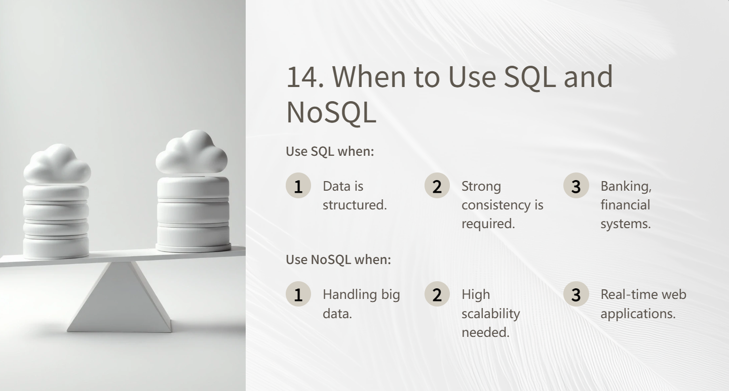

Slide 17

15. Conclusion
Normalization improves database design. ACID properties ensure transaction reliability. Indexing enhances performance. Concurrency control maintains consistency. SQL and NoSQL serve different purposes.

Slide 18

Thank You
Thank You for Listening.
Any Questions?

