Slide 1


Traveling Salesman Problem: Greedy, Dynamic Programming, Backtracking & Pruning

Slide 2


Presented By: Team TSP Troopers
Members are:
Ava-03
Mizan-15
Robin-19
Tonmoy-36
Date:14-08-2025

Slide 3
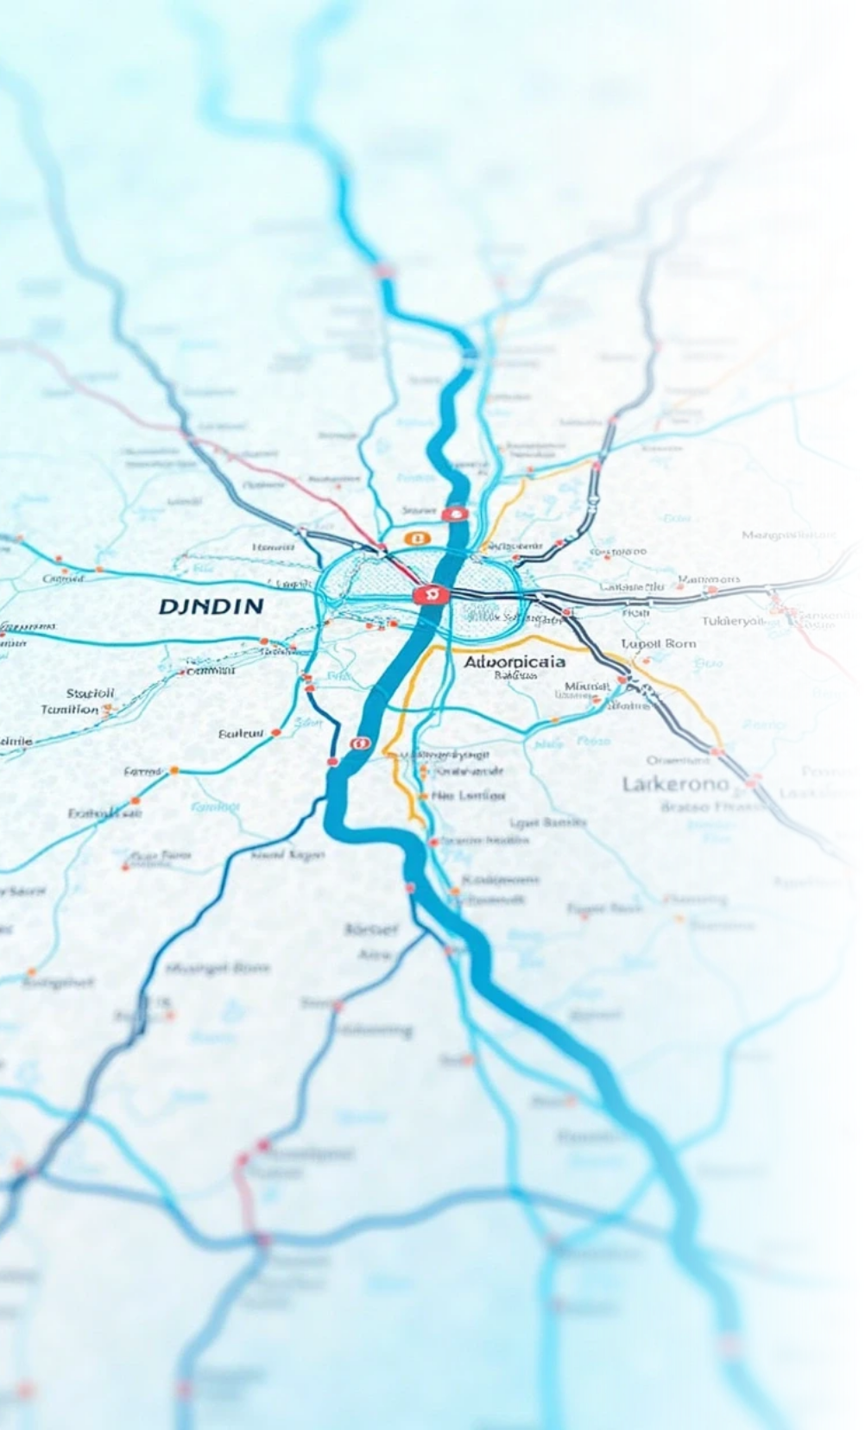


01
What is TSP?
The Traveling Salesman Problem is a classic optimization
problem.
Given a list of cities and distances between them,
Find the shortest possible route that visits each city
exactly once and returns to the starting city.
Why is it important?
:
Used in logistics, planning, manufacturing, and more.

Slide 4

02
TSP Problem Example
Suppose there are 4 cities: A, B, C, D
Distances:
A → B = 10
A → C = 15
A → D = 20
Find the shortest route visiting all cities once and return to A.
B → C = 35
B → D = 25
C → D = 30

Slide 5



03
Greedy Approaches (Heuristics)
Working Principle:
Start from a city, visit the nearest unvisited city until all are
visited, then return.
Example:
From city A, nearest is B (10), then from B → D (25), then D → C (30), back to A (15).
Time Complexity: O(n²) — fast but not always optimal

Slide 6

04
Pseudo Code:
start_city = A
current_city = start_city
visited = {start_city}
while visited.size < total_cities:
next_city = find_nearest_unvisited(current_city)
visited.add(next_city)
current_city = next_city
return to start_city

Slide 7
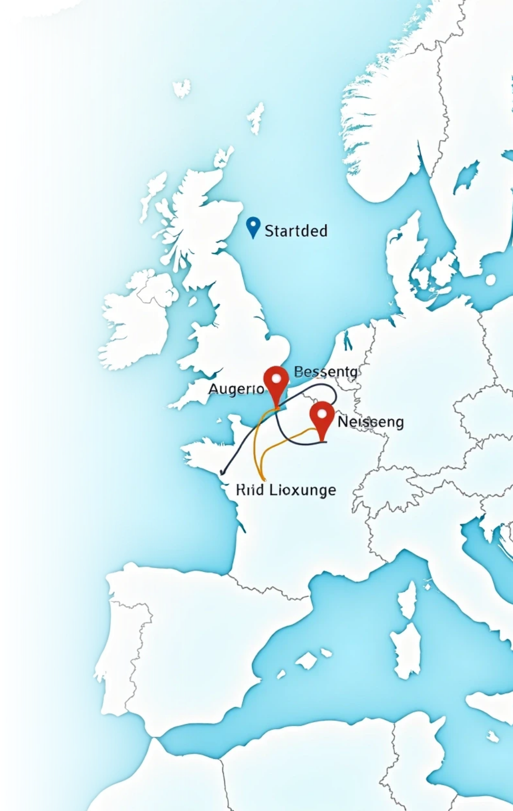
05
Method 2 - Dynamic Programming (Held-Karp)
Working Principle:
Solve TSP by storing solutions of subproblems (subsets of cities), then build up the solution.
Example:
Calculate shortest routes for subsets like {A,B}, {A,C}, {A,B,C} etc.
Time Complexity: O(n² * 2^n) — exact but exponential.

Slide 8


06
Pseudo Code
for each subset S of cities including start:
for each city j in S:
cost[S][j] = min( cost[S - {j}][i] + dist[i][j] ) for all i in S - {j}
final_answer = min( cost[all_cities][j] + dist[j][start] ) for all j

Slide 9
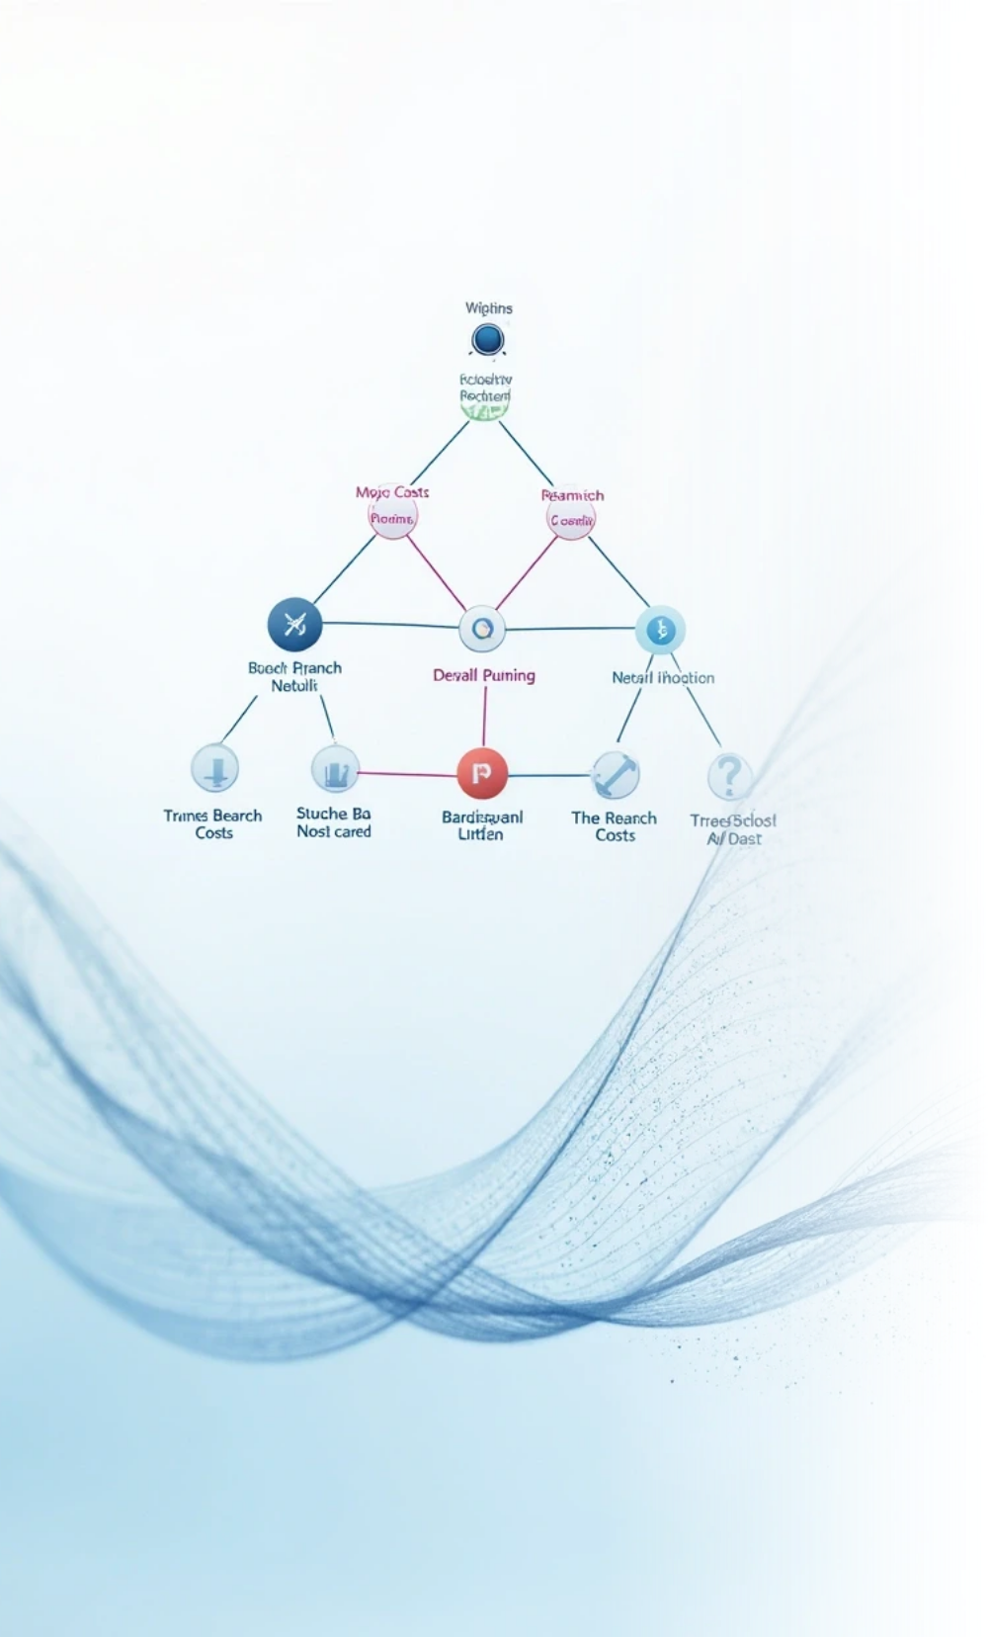
07
Method 3 - Backtracking with Pruning
Working Principle:
Try all permutations recursively.
If partial path cost already exceeds best known, prune (stop exploring)
that path
Example:
Explore route A → B → C → D.
If partial cost > best cost, backtrack early.
Time Complexity:
Worst O(n!) but pruning reduces runtime.

Slide 10
08
Pseudo Code:
function tsp(path, visited, current_cost):
if all cities visited:
update min_cost if current_cost + return_cost < min_cost
return
for each city not in visited:
if current_cost + dist[last_city][city] < min_cost:
tsp(path + city, visited + city, current_cost + dist[last_city][city])

Slide 11
09
Comparison of Approaches
Algorithm | Time Complexity | Optimality | Best Use Case
Greedy | O(n²) | Approx. | Large, fast
DP (Held–Karp) | O(n²·2ⁿ) | Exact | Small/medium
Branch & Bound | Exponential | Exact | Moderate n

Slide 12

10
Conclusion
1.TSP is a fundamental problem in optimization.
2.Greedy is fast but approximate.
3.Dynamic Programming balances exactness and efficiency for moderate n.
4.Backtracking guarantees exact solutions but often impractical for large n.
5.Choose the method based on problem size and accuracy requirements.

Slide 13

Thank You

