Slide 1





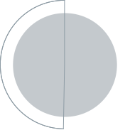






International Conference on Electrical, Computer and Communication Technologies (ECCT 2026)
Paper ID:
571
Paper Title:
Impact of Social Media Usage on Academic
Performance: A Hybrid Machine Learning and
SEM Approach
Presenter:
Md. Mehedi Hasan
Date:
08/05/2026
Organizer
Publication Partner
Support Partner

Slide 2
Authors
Md. Alnoman Robin Mrida, Dept. of CSE, Dhaka International University.
Md. Mehedi Hasan, Dept. of CSE, Dhaka International University.
S M Nabil Ausaf, Dept. of CSE, Dhaka International University.
Paritosh Chandra Ray, Dept. of CSE, Dhaka International University.
Hasan Al Monsur, Associate Director, IS Audit & IT Advisory Services, ACNABIN Chartered Accountants.
Md. Abdul Based, Dept. of CSE, Dhaka International University.
International Conference on Electrical, Computer and Communication Technologies (ECCT 2026)
02

Slide 3
Contents
Introduction
Problem Statement
Related Work
Research Questions
Objectives
Methodology
Results
Outcomes & Impacts
Conclusion
Future Directions
References
International Conference on Electrical, Computer and Communication Technologies (ECCT 2026)
03

Slide 4
Introduction
Rapid growth of digital technologies has transformed student learning and interaction.
Social media plays a dual role: learning tool vs. distraction.
Prior research shows conflicting effects on academic performance.
Need for a comprehensive, data-driven approach.
This study proposes a hybrid Machine Learning + SEM framework.
International Conference on Electrical, Computer and Communication Technologies (ECCT 2026)
04

Slide 5
Problem Statement
Existing studies:
Focus either on prediction (ML) or explanation (SEM).
Lack of:
Integrated frameworks combining both.
Generalizable, multi-country insights.
Challenge:
Capturing complex behavioral relationships affecting academic outcomes.
International Conference on Electrical, Computer and Communication Technologies (ECCT 2026)
05

Slide 6
Related Work
Negative impacts:
Excessive usage → lower GPA, distraction.
Positive impacts:
Collaboration, knowledge sharing.
ML models:
Strong predictive performance.
Lack interpretability.
SEM:
Strong causal insights.
Limited predictive power.
Gap: No unified hybrid approach.
International Conference on Electrical, Computer and Communication Technologies (ECCT 2026)
06

Slide 7
Research Questions
How does social media usage affect academic performance?
Which factors (behavioral vs demographic) are most influential?
Can a hybrid ML + SEM model improve both prediction and explanation?
Does usage intensity mediate academic outcomes?
International Conference on Electrical, Computer and Communication Technologies (ECCT 2026)
07

Slide 8
Objectives
Analyze relationship between social media usage & academic performance.
Identify key influencing factors.
Develop a hybrid ML + SEM framework.
Compare multiple predictive models.
Provide actionable insights for educators & policymakers.
International Conference on Electrical, Computer and Communication Technologies (ECCT 2026)
08

Slide 9
Methodology
Dataset: Multi-country student survey (1625 samples).
Features:
Demographic, Behavioral, Psychological.
Steps:
Data preprocessing & encoding.
Exploratory Data Analysis.
Machine Learning models:
Linear Regression.
Logistic Regression.
Random Forest.
Neural Network.
Structural Equation Modeling (SEM).
Validation:
5-fold cross-validation.
SMOTE for imbalance.
International Conference on Electrical, Computer and Communication Technologies (ECCT 2026)
09

Slide 10
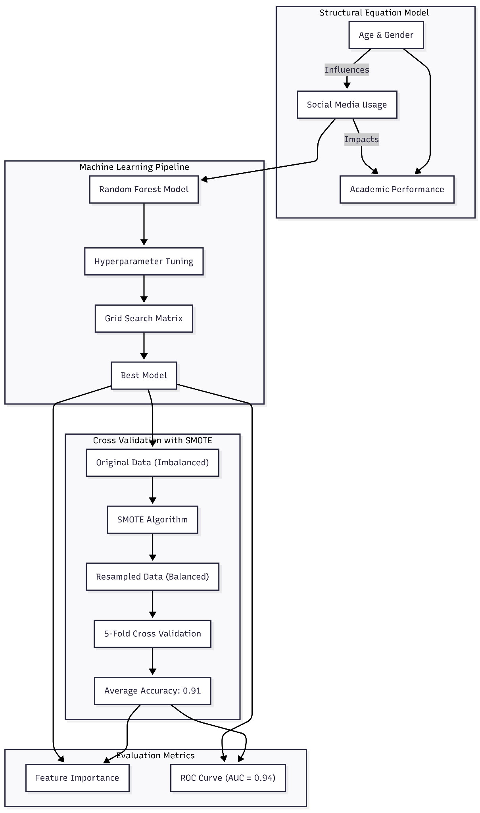
Methodology
Figure 1: Model architecture.
International Conference on Electrical, Computer and Communication Technologies (ECCT 2026)
10

Slide 11
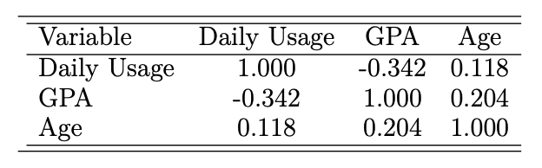
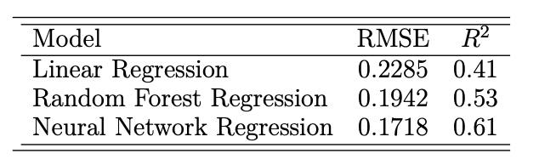
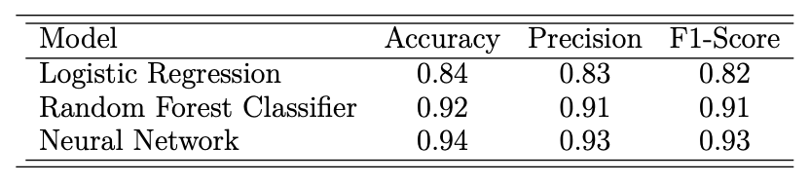
Results
Correlation:
Social media usage negatively correlated with GPA (r = -0.342).
Regression:
Usage significantly reduces academic performance.
Best Models:
Neural Network:
Accuracy: 94%
F1-score: 0.93
SEM Findings:
Usage acts as a mediating variable.
Strong model fit (CFI = 0.991, RMSEA = 0.051).
Figure 2: Correlation Matrix.
Figure 3: Regression Model Performance.
Figure 4: Classification Model Performance.
International Conference on Electrical, Computer and Communication Technologies (ECCT 2026)
11

Slide 12
Outcomes & Impacts
Behavioral factors (usage intensity) are strongest predictors.
Hybrid model improves:
Prediction accuracy.
Interpretability.
Supports:
Evidence-based academic policies.
Balanced social media usage strategies.
International Conference on Electrical, Computer and Communication Technologies (ECCT 2026)
12

Slide 13
Conclusion
Social media usage intensity is the strongest predictor.
Behavioral factors outweigh demographic factors.
Hybrid ML + SEM provides:
Better prediction.
Better explanation.
Encourages balanced, controlled usage instead of restriction.
International Conference on Electrical, Computer and Communication Technologies (ECCT 2026)
13

Slide 14
Future Directions
Use larger & more diverse datasets.
Apply longitudinal studies for causal analysis.
Integrate Explainable AI (XAI).
Include additional variables:
Stress, sleep, GPA tracking.
Develop real-time academic monitoring systems.
International Conference on Electrical, Computer and Communication Technologies (ECCT 2026)
14

Slide 15
References
Key sources:
Kaplan, A.M., Haenlein, M.: Users of the world, unite! The challenges and opportunities of social media. Business Horizons 53(1), 59–68 (2010).
Junco, R.: Too much face and not enough books: The relationship between multiple indices of Facebook use and academic performance. Computers in Human Behavior 28(1), 187–198 (2012)
Kline, R.B.: Principles and practice of structural equation modeling, 4th edn. Guilford Press (2015)
Liu, Y., Zhang, X.: Machine learning approaches for predicting student performance: A review. IEEE Access 10, 12345–12360 (2022)
Cuong, T., Nguyen, K., Zaw Oo, T., Jozsa, K.: The impact of social media use motives on students’ GPA: The mediating role of daily time usage. Education Sciences 15, 317 (2025).
Full references available in paper bibliography
International Conference on Electrical, Computer and Communication Technologies (ECCT 2026)
15

Slide 16
Question and Answer
International Conference on Electrical, Computer and Communication Technologies (ECCT 2026)
16

Slide 17
Thank You
International Conference on Electrical, Computer and Communication Technologies (ECCT 2026)
17

