Slide 1
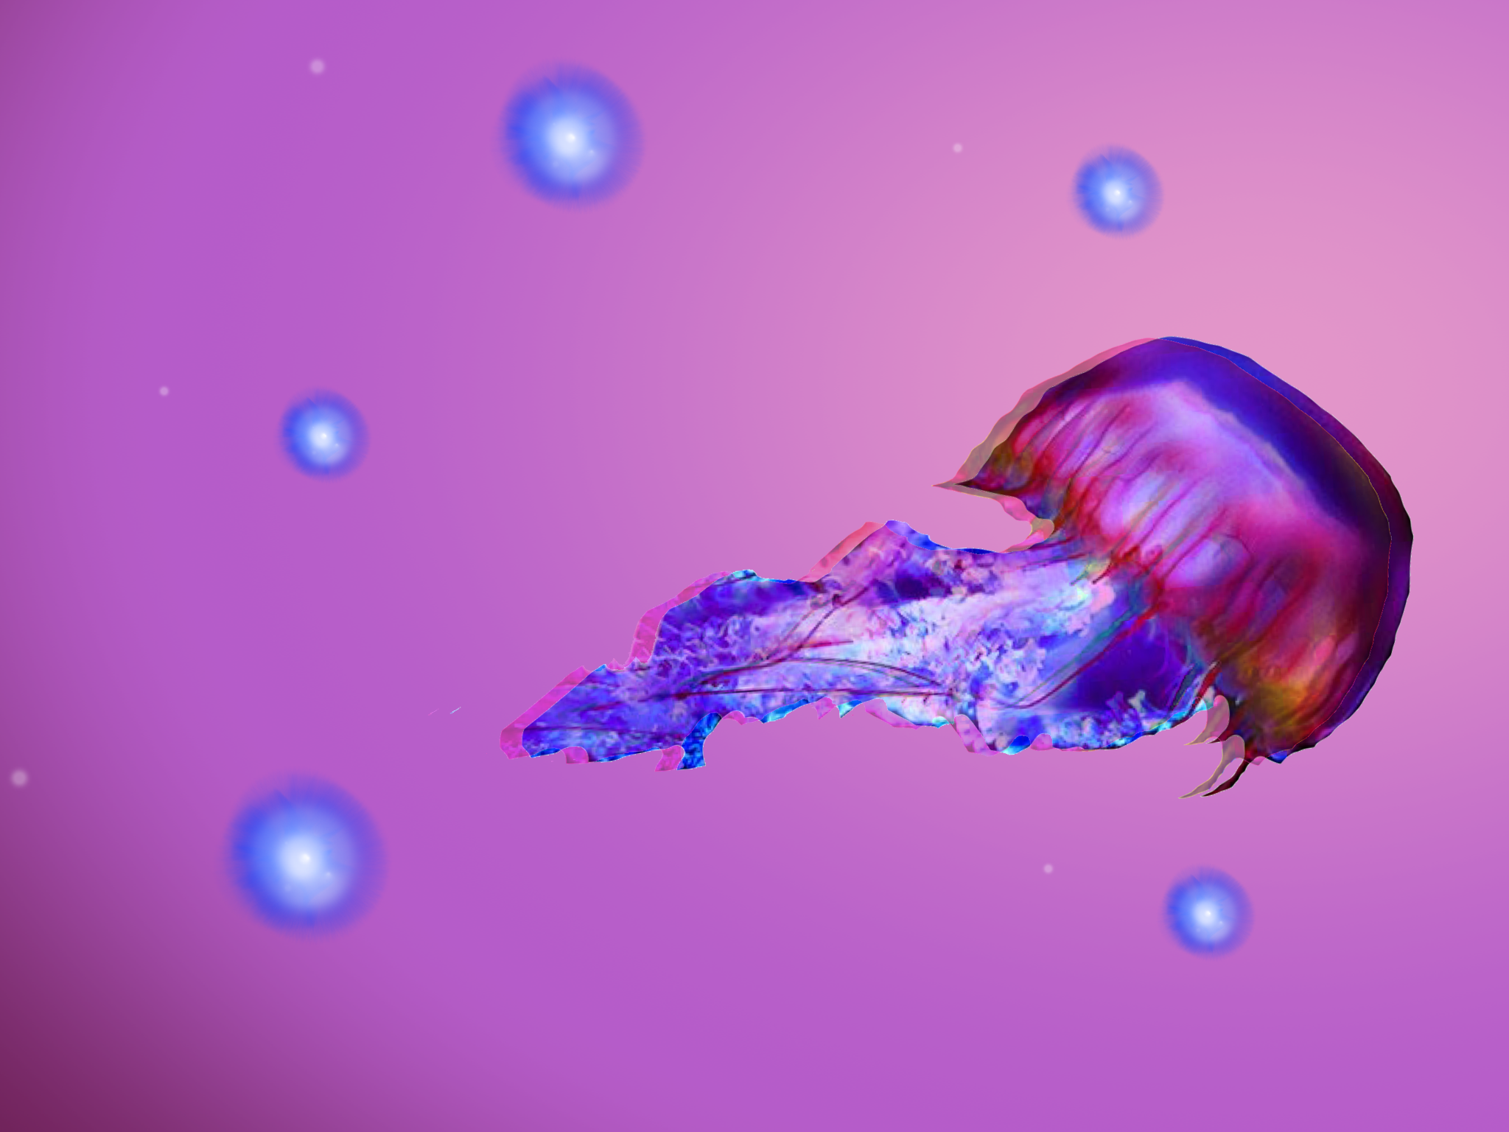
Jellyfish Box
Davide, Federica, Luigi,
Marco, Stefano

Slide 2
Storia

Slide 3
Video

Slide 4

Creative Process

Slide 5
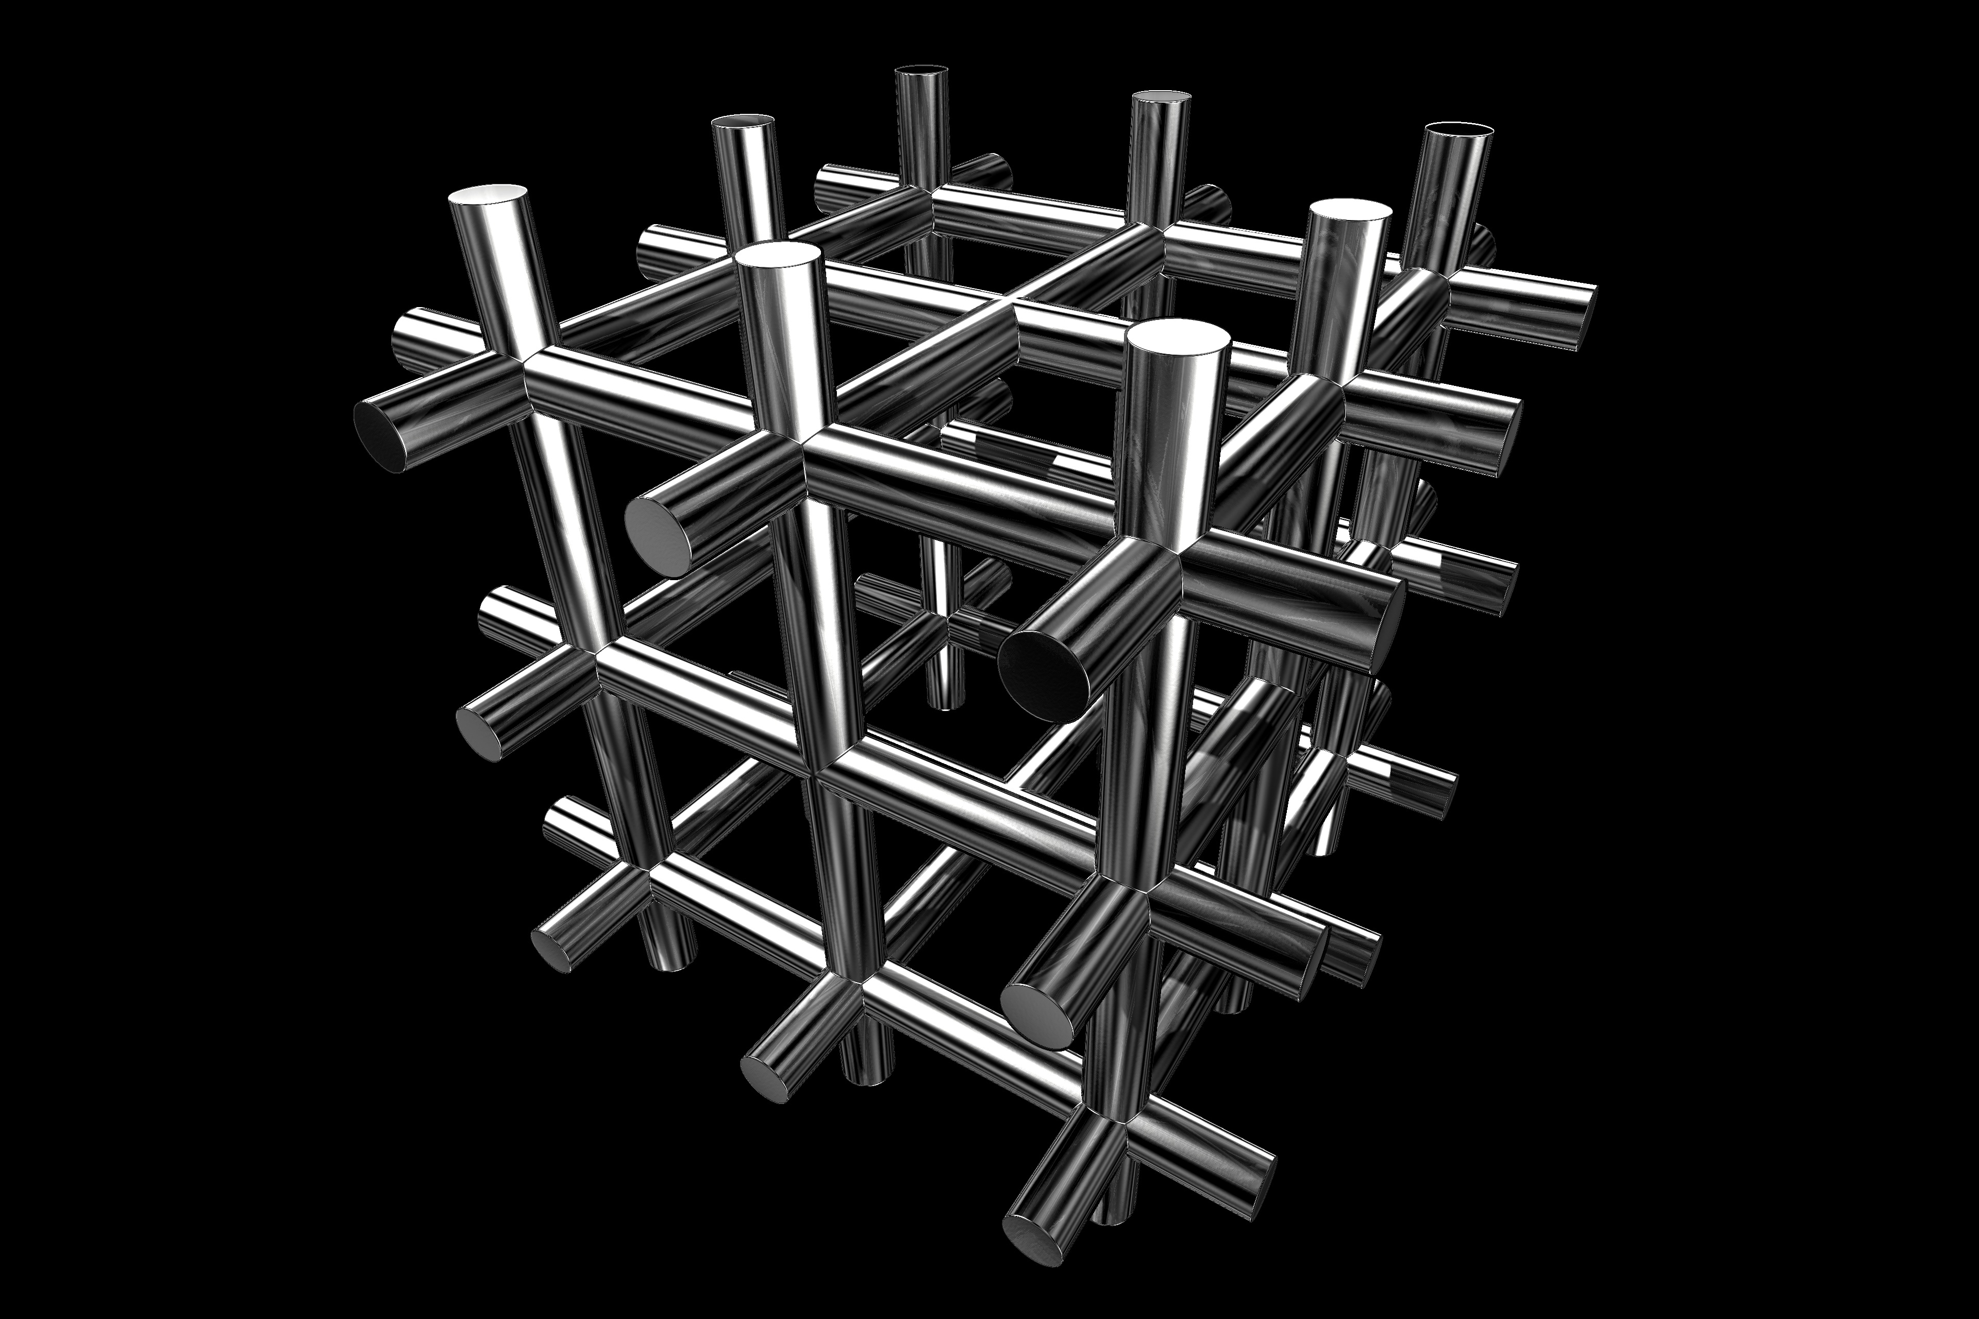
Tech Challenges

