Slide 1
INHERITANCE
Order of execution of constructor and destructor during inheritance

Slide 2
Basic points[Order of execution of constructor and destructor during inheritance ]
If a constructor is defined in the base class and derived class, then on creating the object of derived class, base class constructor will be executed first, then derived class constructor will be called.
Order of execution of destructor will be in reverse order as that of the order of execution of constructor
If a base class is having default constructor, then it is optional for derived class to have a default constructor
If a base class is having parameterized constructor, then it is mandatory for derived class to have a parameterized constructor which will pass the parameters to the base class constructor through initializer list.

Slide 3
Order of execution of constructor and destructor during single inheritance[Default constructor in both classes]
#include<iostream>
using namespace std;
class A
{
public:
A()
{
cout<<"\nCalling default base class constructor";
}
~A()
{
cout<<"\nCalling base class destructor";
}
};
class B:public A
{
public:
B()
{
cout<<"\n Calling default derived constructor";
}
~B()
{
cout<<"\nCalling derived class destructor";
}
};
int main()
{
B obj1;
return 0;
}
Output:
Calling default base class constructor
Calling default derived constructor
Calling derived class destructor
Calling base class destructor

Slide 4
Order of execution of constructor and destructor during single inheritance[Parameterized constructor in both classes]
class B:public A
{
int l;
public:
B(int p):A(p)
{
l=p;
cout<<"\nCalling derived class parameterized:"<<l;
}
~B()
{
cout<<"\nCalling derived class destructor";
}
};
int main()
{
B obj2(1);
return 0;
}
Output:
Calling base class parameterized 1
Calling derived class parameterized: 1
Calling derived class destructor
Calling base class destructor
#include<iostream>
using namespace std;
class A
{
int x;
public:
A(int a)
{
x=a;
cout<<"\nCalling base class parameterized "<<x;
}
~A()
{
cout<<"\nCalling base class destructor";
}
};

Slide 5
Order of execution of constructor and destructor during single inheritance[Parameterized and default constructor in both classes]
#include<iostream>
using namespace std;
class A
{
int x;
public:
A()
{
cout<<"\nCalling base class default";
}
A(int a)
{
x=a;
cout<<"\nCalling base class parameterized "<<x;
}
~A()
{
cout<<"\nCalling base class destructor";
}
};
class B:public A
{
int l;
public:
B()
{
cout<<"\nCalling derived class default";
}
B(int p):A(p)
{
l=p;
cout<<"\nCalling derived class parameterized:"<<l;
}
~B()
{
cout<<"\nCalling derived class destructor";
}
};
int main()
{
//B obj1; //Either default/ or parameterized constructor can be called
B obj2(1);
return 0;
}

Slide 6
Polling Questions(Q1)
In case of inheritance where both base and derived class are having constructors, when an object of derived class is created then___________ .
A. constructor of derived class will be invoked first
B. constructor of base class will be invoked first
C. constructor of derived class will be executed first followed by base class
D. constructor of base class will be executed first followed by derived class
Notes:
D

Slide 7
Q2
If base class has constructor with arguments, then it will be ________________ for the derived class to have constructor and pass the arguments to base class constructor.
A. Optional
B. Mandatory
C. Compiler dependent
D. Compiler Error Situation
Notes:
B

Slide 8
Q3
In case of inheritance where both base and derived class are having constructor and destructor, then which if the following are true ?
1. Constructors are executed in their order of derivation
2. Constructors are executed in reverse order of derivation
3. Destructors are executed in their order of derivation
4. Destructors are executed in reverse order of derivation
A. Only 2 ,4
B. Only 1 , 3
C. Only 1 , 4
D. Only 2, 3
Notes:
C

Slide 9
Q4
#include <iostream>
using namespace std;
class Base
{
public:
Base() { cout << "Base"; }
};
class Derived : public Base
{
public:
Derived(int i) { co ut << i; }
};
int main()
{
Derived d2(10);
return 0;
}
Base10
10Base
Base
10
Notes:
A

Slide 10
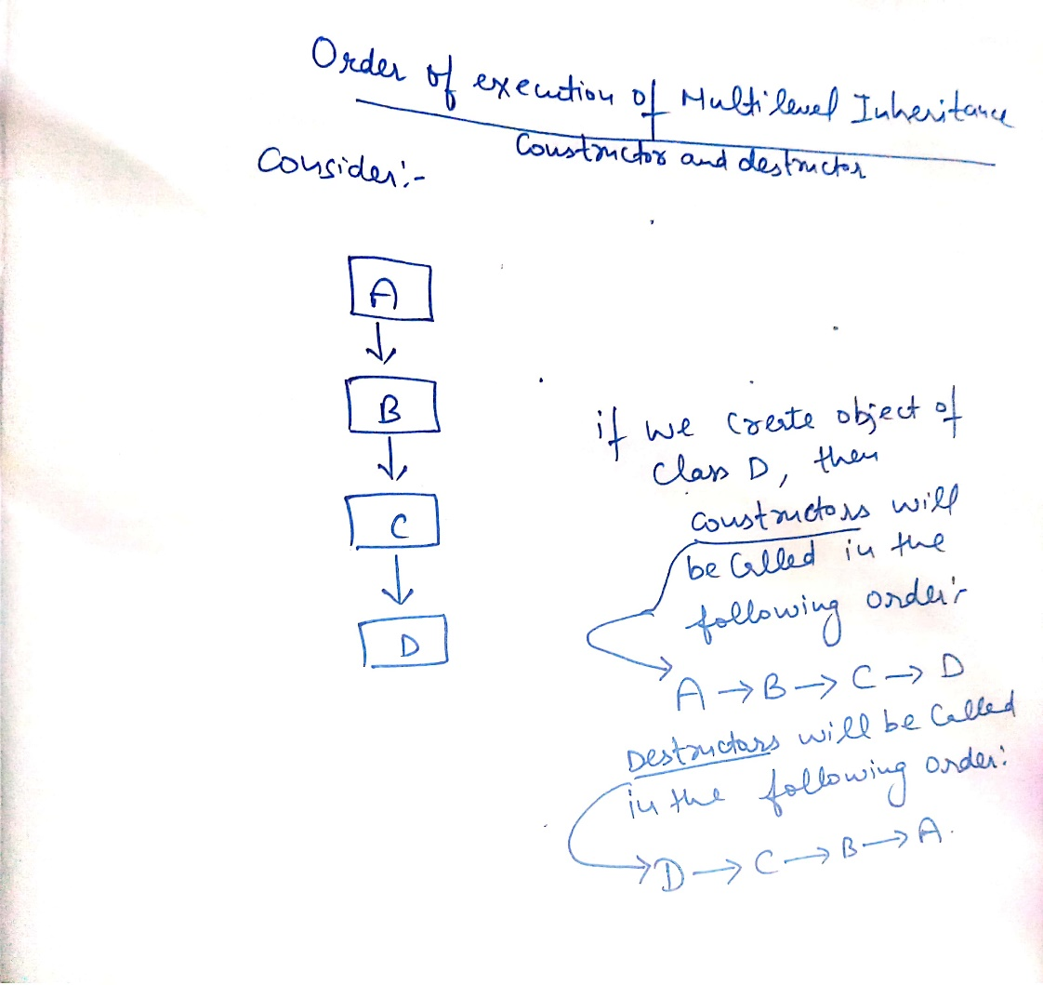
Order of execution of constructor and destructor during Multilevel inheritance

Slide 11
Program-Order of execution of constructor and destructor during Multilevel inheritance
#include<iostream>
using namespace std;
class A
{
int x,y;
public:
A(int r,int s)
{
x=r;
y=s;
cout<<"\nCalling base class constructor:"<<x<<" "<<y;
}
~A()
{
cout<<"\nCalling base class destructor";
}
};
class B:public A
{
int l,m;
public:
B(int p,int q,int r,int s):A(r,s)
{
l=p;
m=q;
cout<<"\nCalling derived class B constructor:"<<l<<" "<<m;
}
~B()
{
cout<<"\nCalling derived B class destructor";
}
};

Slide 12
Program-Order of execution of constructor and destructor during Multilevel inheritance….Continued
class C:public B
{
int n,m;
public:
C(int u,int v,int p,int q,int r,int s):B(p,q,r,s)
{
n=u;
m=v;
cout<<"\nCalling derived class C constructor with values:"<<n<<" "<<m;
}
~C()
{
cout<<"\nCalling derived class C destructor";
}
};
int main()
{
C obj1(1,2,3,4,5,6);
return 0;
}

Slide 13
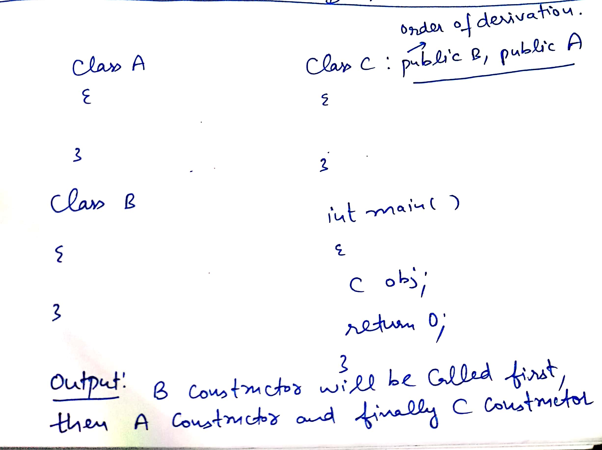
Order of execution of constructor and destructor during Multiple inheritance
Order of execution of constructor during multiple inheritance is dependent upon the order of derivation(or order of inheritance).
Order of execution of destructor will be reverse as that of order of execution of constructor

Slide 14
Order of execution of constructor and destructor during Multiple inheritance…continued…
Class A:public B, virtual C
{
};
Order of execution of constructor
//C() virtual base
//B() ordinary base
//A() derived
If one of the class is inherited in virtual mode, then constructor of that will be executed first and then order of inheritance will be followed and if both are derived in virtual mode, then order of inheritance will be followed(as usual)

Slide 15
Polling Questions
//Output??
#include<iostream>
using namespace std;
class Base1 {
public:
Base1()
{ cout << " Base1's constructor called" << endl; }
};
class Base2 {
public:
Base2()
{ cout << "Base2's constructor called" << endl; }
};
class Derived: public Base1, public Base2 {
public:
Derived()
{ cout << "Derived's constructor called" << endl; }
};
int main()
{
Derived d;
return 0;
}
A. Compiler Dependent
B. Base1′s constructor called
Base2′s constructor called
Derived’s constructor called
C. Base2′s constructor called
Base1′s constructor called
Derived’s constructor called
D. Compiler Error
Notes:
B

Slide 16
Output??
//Output?
#include <iostream>
using namespace std;
class Base1 {
public:
~Base1() { cout << " Base1's destructor" << endl; }
};
class Base2 {
public:
~Base2() { cout << " Base2's destructor" << endl; }
};
class Derived: public Base1, public Base2 {
public:
~Derived() { cout << " Derived's destructor" << endl; }
};
int main()
{
Derived d;
return 0;
}
A. Base1's destructor
Base2's destructor
Derived's destructor
B. Derived's destructor
Base2's destructor
Base1's destructor
C. Derived's destructor
D. Compiler Dependent
Notes:
B

Slide 17
Output??
What will be the order of execution of base class constructors in the following method of inheritance? class A: public B, virtual public C {….}; A) B(); C(); A(); B) C(); B(); A(); C) A(); B(); C(); D) B(); A(); C();
Notes:
B

Slide 18
Program-Order of execution of constructor and destructor during Multiple inheritance
#include<iostream>
using namespace std;
class M
{
protected:
int m;
public:
M(int x)
{
m=x;
cout<<"\nIn M";
}
};
class N
{
protected:
int n;
public:
N(int y)
{
n=y;
cout<<"\nIn N";
}
};
class P:public M,public N
{
int l;
public:
P(int p,int q,int r):M(r),N(q)
{
l=p;
cout<<"\nIn P";
}
void display()
{
cout<<“\n”<<"m="<<m<<" "<<"n="<<n<<" "<<"l="<<l;
}
};
int main()
{
P obj1(3,2,1);
obj1.display();
return 0;
}
Output:
In M
In N
In P
m=1 n=2 l=3

Slide 19
Order of execution of constructor and destructor during hierarchical inheritance
#include<iostream>
using namespace std;
class M
{
protected:
int m;
public:
M(int x)
{
m=x;
cout<<"\nIn M";
}
};
class N:public M
{
protected:
int n;
public:
N(int y):M(y)
{
n=y;
cout<<"\nIn N";
}
};
class P:public M
{
int l;
public:
P(int p):M(p)
{
l=p;
cout<<"\nIn P";
}
};
int main()
{
N obj1(1);//Output In M,In N
P obj2(2);//Output In M,In P
return 0;
}

