Slide 1
Business Intelligence App using Python
Advanced Project
Slash Mark IT Solutions Pvt. Ltd. (AICTE Approved)
Presented by: Alok Kumar

Slide 2
Project Objective
Develop a Business Intelligence application using Python (Jupyter Notebook).
Fetch and analyze news data for extracting meaningful insights.
Perform sentiment analysis to classify articles as positive, negative, or neutral.

Slide 3
Technology Stack
Programming Language: Python
Environment: Jupyter Notebook
Libraries: requests, BeautifulSoup, nltk, pandas, matplotlib, seaborn

Slide 4
Project Workflow
1. Fetch News Articles using APIs
2. Clean and Preprocess the Data
3. Perform Sentiment Analysis using NLP
4. Visualize Data and Sentiment Trends
5. Extract Business Intelligence Insights

Slide 5
Fetching News Articles
Implemented using requests and BeautifulSoup.
Targeted multiple news sources based on keywords.
Extracted headlines and publication dates.

Slide 6
Sentiment Analysis
Used Natural Language Toolkit (NLTK) for sentiment scoring.
Classified articles as Positive, Negative, or Neutral.
Aggregated sentiment results for business reporting.

Slide 7
Sample Outputs and Visualizations
Graphical representation of sentiment trends over time.
Bar charts and pie charts to show article distribution.
Helps identify public opinion and media tone.

Slide 8
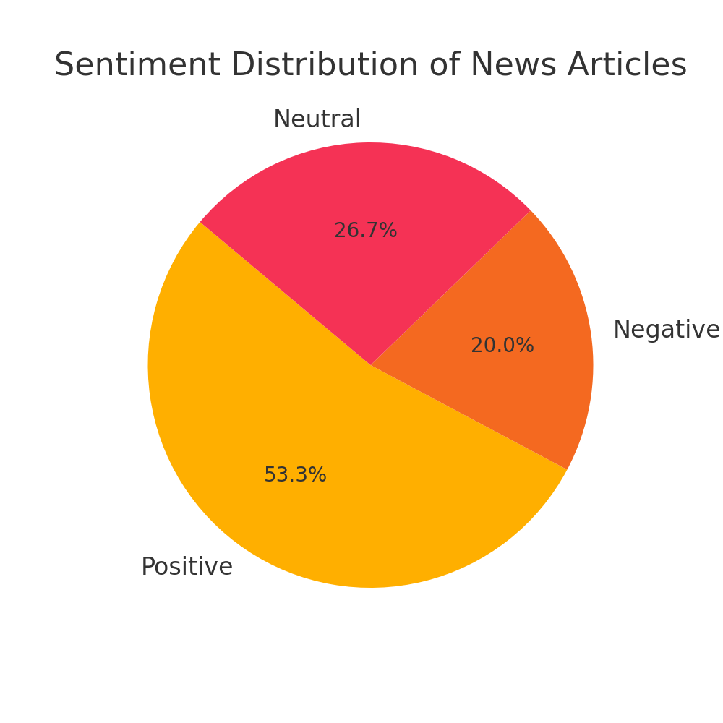
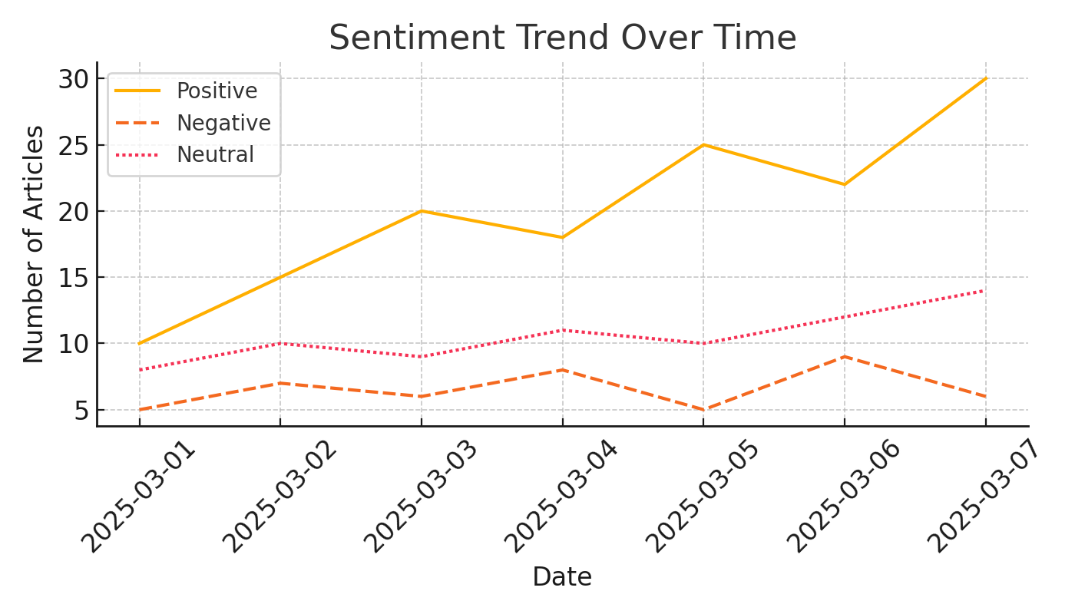
Visualizations

Slide 9
Business Intelligence Insights
Useful for understanding market and customer sentiment.
Assists decision-makers with media monitoring.
Can be extended to product reviews or social media data.

Slide 10
Conclusion
Successfully built a Business Intelligence App in Python.
Demonstrated real-time data analysis and sentiment insights.
Project enhances understanding of NLP and business analytics.

Slide 11
Acknowledgment
Special thanks to Slash Mark IT Solutions Pvt. Ltd.
Guidance under AICTE Approved Internship Program.
Mentorship and support provided throughout the project.

Slide 12
Thank you

