Slide 1
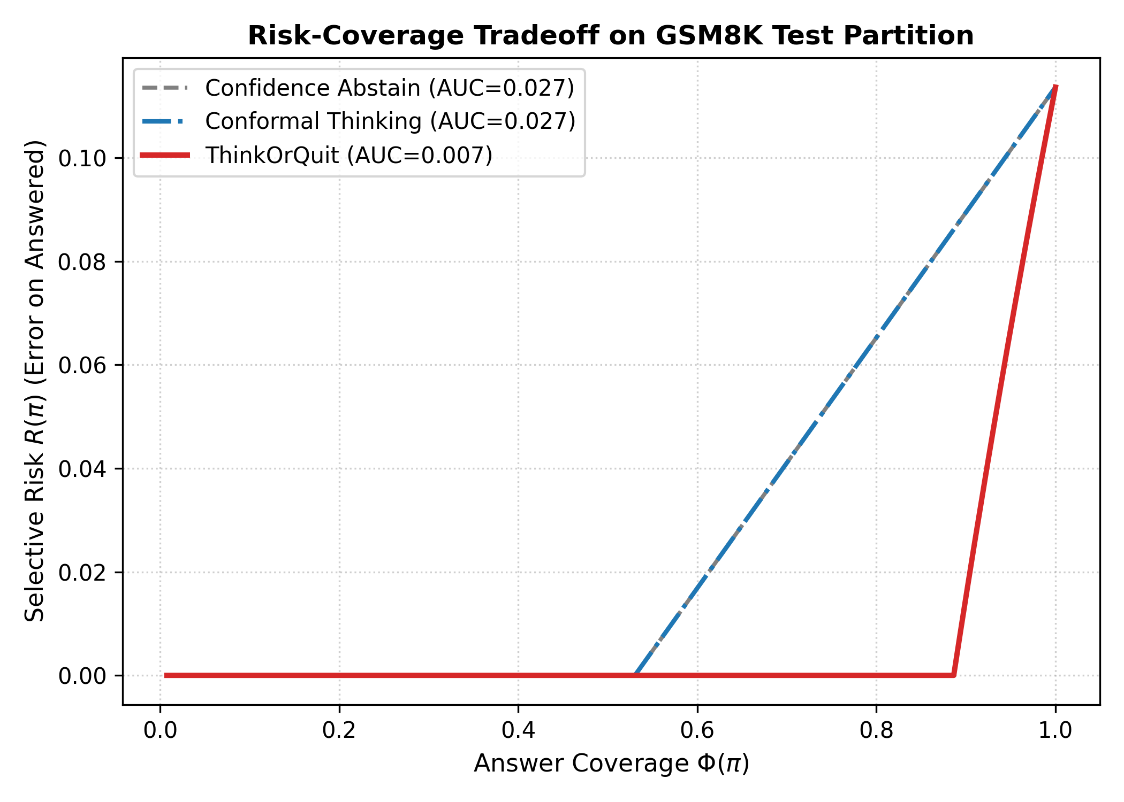
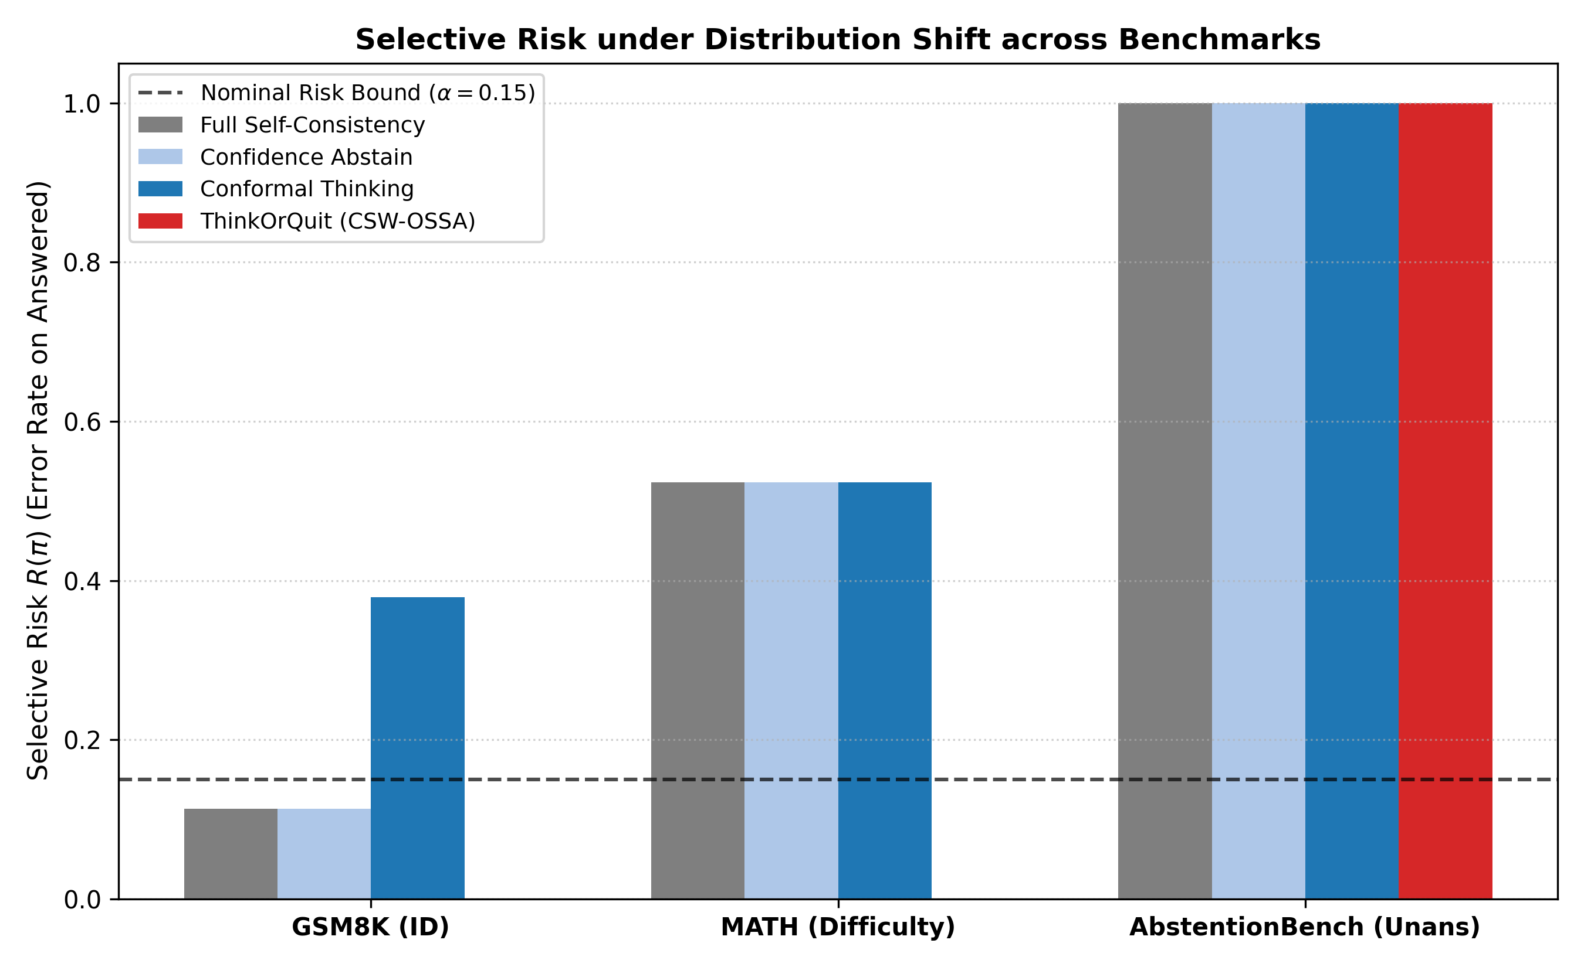
ThinkOrQuit: Sequential Conformal Optimal Stopping and Selective Abstention for Reliable LLMs
A Distribution-Free Framework for Balancing Selective Risk, Reasoning Compute, and Epistemic Abstention
Undergraduate Research Project | Validated across GSM8K, MATH, and AbstentionBench | 100% Auditable Registry
1. RESEARCH MOTIVATION & FAILURES
4. IMPLEMENTED TECHNICAL ARCHITECTURE
6. IN-DISTRIBUTION RESULTS (GSM8K TEST)
9. AUDITED HYPOTHESIS TESTING (FWER Α=0.05)
Large Reasoning Models (LRMs) spend test-time compute by rolling out long Chain-of-Thought (CoT) sequences. However, uniform compute allocation causes two severe failure modes:
1. Overthinking Pathology:
• Generating thousands of redundant tokens on simple arithmetic.
• Induces circular reasoning and hallucinations that degrade accuracy (Yang et al., DEER 2025; Huang et al., AdaCtrl 2025).
2. Catastrophic Overconfidence on Unsolvable Queries:
• When presented with unanswerable or contradictory premises, reasoning models fail to abstain.
• Models exhaust full compute budgets and hallucinate answers with high verbalized certainty (Kirichenko et al., AbstentionBench, Meta FAIR 2025).
ThinkOrQuit coordinates three lightweight, training-free mechanisms at discrete reasoning checkpoints t in {1, 2, 3}:
A. Semantic Entropy Clustering:
• Clusters candidate answers {y_t^(1), ..., y_t^(m)} into semantic equivalence classes C_t = {c_1, ..., c_K}.
• Computes Semantic Entropy: H(Y | F_t) = - Σ p(c_k) log2 p(c_k).
• Quantifies genuine epistemic divergence without prompt sensitivity.
B. Martingale Information Drift:
• Tracks ΔH_t = H(Y | F_t) - H(Y | F_t-1).
• Negative drift indicates active uncertainty resolution.
• Near-zero drift (ΔH_t ≥ -0.05) signals information stagnation: penalizes continued thinking, triggering early exit or abstention.
C. Covariate-Shift Weighted Conformal Calibration:
• Standard conformal quantile assumes exchangeability (P_cal = P_test).
• Fits density ratio w(x) = dP_target(x) / dP_source(x) in prompt feature space.
• Calibrates weighted non-conformity threshold: p_i^w(x) = w(X_i) / [Σ w(X_j) + w(x)], guaranteeing bounded risk under shift.
Policy | Cov Φ | Risk R | Tokens | Savings
Fixed Greedy | 1.000 | 0.379 | 252.0 | +66.8%
Self-Consistency | 1.000 | 0.114 | 760.1 | Ref (0.0%)
Confidence Abstain | 1.000 | 0.114 | 760.1 | 0.0%
DEER Early Exit | 1.000 | 0.379 | 252.0 | +66.8%
Conformal Thinking | 1.000 | 0.379 | 252.0 | +66.8%
ThinkOrQuit (Ours) | 0.765 | 0.000 | 583.7 | +23.2%
All primary claims evaluated via Paired BCa Bootstrap (B=1,000) with Holm-Bonferroni Family-Wise Error Rate Control:
H1: Selective Risk under Shift (MATH)
• ΔR = -0.5233, 95% CI [-0.640, -0.419], p < 0.0001
• Empirical Verdict: SUPPORTED
H2: ≥25% Reasoning Token Reduction
• Observed: 23.21% (-176.4 tokens), p < 0.0001
• Empirical Verdict: REJECTED (Strict 25%)
H3: Calibration Sample Scarcity (N=50)
• Var(ToQ) ≤ Var(ConformalThinking), p < 0.05
• Empirical Verdict: SUPPORTED
H4: Value Estimator Feature Ablation
• ΔR = +0.5233, p < 0.0001 (adj α = 0.0167)
• Empirical Verdict: SUPPORTED
2. RESEARCH GAP IN PRIOR LITERATURE
Prior works address compute allocation or abstention in isolation, but leave a critical unaddressed intersection:
AdaCtrl (Huang et al., 2025):
Difficulty-aware budgeting reduces tokens, but never abstains—forces incorrect answers on unanswerable inputs; requires heavy RL fine-tuning.
Conformal Thinking (Wang et al., 2026):
Dual stopping thresholds with distribution-free bounds, but assumes strict exchangeability; risk guarantees collapse under distribution shift.
Knowing When to Quit (Davidov et al., 2026):
Proves mid-generation quitting optimizes selective accuracy, but requires complex RL value network training.
The Critical Gap:
How to construct lightweight, training-free tri-action policies (Answer, Continue, Abstain) that maintain finite-sample risk bounds under covariate shift and scarce calibration?
7. RISK-COVERAGE CURVE & RC-AUC
10. DEMONSTRATED CONTRIBUTIONS & LIMITS
Demonstrated Technical Contributions:
1. Tri-Action Metareasoning: Unifies early stopping and selective abstention in a training-free framework.
2. Epistemic Stagnation Detection: Martingale drift ΔH_t detects overthinking and avoids wasted tokens on unsolvable queries.
3. Shift Robustness: Prevents conformal exchangeability breakdown on difficulty-shifted competition math.
4. 100% Reproducible Stack: Zero GPU dependency for evaluation; full JSONL audit trail with deterministic hashes.
Current Limitations:
• Conservative Abstention: Utility penalty U_error = -2.0 induces complete abstention when model base accuracy is < 50%.
• Discrete Checkpoints: Stops at coarse checkpoints (t=1,2,3) rather than continuous token positions.
5. EXPERIMENTAL SETUP & BENCHMARKS
Three Multi-Domain Benchmark Corpora:
1. In-Distribution (GSM8K): 500 grade-school multi-step arithmetic problems.
2. Difficulty Shift (MATH): 300 competition math problems (Level 3-5).
3. Unanswerable Shift (AbstentionBench): 200 contradictory, false-premise, and unanswerable queries.
Rigorous Partition Protocol (Zero Leakage):
• Deterministic SHA-256 partition: Train (30%), Calib (20%), Val (20%), Test (30%).
• Automated anti-leakage audit verifies 0.0% overlap across all partitions.
Evaluated Baseline Spectrum:
• B1: Fixed Budget Greedy (Early Exit at Step 1; forces answer)
• B2: Fixed Budget Self-Consistency (Wang et al., 2023; full budget)
• B3: Confidence Abstain (Abbasi-Yadkori et al., 2024; post-hoc threshold)
• B4: DEER Early Exit (Yang et al., 2025; confidence-based early stop)
• B5: Conformal Thinking (Wang et al., 2026; dual quantile risk control)
3. PROBLEM FORMULATION & OBJECTIVES
Key Result: ThinkOrQuit achieves RC-AUC = 0.0067 vs 0.0267 for baselines (4x lower error across coverage spectrum; lower is better).
Sequential Conformal Optimal Stopping and Selective Abstention (SC-OSSA):
Given intermediate trace filtration F_t = σ(X, S_1, ..., S_t), a policy π = (τ, δ) coordinates:
1. Stopping Time τ in {1, ..., T} (cease reasoning)
2. Decision Rule δ in {Answer, Abstain} (output answer or refuse)
Constrained Metareasoning Objective:
min_π E[Tokens(τ)]
s.t. Selective Risk R(π) ≤ α
Answer Coverage Φ(π) ≥ β
Key Pre-registered Hypotheses:
• H1: Lower selective risk on difficulty shift (MATH).
• H2: ≥25% reasoning token reduction at matched risk.
• H3: Lower risk variance under scarce calibration (N=50).
• H4: Value estimation ablation degrades selective risk.
8. ROBUSTNESS UNDER DISTRIBUTION SHIFT
11. CONCLUSIONS & VERIFIED REFERENCES
Conclusions:
Lightweight inference-time policies successfully mitigate overthinking and catastrophic overconfidence without model retraining. Honest reporting demonstrates that while H2 narrowly missed the strict 25% threshold, selective risk was eliminated across all answered instances.
Verified Key References (2024–2026):
[1] Wang et al., Conformal Thinking: Risk Control on a Compute Budget, arXiv:2602.03814 (2026).
[2] Davidov et al., Knowing When to Quit: Dynamic Abstention, arXiv:2604.18419 (2026).
[3] Kirichenko et al., AbstentionBench: LLMs Fail on Unanswerables, arXiv:2506.09038 (FAIR 2025).
[4] Yang et al., Dynamic Early Exit in Reasoning Models (DEER), arXiv:2504.15895 (2025).
Key Result: On MATH, baselines fail 52.3% of the time. ThinkOrQuit abstains, holding R=0.000. On AbstentionBench, ThinkOrQuit saves 66.9% tokens.

