Slide 1
GRpc
Shakti Singh Tanwar

Slide 2
What is gRpc
Language agnostic, high-performance Remote Procedure Call (RPC) framework.

Slide 3
Benefits
Modern, high-performance, lightweight RPC framework.
Contract-first API development, using Protocol Buffers by default, allowing for language agnostic implementations.
Tooling available for many languages to generate strongly-typed servers and clients.
Supports client, server, and bi-directional streaming calls.
Reduced network usage with Protobuf binary serialization.

Slide 4
Ideal For
Lightweight microservices where efficiency is critical.
Polyglot systems where multiple languages are required for development.
Point-to-point real-time services that need to handle streaming requests or responses.

Slide 5
Development Approach
gRPC uses a contract-first approach to API development. Protocol buffers (protobuf) are used as the Interface Design Language (IDL) by default. The *.proto file contains:
The definition of the gRPC service.
The messages sent between clients and servers.

Slide 6
Example
syntax = "proto3";
option csharp_namespace = "GrpcGreeter";
package greet;
// The greeting service definition.
service Greeter {
// Sends a greeting
rpc SayHello (HelloRequest) returns (HelloReply);
}
// The request message containing the user's name.
message HelloRequest {
string name = 1;
}
// The response message containing the greetings.
message HelloReply {
string message = 1;
}

Slide 7
Proto3 Defining A Message Type
syntax = "proto3";
message SearchRequest {
string query = 1;
int32 page_number = 2;
int32 result_per_page = 3;
}

Slide 8
Field Types
Scalar
Composite

Slide 9
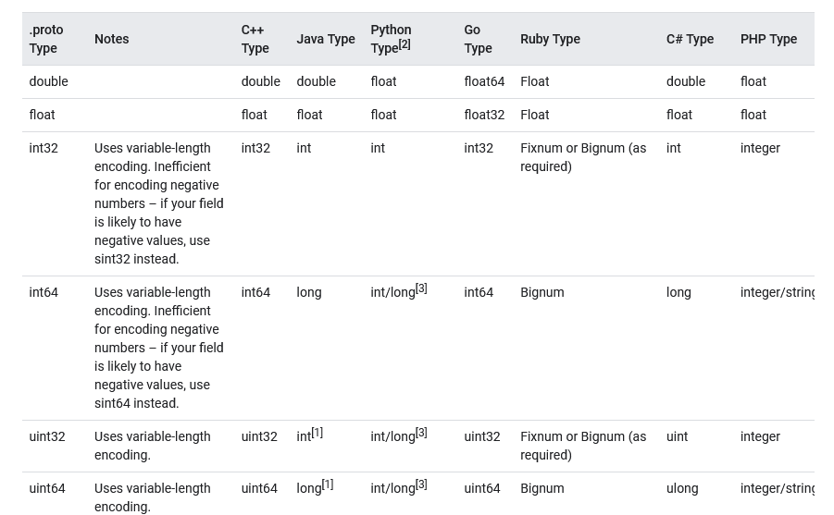
Scalar Fields

Slide 10
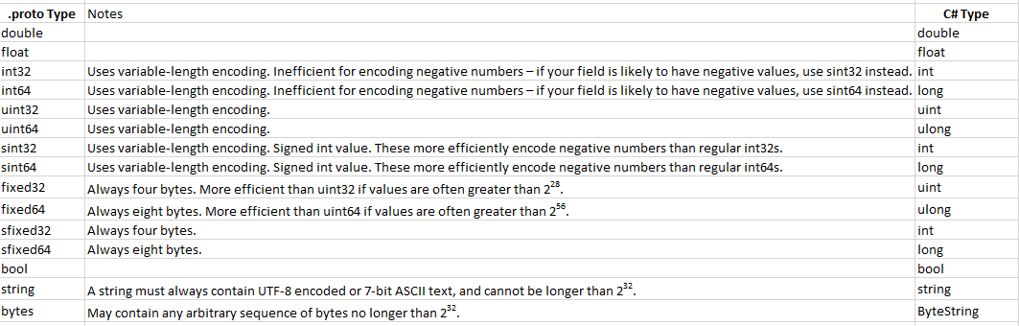
Scalar Fields

Slide 11
Field Numbers
Field numbers are used to identify your fields in the message binary format, and should not be changed once your message type is in use.
Field numbers in the range 1 through 15 take one byte to encode
Field numbers in the range 16 through 2047 take two bytes.
The smallest field number you can specify is 1, and the largest is 229 - 1, or 536,870,911.
You also cannot use the numbers 19000 through 19999 (FieldDescriptor::kFirstReservedNumber through FieldDescriptor::kLastReservedNumber), as they are reserved for the Protocol Buffers implementation
Notes:
The smallest field number you can specify is 1, and the largest is 2²⁹ - 1, or 536,870,911. You also cannot use the numbers 19000 through 19999 (FieldDescriptor::kFirstReservedNumber through FieldDescriptor::kLastReservedNumber), as they are reserved for the Protocol Buffers implementation

Slide 12
Reserved Fields
Message type can be updated by entirely removing a field, or commenting it out
Future users can reuse the field number unknowingly.
Can cause severe issues if they later load old versions of the same .proto, including data corruption, privacy bugs, and so on.
To avoid always specify that the field numbers (and/or names, which can also cause issues for JSON serialization) of your deleted fields are reserved.
The protocol buffer compiler will complain if any future users try to use these field identifiers.

Slide 13
Reserved Fields
enum Foo {
reserved 2, 15, 9 to 11, 40 to max;
reserved "FOO", "BAR";
}

Slide 14
Field Rules
Message fields can be one of the following:
singular: a well-formed message can have zero or one of this field (but not more than one). And this is the default field rule for proto3 syntax.
repeated: this field can be repeated any number of times (including zero) in a well-formed message. The order of the repeated values will be preserved.
In proto3, repeated fields of scalar numeric types use packed encoding by default.
Notes:
Message fields can be one of the following:
singular: a well-formed message can have zero or one of this field (but not more than one). And this is the default field rule for proto3 syntax.
repeated: this field can be repeated any number of times (including zero) in a well-formed message. The order of the repeated values will be preserved.
In proto3, repeated fields of scalar numeric types use packed encoding by default.

Slide 15
Adding Comments
/* SearchRequest represents a search query, with pagination options to * indicate which results to include in the response. */
message SearchRequest {
string query = 1;
int32 page_number = 2; // Which page number do we want?
int32 result_per_page = 3; // Number of results to return per page.
}

Slide 16
Default Values
For strings, the default value is the empty string.
For bytes, the default value is empty bytes.
For bools, the default value is false.
For numeric types, the default value is zero.
For enums, the default value is the first defined enum value, which must be 0.
For message fields, the field is not set. Its exact value is language-dependent. See the generated code guide for details.
The default value for repeated fields is empty (generally an empty list in the appropriate language).

Slide 17
Enumerations
message SearchRequest {
string query = 1;
int32 page_number = 2;
int32 result_per_page = 3;
enum Corpus {
UNIVERSAL = 0;
WEB = 1;
IMAGES = 2;
LOCAL = 3;
NEWS = 4;
PRODUCTS = 5;
VIDEO = 6;
}
Corpus corpus = 4;
}
Notes:
message SearchRequest { string query = 1; int32 page_number = 2; int32 result_per_page = 3; enum Corpus { UNIVERSAL = 0; WEB = 1; IMAGES = 2; LOCAL = 3; NEWS = 4; PRODUCTS = 5; VIDEO = 6; } Corpus corpus = 4; }

Slide 18
Enumerations
There must be a zero value, so that we can use 0 as a numeric default value.
The zero value needs to be the first element, for compatibility with the proto2 semantics where the first enum value is always the default.
Can define alias as well
message MyMessage1 {
enum EnumAllowingAlias {
option allow_alias = true;
UNKNOWN = 0;
STARTED = 1;
RUNNING = 1;
}
}

Slide 19
Composite Message Types
message SearchResponse {
repeated Result results = 1;
}
message Result {
string url = 1;
string title = 2;
repeated string snippets = 3;
}

Slide 20
Importing Definitions
import "myproject/other_protos.proto";

Slide 21
Nested Types
message SearchResponse {
message Result {
string url = 1;
string title = 2;
repeated string snippets = 3;
}
repeated Result results = 1;
}

Slide 22
Http2
gRPC requires HTTP/2
Kestrel supports HTTP/2 on most modern operating systems.
Kestrel endpoints are configured to support HTTP/1.1 and HTTP/2 connections by default.

Slide 23
TLS
Kestrel endpoints used for gRPC should be secured with TLS.
In development, an endpoint secured with TLS is automatically created at https://localhost:5001 when the ASP.NET Core development certificate is present. No configuration is required. An https prefix verifies the Kestrel endpoint is using TLS.
In production, TLS must be explicitly configured. In the following appsettings.json example, an HTTP/2 endpoint secured with TLS is provided:
Notes:
Kestrel endpoints used for gRPC should be secured with TLS. In development, an endpoint secured with TLS is automatically created at https://localhost:5001 when the ASP.NET Core development certificate is present. No configuration is required. An https prefix verifies the Kestrel endpoint is using TLS.
In production, TLS must be explicitly configured. In the following appsettings.json example, an HTTP/2 endpoint secured with TLS is provided:

Slide 24
TLS
{
"Kestrel": {
"Endpoints": {
"HttpsInlineCertFile": {
"Url": "https://localhost:5001",
"Protocols": "Http2",
"Certificate": {
"Path": "<path to .pfx file>",
"Password": "<certificate password>"
}
}
}
}
}

Slide 25
TLS
public static IHostBuilder CreateHostBuilder(string[] args) =>
Host.CreateDefaultBuilder(args)
.ConfigureWebHostDefaults(webBuilder =>
{
webBuilder.ConfigureKestrel(options =>
{
options.Listen(IPAddress.Any, 5001, listenOptions =>
{
listenOptions.Protocols = HttpProtocols.Http2;
listenOptions.UseHttps("<path to .pfx file>",
"<certificate password>");
});
});
webBuilder.UseStartup<Startup>();
});

Slide 26
gRPC calls Types
Unary
Server streaming
Client streaming
Bi-directional streaming

Slide 27
Unary call
var client = new Greet.GreeterClient(channel);
var response = await client.SayHelloAsync(new HelloRequest { Name = "World" });
Console.WriteLine("Greeting: " + response.Message);
// Greeting: Hello World

Slide 28
Server streaming call
A server streaming call starts with the client sending a request message. ResponseStream.MoveNext() reads messages streamed from the service.
The server streaming call is complete when ResponseStream.MoveNext() returns false.

Slide 29
Server streaming call
var client = new Greet.GreeterClient(channel);
using var call = client.SayHellos(new HelloRequest { Name = "World" });
await foreach (var response in call.ResponseStream.ReadAllAsync())
{
Console.WriteLine("Greeting: " + response.Message);
// "Greeting: Hello World" is written multiple times
}

Slide 30
Client streaming call
A client streaming call starts without the client sending a message. The client can choose to send messages with RequestStream.WriteAsync.
When the client has finished sending messages, RequestStream.CompleteAsync() should be called to notify the service.
The call is finished when the service returns a response message.

Slide 31
Client streaming call
var client = new Counter.CounterClient(channel);
using var call = client.AccumulateCount();
for (var i = 0; i < 3; i++)
{
await call.RequestStream.WriteAsync(new CounterRequest { Count = 1 });
}
await call.RequestStream.CompleteAsync();
var response = await call;
Console.WriteLine($"Count: {response.Count}");
// Count: 3

Slide 32
Bi-directional streaming call
A bi-directional streaming call starts without the client sending a message.
The client can choose to send messages with RequestStream.WriteAsync.
Messages streamed from the service are accessible with ResponseStream.MoveNext() or ResponseStream.ReadAllAsync().
The bi-directional streaming call is complete when the ResponseStream has no more messages.

Slide 33
Bi-directional streaming call
A bi-directional streaming call starts without the client sending a message.
The client can choose to send messages with RequestStream.WriteAsync.
Messages streamed from the service are accessible with ResponseStream.MoveNext() or ResponseStream.ReadAllAsync().
The bi-directional streaming call is complete when the ResponseStream has no more messages.

Slide 34
Bi-directional streaming call
var client = new Echo.EchoClient(channel);
using var call = client.Echo();
Console.WriteLine("Starting background task to receive messages");
var readTask = Task.Run(async () =>{
await foreach (var response in call.ResponseStream.ReadAllAsync()) {
Console.WriteLine(response.Message); // Echo messages sent to the service }});
Console.WriteLine("Starting to send messages");
Console.WriteLine("Type a message to echo then press enter.");
while (true){
var result = Console.ReadLine();
if (string.IsNullOrEmpty(result)) { break; }
await call.RequestStream.WriteAsync(new EchoMessage { Message = result });
}
Console.WriteLine("Disconnecting");
await call.RequestStream.CompleteAsync();
await readTask;

Slide 35
Access gRPC trailers
gRPC calls may return gRPC trailers. gRPC trailers are used to provide name/value metadata about a call. Trailers provide similar functionality to HTTP headers, but are received at the end of the call.
gRPC trailers are accessible using GetTrailers(), which returns a collection of metadata. Trailers are returned after the response is complete, therefore, you must await all response messages before accessing the trailers.

Slide 36
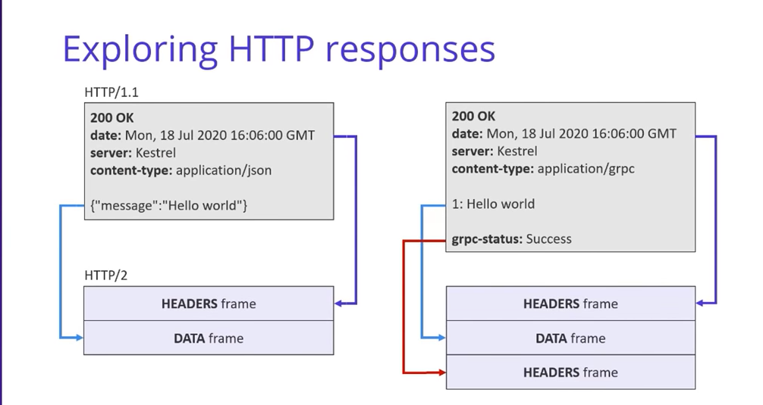
Trailing Headers

