Slide 1
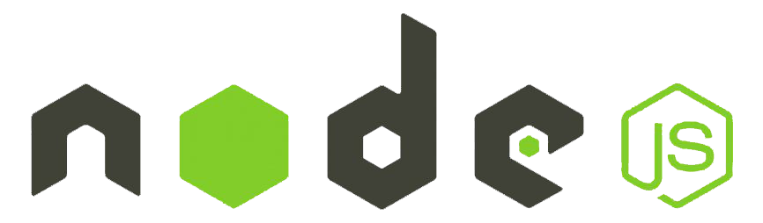
NodeJS

Slide 2
NodeJS not a language.
This is a server environment.
NodeJS can connect with database.
Code and syntax is very similar to JavaScript.
But not exactly the same.
NodeJS free Open-source.
NodeJS use chrome’s V8 engine to execute code.

Slide 3
Why do we use node js
NodeJS mostly use for API.
So we can connect the same database with web, App, Mobile App.
Node is easy to understand who know JavaScript.
Node is super-fast for APIs.
With node and JavaScript, you can become full Stack Developer.

Slide 4
History and More
First Release : 27 May 2009 Version
Current Version : 16.4
Written in C, C++, JavaScript

Slide 5
JavaScript and Node are the Same
JavaScript and NodeJS Code Syntax is Same
If you know JavaScript you can easily understand Node
But both are not exactly the same
You can not connect JavaScript with DB
NodeJS can connect with DB
Node can run on the server side
JavaScript can run on browser

Slide 6
Why should Learn NodeJS
If you are JavaScript developer then you can easy learn Node
You can become a full-stack developer
Free and demand for jobs
Salary is also good as compare to web developer or PHP Developer

Slide 7
Major Topics
What is NodeJS ?
How it works ?
Instal and run
Make basic API
Use with express js
UI with node
a.) UI event
b.) Forms
c.) webpages etc.
NodeJS event
Middleware
Major Package
Connect with DB
Make Major API
API security and token
API Validation
Project
Live with Server

Slide 8
Basic Before Getting Start
What are the client and Server Side ?
What do you Node (Client OR Server Side) ?
How NodeJS use JavaScript ?
What developer make with NodeJS ?

Slide 9
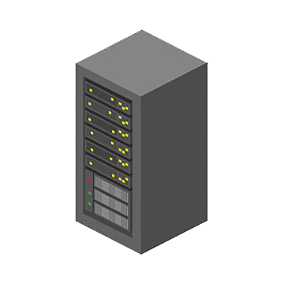

Client Server Sides
Request
Response
Client
Server

Slide 10
Client Server Sides
Request
Response
Client
Server
JavaScript
HTML
CSS
NodeJS

Slide 11


How NodeJS use JavaScript
Results
JavaScript Code
JavaScript Code
Results
Written in C++

Slide 12
What Developer Make with NodeJS
Developer Make API with NodeJS
So we can connect server with client
Node can make API for web, Android and IOS etc.
Make can also make website

Slide 13

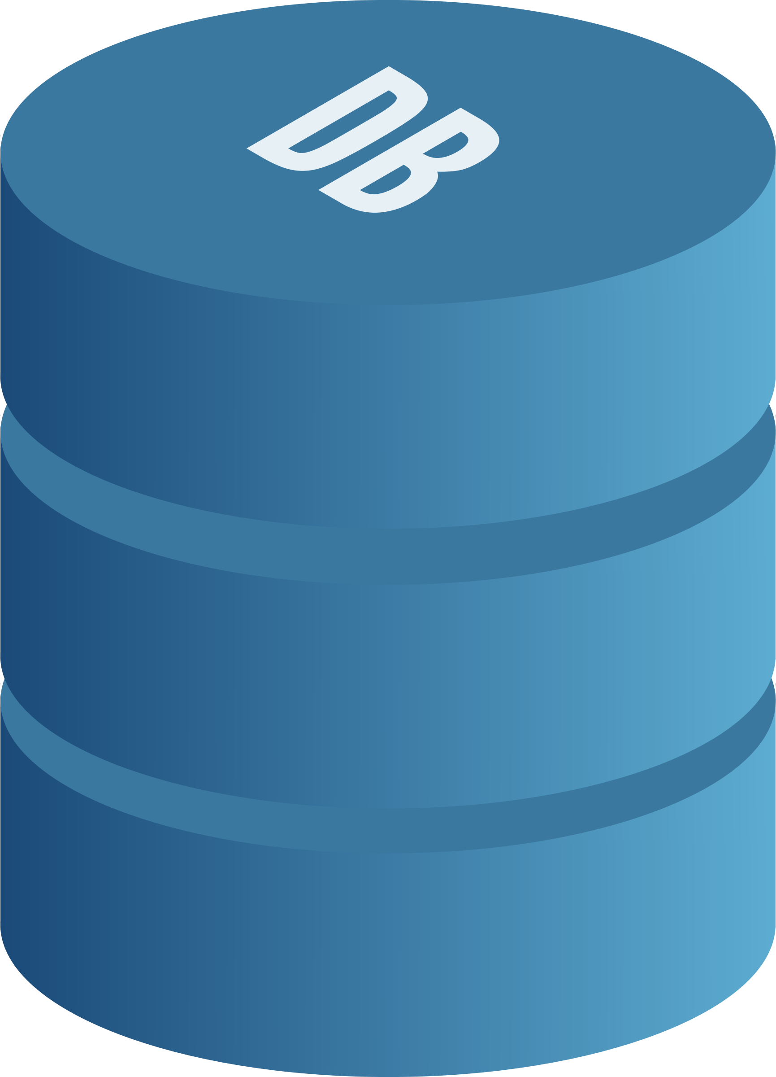


What developer make with nodeJS
Front-End/Back-end
Web App
Database
Server
Mobile App
File Server

Slide 14
Install and Setup NodeJS
Download NodeJS
Install NPM and Node
List of Recommended code editor

Slide 15
First Script with NodeJS
Script with Command Line
Make folder and file

Slide 16
Fundamentals of NodeJS
JavaScript fundamentals for NodeJS.
Condition, Loops and Array.
The import function and variables from another file.

Slide 17
Core Module in NodeJS
What are the core modules ?
What are the global modules ?
Global module example
Non-global module with example
Global module:-> No need to import, it have keep in node library.
Non-global module:-> it must import the module.

Slide 18
Make Basic Server output on Browser
Make Basic Server
Function as parameter in node.
Arrow function.
Get output on Browser.
Http:- it is handle the server request and response.
function dataControl(req,resp){
resp.write("<h2>Hello, This is Alok singh.He is Developer</h2>");
resp.end();
}
http.createServer(dataControl).listen(4000);
const dataControl = (res,resp) =>{
resp.write("<h2>Hello, This is Alok singh.He is Developer</h2>");
resp.end();
}
http.createServer(dataControl).listen(4000);
const app = require('./app')
// console.log(app.z());
// var x=20;
// if(x===20){
// console.log("matched");
// }
//console.log(x);
const arr =[20,12,30,8,4,15,3,12];
//console.log(arr);
result = arr.filter((item)=>{
return item>12;
///console.log(item);
})
console.log(result);
fileSystem: const fs = require('fs');
fs.writeFileSync("app-demo.doc","This is app demo text ficle");

Slide 19
Samll Chalenge for you
What happens if the node_modules folder is deleted
How to recover the node_modules when deleted by mistake
D:/node24>npm install

Slide 20
Nodemon | time saving module
What is the nodemon package?
How to install it ?
How to use ?
Install external package
Nodemon Package:-> nodemon is a tool that helps develop Node.js based applications by automatically restarting the node application when file changes in the directory are detected.
Package install
D:/node24>npm i nodemon
If may be package not working that try open windowsPowershale then run command as
Get-ExecutionPolicy
Set-ExecutionPolicy RemoteSigned
Set-ExecutionPolicy Unrestricted
Set-ExecutionPolicy RemoteSigned -Scope CurrentUser
Interview Qst:- Node is single threaded use it means one command at a one time not using multiple command .

Slide 21
NodeJS is async
Run first Script
Run Second Script (Complex data) -----it will not to finish 2nd Script…..
Run third Script
Continue

Slide 22
Make a Simple API
Make a Server
Create header and API body
Create an API with static
Put data in another file
const data = [
{name:'Alok singh',email:'web.aloksingh8190@gmail.com',contactNO:'8102240270'},
{name:'Aastha Bharti',email:'aastha.bharti@gmail.com',contactNO:'9265275285'},
{name:'Anshika Bharti',email:'anshika.bharti@gmail.com',contactNO:'8882165414'},
{name:'Raja',email:'raja@gmail.com',contactNO:'8882165414'},
];
module.exports = data;
Put Data another file (Import the file)
const http = require('http');
const user_data = require('./user_data');
http.createServer((req,resp)=>{
resp.writeHead(200,{'content-type':'application\json'});
resp.write(JSON.stringify(user_data));
resp.end();
}).listen('5000');

Slide 23
Input from command Line
Set input from command line
Create file with input
Delete file with input
Create and remove file with input
File index
const fs = require('fs');
const input = process.argv;
if(input[2]=="add")
{
fs.writeFileSync(input[3],input[4]);
}else if(input[2]=="remove")
{
fs.unlinkSync(input[3]);
}else{
console.log("Invalid input");}
File description
D:/node24>node index.js add data.txt ‘This is data text file’
Data.txt created
D:/node24>node index.js remove data.txt
Data.txt remove
Enter
Enter

Slide 24
Show File List
Make File and folder
Use path module
Get file names and print
Current directory path
Directory name
const fs = require('fs');
const path = require('path');
const dirPath = path.join(__dirname,'files');
for(i=0;i<5;i++)
{
fs.writeFileSync(dirPath+'/data'+i+'txt','this is data txt file');
//fs.writeFileSync(`data${i}.txt`,'Simple data text')
}
//console.log(dirPath);
Part:1

Slide 25
Show File List
Make File and folder
Use path module
Get file names and print
Current directory path
const fs = require('fs');
const path = require('path');
const dirPath = path.join(__dirname,'files');
// for(i=0;i<5;i++)
// {
// fs.writeFileSync(dirPath+'/data'+i+'txt','this is data txt file');
// //fs.writeFileSync(`data${i}.txt`,'Simple data text')
// }
//console.log(dirPath);
fs.readdir(dirPath,(err,files)=>{
console.warn(files); //Rread and Get the files or data in array
})
fs.readdir(dirPath,(err,files)=>{
files.forEach((item)=>{
console.log("File name is",item); // Get the signle files or data
})
})
Directory name
Part:2

Slide 26
CRUD with File System
Make file.
Read File.
Update File.
Rename File.
Delete File.

Slide 27
CRUD with File System Example
Current directory path
const fs = require('fs');
const path = require('path');
const dirPath = path.join(__dirname,'crud');
const filePath = `${dirPath}/apple.txt`;
fs.writeFileSync(filePath,'this is the samlpe text'); //Create the file
fs.readFile(filePath,'utf8',(err,item)=>{ //Read the file
console.log(item);
})
fs.appendFile(filePath,'and file name is apple.txt',(err)=>{ //Update the file
if(!err) console.log("File is updated");
})
fs.rename(filePath,`${dirPath}/banana.txt`,(err)=>{ //Rename the file
if(!err) console.log("File is renamed");
});
fs.unlinkSync(`${dirPath}/apple.txt`);//delete the file
fs.unlinkSync(`${dirPath}/apple.txt`,(err)=>{ //Delete the file
if(!err) console.log("File is deleted");
});
Directory name

Slide 28
Asynchronous Basic in Nodejs
In synchronous operation task are performs at a time
Users…
Products..
Cities..
In Asynchronous second task don not wait to finish first
Users…
Products..
Cities..

Slide 29
Asynchronous Basic in Nodejs
console.log("Start exe...");
console.log("Login exe...");
console.log("Completed exe...");
// Time invertal
console.log("Start exe...");
setTimeout(()=>{
console.log("Login exe...")},2000)
console.log("Completed exe...");
//Drow back
let a =10;
let b=0;
setTimeout(()=>{
let b=20},2000);
console.log(a+b);

Slide 30
Handle Asynchronous Data in NodeJS
let a =20;
let b=0;
let waitngData = new Promise((resolve,reject)=>{
setTimeout(()=>{
//let b=30
resolve(30)
},2000);
})
waitngData.then((data)=>{
b = data;
console.log(a+b);
})

Slide 31

How NodeJS Works
Call Stack
Node API
Callback Queue
Example
const x = 1;
const y = x+2;
Console.log(‘Sum is ‘ +y );
Call Stack
Node APIs
Event Loop
Callback queue

Slide 32
How NodeJS Works
const x = 1;
const y = x+2;
Console.log(‘Sum is ‘ +y );
Call Stack
Node APIs
Register the function and the tasks here inside the main function.
main()
By default
Event Loop
Callback queue

Slide 33
How NodeJS Works
const x = 1;
const y = x+2;
Console.log(‘Sum is ‘ +y );
Call Stack
Node APIs
Log( ‘Sum is 3’ );
main()
By default
Event Loop
Callback queue
Sum is 3

Slide 34
How NodeJS Works
const x = 1;
const y = x+2;
Console.log(‘Sum is ‘ +y );
Call Stack
Node APIs
main()
By default
Event Loop
Callback queue
Sum is 3

Slide 35
How NodeJS Works
const x = 1;
const y = x+2;
Console.log(‘Sum is ‘ +y );
Call Stack
Node APIs
Event Loop
Callback queue
Sum is 3

Slide 36
How NodeJS Works
console.log('Starting up'); setTimeout(()=>{
console.log('2 second log');
},2000) setTimeout(()=>{
console.log(‘Zero second log');
},0)
console.log('finishing up');
Node APIs
Call Stack
setTimeout(2 sec)
main()
Event Loop
Callback queue
Starting up

Slide 37
How NodeJS Works
console.log('Starting up'); setTimeout(()=>{
console.log('2 second log');
},2000) setTimeout(()=>{
console.log(‘Zero second log');
},0)
console.log('finishing up');
Node APIs
Call Stack
setTimeout(2 sec)
setTimeout(0 sec)
main()
Event Loop
Starting up
Callback queue

Slide 38
How NodeJS Works
console.log('Starting up'); setTimeout(()=>{
console.log('2 second log');
},2000) setTimeout(()=>{
console.log(‘Zero second log');
},0)
console.log('finishing up');
Node APIs
Call Stack
setTimeout(2 sec)
main()
Event Loop
Starting up
Callback queue
setTimeout(0 sec)

Slide 39
How NodeJS Works
console.log('Starting up'); setTimeout(()=>{
console.log('2 second log');
},2000) setTimeout(()=>{
console.log(‘Zero second log');
},0)
console.log('finishing up');
Node APIs
Call Stack
Callback (0 sec)
Event Loop
Starting up
Callback queue
Finising up
setTimeout(2 sec)

Slide 40
How NodeJS Works
console.log('Starting up'); setTimeout(()=>{
console.log('2 second log');
},2000) setTimeout(()=>{
console.log(‘Zero second log');
},0)
console.log('finishing up');
Node APIs
Call Stack
Callback (2 sec)
Event Loop
Starting up
Callback queue
Finising up
Zero Second
Finising up

Slide 41
Express JS
What is Express JS ?
Install Express
Make Example with express JS.
Express.js is a small framework that works on top of Node.js web server functionality to simplify its APIs and add helpful new features.
Explanation:
Import the ‘express’ module to create a web application using Node.js.
Initialize an Express app using const app = express();.
Add routes (endpoints) and middleware functions to handle requests and perform tasks like authentication or logging.
Specify a port (defaulting to 3000) for the server to listen on.
const express = require("express");
const app = express();
app.get('',(req,resp) => {
resp.send('Hello World!, This is home Page');
});
app.get('/about-us',(req,resp) => {
resp.send('Hello World!, This is About us page');
});

Slide 42
Express JS
const express = require("express");
const app = express();
app.get('',(req,resp) => {
resp.send('Hello World!, This is home Page');
});
Response
Request
Server
Client
app.get('',(req,resp) => {
console.log("Data send by browser =>",req.query.name);
resp.send('Hello World!, This is home Page');
});
app.get('',(req,resp) => {
console.log("Data send by browser =>",req.query.name);
resp.send(‘Welocme’+ req.query.name);
});

Slide 43
Render HTML and JSON
How HTML tags ?
Show Json Data
Link page
app.get('',(req,resp) => {
resp.send(`<h1>Welcome to Home page</h1><a href="/about-us">About us</a>`);
});
app.get('/contact-us',(req,resp) => {
resp.send([ {
name:'Alok',
email:'alok@gmail.com',
}, {
name:'Aastha',
email:'aastha@gmail.com',
}]);
});
app.get('/about-us',(req,resp) => {
//resp.send('<input type="date">'+'<input type="emain">');
resp.send(`<input type="date"><a href="/">Go to Home</a>`);
});

Slide 44
Make HTML Pages
Make folder for the HTML files and access it.
Make HTML files
Load HTML files
It access the folder sources help with Path()
const express = require("express");
const path = require('path');
const app = express();
const publicPath = path.join(__dirname,'public');
//console.log(publicPath)
app.use(express.static(publicPath));
It static method load the static pages or content.

Slide 45
Remove extension from URL
Apply get Method.
Remove an extension from URL.
Make 404 Page
Apply 404 Page.
const publicPath = path.join(__dirname,'public');
//console.log(publicPath)
//app.use(express.static(publicPath));
app.get('',(req,resp)=>{
//resp.sendFile(path.join(publicPath,'index.html'));
resp.sendFile(`${publicPath}/index.html`);
});
app.get('/about-us',(req,resp) => {
resp.sendFile(`${publicPath}/about-us.html`);
});
app.get('/contact-us',(req,resp) => {
resp.sendFile(`${publicPath}/contact-us.html`);
});
app.get('*',(req,resp) => {
resp.sendFile(`${publicPath}/404.html`);
});

Slide 46
Template Engine
What is the template engine ?.
Install ejs template Package.
Setup dynamic routing
Make dynamic Page
Instal => npm install ejs
Template Engine :=> It allows you to generate dynamic content by embedding JavaScript to HTML content.
const publicPath = path.join(__dirname,'public');
app.set('view engine','ejs');
app.get('',(req,resp)=>{
resp.sendFile(`${publicPath}/index.html`);
});
app.get('/profile',(req,resp)=>{
const user ={
name:'Alok Singh',
email:'alok@yahoo.com'
}
resp.render('profile',{user});
});
Call onto the .ejs view file
<h2>Welcome <%= user.name%> And Email is <%= user.email%></h2>

Slide 47
Dynemic Page
How to make loop in ejs.
Make header file.
Show header common file.
app.get('/profile',(_,resp)=>{
const user ={
skills:['PhP','Ajax','JavaScript','c++']
}
resp.render('profile',{user});
});
Using Loop
<ul>
<% user.skills.forEach((item)=>{ %>
<li><%= item %></li>
<% })%>
</ul>
Output:
PhP
Ajax
JavaScript
C++
Common page Call
<%- include('common/header'); %>

Slide 48
Middleware
What is middleware ?
How to make the middleware ?
Apply middleware on routes.
Types of middleware
Middleware is a request handler that allows you to intercept and manipulate requests and responses before they reach route handlers.
Middleware Types
Application-level middleware
Router-level middleware
Error handling middleware
Built-in middleware
Third-party middleware

Slide 49
const express = require("express");
const app = express();
const reqFilter = (req,resp,next)=>{
//console.log('reqFilter');
if(!req.query.age)
{
resp.send('Please provide age');
}else if(req.query.age<18)
{
resp.send('You can not access this page.');
}else{
next();
}
}
app.use(reqFilter);
app.get('/',(req,resp)=>{
resp.send("welcome to middleware");
});
app.get('/users',(req,resp)=>{
resp.send("welcome to users page");
});
app.listen(5000);

Slide 50
Route Level Middleware
Route Level middleware
Apply middleware on single Route
Make middleware in different file.
Apply middleware in the group of route.
Router-level middleware works in the same way as application-level middleware, except it is bound to an instance of express. Router().

Slide 51
const express = require("express");
const reqFilter = require('./middleware');
const app = express();
const route = express.Router();
route.use(reqFilter);
app.get('/',(req,resp)=>{
resp.send("welcome to middleware");
});
app.get('/users',(req,resp)=>{
resp.send("welcome to users page");
});
route.get('/about-us',(req,resp)=>{
resp.send("welcome to About us page");
});
route.get('/contact-us',(req,resp)=>{
resp.send("welcome to Contact page");
});
app.use('/',route);

Slide 52
Install MongoDB
Download DB
Install MongoDB
Set Environment for Mongo.
MongoDB compass tool.

Slide 53
MongoDB Basic
MongoDB
{“id”:objectID(“5csdwafca2ecdd21f7”) “F_name”:’Alok’, “F_name”:Singh’, “Address1:Noida’, “Address2”:Noida Sec-62’, }, {“id”:objectID(“5csdwafca2ecdd21f7”) “F_name”:Aasths’, “F_name”:Bharti’, “Address1:New Delhi’, “Address2”:New Ashok Nagar’, }
What is MongoDB
MongoDB vs SQL
MongoDB Basic Command.
MongoDB is non-SQL database.
The data store in collection.
Collection don’t have row and column.
Data store in the form of object.
SQL
id | F_name | L_name | Address1 | Address2
1 | Alok | Singh | Noida | Noida Sec-62
2 | Aastha | Bharti | Delhi | New Ashok Nagar
3 | Anshika | Bharti | New Delhi | Delhi

Slide 54
Crud Operation in MongoDB
How to insert data collection
How to check insert data
How to update data
How to delete data
Insert data using by command
db.products.insertOne({name: Samsung M40',brand:'samsung',price:250,category:'Mobile'})
{ acknowledged: true, insertedId: ObjectId('671684d1fb0510de5c7deacb')}
Output
{ "_id": { "$oid": "671684d1fb0510de5c7deacb" }, "name": "Samsung M40", "brand": "Samsung", "price": 250, "category": "Mobile"}
Output
Insert data using by UI (Manual)
{ "_id": { "$oid": "671685cc94e908c30ff589a3"
},
"name": "Vivo U10",
"brnad": "Vivo",
"price": 150,
"category": "Mobile"}
{ "_id": { "$oid": "6716897294e908c30ff589a4" },
"name":"Vivo u20",
"brand":"Vivo",
"Price":120,
"category":"Mobile“
}

Slide 55
Crud Operation in MongoDB
Update data using by command
db.products.updateOne({name:"iphone M14"},{$set:{price:520}})
{ acknowledged: true, insertedId: null, matchedCount: 1, modifiedCount: 1, upsertedCount: 0
}
Update output data
id: ObjectId('6716858afb0510de5c7deacd')
Name:"iphone M14"
brand: "Apple"
price: 520
category: "Mobile"
Delete data using by command
db.products.deleteOne({brand:"Apple"})
{ acknowledged: true,
deletedCount: 1
}

Slide 56
Connect node with MongoDB
Install MongoDB Package
Connect MongoDB with Node JS.
Show data from MongoDB.
const {MongoClient} = require('mongodb');
//const MongoClient = require('mongodb').MongoClient; //Same as above
//Connection URL
const url = 'mongodb://localhost:27017';
const database = 'node_app_ecom24';
const client = new MongoClient(url);
async function getData()
{
let conn_result = await client.connect();
let db = conn_result.db(database);
let collection = db.collection('products');
let resp = await collection.find({}).toArray();
console.log(resp);
}
getData();

Slide 57
Read data from MongoDB
Read data from MongoDB
Make file for DB Connection.
Handle promise.
Read Single data
Called db connection file
const dbConnect = require('./mongodb’);
dbConnect().then((resp)=>{
resp.find({name: 'Vivo U10'}).toArray().then((data)=>{
console.log(data);
});
})
then () function handle the promise
Find () just like where condition as use in MySQL
await () function handle the promise
Read All data data
const main = async() =>{
let data = await dbConnect();
data = await data.find().toArray();
console.warn(data);
}
main();

Slide 58
Insert Data from MongoDB
Make new file for insert data.
Import MongoDB Connection.
Insert single and Multiple records.
Single Data Insert
const insert = async ()=>{
const db = await dbConnect();
const result = await db.insertOne(
[
{ name:"note V25", brand:"Vivo", price:190, category:"mobile"},
]);
if(result.acknowledged)
{
console.log("data inserted");
}
}
insert();

Slide 59
Insert Data from MongoDB
Make new file for insert data.
Import MongoDB Connection.
Insert single and Multiple records.
Multiple Data Insert
await () function handle the promise
const insert = async ()=>{
const db = await dbConnect();
const result = await db.insertMany(
[
{ name:"Moto G73", brand:"Motorola", price:350, category:"mobile"},
{ name:"Max G25", brand:"Micromax", price:230, category:"mobile"},
{ name:"Max G25", brand:"Micromax", price:230, category:"mobile"}
]);
if(result.acknowledged){
console.log('Data inserted successfully')
}
}
insert();

Slide 60
Update Data from MongoDB
Make new file for update data.
Import MongoDB Connection.
update single and Multiple records.
Update single record
const dbConnect = require('./mongodb'); const updateData = async ()=>{
const db = await dbConnect();
let result = await db.updateOne(
{name:"Vivo U220"},{
$set:{name:'Vivo U210'}
}
);
if(result.acknowledged)
{
console.warn('Data updated Successfully!');
}
}
updateData();
await () function handle the promise

Slide 61
Update Data from MongoDB
Make new file for update data.
Import MongoDB Connection.
update single and Multiple records.
Update multiple records
const dbConnect = require('./mongodb'); const updateData = async ()=>{
const db = await dbConnect();
let result = await db.updateMany(
{name:"Moto G73"},{
$set:{name:'Moto A G73', price:399}
}
);
//console.log(result);
if(result.acknowledged)
{
console.warn('Data updated Successfully!');
}
}
updateData();
await () function handle the promise

Slide 62
Delete Data from MongoDB
Make new file for Delete data.
Import MongoDB Connection.
Delete single and Multiple records.
Delete single ecord
const dbConnect = require('./config/mongodb');
const deleteData = async() =>{
const db = await dbConnect();
let result = await db.deleteOne(
{name:'note 5'}
)
//console.warn(result);
if(result.acknowledged)
{
console.log('Data deleted successfully!');
}
}
deleteData();
await () function handle the promise

Slide 63
Delete Data from MongoDB
Make new file for Delete data.
Import MongoDB Connection.
Delete single and Multiple records.
Delete multiple records
const dbConnect = require('./config/mongodb');
const deleteData = async() =>{
const db = await dbConnect();
let result = await db.deleteMany(
{name:'note 5'}
)
//console.warn(result);
if(result.acknowledged)
{
console.log('Data deleted successfully!');
}
}
deleteData();
await () function handle the promise

Slide 64
API with MongoDB
Make new file for API.
Import and use Mongo config.
Make API for get data.
Test with Postman
const express = require('express');
const dbConnect = require('./config/mongodb');
const app = express();
app.get('/', async(req, resp)=>{
let dbData = await dbConnect();
let result = await dbData.find().toArray();
//console.log(result);
resp.send(result);
})
app.listen(5000);

Slide 65
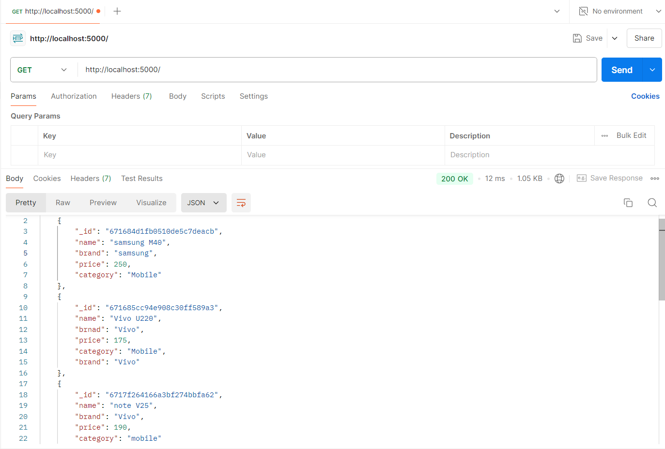
API with MongoDB
Test with Postman

Slide 66
NodeJS Post API Method
Make Post Method for API.
Send data from postman.
Get data in NodeJS by request.
Write code for insert data in MongoDB.
Make Post Method for API.
app.get('/', async(req, resp)=>{
let dbData = await dbConnect();
let result = await dbData.find().toArray();
//console.log(result);
resp.send(result);
}) app.post('/',(req,resp)=>{
// console.log(req.body);
// resp.send(req.body)
resp.send({name:"Alok"})
})

Slide 67
NodeJS Post API Method
Send data from Postman.
const express = require('express');
const dbConnect = require('./config/mongodb'); const app = express();
app.use(express.json());
app.get('/', async(req, resp)=>{
let dbData = await dbConnect();
let result = await dbData.find().toArray();
//console.log(result);
resp.send(result);
})
app.post('/',(req,resp)=>{
console.log(req.body);
resp.send(req.body);
//resp.send({name:"Alok"})
})
app.listen(5000);

Slide 68
NodeJS Post API Method
Write code for insert data in MongoDB
const express = require('express');
const dbConnect = require('./config/mongodb');
const app = express();
app.use(express.json());
app.get('/', async(req, resp)=>{
let dbData = await dbConnect();
let result = await dbData.find().toArray();
//console.log(result);
resp.send(result);
})
app.post('/', async(req,resp)=>{
let data = await dbConnect();
let result = await data.insertOne(req.body)
resp.send(result)
//console.log(result)
})
app.listen(5000);

Slide 69
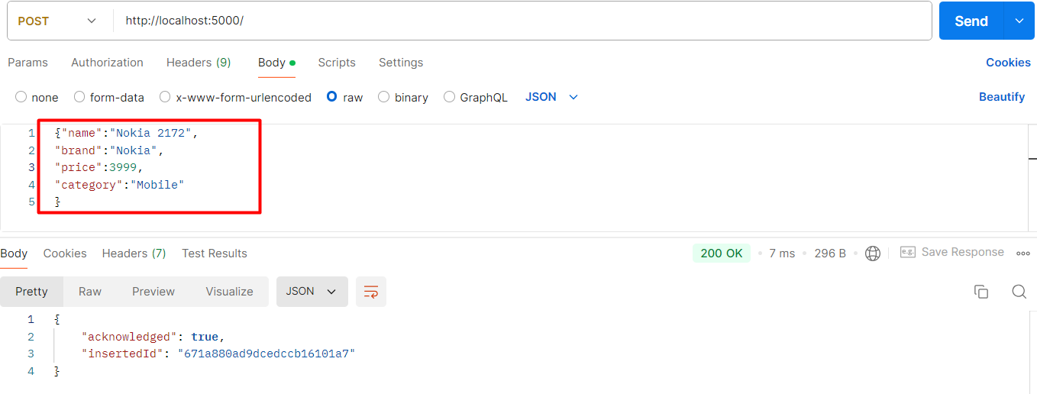
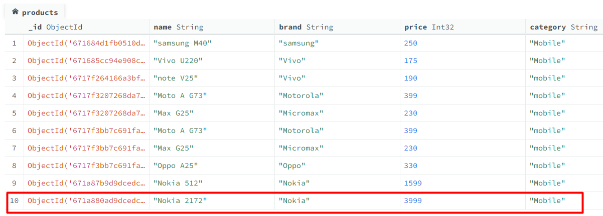
NodeJS Post API Method
Write code for insert data in MongoDB
New entry data in postman
Data insert in MongoDB

Slide 70
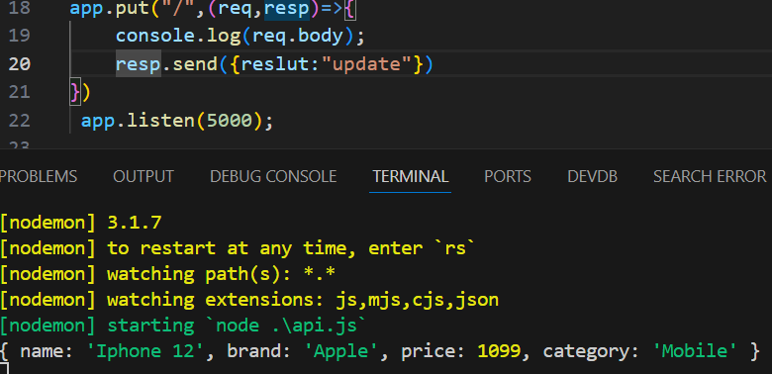
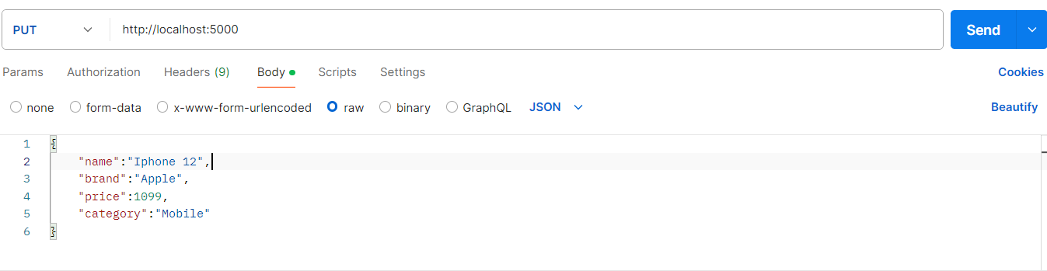
NodeJS Put API Method
Make Put method for API
Send data from Postman.
Handle data in NodeJS by request.
Write code for update data in MongoDB
Send data from Postman
Output
It uses put method to update data with API.
app.put("/", async(req,resp)=>{
let data = await dbConnect();
let result = await data.updateOne(
{name : "Iphone 13"},{
$set:{price:999}}
)
console.log(result);
//resp.send({reslut:"update"})
})

Slide 71
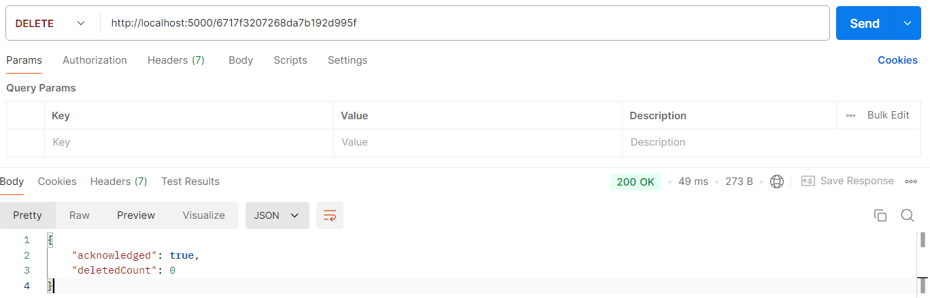
NodeJS Delete API Method
Make delete method for API
Send data from Postman.
Handle data in NodeJS by request.
Write code for delete data in MongoDB
It uses put method to update data with API.
app.delete('/:id', async(req, resp) => {
//console.log(req.params.id)
const data = await dbConnect();
const result = await data.deleteOne({ _id: new mongodb.ObjectId(req.params.id) });
resp.send(result);
});

Slide 72
Start with Mongoose
What is mongoose ?
Different between Mongoose VS MongoDB package .
Install Mongoose.
What is schemas ?
What is model ?
Connect NodeJS and MongoDB with Mongoose
Mongoose : - It is npm package to establish the connection between NodeJS and MongoDB.
Schemas : - it is validate the database fields or column.
Model : - It basically connects NodeJS to MongoDB. It is use the schemas

Slide 73
Start with Mongoose
Connect NodeJS and MongoDB with Mongoose
const mongoose = require('mongoose');
const main = async () =>{
await mongoose.connect("mongodb://localhost:27017/node_app_ecom24");
const productSchema = new mongoose.Schema({
name: String,
brand: String,
price: Number,
// category: String
});
const productsModel = mongoose.model('products',productSchema);
const product = new productsModel({name:"Max 8",brand:"micromax",price:1000});
const result = await product.save();
console.log(result);
}
main();

Slide 74
CRUD With Mongoose
Update Record
Delete Record
Find and Read Result
Update Record
const updateInDB = async () => {
await mongoose.connect("mongodb://localhost:27017/node_app_ecom24");
const productSchema = new mongoose.Schema({name: String, brand: String, price: Number, category: String
});
const productsModel = mongoose.model("products", productSchema);
let data = await productsModel.updateOne(
{ name: "Max 10" },
{
$set: { price: 750, name:"Max 15 pro" },
}
);
console.log(data);
};
updateInDB();00000

Slide 75
CRUD With Mongoose
Delete Record
Find and Read Result
Delete Record
const deleteInDB = async ()=>{
await mongoose.connect("mongodb://localhost:27017/node_app_ecom24");
const productSchema = new mongoose.Schema({
name: String,
//brand: String,
price: Number,
//category: String
});
const productsModel = mongoose.model("products", productSchema);
let data = await productsModel.deleteOne({name:"Max 15 pro"});
console.log(data);
}
deleteInDB();

Slide 76
CRUD With Mongoose
Find and Read Result
Find Single record
const findInDB = async () => {
await mongoose.connect("mongodb://localhost:27017/node_app_ecom24");
const productSchema = new mongoose.Schema();
const productsModel = mongoose.model("products", productSchema);
let data = await productsModel.find({name:"Iphone 12"});
console.log(data);
}
findInDB();
const findInDB = async () => {
await mongoose.connect("mongodb://localhost:27017/node_app_ecom24");
const productSchema = new mongoose.Schema();
const productsModel = mongoose.model("products", productSchema);
let data = await productsModel.find();
console.log(data);
}
findInDB();
Find all records

Slide 77
Post API with Mongoose
Make config file for MongoDB
Make Post Route
Get data from the Post
Connection with MongoDB
const mongoose = require('mongoose');
mongoose.connect("mongodb://localhost:27017/node_app_ecom24");
Products Schema
const productSchema = new mongoose.Schema({
name: String,
price: Number,
brand: String,
category:String
});
// const Product = mongoose.model("Products", productSchema);
module.exports = mongoose.model("Products", productSchema);

Slide 78
Post API with Mongoose
Connection with MongoDB
const express = require('express');
require("./config/config");
const Product = require("./product");
const app = express();
app.use(express.json());
app.post('/create', async(req,resp)=>{
let data = new Product(req.body);
let result = await data.save();
console.log(req.body);
resp.send(result);
});
app.listen(5000);

Slide 79
Get, Delete And Put API
Example of Get Method API
Example of Delete Method API
Example of Put Method API
Get Method API
app.get('/list', async(req, resp) => {
let data = await Product.find();
resp.send(data);
});
Delete Method API
app.delete('/delete/:_id', async(req, resp) => {
//console.log(req.params)
let data = await Product.deleteOne(req.params);
resp.send(data);
});
Condition request
Put Method API
app.put('/update/:_id', async(req, resp) => {
let data = await Product.updateOne(
req.params,
{ $set: req.body }
);
resp.send(data);
});
Set the update data

Slide 80
Search API in NodeJS with Mongoose
Make Simple Get Route for API
Search with Single field
Search with Multiple fields
Test API
const express = require('express');
require("./config/config");
const Product = require("./product");
const app = express();
app.use(express.json());
app.get('/search/:key', async(req,resp)=>{
console.log(req.params.key);
let data = await Product.find(
{
"$or":[
{"name":{$regex:req.params.key} },
{"brand":{$regex:req.params.key} },
{"category":{$regex:req.params.key} }
]
}
);
resp.send(data);
})
app.listen(5000);
Regex with object inside the string

Slide 81
Search API in NodeJS with Mongoose
Install multer npm package.
Make Route for upload file.
Write Code for upload file.
It is the multer function
const express = require('express');
const multer = require('multer');
const app = express();
const upload = multer({
storage:multer.diskStorage({
destination:function(req,file,cb)
{
cb(null,"uploads")
},
filename:function(req,file,cb)
{
cb(null,file.fieldname+"_"+Date.now()+".jpg")
}
})
}).single("user_file");
app.post("/upload",upload,(req,resp) => {
resp.send("file uploaded");
});
app.listen(5000);
It is call back function

Slide 82
OS Module in NodeJS
What is OS module.
Important function od OS module.
OS module: it is provides information related to the operating system and hardware. Also like see the hostname, RAM etc.
const OS = require("os");
//console.log(OS.arch());
// console.log(OS.freemem()/(1024*1024*1024));
// console.log(OS.totalmem()/(1024*1024*1024));
//cconsole.log(os.hostname)
// console.log(OS.platform);
//console.log(OS.release());
console.log(OS.userInfo);

Slide 83
Events and Event Emitter
What is Event and Event Emitter ?
Make an Event and call it.
Events: Event is a send the signal on these given action.
It is the Class
Event Emitter:- it is to generate the event called event emitter
It is the Object
const express = require('express');
const EventEmitter = require('events');
const app = express();
const event = new EventEmitter();
let count=0;
event.on("countAPI",()=>{
count++;
console.log("event called",count);
}) app.get('/',(req,resp) =>{
resp.send("api called");
event.emit("countAPI");
});
app.get('/search',(req,resp) =>{
resp.send("Search api called");
event.emit("countAPI");
});
app.get('/update',(req,resp) =>{
resp.send("Update api called");
event.emit("countAPI");
})
app.listen(5000);

Slide 84
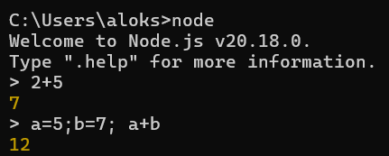
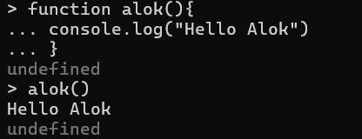
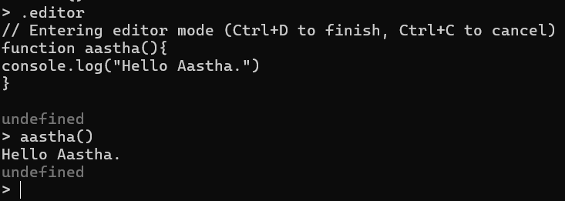
REPL(Read-Eval-Print-Loop
What is REPL
Example of REPL.
REPL: It is a command line tool on which we run the code of Node.js and JavaScript.

Slide 85
Node JS Connect with MySQL
Install MySQL npm Package
Connect NodeJS and MySQL
Get Data from MySQL
Install npm: npm i mysql.
Connection
const mysql = require("mysql"); const conn = mysql.createConnection({
host: "localhost",
user: "root",
password: "",
database: "tbm_audit",
});
conn.connect((error) => {
if (error) {
console.log("Error connecting to database");
} else {
console.log("Connected to database");
}
});
Get Data
conn.query("select *from users", (error, result) => {
console.warn("result", result);
});

Slide 86
Node JS GET API with MySQL
Make config file.
Make route for API.
Get Data from MySQL
Install npm: npm i mysql.
Make file: db_config.js
Get Data
const mysql = require("mysql");
const conn = mysql.createConnection({
host: "localhost",
user: "root",
password: "",
database: "dhr",
});
conn.connect((error) => {
if (error) {
console.warn("Error connecting to database");
} else {
//console.warn("Connected to database");
}
});
module.exports =conn;
const express = require("express");
const conn = require("./config/db_config");
const app = express();
app.get("/", (req, resp) => {
//resp.send("Hello World");
conn.query("select * from users", (err, result) => {
if (err) {
resp.send(error);
} else {
resp.send(result);
}
});
});
app.listen(5000);

Slide 87
Node JS POST API with MySQL
Make route for API.
Insert Data in MySQL
insert Static Data
const express = require("express");
const conn = require("./config/db_config");
const app = express();
app.get("/", (req, resp) => {
conn.query("select * from users", (err, result) => {
if (err) {
resp.send(error);
} else {
resp.send(result);
}
});
});
app.post("/",(req,resp)=>{
const data= {name:"Alok",email:"alok@gmail.com",password:"India#4312"};
conn.query("INSERT INTO users SET ?",data,(err,result)=>{
if(err){
resp.send(err);
}
else{
resp.send(result);
}
});
})
app.listen(5000);

Slide 88
Node JS POST API with MySQL
Make route for API.
Insert Data in MySQL
insert Data through Postman
const express = require("express");
const conn = require("./config/db_config");
const app = express();
app.use(express.json());
app.get("/", (req, resp) => {
conn.query("select * from users", (err, result) => {
if (err) {
resp.send(error);
} else {
resp.send(result);
}
});
});
app.post("/",(req,resp)=>{
const data= req.body;
conn.query("INSERT INTO users SET ?",data,(err,result,fields)=>{
if(err) err;
resp.send(result);
});
})
app.listen(5000);

Slide 89
Node JS PUT API with MySQL
Make route for API.
Get Data from Postman
Update Data in MySQL
Update Data statically
const express = require("express");
const conn = require("./config/db_config");
const app = express();
app.put("/", (req, resp) => {
const data = ["Anshi","anshi@gmail.com","India@4312",5];
conn.query("update users set name =?,email=?,password=? where id=?",data,(err,result,fields)=>{
if (err) throw err;
resp.send(result);
});
});
app.listen(5000);

Slide 90
Node JS PUT API with MySQL
Make route for API.
Get Data from Postman
Update Data in MySQL
Update Data Dynamically
const express = require("express");
const conn = require("./config/db_config");
const app = express();
app.use(express.json());
app.put("/:id", (req, resp) => {
const data = [req.body.name,req.body.email,req.body.password,req.params.id];
conn.query("update users set name =?,email=?,password=? where id=?",data,(err,result,fields)=>{
if (err) throw err;
resp.send(result);
});
});
app.listen(5000);

Slide 91
Node JS Delete API with MySQL
Make route for API.
Get Data from Postman
Delete Data in MySQL
const express = require("express");
const conn = require("./config/db_config");
const app = express();
app.use(express.json());
app.delete('/:id',(req,resp)=>{
conn.query("DELETE FROM users WHERE id= "+ req.params.id,(error,result)=>{
if(error) throw error;
resp.send(result);
});
// resp.send(req.params.id);
})
app.listen(5000);

Slide 92
Node JS Project
E-commerce dashboard
What is E-commerce Dashboard Project
A Dashboard where we manage all Products of a E-Commerce Company
E.g Amazon Flipkart etc.
This is the sample and basic project.
We make API IN Node JS.
We Make front end in React and Angular
Sample APLI will Work in both technology.

Slide 93
Why this project is important.
We get to know how to integrate node JS with front end.
How to make basic project Structure.
How to manage multiple APIs.
How we can Pass data one PAI to another API.
Why this project is important.
We use MongoDB as database.
Even database don’t make an impact on front end .
Every API will fetch data from database.

Slide 94
How we start with Project.
First we setup Node JS.
After that we setup front end.
In every video, we learn one topic.
E.g In one video we make API and in the next video we integrate this API with front end.
Major topics of project .
Project setup.
Make Login, Register user feature.
Product listing.
Add new Product.
Search product.
Update product.
Hard Delete and soft delete product.
Sorting ,filtering ,pagination.
Categories.
Security toke with Login and Register
Routing.
Much more…

Slide 95
Backend (NodeJS) Setup.
Download NodeJS
Make Package. Json file.
Install express and MongoDB Package.
Install Nodemon.
Make index file and run it.

Slide 96
Frontend (React js) Setup.
Install React App.
Run App.
Make small changes.

Slide 97
Routing in React js.
Install Router.
Make Header file.
Make Links.
Make Route.

Slide 98
Header and footer
Add style in Header.
Make Header Component.
Add style in footer.
Update product structure.

Slide 99
Signup Page Layout
Make Component for Signup.
Make input fields.
Get form Data.

Slide 100
Signup API
Make DB and collection.
Make config file
Make model
Make Route for API.
Test API with Postman.
Fix cros issue in NodeJS

Slide 101
Integrate Signup API in React
Integrate API.
Redirect Page
Test Flow
Complete Signup Flow
Keep user data in local Storage.
Make Private component.
Handle Signup Page with local Storage.
Update Navbar for with Logout and Signup menu.
Private component: Private components are used to control access to certain parts of an application. Typically, you want to restrict access to certain routes or components based on whether a user is authenticated or has certain permissions.

Slide 102
Logout
Make function for logout.
Clear Local Storage.
Redirect user to signup.
Bug fix for last part.
Login API in Node JS
Make Route for API.
Pass data for Postman.
Fetch Result from DB.
Remove password from Register and Login API.
Test the flow.

Slide 103
Login component in React JS
Make Login Component
Make Login Route.
Make Input Fields.
Get input data State.
Test the flow.
Login API Integration
Test API with Postman.
Call PAI on Login Button Click.
Set Local Storage.
Redirect the page.
Update Navbar.
Test flow.

Slide 104
Update Navbar
Hide products menu before login
Show logged-in user name.
Add logo and style.
Test the flow.
Insta -> code .step
Add Product API
Make collection for product.
Define model for product collection.
Make route for add product.
Send data from postman.
Insta -> code .step

Slide 105
Add Product API
Make collection for product.
Define model for product collection.
Make route for add product.
Send data from postman.
Insta -> code .step
Add Product API
Make new component.
Define input fields.
Get data from input fields.
Insta -> code .step
Call API for Add Product
Get use id from local Storage.
Call API to add Product.
Get result and test flow.
Insta -> code .step

Slide 106
Product List API
Make Route for product list API.
Fetch data from Database .
Test API with postman.
Insta -> code .step
Integrate Product List API
Make function and define State.
Call API for Products List.
Make statics list.
Render Products list.
Insta -> code .step

Slide 107
Delete Product API
Make Route for API.
Get id with params in API URL.
Delete product from DB.
Test API with Postman.
Insta -> code .step
Integrate Delete Product API
Add delete column.
Make function for delete API call.
Call delete product API.
Test the flow.
Insta -> code .step

Slide 108
Update product component UI
Add link for update Product.
Make component for update product
Make input fields for updating product.
Collect input fields data.
Insta -> code .step
API for get single Product
Make API route.
Fetch data from database.
Test API with Postman.
Insta -> code .step
Prefill update Product form
Get id from UR perms.
Fetch product data.
Set data in input fileds.
Insta -> code .step

Slide 109
Prefill update Product form
Get id from UR perms.
Fetch product data.
Set data in input fields.
Insta -> code .step
API for update Product
Make API route.
Write code for update.
Send data form Postman.
Test API.
Insta -> code .step
Integrate API for Update Product
Use fetch method for API integration.
Send data with put method.
Redirect to product list page.

Slide 110
Search API for product
Make Route for API.
Write code for search and fetch data from DB.
Test API with Postman.
Integrate Search API
Make input box for search.
Make search Handle function.
Call API for search product.
Update list on search

Slide 111
JWT Authentication
Add JWT package.
Define the key for token.
Add token with login and register API.
Test the token with API in postman.
Handle Auth Token in ReactJS
Get token from API(Login and Register).
Store token in local storage.
Update API Request for testing token.
Test the token with API in postman.

Slide 112
Verify Auth token in NodeJS
Send token with postman
Make middleware for verifying token.
Verify token and send response .

Slide 113
Send Auth Token from ReactJs
Check API Response without token.
Send token in all API.
Test All API with token.

Slide 114
What is NodeJS
Node is not a language.
This is the server environment.
NodeJS Connect with database.
Code and syntax is very similar to JavaScript.
But not exactly the same.
NodeJS free open source.
NodeJS use Chrome’s V8 engine to execute code.

Slide 115
Why do we use Node
NodeJS mostly used for API.
So we can connect the same database with Web, APP, Mobile APP
Node is easy to understand who know the JavaScript.
Node is super-fast for API.
With Node and JavaScript, you can become a full stack developer.
History and More…
First Release : May 27 2009
Current Version:20.16.
Written in C, C++, JavaScript.

