Slide 1

Screening for COVID-19 using Chest X-ray Images and ML techniques
Supervised by Julian Stier
Mohamed Abdallah Zaghlol Abdo Dorra El Mekki
Muhammad Hadeeq Alok chauhan
24 July 2020
Notes:
1

Slide 2
Overview
2
Motivation
Recent COVID-19 outbreak requires urgent need of faster and cheaper tests.
Main challenge
The use of ML techniques for faster detection of COVID-19.
Main results
A hierarchical ML model that outperforms the existing state-of-art models in terms of accuracy.
Screening for COVID-19 using Chest X-ray Images and ML techniques
Notes:
1

Slide 3
Motivation
Related work
Table of contents
Research questions
Methodology
Experiments
Conclusion
Notes:
1

Slide 4
Motivation
4
What are the main challenges?
Gradual increase in COVID-19 cases
Urgent need of faster and cheaper tests
Prognostic predictions with Chest X-Ray
Machine learning model classification
Classifying Chest X-Ray images
Normal
Pneumonia
Covid-19
Non-Covid-19
Initial wave
Chest X-Ray
Laboratory Testing
Our Project
Takes time
Large scale implementation of costly COVID-19 testing is not affordable
Classify Chest X-Ray images with hierarchical classification
Motivation
Related work
Research questions
Methodology
Experiment
Conclusion
Screening for COVID-19 using Chest X-ray Images and ML techniques
Notes:
1

Slide 5
Related work
5
CheXNet is a convolutional Neural Network model.
CheXNet model achieves an accuracy of 87.2% for 4 classes (Viral, normal, Covid, Bacteria) and 90.5% for 3 classes (Covid, Pneumonia, normal) [12].
Motivation
Related work
Research questions
Methodology
Experiment
Conclusion
Screening for COVID-19 using Chest X-ray Images and ML techniques

Slide 6
Research questions
6
Is it possible to achieve better accuracy than existing state-of-the-art models by using a hierarchical classification technique?
Motivation
Related work
Research questions
Methodology
Experiment
Conclusion
Screening for COVID-19 using Chest X-ray Images and ML techniques
Notes:
What detailed questions/challenges did you plan to solve? • What was the exact challenge/research question you solved? • Maximum 2-3 slides • Maximum 3-4 questions
1

Slide 7
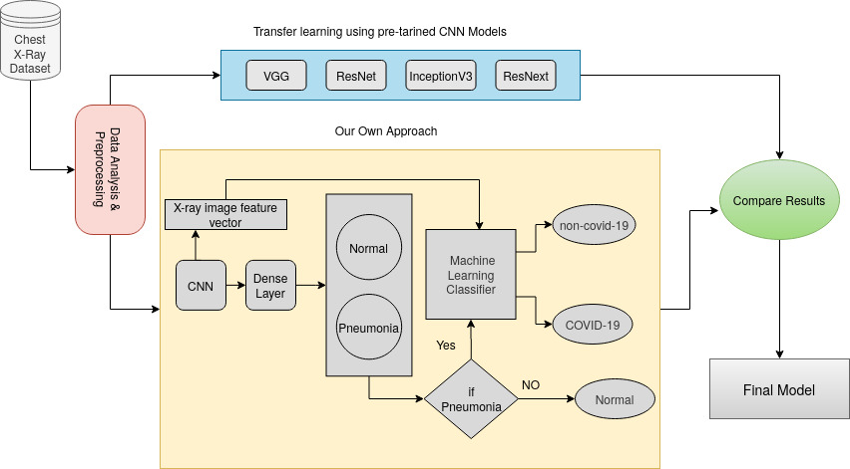
Method
7
Fine-tune pre-trained classification models “first approach”.
Hierarchy classification “our approach”.
Why we need hierarchical classification?
Why machine learning works better than end to end models in the second phase of our own approach?
Figure 1: Pipeline
Motivation
Related work
Research questions
Methodology
Experiment
Conclusion
Screening for COVID-19 using Chest X-ray Images and ML techniques

Slide 8
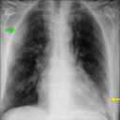
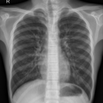
Experiment: Dataset [4] (1)
8
Examples from dataset
Figure 2: COVID-19 positive CXR
Figure 3: Normal CXR
Screening for COVID-19 using Chest X-ray Images and ML techniques
Notes:
Figure 2 is the example of positive CXR for COVID-19 with radiographic findings. The green and yellow arrows are pointing to the white space in both lungs,
Anesthetist and biologist, if the lesions are centralized, it is more likely to be a bacterial infection, but if the lesions spread in bilateral regions and the base area of the lungs, COVID-19 infection is more likely to occur [10].
COVID is detected in the bilateral consolidation of the lungs in 47% of the cases [7]
1

Slide 9
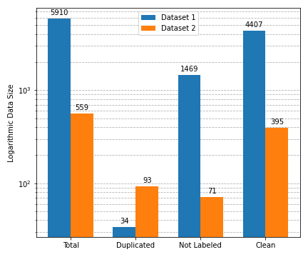
Experiment: Dataset (2)
9
Data Cleaning & Data Selection
The 1st Dataset [18] contains 56 Covid-19 X-Ray images.
The 2nd Dataset [17] contains 317 Covid-19 X-Ray images.
Remove duplicated images.
Select the target data.
Figure 4: Data statistics
Screening for COVID-19 using Chest X-ray Images and ML techniques
Notes:
The used dataset is collected from two different sources. The first dataset has the dominant number of normal X-Ray images and and a limited number of Covid-19 cases.
The second dataset [4], contains numerous subclasses of pneumonia diseases. And it has 317 covid 19, 5 times more than the 1st one;
From both datasets, we have collected a total of 373 Covid-19 cases.
Merging both datasets raised a new issue: duplicated images were found. In order to avoid overfitting, We eliminated these images.
First, duplicate images are eliminated. Secondly, comparing the similarity between images allows us to identify images that are cropped or resized. After cleaning the data and removing duplicate images using the CCleaner tool, we selected the target data by eliminating unlabeled images.
Figure 4 shows the data cleaning process in numbers. Respectively, 0.5% and 30% from dataset 1 and dataset 2 were removed.
1

Slide 10
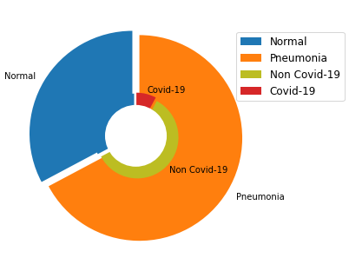
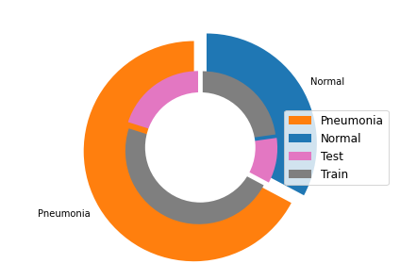
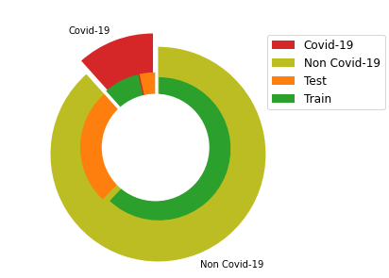
Experiment: Dataset (3)
10
Data distribution
Figure 5: Data distribution
Figure 6: Data distribution of 1st phase
Figure 7: Data distribution of 2nd phase
Table 1: 1st phase classification
Table 2: 2nd phase classification
 | Train | Test | Total
Normal | 1094 | 480 | 1574
Pneumonia | 2264 | 964 | 3228
Total | 3358 | 1444 | 4802
 | Train | Test | Total
Covid-19 | 262 | 113 | 375
Non-Covid-19 | 2002 | 851 | 2853
Total | 2264 | 964 | 3228
Screening for COVID-19 using Chest X-ray Images and ML techniques
Notes:
the Train-Test Split ratio is 7:3.
According to our pipeline (Figure 1), we have two classification phases. Normal vs Pneumonia, then in a second step; COVID-19vs Non-COVID-19. Figure 6 and 7 represent the data distribution
For a global visualization of the datadistribution, see Figure 6.
1

Slide 11
Experiment: Results
11
Evaluation metrics like precision, recall, F1-score and accuracy has been used to measure the performance of all the model.
Table 3: Comparing results
Models | Precision | Recall | F1-score | Accuracy
Vgg-16 | 79% | 83% | 80% | 80%
ResNet | 84% | 85% | 84% | 84%
ResNeXt | 76% | 78% | 77% | 77%
Inception_V3 | 74% | 69% | 70% | 74%
ResNet + SVM | 89% | 90% | 89% | 94%
Vgg + SVM | 84% | 85% | 85% | 87%
Pretrained Models (First approach)
Hierarchical classification
(our approach)
Motivation
Related work
Research questions
Methodology
Experiment
Conclusion
Screening for COVID-19 using Chest X-ray Images and ML techniques
Notes:
We have also investigated resnet along with logistic regression, FNN, Decision tree for the classification.
we chose to train the 2nd phase using ML algo limited dataset
we also trained the resnet with FNN and we got 42% for recall and this confirms our decision
1

Slide 12
Experiment: Discussion
12
ResNet +SVM achieves the highest accuracy.
ResNet is the most performing model in feature extraction.
Machine learning algorithms perform well on small data.
The results are stable.
Cumulative error from hierarchical classification.
Limitation:
Motivation
Related work
Research questions
Methodology
Experiment
Conclusion
Screening for COVID-19 using Chest X-ray Images and ML techniques
Notes:
Missing statistics (std, mean) on the metrics.
1

Slide 13
Conclusion
13
Conclusion
ResNet +SVM achieves the highest accuracy.
Using machine learning algorithm for the second phase of the hierarchical classification improved the results.
Future work
Exploration of different neural architectures design for medical field.
Use techniques to avoid the bias data such as up-sampling technique.
Motivation
Related work
Research questions
Methodology
Experiment
Conclusion
Screening for COVID-19 using Chest X-ray Images and ML techniques
Notes:
From this experiment, we concluded that how important it is to classify Covid-19 images, Rather than coming up with an architecture which has higher performance in terms of accuracy.
Especially in medical field, recall is an important factor.
Because it guarantee that algorithm has correctly classified the class in which we are interested in(Covid-19).
1

Slide 14
References
14
[4] P. Morrison J. P. Cohen and L. Dao. 2020. COVID-19 image data collection. arXiv 2003.11597 (2020). https://github.com/ieee8023/covid-chestxray-dataset
[17] https://drive.google.com/drive/folders/1BTVzZZNjuNupoEz-p3Z3OJfVLAZe6yP
[18] https://www.kaggle.com/praveengovi/
[12] Mangal, Arpan, Surya Kalia, Harish Rajgopal, Krithika Rangarajan, Vinay Namboodiri, Subhashis Banerjee, and Chetan Arora. "CovidAID: COVID-19 Detection Using Chest X-Ray." arXiv preprint arXiv:2004.09803 (2020).
Screening for COVID-19 using Chest X-ray Images and ML techniques
Notes:
1

Slide 15
15
Thank You!
Any Questions?
Screening for COVID-19 using Chest X-ray Images and ML techniques
Notes:
1

