Slide 1

CUSTOMER INSIGHTS
Presented by: Alok Chakravarthi HS

Slide 2
Table of content
01
02
03
04
Introduction
Data Quality Assessment
Exploratory Data Analysis (EDA)
Data Visualizations
05
06
07
Actionable Insights
Conclusion
Recommendation

Slide 3

1.Introduction
The Customer Insights aims to leverage data analytics for data-driven business decision-making. It seeks to understand customer behavior and sales trends to optimize marketing strategies, enhance customer satisfaction, increase sales and to optimize marketing effort

Slide 4
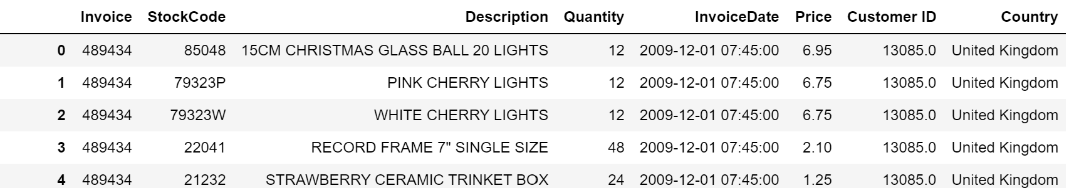
2. Data Quality Assessment
The dataset contains 1067371 rows and 8 columns, with the following key attributes:
Index-based information like InvoiceDate, Customer ID, Invoice.
Order-related attributes, including Quantity, and Price.
Customer details such as Country.
Product specifics encompass Description and StockCode.
Figure: First 5 rows and several columns of the dataset

Slide 5
3. Exploratory Data Analysis (EDA)
Getting 2 year transactional 2009-2011 the data from excel file and converting it to .csv.
Handling missing values in the dataset Customer ID, Description.
By doing this we got 243007 missing records in Customer ID and 4328 records in Description.
We drop the Missing Customer ID as its unique and primary aspect for customer.
By handling Customer ID the Description feature is also handled.
We filter out that negative values in the dataset Quantity and Price.
We convert the InvoiceDate into DateTime as we can analyze timing and frequency

Slide 6
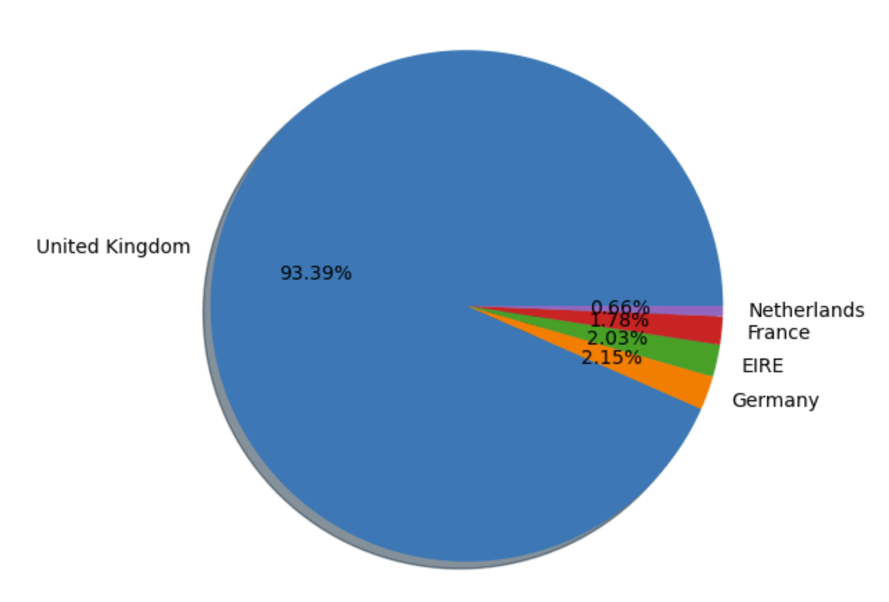
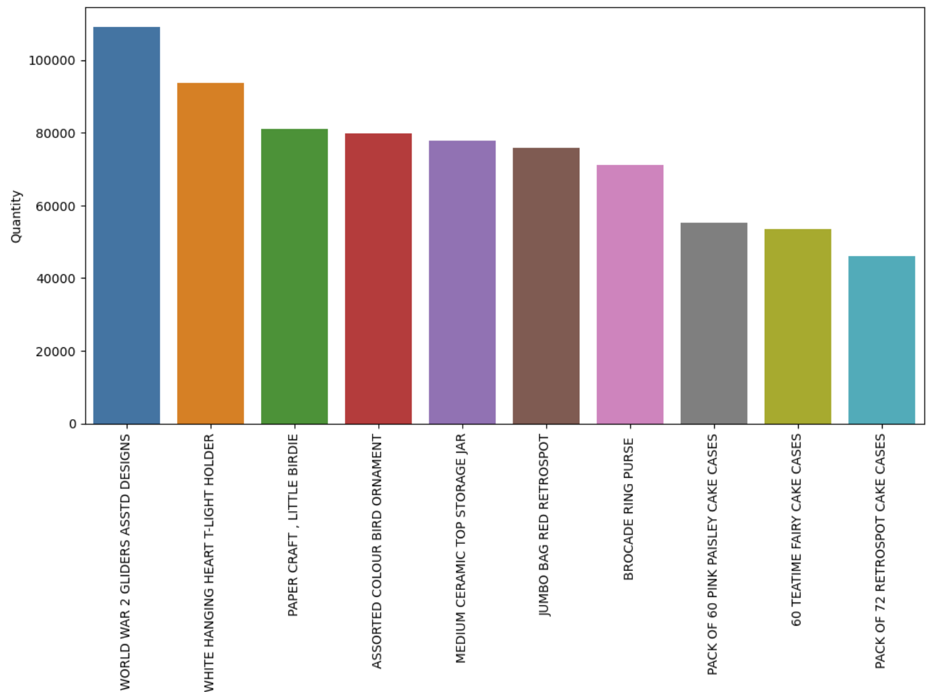
4. Data Visualizations
4.1 Top Country Sales
4.2 Top Product
Highest Number of purchases.
We can focus on these countries first, International marketing strategy
This gives us insights of top 10 products and quantity sold.
This gives info of we will have to focus on the inventory, marketing strategy, business operations.
This can increase sales and profit.

Slide 7
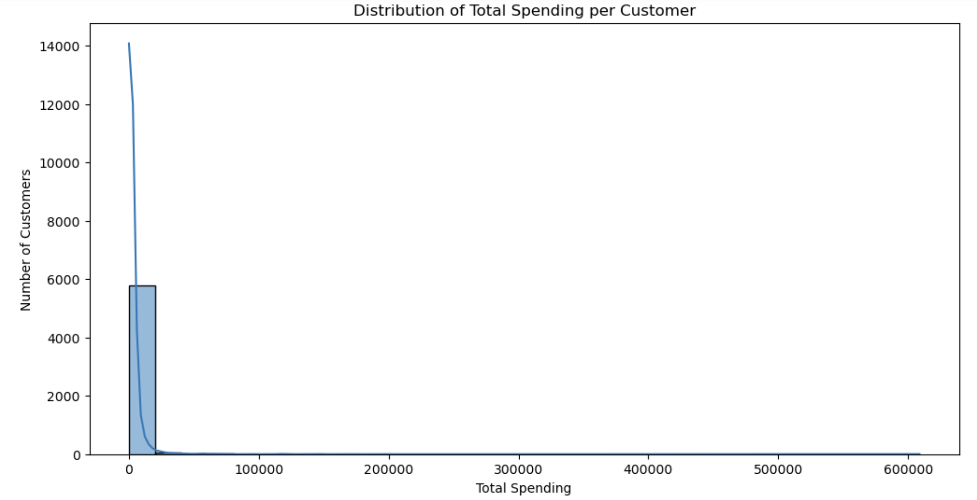
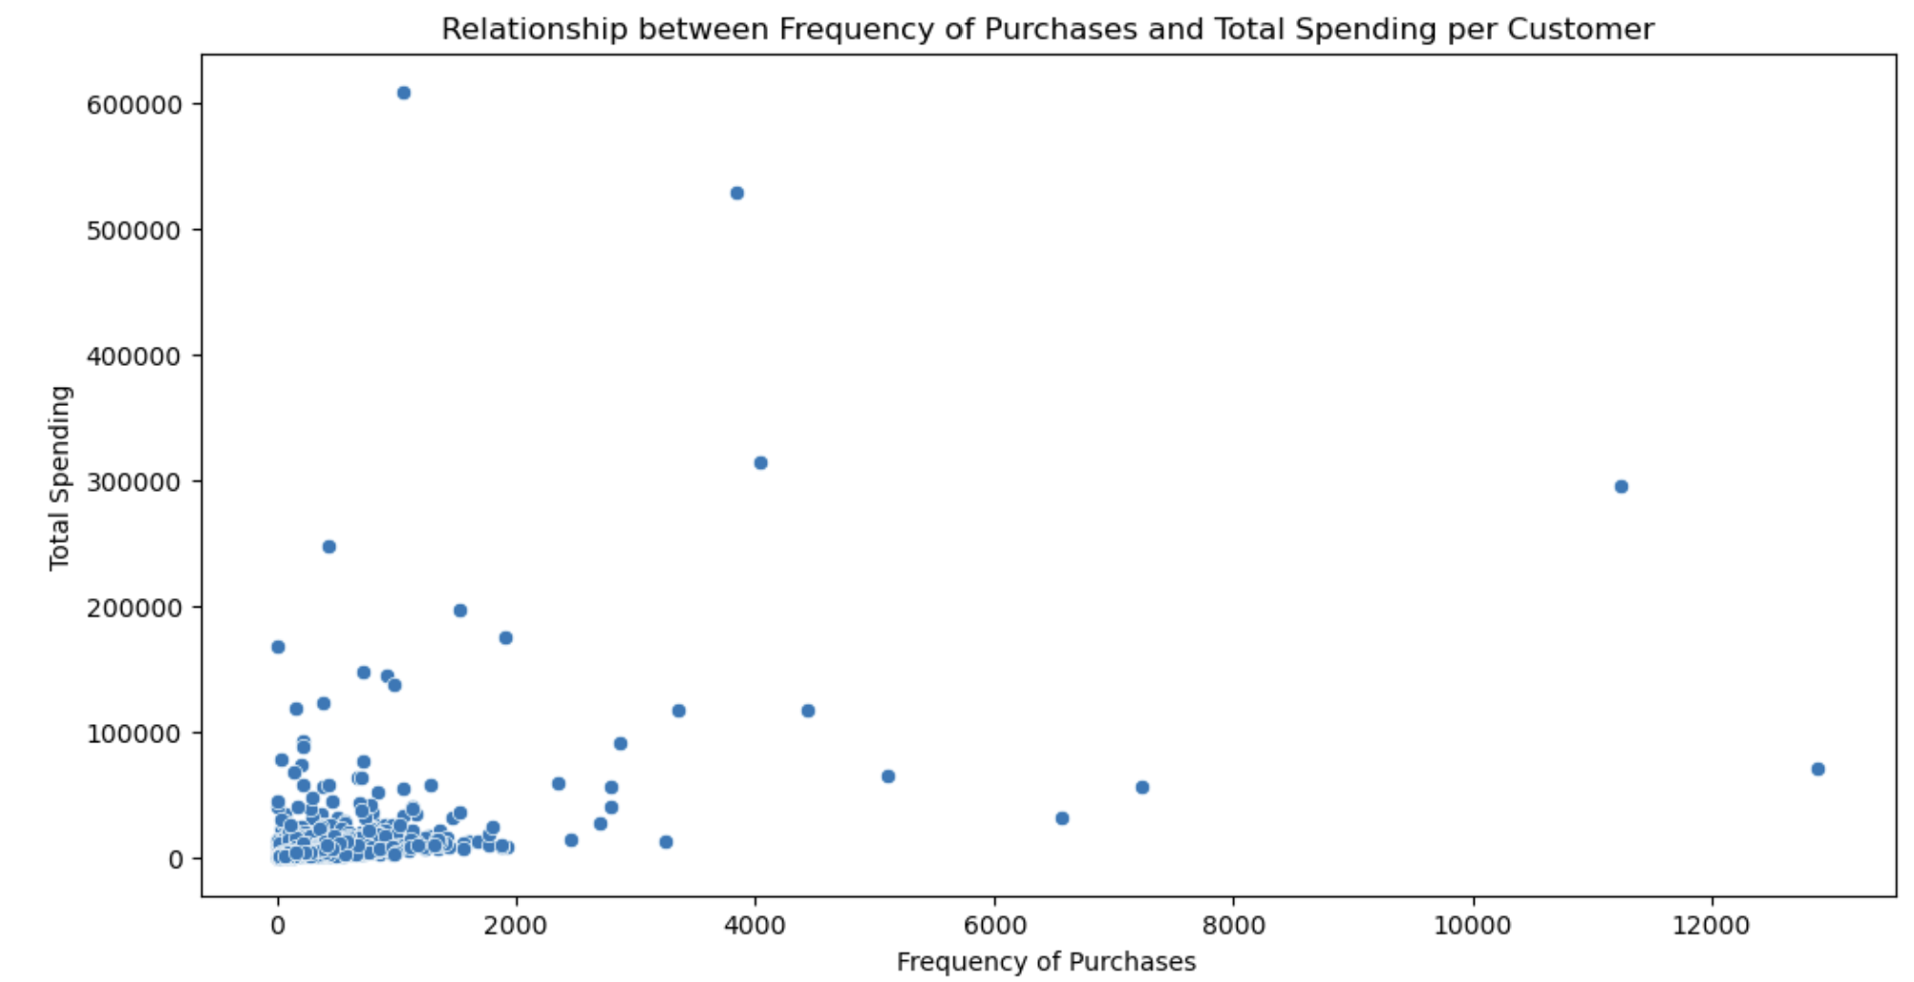
4. Descriptive Analysis
4.3 Total Spending
4.4 Total Spending Frequency
Identifying high value Customers
Correlation of how often customer makes purchase and how much they spend .

Slide 8
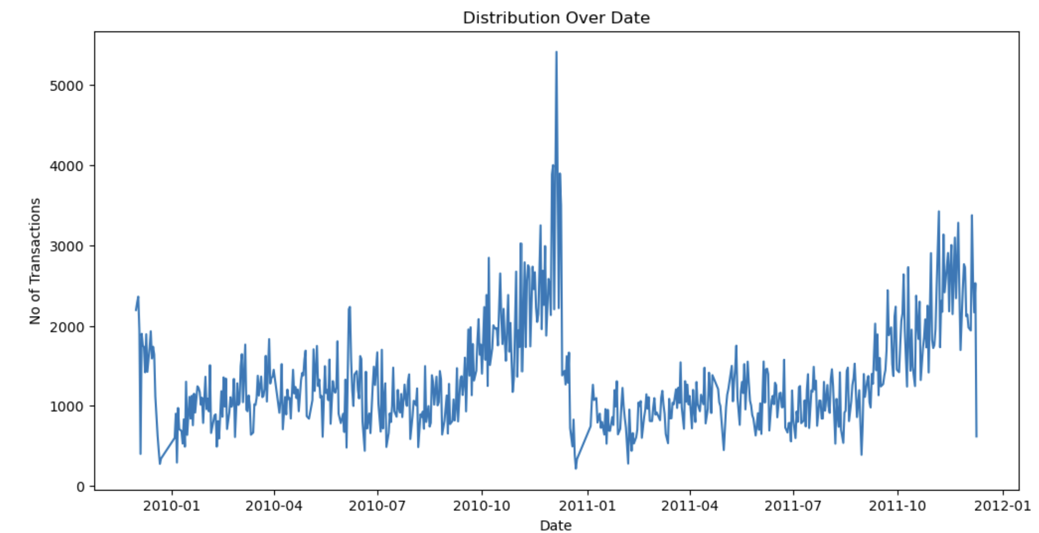
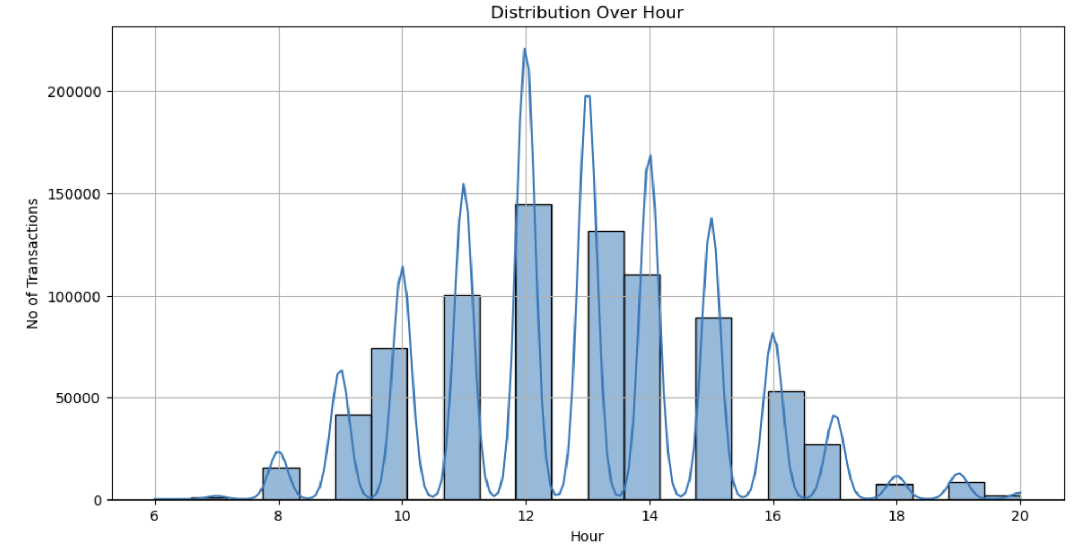
4. Descriptive Analysis
4.5 Sales over date
4.6 Sales over hours
Trends or seasonality in customer purchase
Identify peak hours of sales, helps us marketing and staffing

Slide 9
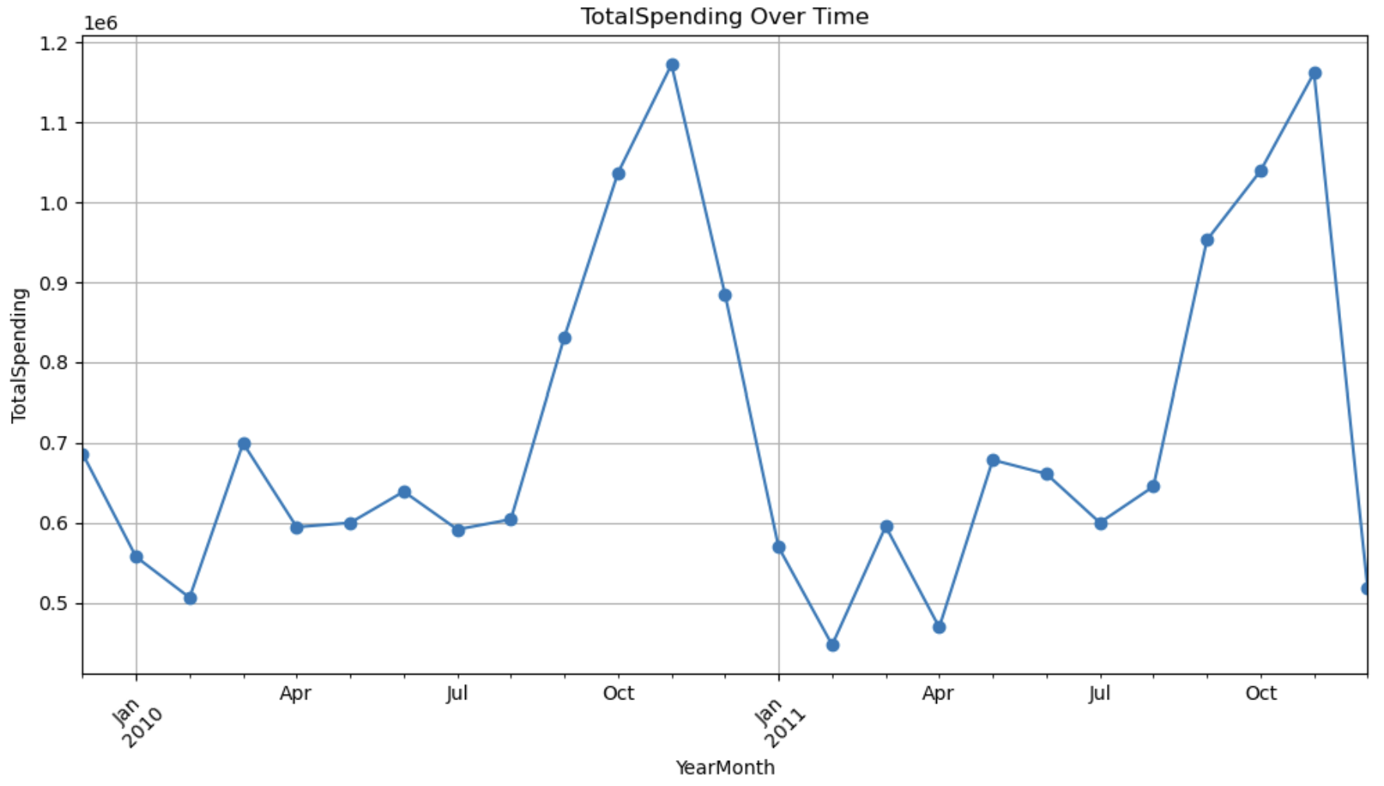
4. Descriptive Analysis
4.7 Time Series plot
Seasonal patterns or trends of customer spending over 2 years

Slide 10
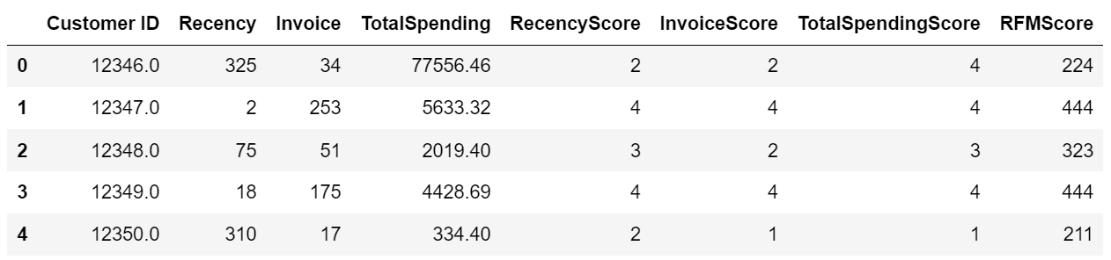
5. Actionable Insights
RFM Analysis
Use RFM Analysis for getting insights of customer
Recency – We compare by last and latest date of transaction.
Frequency – Groupby Customer ID and transaction.
Monetary – Groupby Customer ID and TotalSpending.
Merging all 3 with Customer ID
Calculating Quartiles and assigning labels.
Creating RFMScore.

Slide 11

6.Conclusion
The top five countries based on the percentage of total orders were the United Kingdom, Germany, France, Ireland, and Spain.
Orders peaked in the months of November, October, December, September, and May.
The total amount of each order was calculated using the product of unit price and quantity.
New columns were created using InvoiceDate, such as Year, Month, Day, Hour.
Top customer IDs were found to be 17841.0, 14911.0, 12748.0, 14606.0, and 14096.0.
Customer segmentation by RFM Analysis.

Slide 12
7.Suggestion
Explore opportunities to expand operations and marketing efforts in countries with max sales.
Focus on promoting top-selling products to take advantage on their popularity.
Inventory maintenance based on seasonal demand.
Pricing strategies for products with high prices to maximize income.
Recommendation to encourage repeat purchases and to maintain long customer relationships.
Using RMF Analysis we can make personal recommendation on each of the aspect w.r.t CustomerID.

Slide 13

THANK YOU
Open for questions

