Slide 1

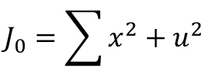
TIME:
1
2
3
STATE
u² , J_{k+1}
1²+0
u² , J_{k+1}
0
0²,0
1
0²,(2-E(W))²
2²+___
2²+0
0
Model:
2
0²,0
$$J_{0}=\sum{x^{2}+u^{2}}$$
$$x_{k+1}=x_{k}+u_{k}+w_{k}$$
1²,(3-E(W))²
3²+0
0
3
0²,0

Slide 2
For SINGLE Storage Model
TIME:
1
2
STATE (E)
KD₁² , J_{k+1}
0
1
K[2-E(W)]², 0
___
0
2
K[2-E(W)+1]², 0
0
Therefore, u_{Opt} can be calculated without E(W) offset, as long as u_{Opt}>E(W)
3

