Slide 1
Stock Picker Widget
Alok Joshi

Slide 2
Contents
Problem statement
Design and Components
Future improvements

Slide 3
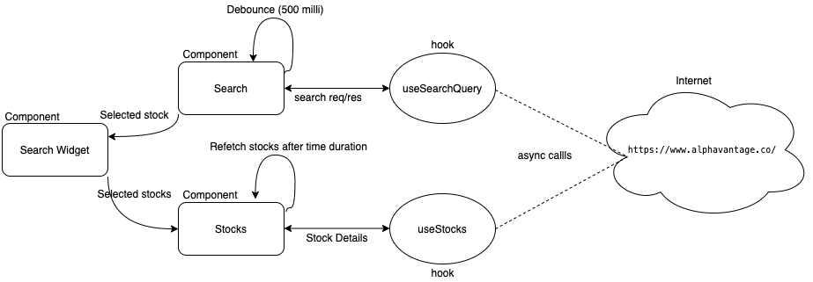
Design & Components

Slide 4
Future Improvements
Provide pagination for the search results or Progressive scroll behavior

