Slide 1
Stock Picker Widget
Alok Joshi

Slide 2
Contents
Problem statement
Design and Components
Screen shots
Future improvements

Slide 3
Problem statement
Build a stock picker widget which when loaded will show a search bar, user can type in the symbol of the stock. As the user input the symbol we should show an auto-complete to list all the stocks which qualify the search term. If the user clicks on any of the search item it should show all the details of the stock. If the user clicks enter or search button without autocomplete selection it should show the stock details if the symbol exist else show stock not found message.

Slide 4
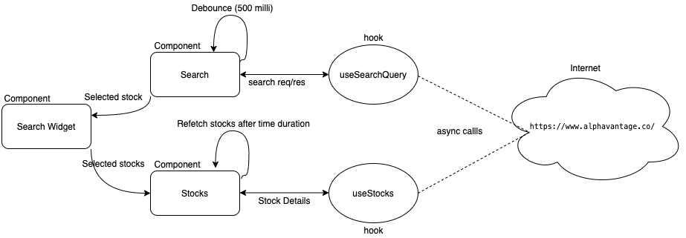
Design & Components

Slide 5
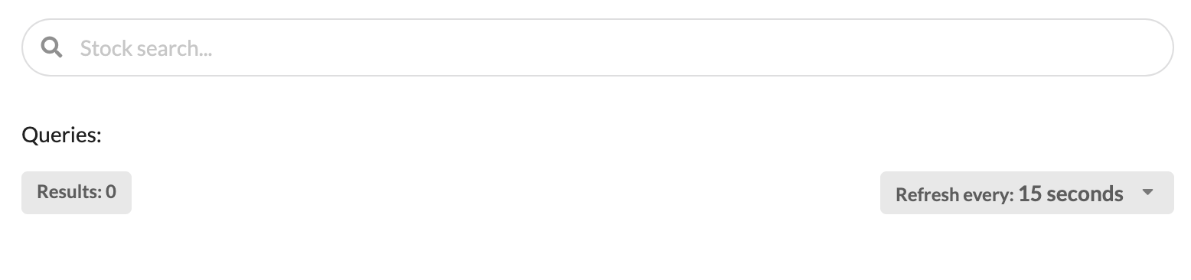
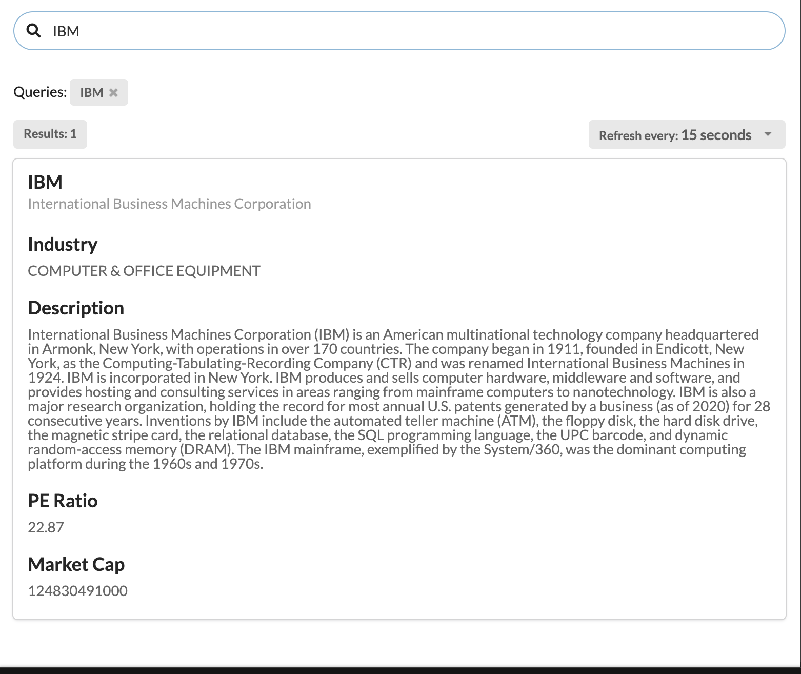
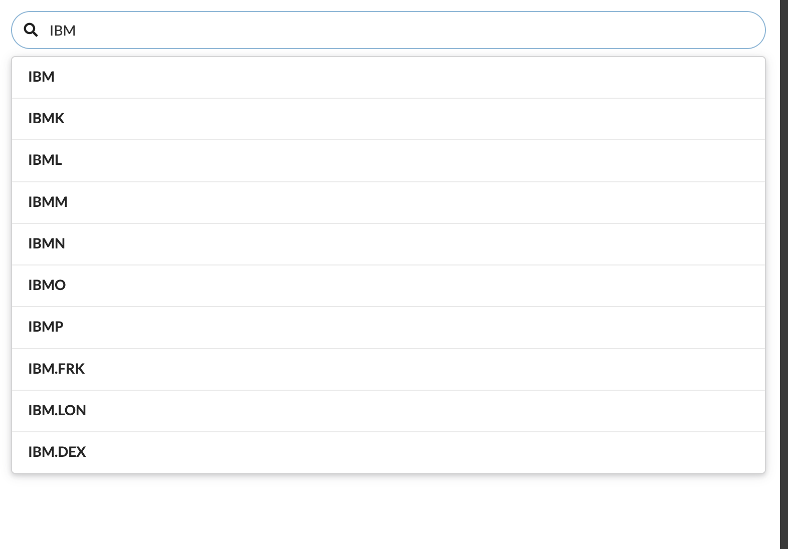
Screen shots

Slide 6
Future Improvements
Provide pagination for the search results or Progressive scroll behavior

