Slide 1
Stock Picker Widget
Alok Joshi

Slide 2
Contents
Problem statement
Design and Components
Screen shots
Future improvements

Slide 3
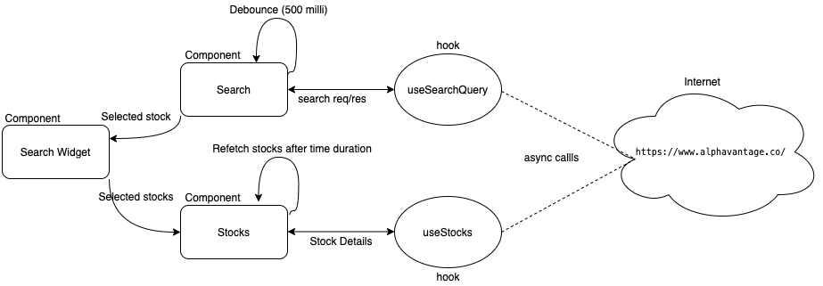
Design & Components

Slide 4
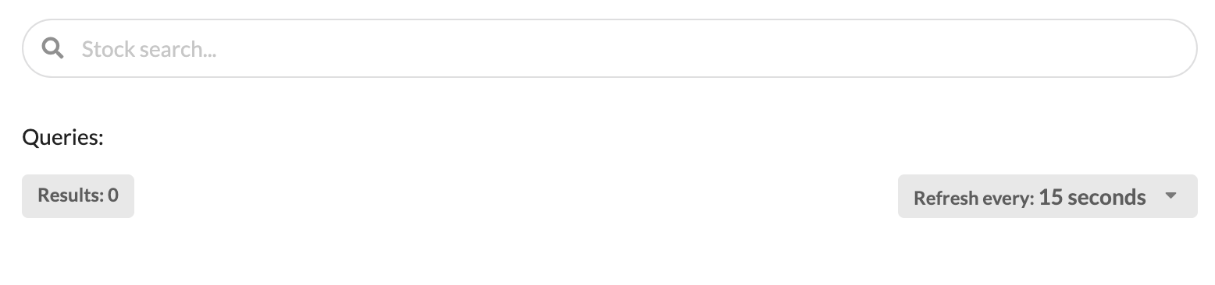
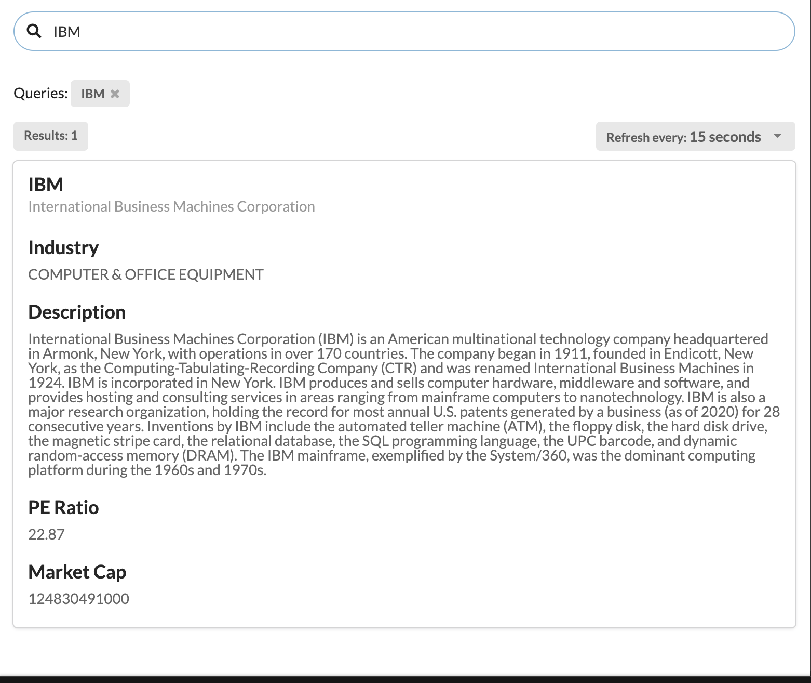
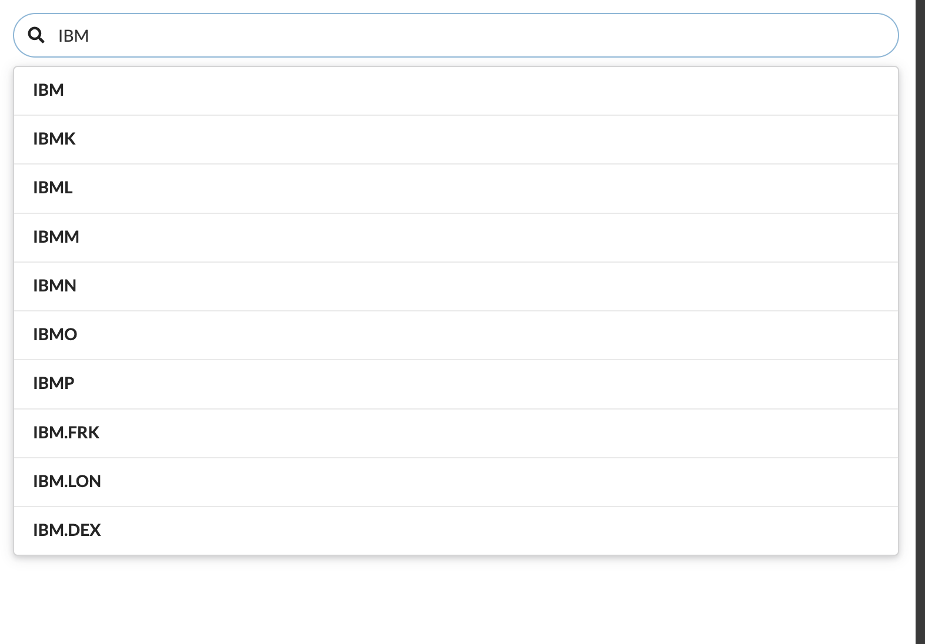
Screen shots

Slide 5
Future Improvements
Provide pagination for the search results or Progressive scroll behavior

