Slide 1
INTRODUCTION TO ARM

Slide 2
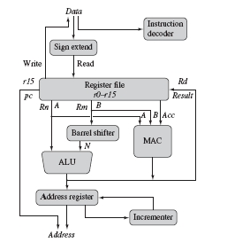
ARM Core Dataflow Model Von Neumann implementation

Slide 3
Data enters the processor core through data bus
It could be instruction or a data
Instruction decoder translates instructions before they are executed.
It has 2 instruction types for transferring data in and out of the processor(load/store)
Data items are placed in register file-storage bank made of 32 bit registers
Sign extend converts signed 8-bit and 16-bit numbers to 32 bit values
Two source registers-Rn and Rm Single destination register Rd
Source operands are read from register file using internal buses A and B

Slide 4
ALU takes the register values Rn and Rm and computes the result
Barrel shifter computes the result for any number of shifts within 1 clock cycle .
This is achieved as it is combinational logic (not sequential)
ex: ADD R3,R2,LSL#4
Multiply-Accumulate Circuit is used to perform both multiply and add
Ex : Matrix addition and multiplication
Load and store instructions use the ALU to generate an address to be held in the address register and broadcast on the Address bus

Slide 5
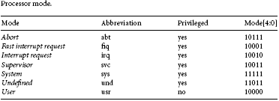
Processor mode

Slide 6
From unprivileged mode we cannot go to privileged mode by changing the bits of CPSR
But however we can move from privileged to non privileged mode

Slide 7
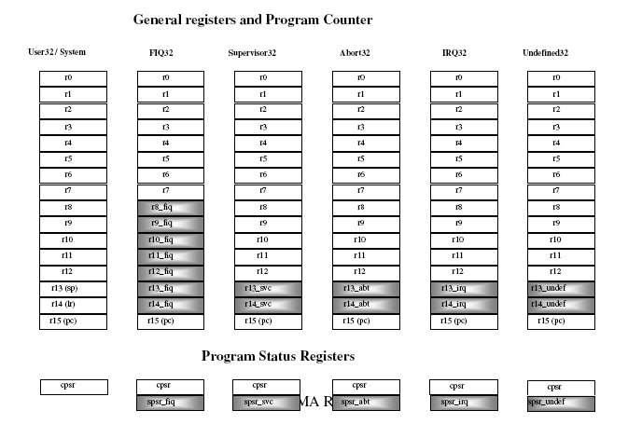
Register Organization of ARM Core

Slide 8
FIQ uses all registers R0 to R7 of the user mode and a new set of R8-R14 which is banked and not the one in user mode.
When the same R0-R7 is used in FIQ mode, the data will be deleted or overwritten.
ARM operating states
State of core determines which instruction is being executed
ARM
Thumb
Jazelle
Jazelle executes 8-bit instructions and is a hybrid mix of software and hardware designed to speed up the execution of Java bytecodes

Slide 9
Interrupts and Exceptions
ARM treats interrupts as special exceptions
When occurs, the processor sets pc to a specific memory address and this is within the special address range called vector table
When an exception or interrupt occurs , the processor suspends normal execution and starts loading instructions from the exception vector table. Each vector table contains a form of branch instruction pointing to the start of a specific routine .

Slide 10
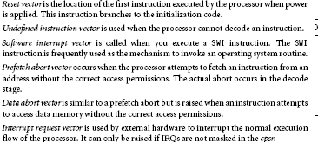

Slide 11
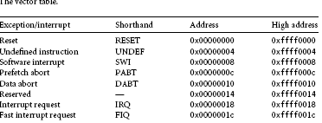

Slide 12
Exceptions Priority I Bit F Bit
Reset 1 1 1
Data Abort 2 1 -
FIQ 3 1 1
IRQ 4 1 -
Prefetch Abort 5 1 -
SWI 6 1 -
Undefined 6 1 -

Slide 13
Pipelining
Pipelining speeds up execution by fetching the next instruction while the other instructions are being decoded and executed
3 stage pipelining

Slide 14


Slide 15
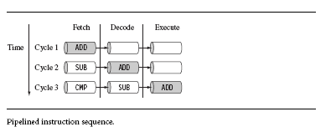

Slide 17
Fetch instruction from memory and puts in instruction pipeline
Decodes the instruction and reads the operand from register file
Shifts operand if required. Performs ALU operation. If load or store then computes the address
If required memory is accessed
If arithmetic operation, result is buffered for 1 cycle
Result is written into register file

Slide 18
Stall
Add R0,R1,R2
Sub R4,R3,R0
F D E B W
F D S S E B W

Slide 19
Core Extensions
These are some of the hardware extensions placed next to the ARM core
They are used to improve performance, manage resources and provide extra functionality and flexibility in handling particular applications
3 hardware extensions
-Cache and tightly coupled memory
-memory management
-coprocessor interface

Slide 20
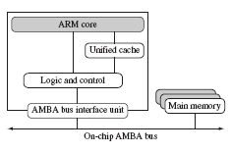
Cache and Tightly Coupled Memory

Slide 21
Cache is a block of fast memory placed between main memory and core
Processor can run without waiting for data from slow external memory
Von Neumann style combines both data and instruction into a single unified cache

Slide 22
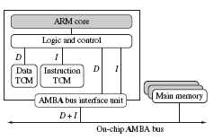

Slide 23
Separate cache for data and instruction
Cache provides overall increase in performance but at the rate of predictable execution
For RTS, the time taken for loading and storing instructions or data must be predictable
This is achieved using Tightly coupled memory
TCM is fast SRAM located close to the core and guarantees the clock cycles required to fetch instructions and data
It appears as memory in the address map and can be accessed as fast memory
By combining both cache and TCM we can have both improved performance and predictable real time response

Slide 24
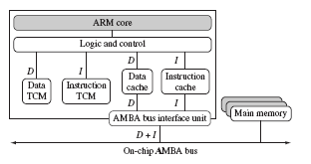

Slide 25
Memory Management
3 different types of memory management hardware
No extensions providing no protection
A memory protection unit providing limited protection
A memory management unit providing full protection

Slide 26
Coprocessor
A coprocessor extends the processing features of the core by extending the instruction set or by providing configuration registers
More than 1 coprocessor could be interfaced through coprocessor interface
It can be accessed through a group of dedicated ARM instructions that provide a load-store type interface

Slide 27
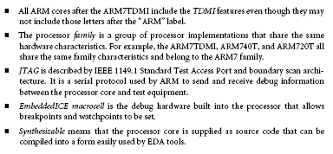
Nomenclature

