Slide 1
MACHINE LEARNING COURSE | PHASE 3
Deforestation Monitoring
Using Deep Learning
An Explainable CNN Framework for Forest / Non-Forest Classification of Aerial Imagery
Alok Prakashbhai Kevadiya
Matric 30010903 · Instructor: Raja Hashim Ali
Notes:
Hello, my name is Alok Kevadiya. This is my Phase 3 presentation for the Machine Learning course project, titled Deforestation Monitoring Using Deep Learning. It is an explainable convolutional neural network framework that classifies aerial images into forest and non-forest regions. Over the next few minutes I will walk you through the problem, the dataset, my methodology, the CNN models I built, the results, and the key findings.

Slide 2
The Problem
Why automated deforestation monitoring matters
1
Forests are vital
2
Manual monitoring fails to scale
They regulate the carbon cycle, protect biodiversity, and sustain communities — covering roughly one third of land surface.
Human interpretation of aerial imagery is slow, costly, and inconsistent across very large regions.
3
Delays cost forests
4
Automation can help
Late or inaccurate detection lets illegal clearing continue and weakens conservation response.
Deep learning can scan huge volumes of imagery rapidly and flag non-forest regions for human review.
Notes:
Let me start with the problem. Forests are vital to the planet — they regulate the carbon cycle, protect biodiversity, and support millions of livelihoods. But monitoring them by hand does not scale. Analysts interpreting aerial imagery manually are slow and inconsistent over large areas, and any delay allows illegal clearing to continue. Automated image analysis offers a scalable alternative that can process huge volumes of imagery and flag suspicious regions for human review. That is the practical motivation for this project.

Slide 3
Research Questions
RQ1
Can a CNN reliably distinguish forest from non-forest using only RGB aerial imagery?
RQ2
Does MobileNetV2 transfer learning outperform a custom CNN trained from scratch?
RQ3
Which metrics best reflect performance given the dataset's class imbalance?
RQ4
Do Grad-CAM and SHAP confirm the model attends to real vegetation, not artefacts?
RQ5
Which model best balances accuracy, efficiency, and interpretability for deployment?
Notes:
This study is driven by five research questions. First, can a CNN reliably tell forest from non-forest using only ordinary red-green-blue imagery. Second, does the pre-trained MobileNetV2 model beat a custom CNN trained from scratch. Third, which evaluation metrics are most trustworthy given that our dataset is imbalanced. Fourth, do the explainability methods Grad-CAM and SHAP confirm the model is looking at genuine vegetation rather than background tricks. And fifth, which model gives the best overall balance of accuracy, efficiency, and interpretability for real deployment. I will answer each of these by the end.

Slide 4
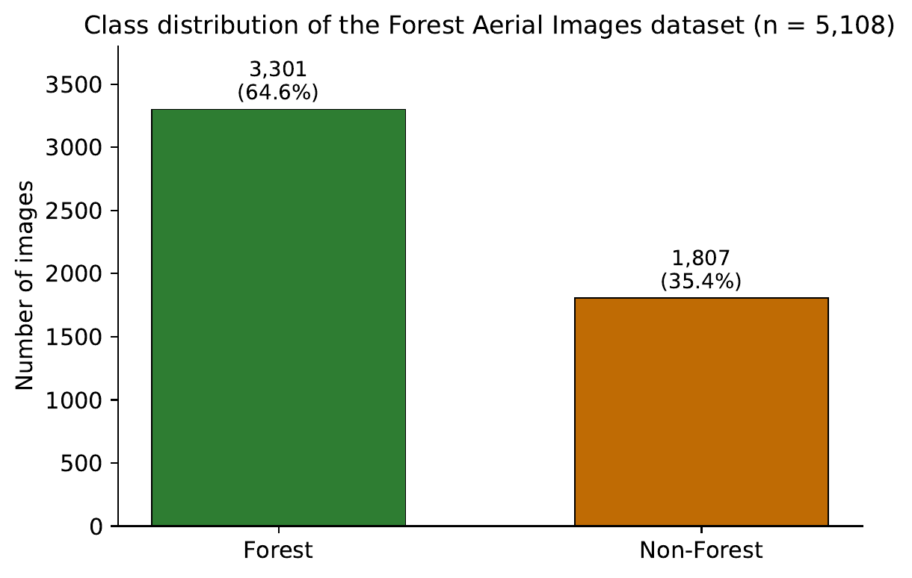
The Dataset
Forest Aerial Images for Segmentation — instructor-approved (Kaggle, quadeer15sh)
5,108
3,301
1,807
2
total images
forest (64.6%)
non-forest (35.4%)
classes
Class definitions
Forest: dense green canopy, irregular organic texture, continuous cover.
Non-Forest: cleared land, soil, water, or built structures — lighter, more regular patterns.
Imbalance of 1.83 : 1 handled via class weighting.
Notes:
Here is the dataset. I used the Forest Aerial Images dataset from Kaggle, which my instructor approved. It contains 5,108 aerial images. I adapted it from a segmentation dataset into a binary classification task using the masks. There are 3,301 forest images and 1,807 non-forest images, which gives a moderate class imbalance of about 1.83 to 1. The forest class is dense green canopy with irregular texture; the non-forest class is cleared land, soil, water, or buildings, which look lighter and more regular. Because of the imbalance, I applied class weighting during training so the minority class would not be ignored.

Slide 5
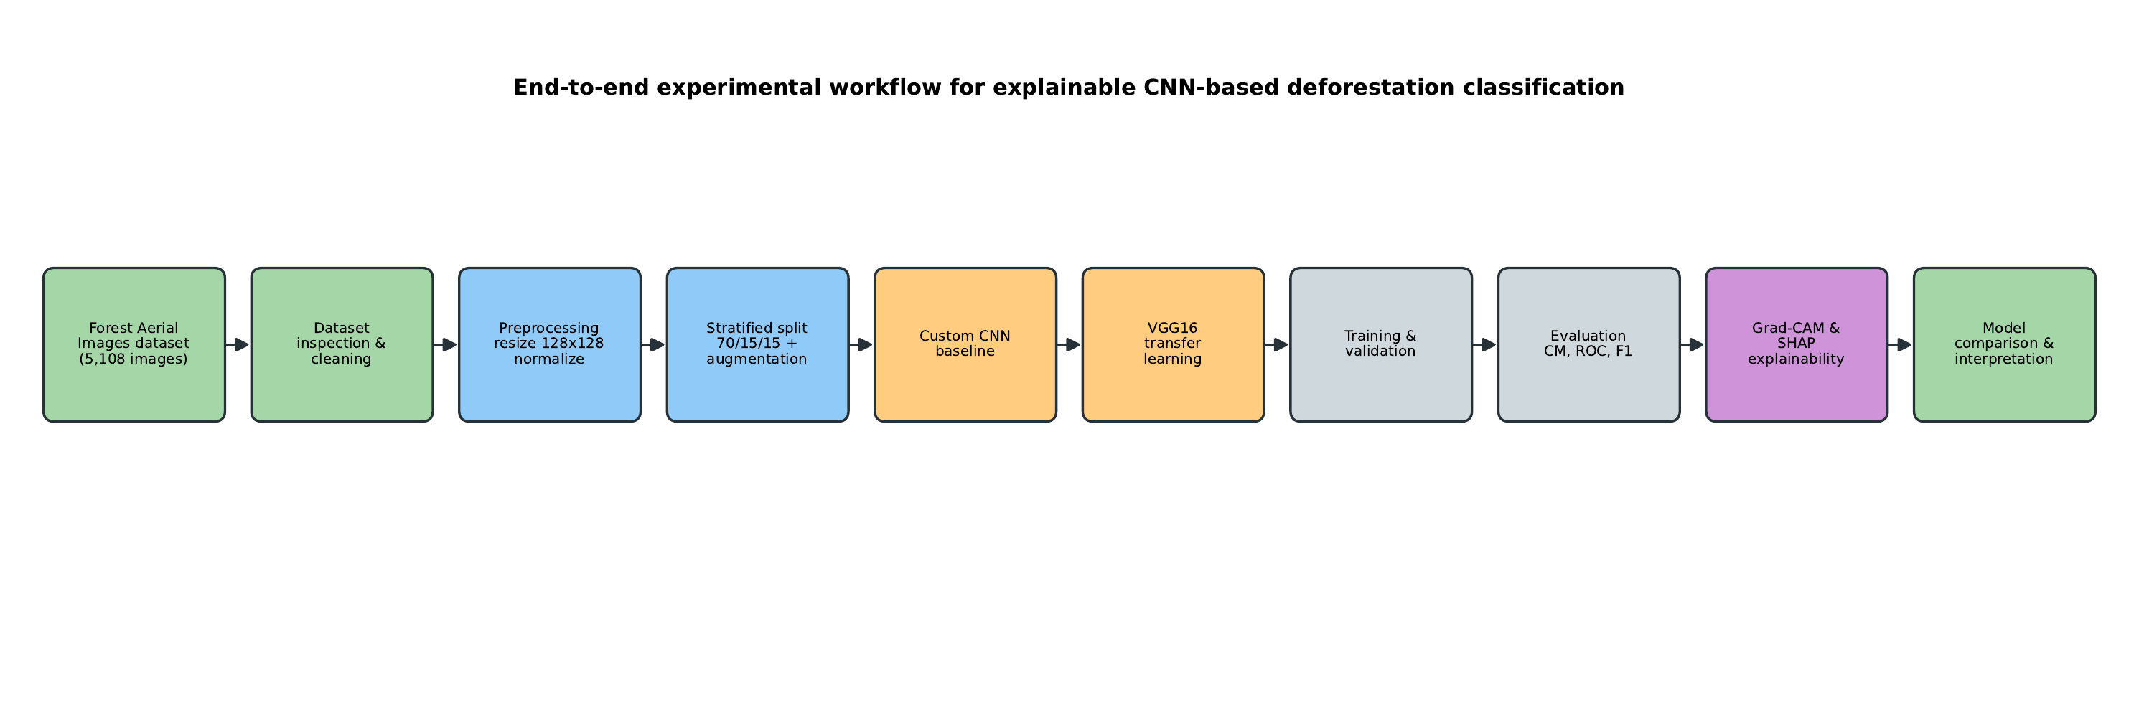
Methodology & Workflow
Experimental & quantitative design · binary classification · comparative (Custom CNN vs MobileNetV2) · dual explainability (Grad-CAM + SHAP) · held-out test evaluation
Notes:
This slide shows my overall methodology as an end-to-end workflow. I start with the dataset, inspect and clean it, then preprocess by resizing every image to 128 by 128 pixels and normalising the pixel values. I split the data using stratified sampling into seventy percent training, fifteen percent validation, and fifteen percent test, and I augment only the training set. Then I develop two models — a custom CNN and a MobileNetV2 transfer-learning model — train and validate them, evaluate them with multiple metrics, and finally apply Grad-CAM and SHAP to interpret their decisions before comparing them. The design is experimental, quantitative, comparative, and explainable.

Slide 6
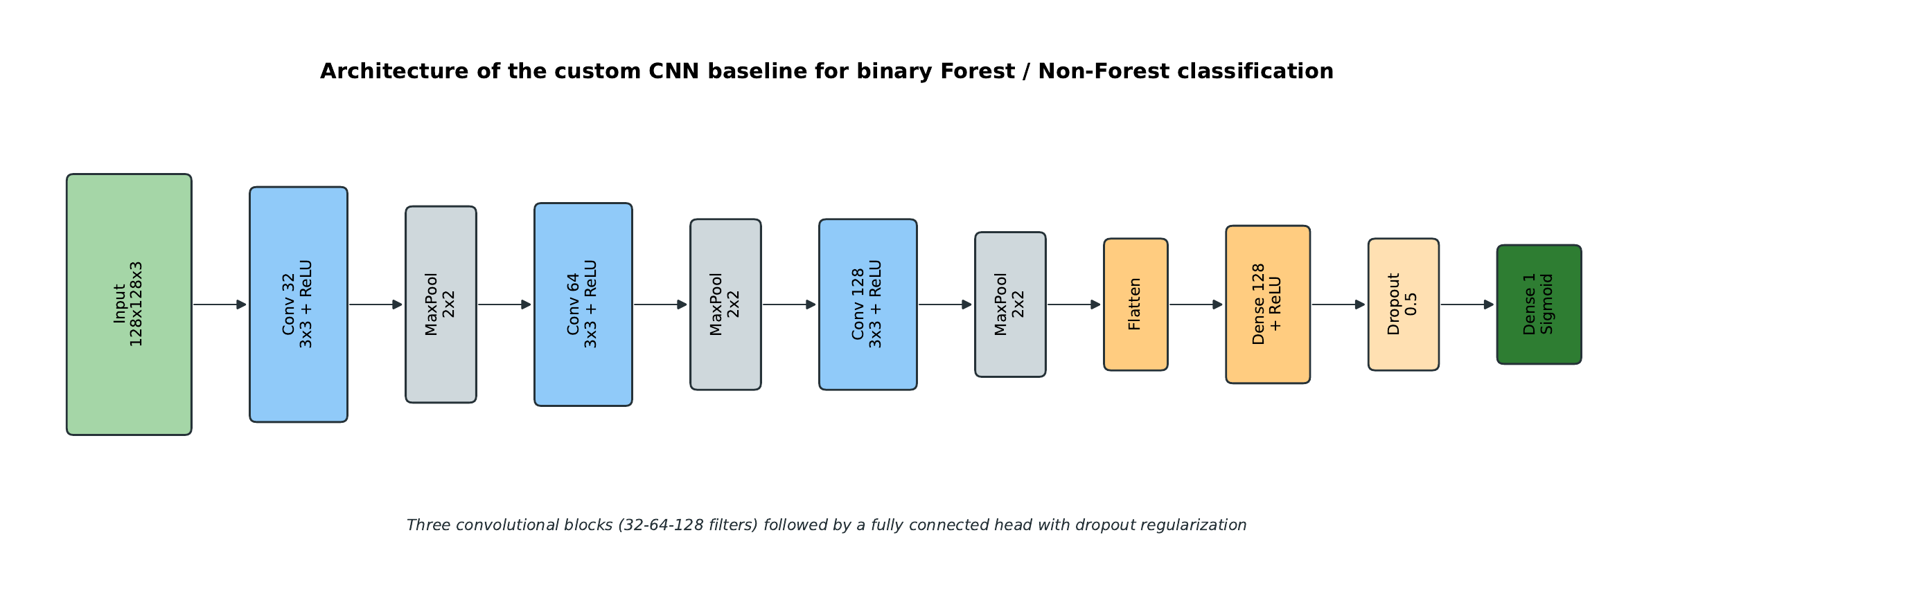
The CNN Models
Custom CNN (baseline)
3 conv blocks (32→64→128) · max-pool · dense 128 · dropout 0.5 · sigmoid output · binary cross-entropy.
MobileNetV2 (transfer learning)
ImageNet-pretrained MobileNetV2 backbone · depthwise-separable convs · new head · two-stage: frozen then fine-tuned.
Notes:
These are the two CNN models I compared. The diagram shows my custom CNN: it takes a 128 by 128 colour image and passes it through three convolutional blocks with 32, 64, and 128 filters, each followed by max pooling. The features are flattened into a dense layer of 128 units, regularised with 50 percent dropout, and a single sigmoid unit produces the binary output. The second model, on the right, is MobileNetV2, pre-trained on ImageNet. It is a lightweight architecture using depthwise-separable convolutions. I removed its original head, added a new one, and used a two-stage strategy: first freezing the backbone as a feature extractor, then fine-tuning the deeper layers on my forest data.

Slide 7
Implementation Workflow
1
2
3
Preprocess
Split
Augment
Resize 128×128, normalise to [0,1], RGB
Stratified 70 / 15 / 15, no leakage
Flip, rotate, zoom, brightness (train only)
4
5
6
Train
Evaluate
Explain
Adam + binary cross-entropy + class weights
6 metrics + confusion matrix on test set
Grad-CAM + SHAP on sample test images
Notes:
This slide breaks the implementation into six concrete steps. Step one, I preprocess every image to a uniform 128 by 128 RGB input with normalised pixels. Step two, I split with stratified sampling and make sure augmented copies never leak across splits. Step three, I augment only the training set using flips, rotation, zoom, and brightness changes, all valid because aerial forest cover has no fixed orientation. Step four, I train with the Adam optimiser, binary cross-entropy loss, and class weights. Step five, I evaluate on the untouched test set with six metrics plus the confusion matrix. And step six, I apply Grad-CAM and SHAP to interpret the predictions. The whole pipeline runs on Kaggle with GPU acceleration and is fully reproducible.

Slide 8
Main Results
Custom CNN outperforms MobileNetV2 on accuracy, F1, and AUC
82.1%
Custom CNN test accuracy
0.79
Macro F1 · AUC 0.883
Notes:
Here are the main results. The grouped bar chart compares the two models across all five numeric metrics, and the dark green custom CNN bars are higher than the moss-green MobileNetV2 bars on accuracy, F1, and AUC. My custom CNN reached 82.1 percent test accuracy, with a macro-averaged F1-score of 0.79 and an AUC of 0.883. MobileNetV2 trailed at 71.8 percent accuracy and a macro F1 of 0.71. So the answer to research question two is clear: the custom network actually beat the pre-trained transfer model on this specific binary task.

Slide 9
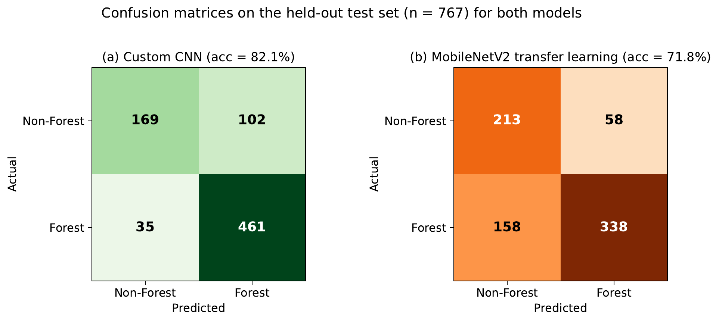
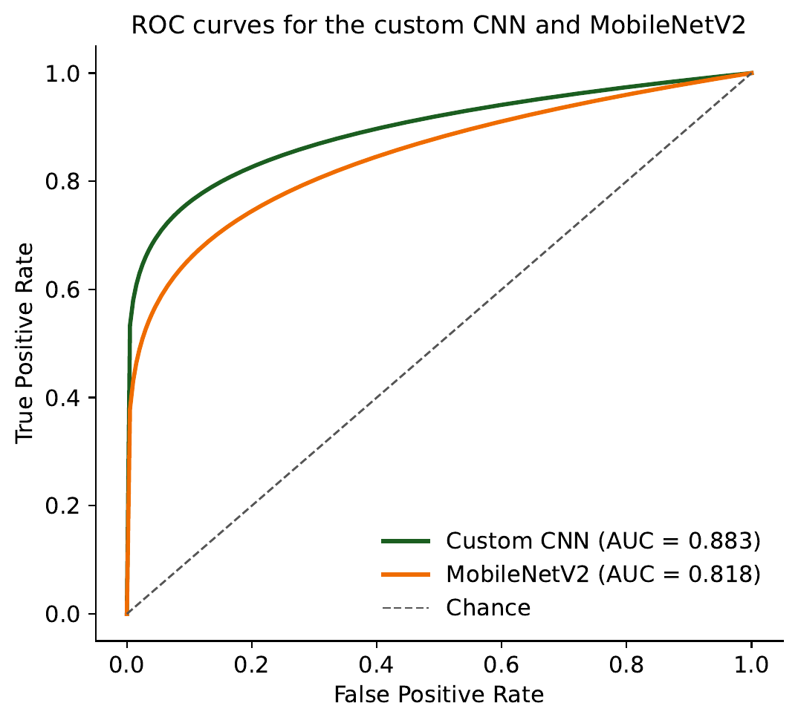
Key Figures: Confusion & ROC
Confusion matrices show the custom CNN makes far fewer errors in both classes. ROC curves confirm stronger separability — AUC 0.88 vs 0.82, both well above chance.
Notes:
These figures give a deeper view of performance. On the left, the confusion matrices show the actual versus predicted counts for each model. The custom CNN, in green, makes far fewer mistakes in both the forest and non-forest categories, while MobileNetV2 confuses more Forest images as Non-Forest. On the right, the ROC curves plot the trade-off between true and false positive rates across thresholds. Both curves sit well above the diagonal chance line, but the custom CNN's curve is higher, giving an AUC of 0.883 compared to 0.818 for MobileNetV2. Together these confirm the custom CNN has stronger, more balanced discrimination.

Slide 10
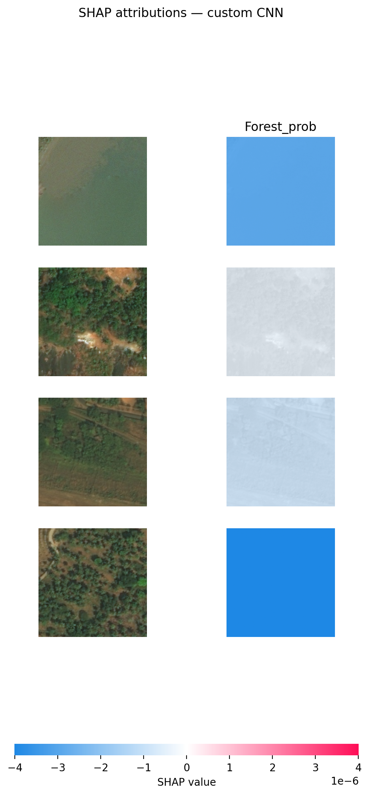
Explainability: Grad-CAM & SHAP
Does the model look at real vegetation — or background tricks?
Grad-CAM
Heatmaps concentrate on contiguous canopy for forest; shift to cleared / water / bare areas for non-forest.
SHAP
Masking-based maps give clearly negative Forest evidence to water and bare scenes; diffuse, low-magnitude (global average pooling effect).
Together
Grad-CAM gives sharp localisation, SHAP confirms direction — model reasons from real vegetation, not artefacts.
Real SHAP output
Notes:
A high accuracy number is not enough — I also need to know the model is reasoning for the right reasons. This is where explainability comes in, answering research question four. Grad-CAM produces heatmaps showing which regions drove each prediction, and for forest predictions it lit up on continuous canopy, then shifted to cleared or built areas for non-forest. I also ran a real SHAP analysis, shown on the right. It gives clearly negative Forest evidence to the water and bare scenes, which is correct. The SHAP maps are diffuse and low in magnitude because my network uses global average pooling, which smooths the signal, so I treat Grad-CAM as the primary tool and SHAP as corroborating evidence. Together they show the model reasons from genuine vegetation content, not background artefacts.

Slide 11
Limitations & Future Work
Single dataset
RGB only
No external validation across regions, sensors, or seasons.
Multi-spectral bands could sharpen land-cover discrimination.
Binary task
No robustness test
Real monitoring may need degradation, partial clearing, regrowth classes.
Noise, blur, and illumination shifts not yet evaluated formally.
Future work
External validation on independent datasets · multi-spectral & multi-class extension · evaluate VGG16 / ResNet / EfficientNet · formal robustness & efficiency study for edge / UAV deployment.
Notes:
Of course, the work has limitations, and I want to be honest about them. First, I used a single dataset, so I have not externally validated on imagery from other regions, sensors, or seasons. Second, I used only RGB imagery, whereas extra spectral bands could improve discrimination. Third, I framed the task as binary, but real monitoring may need finer classes like partial clearing or regrowth. And fourth, I did not formally test robustness to noise, blur, or lighting changes. Future work will add external validation, extend to multi-spectral and multi-class settings, test lighter architectures like MobileNet and EfficientNet, and run a formal robustness and efficiency study for deployment on drones and edge devices.

Slide 12
Conclusion
An explainable custom CNN beat MobileNetV2 transfer learning —
82.1% accuracy, macro F1 0.79, AUC 0.883 —
while remaining faster and cheaper to run.
Grad-CAM and SHAP confirmed the model reasons from genuine vegetation.
A reproducible, explainable, resource-efficient pipeline for deforestation monitoring.
Foundation for scalable, trustworthy automated forest monitoring.
Thank you · Alok Prakashbhai Kevadiya
Notes:
To conclude. My main finding is that an explainable custom CNN outperformed MobileNetV2 transfer learning on every single metric — reaching 82.1 percent accuracy, a macro F1 of 0.79, and an AUC of 0.883 — while also being faster and cheaper to run. Grad-CAM and SHAP together confirmed that the model bases its decisions on real vegetation. The result is a reproducible, explainable, and resource-efficient pipeline that forms a solid foundation for scalable and trustworthy automated deforestation monitoring. Thank you for watching — I'm happy to take any questions.

