Slide 1
Electricity Bill Management
Team:
TechFreak
TEAM MEMEBERS:
ALOK PAL(Team Lead)
KARANVEER SINGH
YESHWANTH AKARAPU

Slide 2
Contents
Project description.
Each team member’s responsibilities.
Core requirements of the project.
Implementation details – language, platform, s/w.
Testing – unit testing or TSL.
Feedback from peer reviews and how you reflected their comments on your project (first review).
Code inspection results and your resolution.
Any limitations that you faced during the project.
Project Demo.

Slide 3
Project description
The main aim of our project is to develop an application which is handled by the electricity board department to generate electricity bill for the customers.

Slide 4
Each team member’s responsibilities
Alok Pal -Database designing
-User login functionality
-Customer detail update module
Karanveer Singh -Rate setting module
-Customer detail module
-Password change module
Yeshwanth Akarapu -Bill Printing Module
–Bill Payment Module
-Bill Generation Module

Slide 5
Core requirements of the project.
To develop an application which is handled by the electricity board department to generate and manage customer’s electricity bill in an secure and easy to use automated environment.
Simple design of application ensure its scalability to meet the growing demands from clients.

Slide 6
Implementation details – language, platform, s/w
Language use- Java, SQL.
Platform- Platform independent.
Software tools- Neat beans, My SQL.

Slide 7
Testing – unit testing using JUnit
JUnit has become a standard for testing in Java programming language and is supported by almost all IDE’s.
Using Junit we can easily create and manage a rich unit test case suite for the entire software.
Every time you make a small or a big modification in the code, you can make sure that the function is performing well and has not broken.

Slide 8
Feedback from peer reviews and how you reflected their comments on your project (first review)
Peer review was really useful we got very useful feedbacks like:
We were advised to add functionality where an application user can actually see the consolidated bill reports in pdf or other printable format.
We were also advised to keep the design simple so as to ensure the scalability.

Slide 9
Code inspection results and your resolution
Things we missed earlier and added later
Modified the header comments in every program to include the Author and code description.
Added comments for every functional block of code so as to make it understandable for third person.

Slide 10
Limitations that we faced during the project
Initial design of project also included another module for Customer’s login but due to time crunch we defer our plans.
Inability to perform load testing due to non availability of any real time data.
This is just a desktop version of application and cannot support concurrent users.

Slide 11
Project Demo
Application modules:
User login.
Bill management.
New customers.
Bill generate.
Bill received.
Update customers.
Change password.

Slide 12
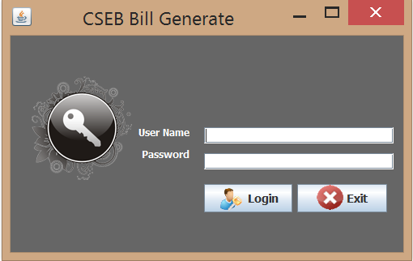
User Login
Through CSEB Bill Generate, admins can login into the application through their username and password which are given to them by the database manager.

Slide 13
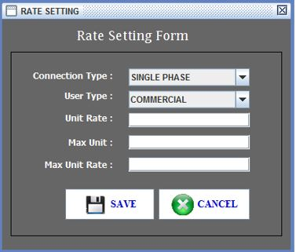
Bill management(Rate setting form)
In Rate Setting form:-
We need to preset the unit rate for the different types of the connection types and user types before generating bill for the customers.

Slide 14
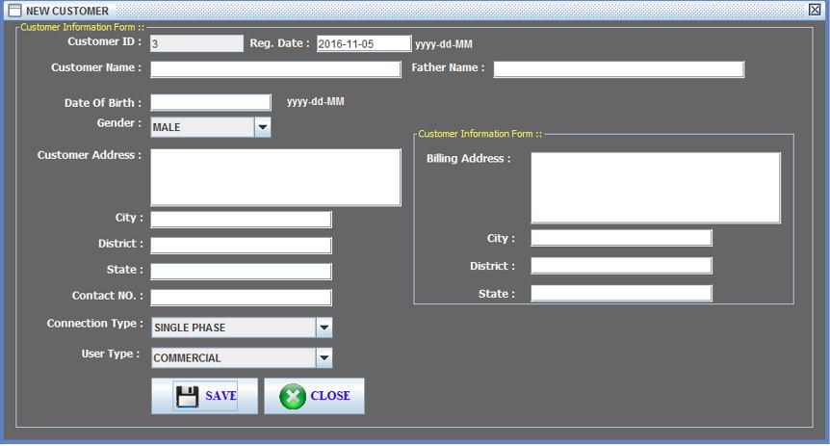
New customers:
In this block we update information of the new customer

Slide 15
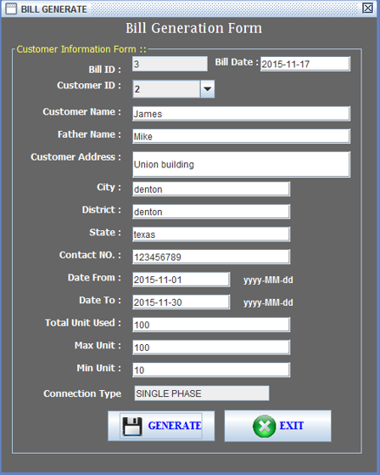
Bill Generate

Slide 16
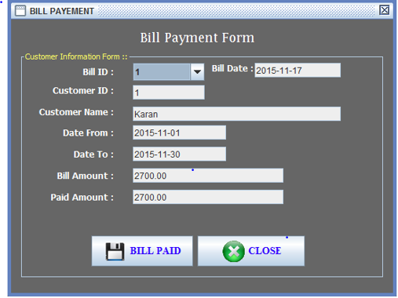
Bill Payment: After customers pays the bill we need to update the data base.

Slide 17
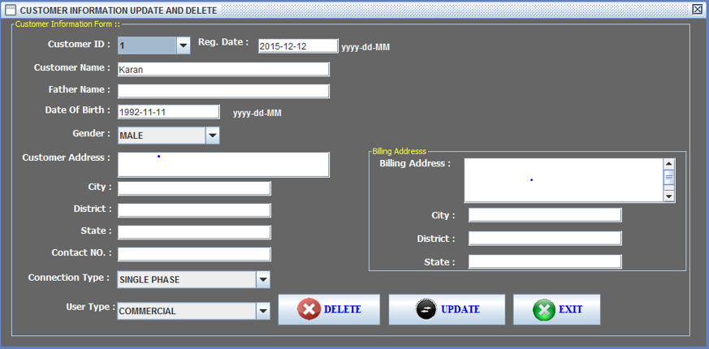
Update customers. Here users can update customer’s persona details

Slide 18
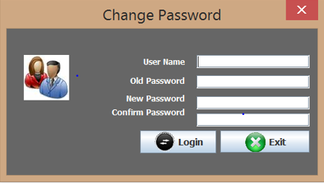
Change password: Change your password through this tab.

Slide 19
THANK YOU

