Slide 1

Test it! Unit, mocking and in-container Meet Arquillian!
Ivan St. Ivanov

Slide 2
Agenda
Introduction to testing
Pure unit testing with JUnit
Stubs and mocks. Mockito library
In-container testing with Arquillian

Slide 3


Slide 4


Slide 5


Slide 6


Slide 7


Slide 8
Characteristics
Fast
Run anywhere
IDE
Build tool
CI server
Repeatable
Leverage known tooling

Slide 9
Levels
Unit
Functional
Integration
Acceptance

Slide 10
Unit testing
Single unit of code
In isolation
Benefits:
Quick feedback
Facilitate change
Document features
Limitations
Won’t catch integration errors
Too much mocking

Slide 11
“ The purpose of automated testing is to enable change. Verifying correctness is just a nice side effect.
- Jeremy Norris

Slide 12


Test frameworks

Slide 13
Introduction to JUnit
No need to extend framework classes
Annotate test methods with @Test
Preparation methods with @Before and @BeforeClass
Cleanup activities with @After and @AfterClass
Check with Assert methods
Extensible with test runners

Slide 14
Example JUnit test case
public class FooBarTest {
private Foo foo;
@Before
public void setup() {
foo = new Foo();
foo.init();
}
@Test
public void testBar() throws Exception {
Assert.assertEquals("bar", foo.getBar());
}
@After
public void tearDown() {
foo.cleanup();
}
}

Slide 15


Slide 16
Stubs and mocks
Units are not isolated
Stubs
Test doubles
Predetermined behavior
Mocks
Validate behavior as well
Unit under test implies dependency injection

Slide 17
Dependency injectability
Sample usecase
Conference manager
Cache
Wrong:
Create Cache inside Conference manager
Lookup Cache
Correct
Constructor or setter injection

Slide 18



Mocking libraries

Slide 20

Greeting earthlings

Slide 21
Core principles
Tests should be portable to any container
Tests should be executable from both IDE and build tool
The platform should extend existing test frameworks

Slide 22




Step 1 – pick a container
Container extensions
JBoss, Tomcat, Weld, Glassfish, Jetty, WebSphere, WebLogic

Slide 23
Step 2 – connect the container
Container types
Embedded
Remote
Managed

Slide 24




Step 3 – package and deploy
ShrinkWrap library
Deployment
Resolve from Maven
Create descriptors

Slide 25
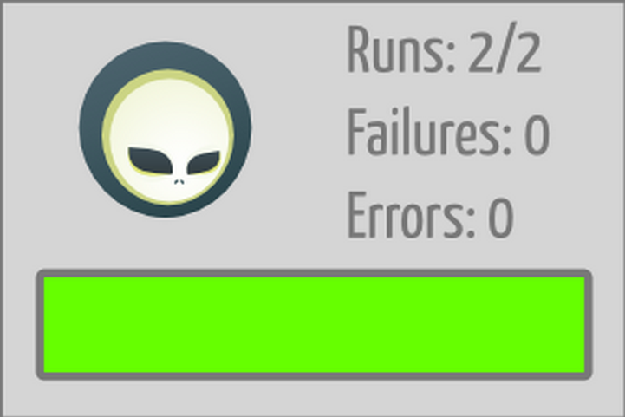
Step 4 – run the test
Tests runs in-container
CDI, EJB, JNDI available
No need to mock most of the services
Present the result as a normal unit test

Slide 26

Step 5 – undeploy the test
Undeploy the test archive
Disconnect or stop the container

Slide 28
That’s not all
Persistence extension
Warp
Drone
Graphene
AngularJS, Android, OSGi
…

Slide 29


Slide 30
Resources
Testing
http://en.wikipedia.org/wiki/Software_testing
Unit testing
http://en.wikipedia.org/wiki/Unit_testing
Mocks and stubs
http://martinfowler.com/articles/mocksArentStubs.html
Arquillian
http://aslakknutsen.github.io/presentations/
https://rpestano.wordpress.com/2014/06/08/arquillian/ https://rpestano.wordpress.com/2014/10/25/arquillian-and-mocks/

Slide 31
About this demo
Slides
http://bit.ly/bgjug-testing-slides
Showcase – initial
http://bit.ly/bgjug-testing
Showcase – final
http://bit.ly/bgjug-testing-final

