Slide 1

OpenJDK Development
Ivan St. Ivanov
Dmitry Alexandrov
Martin Toshev

Slide 2
Agenda
The OpenJDK platform
Development Process
Architecture Overview

Slide 3
The OpenJDK Platform

Slide 4
The OpenJDK Platform
Overview
Adoption
Contribution

Slide 5
Overview
A free and open-source implementation of the Java Platform, Standard Edition
GPL v2 for the VMs and GPL v2 + classpath exception for class libraries
Major Linux distributions (Ubuntu, Fedora…) offer it as default JDK
Who’s working on Open JDK?
Oracle, IBM, SAP, RedHat, Goldman Sachs

Slide 6
Overview
A free and open-source implementation of the Java Platform, Standard Edition
GPL v2 for the VMs and GPL v2 + classpath exception for class libraries
Major Linux distributions (Ubuntu, Fedora…) offer it as default JDK
Who’s working on Open JDK?
Oracle, IBM, SAP, RedHat, Goldman Sachs
And many Java User Groups!

Slide 7
Adoption
Adopt OpenJDK is an initiative helping Java communities to join in contributing to Java
Types of contributions:
Fix compiler warnings
Write new tests or convert existing ones
Build helpers
Tutorials
Major contributions to projects like Lambda and Jigsaw
Some of the contribution will make it to the official OpenJDK project!

Slide 8
Contribution
Starter level:
Understand and build OpenJDK
Test fests
Help promote using Lambdas
Cleanup javac warnings
Generify and coinify OpenJDK internals
Automatic build of OpenJDK
Other small enhancements

Slide 9
Contribution
Intermediate level:
Only after getting used to the ‘patch’ process
Pick up a project to contribute
Jigsaw and Penrose
Nashorn
Some other JDK Enhancement Proposal (JEP)
Always consult the mailing lists!

Slide 10
Contribution
Advanced level:
Find and eliminate memory leaks
Performance improvements
Concurrency testing
Some new projects:
Coroutines in Java
Preparation for Tuples
Value types
Javadoc overhaul

Slide 11
Contribution
Contribution targets:
OpenJDK groups:
Collection of participants sharing common interests
Longer living than projects
Examples: HotSpot, Security, JMX, Core Libraries
OpenJDK projects:
Produce specific artifacts
Must be sponsored by one or more Groups
Examples: Coin, Lambda, New I/O, Jigsaw
Notes:
Groups -> http://openjdk.java.net/groups/
Projects -> http://openjdk.java.net/projects/

Slide 12
Contribution
Communication channels:
Mailing lists
Preferable: announce, discuss and group/project mailing lists
IRC channel
Wiki pages
Blog aggregator
Notes:
Mailing lists -> http://mail.openjdk.java.net/mailman/listinfo
Wikis -> https://wiki.openjdk.java.net/dashboard.action, https://java.net/projects/adoptopenjdk/pages/AdoptOpenJDK
IRC -> http://openjdk.java.net/irc/
Blog aggregator -> http://planetjdk.org/

Slide 13
Contribution
Contribution allows to:
move Java forward
give back something to the platform
help our JUG gain its own identity and focus
acquire new knowledge

Slide 14
Contribution
Contribution allows to:
move Java forward
give back something to the platform
help our JUG gain its own identity and focus
acquire new knowledge
have some fun ☺

Slide 15
Development Process

Slide 16
Development Process
The community
Becoming a contributor
The source tree
Development environment

Slide 17
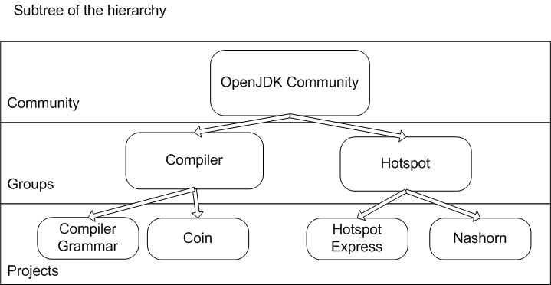
The community
Notes:
http://openjdk.java.net/census#members

Slide 18
The community
General roles:
Participant - may propose changes and participate in discussions
Contributor - may submit changes and participate in a project or a group
OpenJDK member - may propose new groups and may lead a group
OpenJDK Lead - leads JDK release projects
Notes:
General roles:
Participant - subscribed to one or more mailing lists;
may post messages and make small contributions
Contributor - has signed (or employer has signed) the Oracle Contributor Agreement;
may submit patches, propose projects, and participate in groups and projects;
OpenJDK member - has been nominated and elected by vote of existing OpenJDK Members;
may propose new groups and may lead a group
may vote on new OpenJDK members
may vote on new at-large members of the governing board
OpenJDK Lead
appointed by Oracle
leads JDK release projects
is a member of the governing board

Slide 19
The community
Group roles:
Group Member - has write access to the group's web content and file repositories
Group Lead - responsible for directing and coordinating the group's activities;
Notes:
Group Roles:
Group Member - elected by other group members
may nominate other contributors to be elected a group member
has write access to the group's web content and file repositories
Group Lead - approved by group members and ratified by governing board;
responsible for directing and coordinating the group's activities;
has the authority to sponsor projects;
obligation to act as contact point for group and look after content;
obligation to publish a quarterly report on activities on the group

Slide 20
The community
Project roles:
Author - may create change sets but may not push them directly
Commiter - may create and push change sets
Reviewer - reviews and approves change sets
Project Lead - responsible for directing and coordinating the project's activities
Notes:
Project Roles:
Author - self-nominated contributor appointed by project lead;
may create change sets but may not push them directly
Commiter - nominated and approved by other commiters;
may create and push change sets;
may vote on new commiters
Reviewer - an experienced commiter nominated & elected by other reviewers in the project;
role only exists in projects where project lead has designated a reviewer role is required
and only for change sets the project lead designates;
reviews and approves change sets
Project Lead - A commiter for the project responsible for directing and coordinating the
project's activities;
considered a reviewer and maintain reviewer status;
elected by sponsoring group lead(s);
has full authority over all technical matters related to project;
has the authority to appoint and remove authors;
obligation to act as a contact point for project and manage content;
obligation to publish a quarterly report on activities on the project

Slide 21
Becoming a contributor
Sign OCA (Oracle Contributor Agreement) – specify OpenJDK as the project and your java.net user as the username
Send the signed OCA to oracle-ca_us@oracle.com
Find some interesting bug or enhancement (RFE) to work on from bugs.sun.com

Slide 22
Becoming a contributor
You may subscribe to a particular mailing list of interest – list is available at mail.openjdk.java.net/mailman/listinfo
Discuss any changes you want to make in the appropriate mailing list using the format:
<Bug_or_RFE_Id>: <Bug_or_RFE_Title>

Slide 23
Becoming a contributor
Add a proposed code change (patch) to the discussion using any of the following commands:
hg export -g
hg diff -g
If applicable attach JTReg tests to the suggested changeset

Slide 24
The source tree
Repositories:
root (infrastructure files and scripts)
hotspot (Java Virtual Machine – JVM)
langtools (the javac compiler and other tools)
jdk (class libraries)
jaxp (JAXP API)
jaxws (JAX-WS API)
corba (CORBA API)
nashorn (JavaScript Engine)
Notes:
overview: http://hg.openjdk.java.net/
overview: https://wiki.openjdk.java.net/dashboard.action
overview: hgview

Slide 25
Development Environment
Development environment is already available (see references):
Virtual Box VM
2-4 CPU
3.0 GB RAM
20 GB HDD
OS: Ubuntu 12.04
IDE: Eclipse (JDT, CDT)
DVCS: Mercurial

Slide 26
Development Environment
Full OpenJDK build
make all (about 1 hour)
Targeted project build
make [jdk, jdk-only,corba..]
ANT (Build.xml)
Notes:
overview: development environment

Slide 27
Development Environment
jtreg is the test harness used by the OpenJDK test framework
Use targets from $REPO_DIR/test/Makefile to run tests
For example:
make TEST="jdk_lang jdk_net"
make jdk_all
Notes:
overview: development environment (source code, building projects and running tests)

Slide 28
Architecture Overview

Slide 29
Architecture Overview
The compiler (javac)
The runtime
Code walkthrough

Slide 30

The Compilter
Compilation Flow:
Main entry point for the GCJ (GNU Compiler for Java):
com.sun.tools.javac.main.JavaCompiler
Notes:
Compilation flow:
1) All the source files specified on the command line are read, parsed into syntax trees, and then all externally visible definitions are entered into the compiler's symbol tables.
2) All appropriate annotation processors are called. If any annotation processors generate any new source or class files, the compilation is restarted, until no new files are created (for example annotations used by various aspect-oriented tools that perform code generation benefit from this flow).
3) Finally, the syntax trees created by the parser are analyzed and translated into class files. During the course of the analysis, references to additional classes may be found. The compiler will check the source and class path for these classes; if they are found on the source path, those files will be compiled as well, although they will not be subject to annotation processing.

Slide 31
The Compiler
A very simple abstract file systems is used by the various tools of the Java ecosystems (including javac):
javax.tools.JavaFileManager
Error messages during compilation are reported by means of:
com.sun.tools.javac.util.Log

Slide 32
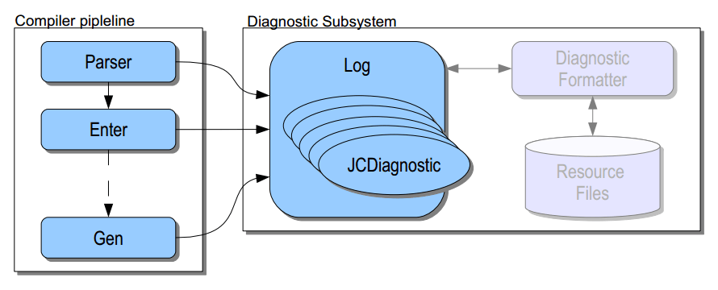
The Compiler
Logger pipeline:
(source: JavaOne, Maurizio Cimadamore & Jonathan Gibbons, Sun
Microsystems)
Notes:
1) The compiler pipeline pushes diagnostics to Log.
2) DiagnosticFormatter controls the way in which diagnostics are rendered by javac.

Slide 33
The Compiler
The lexer (maps source text into a stream of tokens) is provided by:
com.sun.tools.javac.parser.Scanner
The parser (converts the stream of tokens into one or more syntax trees) is provided by:
com.sun.tools.javac.parser.JavacParser
Notes:
The classes in the com.sun.source.tree package provide public read access to the syntax trees.

Slide 34
The Compiler
Annotation processing is handled by:
com.sun.tools.javac.processing.JavacProcessingEnvironment
During the ‘analyze and generate’ phase a number of visitors are used to modify the syntax tree and generate the class files.
Notes:
Relevant classes used in the ‘analyze and generate phase’ are:
Attr - names, expressions and other elements within the syntax tree are resolved and associated with the corresponding types and symbols. Many semantic errors may be detected here.
Flow - flow analysis is used to check for definite assignment to variables, and unreachable statements, which may result in additional errors.
TransTypes- code involving generic types is translated to code without generic types, using TransTypes.
Lower - “syntactic sugar" is processed, using Lower, which rewrites syntax trees to eliminate particular types of subtree by substituting equivalent, simpler trees. This takes care of nested and inner classes, class literals, assertions, foreach loops, and so on. For each class that is processed, Lower returns a list of trees for the translated class and all its translated nested and inner classes.
Gen - code for methods is generated by Gen, which creates the Code attributes containing the bytecodes needed by a JVM to execute the method. If that step is successful, the class is written out by ClassWriter.
To save memory, references to these parts of the tree and symbols will be nulled out, to allow the memory to be recovered by the garbage collector.

Slide 35
The Runtime
The Java runtime environment (virtual machine) is provided by the hotspot project.
Provides :
bytecode execution - using an interpreter, two runtime compilers or On-Stack Replacement
storage allocation and garbage collection
runtimes - start up, shut down, class loading, threads, interaction with OS and others
Notes:
- About 250000 lines of code
- The HotSpot continually analyzes the program's performance for "hot spots".
- Sun's JRE features two virtual machines, one called Client and the other Server. The Client version is tuned for quick loading. It makes use of interpretation. The Server version loads more slowly, putting more effort into producing highly optimized JIT compilations, that yield higher performance. Both VMs compile only often-run methods, using a configurable invocation-count-threshold to decide which methods to compile.

Slide 36
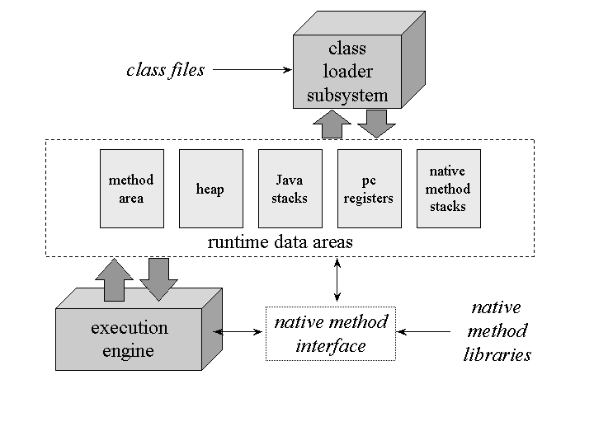
The Runtime
Architecture
Notes:
Each thread of execution has the following components:
Program Counter (PC)
Address of the current instruction (or opcode) unless it is native. If the current method is native then the PC is undefined. All CPUs have a PC, typically the PC is incremented after each instruction and therefore holds the address of the next instruction to be executed. The JVM uses the PC to keep track of where it is executing instructions, the PC will in fact be pointing at a memory address in the Method Area.
Stack
Each thread has its own stack that holds a frame for each method executing on that thread. The stack is a Last In First Out (LIFO) data structure, so the currently executing method is at the top of the stack. A new frame is created and added (pushed) to the top of stack for every method invocation. The frame is removed (popped) when the method returns normally or if an uncaught exception is thrown during the method invocation. The stack is not directly manipulated, except to push and pop frame objects, and therefore the frame objects may be allocated in the Heap and the memory does not need to be contiguous.
Native Stack
Not all JVMs support native methods, however, those that do typically create a per thread native method stack. If a JVM has been implemented using a C-linkage model for Java Native Invocation (JNI) then the native stack will be a C stack. In this case the order of arguments and return value will be identical in the native stack to typical C program. A native method can typically (depending on the JVM implementation) call back into the JVM and invoke a Java method. Such a native to Java invocation will occur on the stack (normal Java stack); the thread will leave the native stack and create a new frame on the stack (normal Java stack).
Stack Restrictions
A stack can be a dynamic or fixed size. If a thread requires a larger stack than allowed a StackOverflowError is thrown. If a thread requires a new frame and there isn’t enough memory to allocate it then an OutOfMemoryError is thrown.

Slide 37
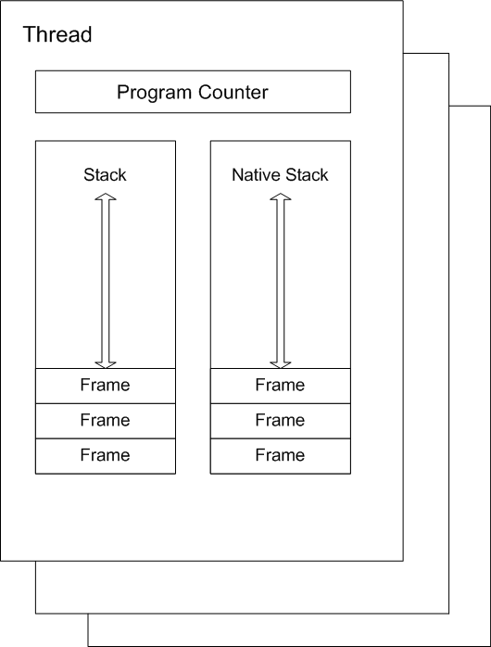
The Runtime
Thread stack

Slide 38
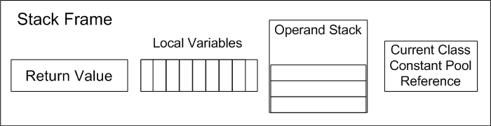
The Runtime
Stack frame
Notes:
A new frame is created and added (pushed) to the top of stack for every method invocation. The frame is removed (popped) when the method returns normally or if an uncaught exception is thrown during the method invocation.
Each frame contains:
Local variable array
Return value
Operand stack
Reference to runtime constant pool for class of the current method

Slide 39
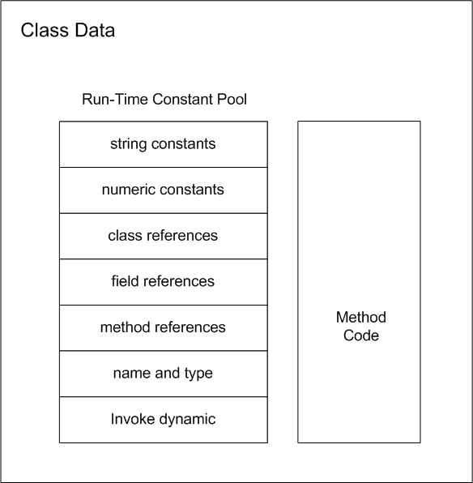
The Runtime
Class Data
Notes:
A compiled class file consists of the following structure:
ClassFile {
u4 magic;
u2 minor_version;
u2 major_version;
u2 constant_pool_count;
cp_info contant_pool[constant_pool_count – 1];
u2 access_flags;
u2 this_class;
u2 super_class;
u2 interfaces_count;
u2 interfaces[interfaces_count];
u2 fields_count;
field_info fields[fields_count];
u2 methods_count;
method_info methods[methods_count];
u2 attributes_count;
attribute_info attributes[attributes_count];
}

Slide 40
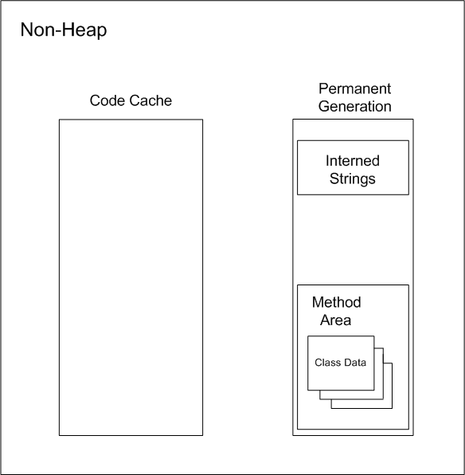
The Runtime
Non-Heap
Memory
Notes:
Objects that are logically considered as part of the JVM mechanics are not created on the Heap.
The non-heap memory includes:
Permanent Generation that contains the method area and interned strings
Code Cache used for compilation and storage of methods that have been compiled to native code by the JIT compiler
The method area stores per-class information such as:
Class Loader Reference
Run Time Constant Pool
Numeric constants
Field references
Method References
Attributes
Field data (per field)
Name
Type
Modifiers
Attributes
Method data (per method)
Name
Return Type
Parameter Types (in order)
Modifiers
Attributes
Method code (Per method)
Bytecodes
Operand stack size
Local variable size
Local variable table
Exception table (per exception handler - start point, end point, PC offset for handler code, constant pool index for exception class being caught)

Slide 41
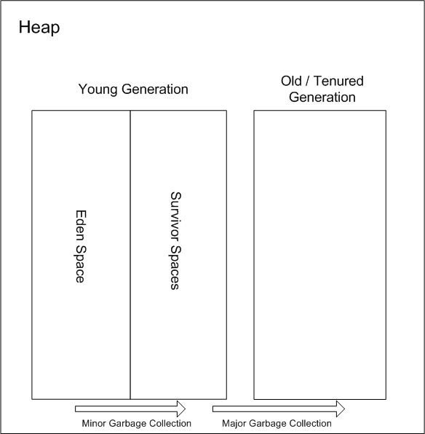
The Runtime
Heap
Memory
Notes:
The Heap is used to allocate class instances and arrays at runtime. Arrays and objects can never be stored on the stack because a frame is not designed to change in size after it has been created. The frame only stores references that point to objects or arrays on the heap. Unlike primitive variables and references in the local variable array (in each frame) objects are always stored on the heap so they are not removed when a method ends. Instead objects are only removed by the garbage collector.
To support garbage collection the heap is divided into three sections:
Young Generation - Often split between Eden and Survivor
Old Generation (also called Tenured Generation)
Permanent Generation
Objects and Arrays are never explicitly de-allocated instead the garbage collector automatically reclaims them.
Typically this works as follows:
1) New objects and arrays are created into the young generation
2) Minor garbage collection will operate in the young generation. Objects, that are still alive, will be moved from the eden space to the survivor space.
3) Major garbage collection, which typically causes the application threads to pause, will move objects between generations. Objects, that are still alive, will be moved from the young generation to the old (tenured) generation.
4) The permanent generation is collected every time the old generation is collected. They are both collected when either becomes full.
mark word - The first word of every object header. Usually a set of bitfields including synchronization state and identity hash code. May also be a pointer (with characteristic low bit encoding) to synchronization related information. During GC, may contain GC state bits.
klass pointer - The second word of every object header. Points to another object (a metaobject) which describes the layout and behavior of the original object. For Java objects, the "klass" contains a C++ style "vtable".
Note that both Java objects and VM-internal objects have a common object header format.
The Young Generation
The young generation must support fast allocation, but we expect most of those objects to become unreachable fairly quickly. We would like not to have to expend any effort on the unreachable objects, since there are so many of them. So when our young generations need to be collected, we identify the lreachable objects in them and copy them out of the young generation. Once we've copied out the reachable objects, the objects remaining in the young generation are unreachable, and the space for them can be recovered without attention to each individual unreachable object. This operation of copying the reachable objects out of a generation we call “scavenging”, so we often refer to our young generation collectors as “scavengers”. An advantage of scavenging is that it is fast. A disadvantage is that it requires room of a second copy of all the reachable objects from the scavenged generation.
The Old Generation
Once objects have been scavenged out of the young generation we expect them to remain reachable for at least a while, and to reference and be referenced by other objects that remain reachable. To collect the space in the old generation we need algorithms that can't depend on high density of unreachable objects. In particular we can't count on having enough space to scavenge such objects somewhere else. Copying objects in the old generation can be expensive, both because one has to move the objects, and because one has to update all the references to the object to point to the new location of the object. On the other hand, copying objects means that one can accumulate the recovered space into one large region, from which allocation is faster (which speeds up scavenging of the young generation), and allows us to return excess storage to the operating system, which is polite.
The Permanent Generation
In addition to the objects created by the Java application, there are objects created and used by the HotSpot virtual machine whose storage it is convenient to have allocated and recovered by the storage manager. To avoid confusing things, such objects are allocated in a separate generation, the so-called “permanent” generation. In fact, the objects in it are not “permanent”, but that's what it has been called historically. For example, information about loaded classes is stored in the permanent generation, and recovered when those classes are no longer reachable from the application.

Slide 42
The Runtime
Three phases of class-loading:
Loading
Linking
Initialization
Notes:
Loading: finding and importing the binary data for a type
Linking: performing verification, preparation, and (optionally) resolution
Verification: ensuring the correctness of the imported type
Preparation: allocating memory for class variables and initializing the memory to default values
Resolution: transforming symbolic references from the type into direct references.
Initialization: Invoking Java code that initializes class variables to their proper starting values.

Slide 43
The Runtime
Execution engine:
while(true) {
bytecode b = bytecodeStream[pc++];
switch(b) {
case iconst_1: push(1); break;
case iload_0: push(local(0)); break;
case iadd: push(pop() + pop()); break;
}
}

Slide 44
The Runtime
Execution engine:
while(true) {
bytecode b = bytecodeStream[pc++];
switch(b) {
case iconst_1: push(1); break;
case iload_0: push(local(0)); break;
case iadd: push(pop() + pop()); break;
}
} NOT that simple …

Slide 45
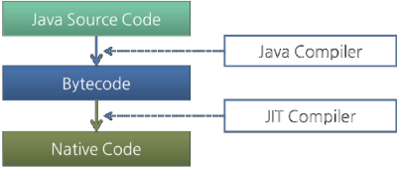
The Runtime
Different execution techniques:
interpreting
just-in-time (JIT) compilation
adaptive optimization (determines "hot spots" by monitoring execution)
Notes:
The bytecode is first interpreted while the JIT is translating it in the background. Once the JIT compilation is complete, the JVM switches to using that code instead of the interpreter.

Slide 46
The Runtime
Simple JIT compilation flow (performed during normal bytecode execution):
1) bytecode is turned into a graph
2) the graph is turned into a linear sequence of operations that manipulate an infinite loop of virtual registers (each node places its result in a virtual register)
Notes:
The bytecode is first interpreted while the JIT is translating it in the background. Once the JIT compilation is complete, the JVM switches to using that code instead of the interpreter.

Slide 47
The Runtime
Simple JIT compilation flow (performed during normal bytecode execution):
3) physical registers are allocated for virtual registers (the program stack might be used in case virtual registers exceed physical registers)
4) code for each operation is generated using its allocated registers

Slide 48
The Runtime
Typical execution flow (when using the java/javaw launcher):
Parse the command line options
Establish the heap sizes and the compiler type (client or server)
Establish the environment variables such as CLASSPATH
If the java Main-Class is not specified on the command line fetch the Main-Class name from the JAR's manifest
Create the VM using JNI_CreateJavaVM in a newly created thread (non primordial thread)
Notes:
JNI_CreateJavaVM
The JNI invocation method performs, the following:
Ensures that no two threads call this method at the same time and that no two VM instances are created in the same process. Noting that a VM cannot be created in the same process space once a point in initialization is reached, “point of no return”. This is so because the VM creates static data structures that cannot be re-initialized, at this time.
Checks to make sure the JNI version is supported, and the ostream is initialized for gc logging. The OS modules are initialized such as the random number generator, the current pid, high-resolution time, memory page sizes, and the guard pages.
The arguments and properties passed in are parsed and stored away for later use. The standard java system properties are initialized.
The OS modules are further created and initialized, based on the parsed arguments and properties, are initialized for synchronization, stack, memory, and safepoint pages. At this time other libraries such as libzip, libhpi, libjava, libthread are loaded, signal handlers are initialized and set, and the thread library is initialized.
The output stream logger is initialized. Any agent libraries (hprof, jdi) required are initialized and started.
The thread states and the thread local storage (TLS), which holds several thread specific data required for the operation of threads, are initialized.
The global data is initialized as part of the I phase, such as event log, OS synchronization primitives, perfMemory (performance memory), chunkPool (memory allocator).
At this point, we can create Threads. The Java version of the main thread is created and attached to the current OS thread. However this thread will not be yet added to the known list of the Threads. The Java level synchronization is initialized and enabled.
The rest of the global modules are initialized such as theBootClassLoader, CodeCache, Interpreter, Compiler, JNI, SystemDictionary, and Universe. Noting that, we have reached our “point of no return”, ie. We can no longer create another VM in the same process address space.
The main thread is added to the list, by first locking the Thread_Lock. The Universe, a set of required global data structures, is sanity checked. The VMThread, which performs all the VM's critical functions, is created. At this point the appropriate JVMTI events are posted to notify the current state.
The following classes java.lang.String, java.lang.System,java.lang.Thread, java.lang.ThreadGroup,java.lang.reflect.Method, java.lang.ref.Finalizer,java.lang.Class, and the rest of the System classes, are loaded and initialized. At this point, the VM is initialized and operational, but not yet fully functional.
The Signal Handler thread is started, the compilers are initialized and the CompileBroker thread is started. The other helper threads StatSampler and WatcherThreads are started, at this time the VM is fully functional, the JNIEnv is populated and returned to the caller, and the VM is ready to service new JNI requests.

Slide 49
The Runtime
Typical execution flow (when using the java/javaw launcher):
6. Once the VM is created and initialized, load the Main- Class
7. Invoke the main method in the VM using CallStaticVoidMethod
8. Once the main method completes check and clear any pending exceptions that may have occurred and also pass back the exit status
9. Detach the main thread using DetachCurrentThread , by doing so we decrement the thread count so the DestroyJavaVM can be called safely
Notes:
DestroyJavaVM
This method can be called from the launcher to tear down the VM, it can also be called by the VM itself when a very serious error occurs.
The tear down of the VM takes the following steps:
Wait until we are the last non-daemon thread to execute, noting that the VM is still functional.
Call java.lang.Shutdown.shutdown(), which will invoke Java level shutdown hooks, run finalizers if finalization-on-exit.
Call before_exit(), prepare for VM exit run VM level shutdown hooks (they are registered through JVM_OnExit()), stop the Profiler,StatSampler, Watcher and GC threads. Post the status events to JVMTI/PI, disable JVMPI, and stop the Signal thread.
Call JavaThread::exit(), to release JNI handle blocks, remove stack guard pages, and remove this thread from Threads list. From this point on we cannot execute any more Java code.
Stop VM thread, it will bring the remaining VM to a safepoint and stop the compiler threads. At a safepoint, care should that we should not use anything that could get blocked by a Safepoint.
Disable tracing at JNI/JVM/JVMPI barriers.
Set _vm_exited flag for threads that are still running native code.
Delete this thread.
Call exit_globals(), which deletes IO and PerfMemoryresources.
Return to caller.

Slide 50

Code Walkthrough
Notes:
COMPILER:
Official API:
javax.annotation.processing - Facilities for declaring annotation processors and for allowing annotation processors to communicate with an annotation processing tool environment
javax.lang.model (including subpackages) - classes and hierarchies of packages used to model the Java programming language
javax.tools - provides interfaces for tools which can be invoked from a program, for example, compilers
Supported API:
com.sun.source (including subpackages) - representation of the compiler syntax trees
com.sun.tools.javac - the javac main program and command-line entry point provides supported API for very simple invocation of the compiler
Internal API and implementation classes:
com.sun.tools.javac.api - Implementation of JavaCompiler and other API in javax.tools.
com.sun.tools.javac.code - representation of the semantic elements of a Java program, such as symbols, scopes and types, implementing API in javax.lang.model.*
com.sun.tools.javac.comp - primary processing phases for the compiler, such as attribution, flow analysis, "desugaring" and erasure
com.sun.tools.javac.file - access to the native file system, including the implementation of javax.tools.StandardFileManager
com.sun.tools.javac.nio - access to the native file system using the java.nio.file API, including JavacPathFileManager
com.sun.tools.javac.jvm - classes for reading and writing class files, and the code generation phase of the compiler
com.sun.tools.javac.main - main driver code for any compilation. It provides option decoding and sequences through the various steps for compilation
com.sun.tools.javac.model - additional implementation classes for javax.lang.model.*
com.sun.tools.javac.parser - read Java source code to generate syntax trees
com.sun.tools.javac.processing - implementation classes for annotation processing API defined injavax.annotation.processing.*
com.sun.tools.javac.resources - resource files for localized messages and version info
com.sun.tools.javac.tree - representation and utility classes for the compiler's syntax trees, implementing API in com.sun.source.*
com.sun.tools.javac.util - basic utility classes, including support for reporting diagnostics
Demo: modifying the compiler:
add the # operators that is a synonym to != (in the TokenKind class)
add precedence for the operator (in the opPrec() method of the TreeInfo class)
modify the constructor of TreeInfo – add the operator to the opname array
add support for the operator in the textual representation of the AST (in the operatorName() method of the Pretty class)
add the new operator to the list of system names recognizable by the compiler (in the Symtab) class – duplicate the lines for the != operator

Slide 51
What’s next ?
Adopt OpenJDK @ OpenFest
Mani Sarkar, November 2nd, 14:00, Interpred
Official unofficial OpenJDK dinner
To be announced
Adopt OpenJDK @ Java2Days
December 4th- December 5th , IEC

Slide 52

Q&A

Slide 53
References
OpenJDK Contribution
http://openjdk.java.net/contribute/
OpenJDK Development Environment
https://github.com/martinfmi/openJDK_Ubuntu_12.04_Eclipse
Mercurial Quick Start
http://mercurial.selenic.com/wiki/QuickStart

Slide 54
References
Adopt OpenJDK wiki
https://java.net/projects/adoptopenjdk/pages/AdoptOpenJDK
Video: OpenJDK Governance and Development Process Overview
http://www.youtube.com/watch?v=jebmrXo-Y3Y

Slide 55
References
The OpenJDK Developers' Guide
http://openjdk.java.net/guide/
The Java programming language compiler group
http://openjdk.java.net/groups/compiler/
The Hacker's Guide to Javac
http://scg.unibe.ch/archive/projects/Erni08b.pdf

Slide 56
References
JavaOne: Java Programming Language Tools in JDK Release 7
https://blogs.oracle.com/mcimadamore/resource/09J1_langtools_all.pdf
How to Modify javac, JavaMagazine, August, 2012
http://www.oraclejavamagazine-digital.com/javamagazine/20120708?pg=51#pg51

Slide 57
References
Hotspot Internals
https://wiki.openjdk.java.net/display/HotSpot/Main
FOSDEM 2007, Java Hotspot Virtual Machine
http://openjdk.java.net/groups/hotspot/docs/FOSDEM-2007-HotSpot.pdf

Slide 58
References
Memory Management in the Java Hotspot Virtual Machine
http://www.oracle.com/technetwork/java/javase/memorymanagement-whitepaper-150215.pdf
The Architecture of the Java Virtual Machine
http://www.artima.com/insidejvm/ed2/jvm2.html

Slide 59
References
JVM Internals
http://blog.jamesdbloom.com/JVMInternals.html
Understanding JVM Internals
http://www.cubrid.org/blog/dev-platform/understanding-jvm-internals/

